Slide 1
www.carteeh.org

Slide 2
Lecture #12: Emissions Measurements, Characterization Methods, and Data Sources
Thomas Durbin and Georgios Karavalakis, Ph.D.
University of California Riverside, Center for Environmental Research and Technology
durbin@cert.ucr.edu, 951-781-5794
The author declares that there is no conflict of interest
Lecture Track(s): TT
Notes:
Health Track (HT)—mainly targeted at urban planners, transportation planners, and engineers with limited knowledge of public health-related concepts;
Transportation Track (TT)—mainly targeted at environmental epidemiologists and public health professionals with limited knowledge of transportation-related concepts; and;
Planning and Policy Track (PPT)—mainly targeted at planners, civil servants, and policy and decision makers with particular interest in the science-policy link.

Slide 3
Introduction – Why do we measure emissions
Society relies on internal combustion engines (ICEs) for transportation, commerce and power generation: utility devices.
ICEs power the 600 million passenger cars and other vehicles on our roads today. 250 million vehicles (cars, buses, and trucks) were registered in 2008 in US alone.
A significant portion of air pollution in urban areas can be attributed to combustion from transportation sources.
On road and off-road sources represent 56% and 32% of the NOx emissions in the Los Angeles Basin – 88% of the total.
Particulate Matter (PM) emissions – soot and smoke from the exhaust and particles that form in the air (secondary organic aerosol)
Ozone (O₃) is formed from the precursors, volatile organic compounds (VOCs) and oxides of nitrogen (NOx) and can aggravate or contribute to respiratory illness or heart disease, and damage plants and other things.
The World Health Organization (WHO) estimated that 7 million people died from air quality in 2012
Notes:
This slide notes the importance and scope of internal combustion (IC) engines in society. Then it touches on the impacts of IC on air quality in urban area, in terms of deaths, and specific pollutants.

Slide 4

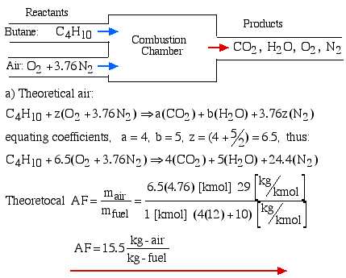
How are emissions formed in engines -
Fundamental Combustion Chemistry
Stoichiometric combustion - where the amount of fuel and air is correctly matched to allow complete combustion of the fuel without having excess air
---combustion of methane CH₄(g) + 2 O₂(g) → CO₂(g) + 2 H₂O(g)
---burning of naphthalene C₁₀H₈ + 12 O₂ → 10 CO₂ + 4 H₂O
---combustion of ethane 2 C₂H₆ + 7 O₂ → 4 CO₂ + 6 H₂O
---combustion of butane (commonly found in lighters) 2C₄H₁₀(g) +13O₂(g) → 8CO₂(g) +10H₂O(g)
---combustion of methanol (also known as wood alcohol) 2CH₃OH(g) + 3O₂(g) → 2CO₂(g) + 4H₂O(g)
---combustion of propane (used in gas grills and fireplaces) 2C₃H₈(g) + 7O₂(g) → 6CO₂(g) + 8H₂O(g)
Notes:
This slide looks at the fundamental combustion equations. One the left side it shows the basic equation without nitrogen. It then gives examples of combustion for different hydrocarbons, showing how the CO2 vs. H2O ratio changes depending on the fuel. Specifically, fuels higher H to C ratios have a greater tendency to produce higher percentages of H2O compared to CO2. The right side adds in nitrogen to the equation and introduces the concept of stoichiometric combustion.

Slide 5
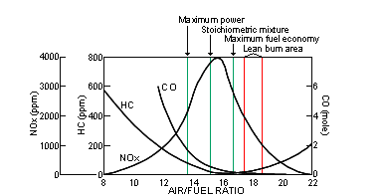
How are emissions formed in engines -
Stoichiometric Combustion Chemistry in ICEs
Notes:
This slide shows how pollutants can form as combustion varies from stochiometric in either the rich or lean direction, with HC and CO increasing for rich air/fuel ratios, and NOx increasing for lean air/fuel ratios. Under rich conditions, there is less oxygen to help oxidize HC and CO to CO2. Under lean conditions, there is excess oxygen, so the oxygen from the NOx can not be reduced as readily.

Slide 6
How are emissions formed in engines -
NOx Formation
Notes:
This slide talks about the formation of NOx, how it is due to the break up of diatomic nitrogen and oxygen, and how the activation energy is such that this reaction only occurs at high temperatures. Here you can also emphasize that diesel engine (that operate at higher compression ratios since the combustion mixture is compressed to ignite) have higher NOx emissions than gasoline vehicles.

Slide 7
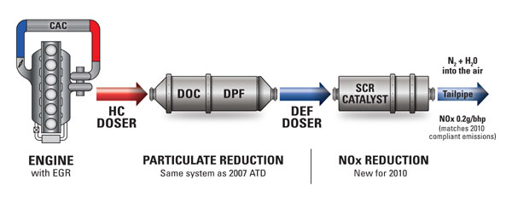

How are emissions formed in engines -
Emissions Reduction Systems of Heavy-Duty Diesel Engines
Diesel Exhaust Fluid (DEF) injected into exhaust
Engine out emissions
NOx
Tailpipe emissions (SCR out)
CO
Engine
THC
NOx
PM
NOx reduced in Exhaust Gas Recirculation (EGR)
THC and CO reduced in Diesel Oxidation Catalyst (DOC)
PM trapped in Diesel Particulate Filter (DPF)
NOx reduced in Selective Catalytic Reduction (SCR)
Notes:
This slide shows a emission reduction system for diesel engines. This shows the various catalysts (DOC – diesel oxidation catalyst for HC and CO; DPF – diesel particle filter for PM; and SCR – selective catalytic reduction for NOx) that reduce pollutants to relatively lower levels that are seen when we make emissions measurements.

Slide 8
How do we measure emissions -
Dilution Tunnel - Constant Volume Sampling
Full exhaust is captured and diluted with filtered air
Allows full mass of exhaust to be measured – don’t need exhaust flow
Dilution used to prevent water condensation
Notes:
This slide shows a schematic of a dilution system. The discussion can start by talking about why it is important to have a dilution tunnel for making emissions measurements, which is highlighted in the bullet points. Then the inset box shows the instruments that are used for measure each type of pollutant, including nondispersive infrared (NDIR) for CO and CO2, chemiluminescence (CLD) for NOx, and a flame ionization detector (FID) for HCs and CH4. The sample bags show that there are two samples collected, one for the sample from the diluted exhaust, and one background ambient sample.

Slide 9
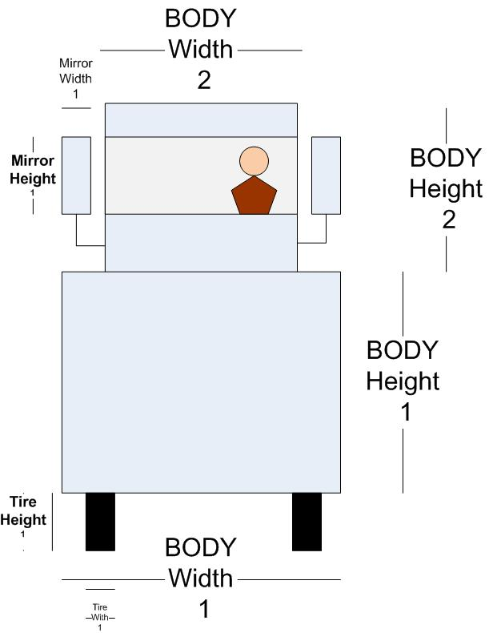
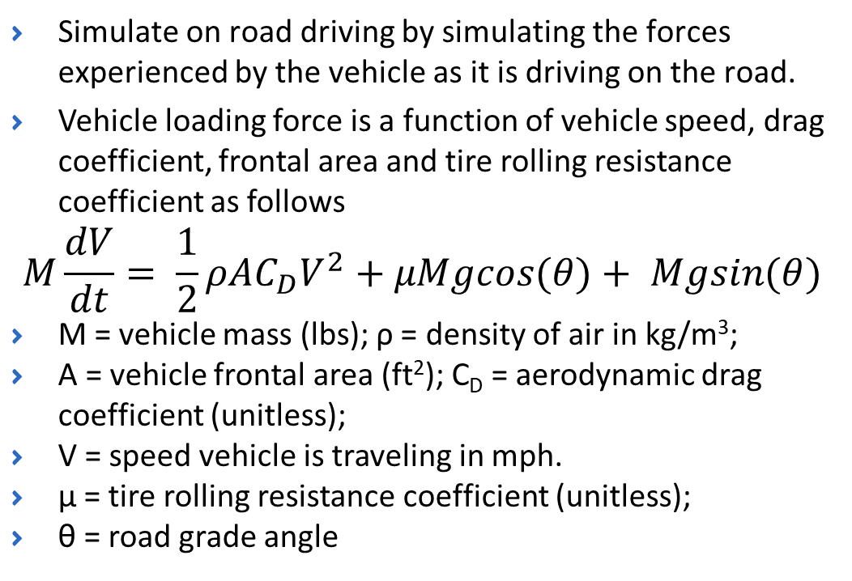
How do we measure emissions -
Chassis Dynamometer Testing
Simulate on road driving by simulating the forces experienced by the vehicle as it is driving on the road.
Vehicle loading force is a function of vehicle speed, drag coefficient, frontal area and tire rolling resistance coefficient as follows
$$M\frac{dV}{dt}= \frac{1}{2}ρAC_{D}V^{2}+μMgcos(θ)+ Mgsin(θ)$$
M = vehicle mass (lbs); ρ = density of air in kg/m³;
A = vehicle frontal area (ft²); C_{D} = aerodynamic drag coefficient (unitless);
V = speed vehicle is traveling in mph.
μ = tire rolling resistance coefficient (unitless);
θ = road grade angle
Notes:
Certification testing of vehicles is conducted on a chassis dynamometer. A chassis dynamometer simulates the forces experienced by a vehicle while it is driving on the road. This includes aerodynamic drag, which is represented by the V^2 term in the equation. This is a function of the frontal area of the vehicle x a coefficient of drag term, that varies depending on the type of vehicle. The other main term is road friction, and a terms designed to represent the road grade.

Slide 10
How do we measure emissions -
Federal Test Procedure – Light-Duty Dynamometer Test Cycle
Notes:
The speed vs. time driving trace pictured is for the FTP for light-duty vehicles. It consists of three different phases, a cold start phase that is ran after an overnight soak, a transient phase after the vehicle is warmed, and then a hot start phase. The vehicle is turned off for 10 minutes in between the transient phase and the hot start phase, to simulate brief shut off of the engine. This cycle is also important in determining the gas mileage over city driving conditions. Other driving cycles include a highway fuel economy test, a US06 test designed to represent more aggressive driving conditions, and a SC03 cycle.

Slide 11
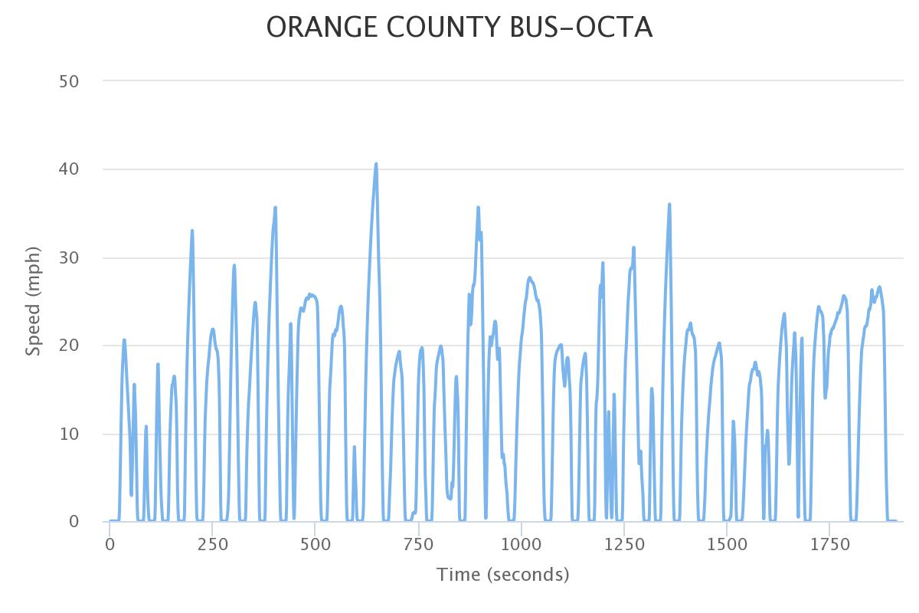
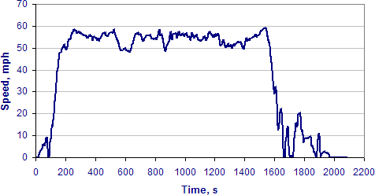
How do we measure emissions -
Heavy-Duty Dynamometer Test Cycles
Drayage Cycles
UDDS
Refuse Hauler
CARB - Cruise
Orange County Transit Authority
Notes:
This slide shows a range of different driving cycles that can be utilized for testing heavy-duty vehicles. This includes the Urban Dynamometer Driving Schedule (UDDS), which is designed to represent driving conditions comparable to those used to develop the engine dynamometer FTP. The California Air Resources Board (CARB) has developed a series of cycles designed to represent creep, city transient driving, and cruise cycles. The refuse hauler cycle represents driving from a central fleet yard to a neighborhood, and then slowly moving from house-to-house for curbside pickup. The Orange County Transit Authority (OCTA) cycle represents typical driving for a transit bus. Finally, a series of cycles have been developed to represent drayage truck driving, including a segment for near dock driving, a segment for local driving, and segment for regional transport of goods.

Slide 12
How do we measure emissions -
Engine Dynamometer Testing
Engine dynamometer certification testing has been in place since 1974 for heavy-duty diesel engines
Engine dynamometers simulate the work and characteristics of engine operation under in-use operation
Notes:
Engines for heavy-duty vehicles are certified on an engine dynamometer, such as the one pictured in the slide. The dynamometer provides a load to the engine that represents different types of operation. The main certification test is called the Federal Test Procedure (FTP), the profile of which in terms of normalized torque and engine speed is shown in the slide. The certification procedures have been expanded in recent to years to include a steady state cycle with multiple load points. Work is also ongoing to add another cycle that characterizes emissions under low load conditions, since this is the operating range where SCR system do not work as well. Engines that are used for off-road applications are also certified on an engine dynamometer, but using different cycles, including a steady state cycle and the non-road transient cycle (NRTC).

Slide 13
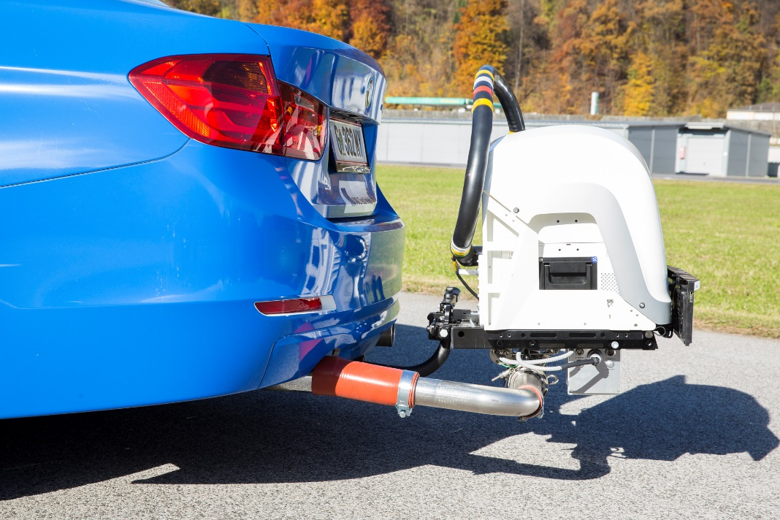
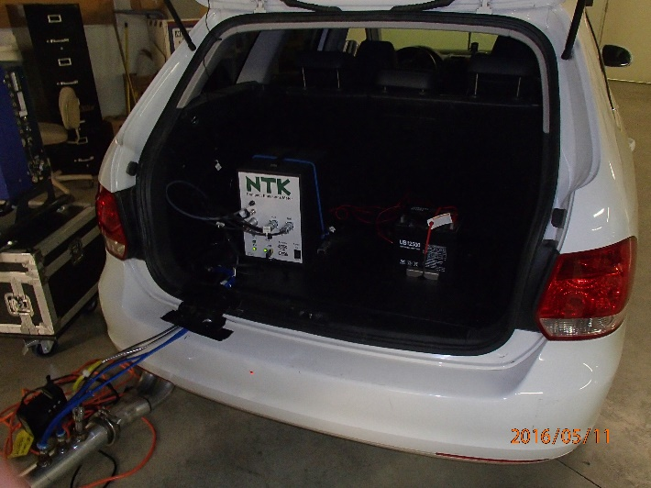
How do we measure emissions -
Portable Emissions Measurement Systems (PEMS)
Miniature emissions measurement systems
Measurement methods are tied to similar requirements as for laboratory instruments
The exhaust flow is measured with a exhaust flow meter, since only a part of the exhaust is sampled.
Utilized for in-use regulatory measurements in the U.S. for heavy-duty vehicles via Not-to-Exceed (NTE) regulations and in Europe and elsewhere via Real Driving Emissions (RDE) regulations
Notes:
PEMS systems have been used for regulatory measurements of heavy-duty vehicles since ~ the 2007 timeframe. The PEMS on the trailer hitch is one that is designed to measure emissions meeting regulatory requirements under 40 Code of Federal Regulations Part 1065. The smaller unit inside the hatchback is a mini-PEMS. Subsequently, Europe incorporated PEMS into their regulation process for light-duty vehicles under the RDE regulations, which were put in place beginning with the 2017 model year. These mini-PEMS can provide emissions measurements with accuracies that are approaching those of the full 1065 PEMS.

Slide 14
How do we measure emissions -
In-Field Remote Sensing and Tunnel/Tent Methods
Remote Sensing Device (RSD)
On-Road Heavy-Duty Measurement System (OHMS)
Tunnel Probe method
Bishop and Haugen, 2018.
Hager Environmental & Atmospheric Technologies, 2018.
Preble, et al., 2019.
Notes:
These are three devices that can be used to measure emissions in the field. The first shows a remote sensing device. This device uses laser light shined through a exhaust plumb to determine pollutant concentrations in the exhaust via signal attenuation. The OHMS system uses a tent to confine exhaust emissions such that it can be pulled via a exhaust collection pipe into a truck that is equipped with emissions analyzers. The third system utilizes a similar methodology in that a probe used to capture exhaust plumbs of vehicles as they enter a tunnel. The exhaust is drawn through a probe into a van that is equipped with exhaust analyzers.
These systems have a very important role in that they can characterize thousands of vehicles over the period of about a week, which provides good information about the percentage of high emitters in the in-use fleet, and also how much emissions have gone down in the in-use fleet over time.

Slide 15
Factors affecting vehicle emissions -
Tightening Emissions Standards over the Years
ICCT, 2017.
Notes:
This plots shows how dramatically the emissions standards for light-duty vehicles have declined over a period from 1990 through 2025.The graph is based on the standards for MNHC/NMOG and NOx added together. The plot shows separate lines for the U.S., Europe, and China. The results show reductions on the order of 80 to 90% over the period. The results show initially lower standards for the U.S., followed by Europe, and then later by China.

Slide 16
Factors affecting vehicle emissions -
Declining in-use fleet emissions over time for NOx
Bishop, G.A. and M.J. Haugen, 2018, Investigate the Durability of Diesel Engine Emission Controls, Final report for CARB Contract No. 11-309, March.
Notes:
These measurements show the decline of NOx emissions for a sample of vehicles collected at testing campaigns conducted in California. The data are collected with the OHMS system described above. One location is the Port of Los Angeles (POLA). The other location is the Cottonwood truck stop in northern California near Redding, CA. The data show a strong trend of declining emissions after 2010 at Cottonwood, which 2010 represents the first year that SCR system were mandated for heavy-duty engines. The trend is not as strong at POLA, probably because the port bought many vehicles between 2007 and 2010, before SCRs were mandated, and since the exhaust temperature is likely lower for the POLA, so that the SCR (where applicable) might below their operating temperatures. The OHMS measures NO and NO2 separately, so the total NOx bar is separated into these two components.

Slide 17
Factors affecting vehicle emissions -
High NO_{x} During Cool Exhaust High Load Conditions
From Miller et al (2013), Final report to SC-AQMD and CWI “In-Use Emissions Testing and Demonstration of Retrofit Technology for Control of On-Road Heavy Duty Engines”, Sep 2013
Notes:
This plot shows how NOx emissions can vary over the course of a typical driving cycle, with the vehicle speed in green. This cycle shows how a vehicle will travel from a standstill to a cruise condition. Cumulative NOx emissions are shown in blue, while the SCR inlet temperature is shown in red. The graph shows that the majority of the NOx emissions for the cycle come in the period from approximately 700 to 1800 seconds. This is a period where the exhaust temperature is less than 200 to 250C, with 200C being the approximate temperature below which the SCR is not active, and with 250C being the temperature where the SCR temperature starts to get more optimal. Note that during the cruise period, where the exhaust is above 300C, NOx emissions are relatively low.

Slide 18
Factors affecting vehicle emissions -
RSD studies of light-duty vehicle emissions over time
Percentage of HC contributed by the highest 1% of emitters
Bishop, G.A., and M.J. Haugen, 2017, Long-term on-road light-duty vehicle emission measurements – The legacy of the Coordinating Research Council’s E-23 and E-106 programs, 27th CRC On-Road Vehicle Emissions Workshop, Long Beach, CA, March
Bishop, G. and M. Haugen, 2018, A Nearly Thirty-year Record of On-Road Vehicle Emissions in the Chicago, IL Area, Proceedings of the CRC Real-world Emissions Conference, March, San Diego, CA
Notes:
The results RSD measurements conducted over time have also shown how much emissions in the in-use fleet have declined over time. The results on the left side of the slide show emissions from four different RSD measurement campaigns done in 1992, 1997, 2006, and 2016 in Chicago at the same location. The results show that emissions have declined over time as the emissions standards have been reduced. The results in the 2016 also show higher levels of emissions, particularly for NOx, for 1990 model year vehicles, than in the previous 2006 study. This indicates that there has been some deterioration in the emissions over that period.
On the right side of the slide, the results show the impact of high emitters on the total fleet emissions, and how this has changed over time. In 1999, highest 1% of the fleet contributed 83% of the total fleet emissions. In 2015, the , highest 1% of the fleet contributed only 54% of the total fleet emissions. The size of the circles also gives a perspective of how much the emissions from high emitters has declined over time.

Slide 19
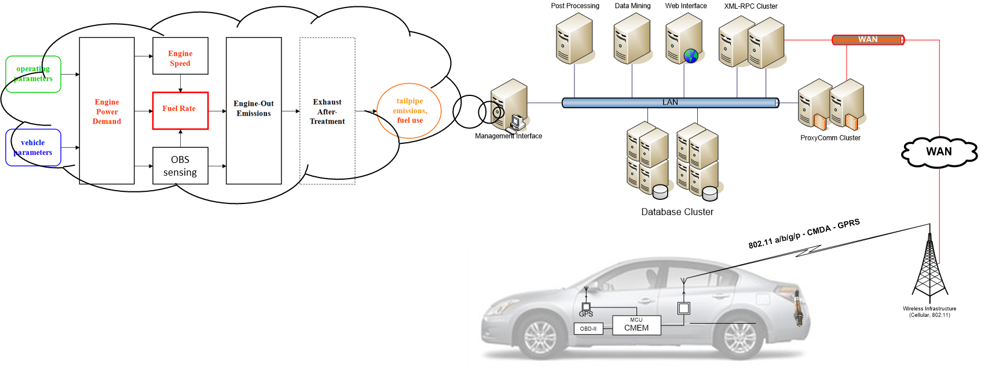
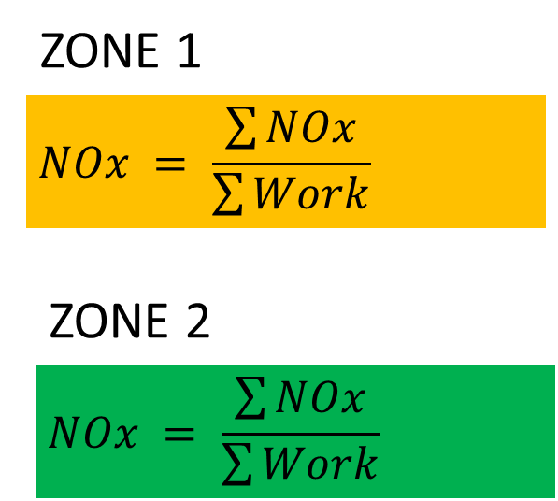
Emissions measurements in a modern world -
On Board Sensing, Analysis, and Reporting (OSAR)
Notes:
As emissions monitoring continues to advance, the possibility of making reliable emissions measurements with sensors is becoming more of a possibility. One such system is UCR’s on-board sensing, analysis, and reporting (OSAR) system. Emissions and engine operational data from on vehicle sensors could be transmitted cellularly and managed from a server. This data could be utilized to understand when the vehicle is operating with high emissions, or in highly populated areas or areas with sensitive populations such as around schools. Based on this feedback the vehicle’s calibration could even be changed to ensure lower emissions in highly sensitive areas.

Slide 20
Discussion
Emissions measurements are a critical component in ensuring regulations can be successfully implemented to improve air quality
Regulatory compliance
Regulatory planning
Vehicle/engine emissions data are the fundamental base of emissions inventory model that are used to develop air quality state implementation plans (SIPs)
Inaccurate emissions data can lead to model results that lead to over regulation in some areas and under regulation in others
Inaccurate emissions data can also lead to the promotion of some technologies that may be less viable over others that may be more viable

Slide 21
Research Gaps and Future Directions
Better understanding of discrepancies between real-world and laboratory testing emissions
Improving measurement techniques as emissions drop to very low levels
Developing consistent performance tests for electric and hybrid vehicles
Better understanding of how emissions transform in the atmosphere to secondary pollutants

Slide 22
Take-Home Messages
Accurate emissions data is critical to develop regulatory models and to implement regulations that promote the most viable options to improving air quality
A number of factors can influence emissions from vehicles/engines
The emissions continue to go down as newer, more durable vehicles that are certified to meet lower emissions standards become more prevalent in the in-use fleet
Emissions can be higher for some operating conditions compared to others, such as the ineffectiveness of SCR under low load conditions
A small fraction of high emitting vehicles in the in-use fleet that contribute a disproportionately high portion of emission
Over the past several decades, emissions standards have become much lower, requiring more sophisticated emissions control systems
Methods for measuring low level pollutants are continuing to develop to meet the challenges of characterizing engines/vehicles with very low emission levels
Sensor-based emissions measurements could play a significant role in in-use emissions monitoring and compliance

Slide 23
References
Bishop et al., 2015. On-road heavy-duty vehicle emissions monitoring system. Environ. Sci. Technol., 49, 1639-1645.
Bishop, G.A. and Haugen, M.J., 2017. Long-term on-road light-duty vehicle emission measurements – The legacy of the Coordinating Research Council’s E-23 and E-106 programs, 27th CRC On-Road Vehicle Emissions Workshop, Long Beach, CA, March
Bishop, G. and Haugen, M., 2018. A Nearly Thirty-year Record of On-Road Vehicle Emissions in the Chicago, IL Area, Proceedings of the CRC Real-world Emissions Conference, March, San Diego, CA
Bishop, G.A. and Haugen, M.J., 2018. Investigate the Durability of Diesel Engine Emission Controls, Final report for CARB Contract No. 11-309, March.
Hager Environmental & Atmospheric Technologies, 2018. Paris Project with ICCT, December.
International Council on Clean Transportation, 2017, China’s Stage 6 Emission Standard for New Light-Duty Vehicles (Final Rule), Policy Update, March.
Miller et al., 2013. In-Use Emissions Testing and Demonstration of Retrofit Technology for Control of On-Road Heavy Duty Engines, Final report to SCAQMD and CWI, September.
Preble, C.V., Harley, R.A., and Kirchstetter, T.W., 2019 Measuring Real-World Emissions from the On-Road Heavy-Duty Truck Fleet, Final report for CARB Contract No. 12-315, March.
Schneider, J.E., 2005. Environmental Science and Technology, 39, 6153-6161
United States Code of Federal Regulations, Title 40: Protection of Environment, Part 86: Control of emissions from new and in-use highway vehicles and engines, 40 C.F.R. 86 Appendix I
United States Code of Federal Regulations, Title 40: Protection of Environment, Part 86: Control of emissions from new and in-use highway vehicles and engines, 40 C.F.R. 86, 2004.

Slide 24
Reading List - Data Sources
Dixit, P., Miller, J.W., Cocker III, D.R., Oshinuga, A., Jiang, Y., Durbin, T.D., and Johnson, K.C., 2017. Differences between Emissions Measured in Urban Driving and Certification Testing of Heavy-duty Diesel Engines, Atmospheric Environment, 166, 275-285.
Miller, W., Johnson, K.C., Durbin, T., and Dixit, P., 2013. In-Use Emissions Testing and Demonstration of Retrofit Technology for Control of On-Road Heavy-Duty Engines, Draft Final Report for the South Coast Air Quality Management District under Contract No. 11612, September.
Jiang, Y., Yang, J., Cocker III, D., Karavalakis, G., Johnson, K.C., and Durbin, T.D., 2018. Characterizing emission rates of regulated pollutants from model year 2012+ heavy-duty diesel vehicles equipped with DPF and SCR systems, Science of the Total Environment 619–620, 765–771.
Durbin, T.D., Johnson, K.C., Karavalakis, G., Jiang, Y., and Yang., J., 2017. Heavy-Duty Chassis Dynamometer Test Program, Final Report for the Truck & Engine Manufacturers Association by the University of California at Riverside, February.
Karavalakis, G., Short, D., Vu, D., Russell, R., Asa-Awuku, A., Durbin, T., 2015. A complete assessment of the emissions performance of ethanol blends and iso-butanol blends from a fleet of nine PFI and GDI vehicles, SAE Technical Paper No. 2015-01-0957.
California Air Resources Board, 2018. EMFAC2017 Volume III -Technical Documentation V1.0.2, March. https://www.arb.ca.gov/msei/downloads/emfac2017-volume-iii-technical-documentation.pdf (access 11/13/2018).

Slide 25
Reading List - Data Sources
U.S. Environmental Protection Agency, 2013. Assessing the effect of five gasoline properties on exhaust emissions from light-duty vehicles certified to Tier 2 standards: Analysis of data from EPAct phase 3 (EPAct/V2/E-89). Final Report. EPA-420-R-13-002, April, http://www.epa.gov/otaq/models/moves/epact.htm.
Carder, D., Gautam, M., Thiruvengadam, A., and Besch, M., 2014. In‐Use Emissions Testing and Demonstration of Retrofit Technology for Control of On‐Road Heavy‐Duty Engines. Final Report by West Virginia University for the South Coast Air Quality Management District.
Clark, N.N., Gautam, M., Wayne, W. S., Lyons, D.W., and Thompson, G. J., 2007. Heavy-duty vehicle chassis dynamometer testing for emissions inventory, air quality modeling, source apportionment, and air toxics emissions inventory. CRC Report No. E55/59.
Clark, N.N., Gautam, M., Wayne, W.S., Thompson, G.J., and Lyons, D.W., 2004. California heavy heavy-duty diesel truck emissions characterization for project E-55/E-59 phase 1.5. CRC Report No. E55/59. Final Report for the Coordinating Research Council.
Yanowitz, J., McCormick, R., and Graboski, M.S., 2000. In-Use Emissions from Heavy-Duty Diesel Vehicles, Environ. Sci. Technol., 34, 729.

Slide 26
List of Abbreviations
Pollutants - Particulate Matter (PM), Ozone (O₃), volatile organic compounds (VOCs), oxides of nitrogen (NOx), nitric oxide (NO), nitrogen dioxide (NO₂), carbon monoxide (CO), carbon dioxide (CO₂), total hydrocarbons (THC),
Engine-related - internal combustion engines (ICEs), air/fuel ratio (AF), diesel oxidation catalyst (DOC), diesel particle filter (DPF), selective catalytic reduction (SCR), diesel emissions fluid (DEF), charge air cooling (CAC), exhaust gas recirculation (EGR),
Emissions methods - nondispersive infrared (NDIR), chemiluminescence (CLD), flame ionization detector (FID), Portable Emissions Measurement Systems (PEMS), Not-to-Exceed (NTE), Real Driving Emissions (RDE), Remote Sensing Device (RSD), On-Road Heavy-Duty Measurement System (OHMS), On Board Sensing, Analysis, and Reporting (OSAR)
Test Cycles - Federal Test Procedure (FTP), Urban Dynamometer Driving Schedule (UDDS), California Air Resources Board (CARB), Orange County Transit Authority (OCTA)
Other - World Health Organization (WHO), state implementation plans (SIPs)

