Slide 1
www.carteeh.org

Slide 2
Lecture #14: Air Pollution Measurement Methods and Data Sources
Wen-Whai Li, Ph.D., P.E.
The University of Texas at El Paso
wli@utep.edu; (915) 747-8755
Materials used in the presentation are for education and discussion purposes only. Do not use or cite the materials without the permission of the author
The author declares that there is no conflict of interest
Lecture Track(s): HT/TT/PPT
Notes:
Health Track (HT)—mainly targeted at urban planners, transportation planners, and engineers with limited knowledge of public health-related concepts;
Transportation Track (TT)—mainly targeted at environmental epidemiologists and public health professionals with limited knowledge of transportation-related concepts; and;
Planning and Policy Track (PPT)—mainly targeted at planners, civil servants, and policy and decision makers with particular interest in the science-policy link.

Slide 3
Introduction
The objectives for air pollution measurements are
Provide air pollution data to the general public in a timely manner
Support compliance with NAAQS and emission strategy development
Support for air pollution research studies in exposure and health assessment and sources identification.
In this presentation, we shall go over following subjects:
Principles of air pollution measurements
Supplemental meteorological measurements
Measurements of Particulate matter
Measurements of Gaseous materials
Available data sources
Discussion and Summary
Notes:
There are two types of air pollution measurements required in air quality study, namely, the ambient monitoring and the source monitoring. Ambient monitoring aims at monitoring ambient air concentrations at specific locations and times for targeted pollutants. Source monitoring is conducted to determine the emissions of pollutants. Ambient air quality data can be used for regulatory compliance, exposure and health assessment, and receptor modeling. Source data are used for emission compliance at industrial facilities and in source modeling for estimating onsite and offsite exposure concentrations. Along with the pollution measurements, other parameters are routinely monitored to supplement the air pollution data. Depending on the applications and purposes of the pollution data, these parameters include atmospheric conditions (such as upper-air and surface meteorological data of wind direction, wind speed, humidity, temperature, etc), traffic data (fleet mix, traffic counts, etc), facility operating conditions (such as operating temperature, on/off time, material used etc), … etc.

Slide 4
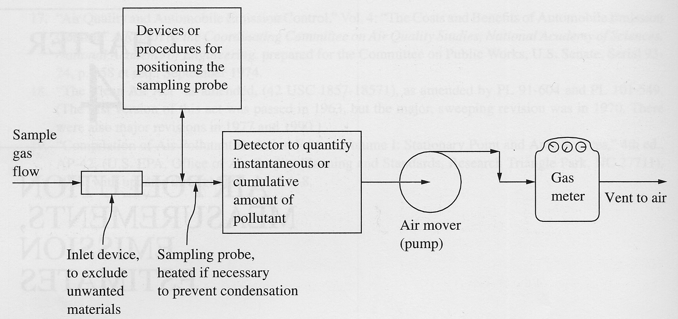
Principle of Air Pollution Measurements
Notes:
Air Mover: create a flow of air carrying pollutants in the air to be analyzed into a sample collection device
Inlet device: to filter out unwanted materials such as bugs, moistures, debris, etc
Inlet Design: isokinetic sampling with least disturbance to the atmospheric/ambient conditions
Sampling media and collection devices: filers, impactors, impingers, absorbants, etc
Air flow control devices: ratameters, flow meters, pressure valves, etc

Slide 5
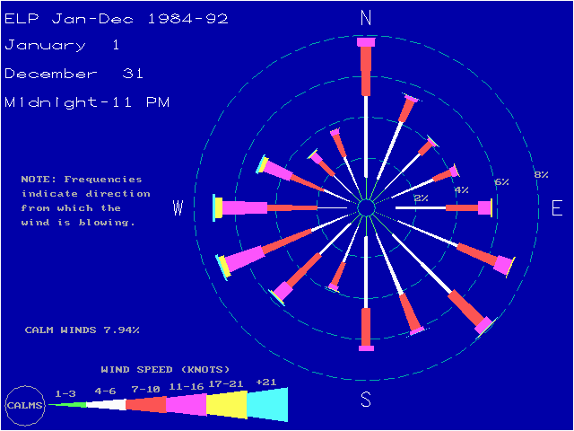
Supplemental Meteorological Measurements
Surface Meteorology
Wind Direction
Wind Speed
Atmospheric Temperature
Atmospheric Humidity
Atmospheric Pressure
Vertical Temperature Profile
Windrose
Graphical presentation of the frequency
of occurrence of wind direction and
wind speed categories
Notes:
Ambient Air Monitoring
Measurements of Air Pollutants
Time-integrated Air Monitoring
Particulate Matter
Hi-vol: 1 m³/min
Mid-vol: 100 l - 1 m³/min
Low-vol: 10 l - 100 l /min
Quite often the sampling rate will be set at 1 m³/hr, which is approximately the same as the inhalation rate of an adult.
Personal: < 10 l/min
Vapor
Grab samples
Canister
Media
Continuous Air Monitoring
Measurements of Meteorological Parameters
Measurements of Surface Meteorology
Wind Direction
Wind Speed
Atmospheric Temperature
Atmospheric Humidity
Atmospheric Pressure
Vertical Temperature Profile
Upper Air Measurement
Balloon Measurements
Radiosonde: A balloon-borne instrument fitted with radio transmitters for simultaneous measurements and transmission of meteorological parameters of temperature, pressure, and relative humidity.
Rawinsonde: When the radiosonde is tracked by radar in order to obtain data on wind speed and direction at various altitudes, the system is known as rawinsonde. They are ypically tracked by a radar or radio direction finder.
Rocket-fired Equipment falling through the atmosphere: A Rocket is fired to release a sphere in the atmosphere. The sphere falls toward the earth. The velocity and accelerations are determined and the air density at different level can be deduced through the use of a ground-based radar. Air density can be determined because the air density increases and the drag force increases as the sphere falls through the atmosphere. Instrument packages are ejected from the sphere and slowly descend by parachute. Data is radioed to the ground.
Remote Sensing: Remote sensing attempts to measure the characteristics of the atmosphere with instrumentation that does not have a sensing element in or surrounding the volume of interest in the atmosphere. The instruments include sodar, long-wavelength radar, short-wavelength radar, CW lidar, and pulsed lidar.

Slide 6
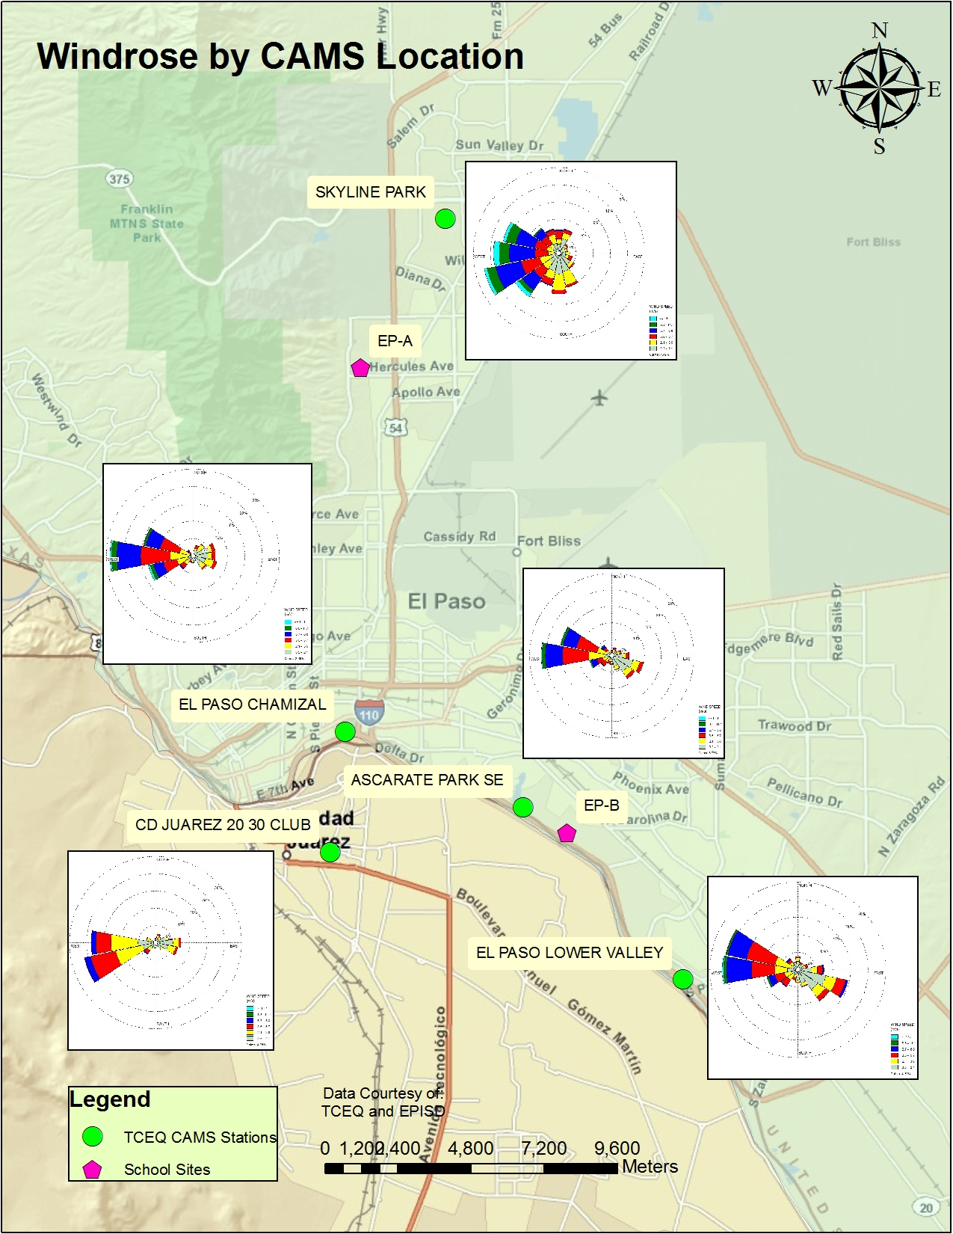
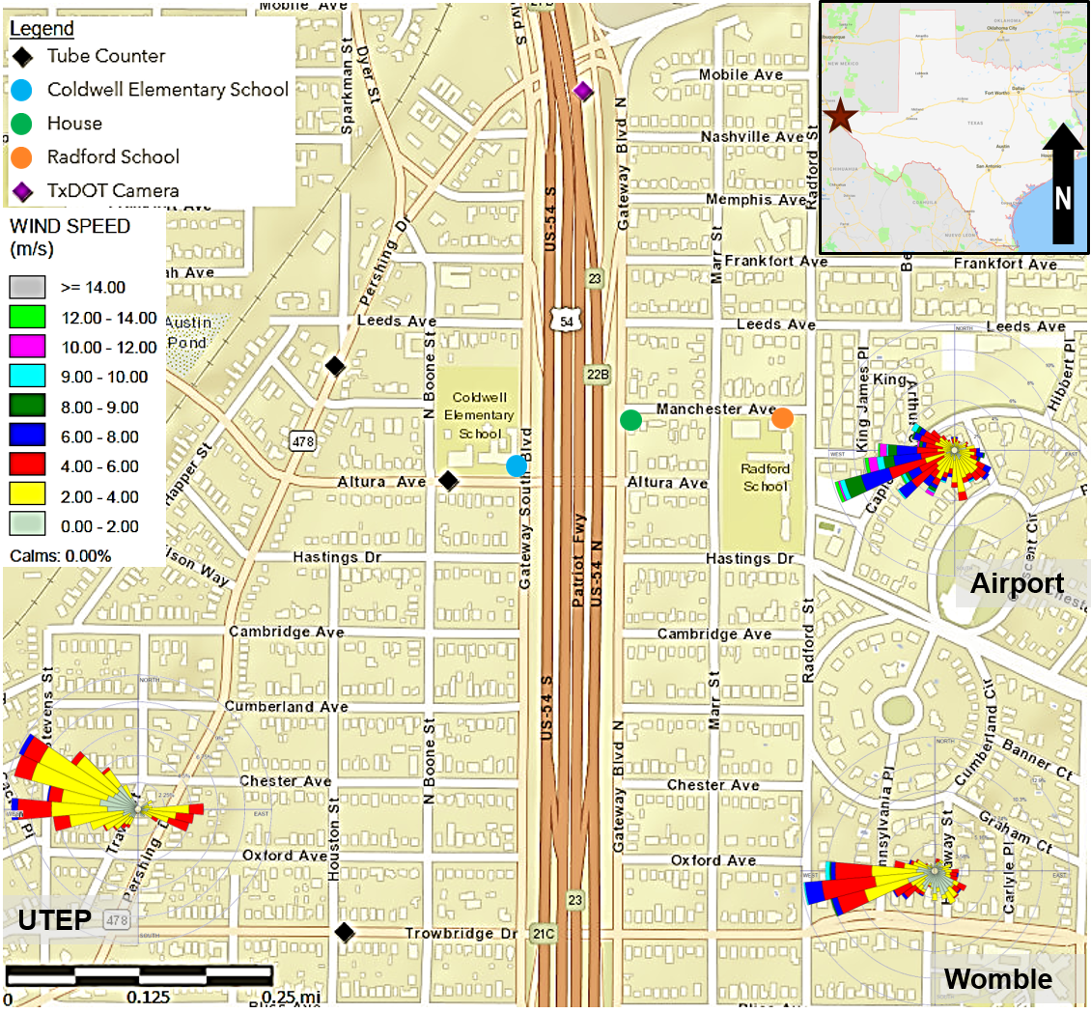
Supplemental Meteorological Measurements
Notes:
Windrose: Windrose is the graphical presentation of the frequency of occurrence of wind direction and wind speed categories for the purpose of identifying prevailing winds for air pollution study.
One can construct any windrose plots using the portion of wind data of interest. For instance, a windrose can be constructed for a fixed duration of time or for a specific time segment of the same fixed duration. You can construct a windrose using one year of wind record or you can construct a windrose using only the nighttime wind data, depending on the purposes of your research/analyses.
How to read a windrose: each spoke represents the percentage of time during the period that winds are coming from in various wind speed categories.

Slide 7
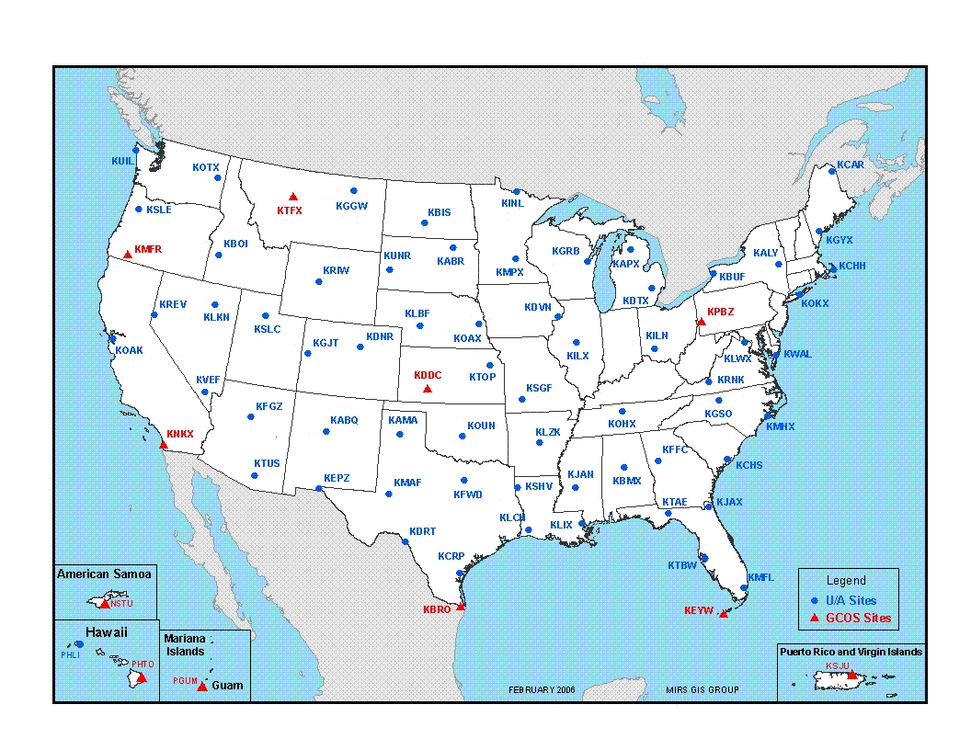
Supplemental Meteorological Measurements
Upper Air Meteorology
Balloon Measurements
Radiosonde
Rawinsonde ("radar wind-sonde")
Remote Sensing
Mixing Height
the distance between the surface and
the top of the planetary boundary,
where turbulence diminishes and
surface friction becomes insignificant.
It is the layer from the ground-level to the
altitude about where the neutral condition is
reached is a region that vertical mixing would
occur more rigorously.
Notes:
Upper Air Measurement
Balloon Measurements
Radiosonde: A balloon-borne instrument fitted with radio transmitters for simultaneous measurements and transmission of meteorological parameters of temperature, pressure, and relative humidity.
Rawinsonde: When the radiosonde is tracked by radar in order to obtain data on wind speed and direction at various altitudes, the system is known as rawinsonde. They are typically tracked by a radar or radio direction finder.
Rocket-fired Equipment falling through the atmosphere: A Rocket is fired to release a sphere in the atmosphere. The sphere falls toward the earth. The velocity and accelerations are determined and the air density at different level can be deduced through the use of a ground-based radar. Air density can be determined because the air density increases and the drag force increases as the sphere falls through the atmosphere. Instrument packages are ejected from the sphere and slowly descend by parachute. Data is radioed to the ground.
Remote Sensing: Remote sensing attempts to measure the characteristics of the atmosphere with instrumentation that does not have a sensing element in or surrounding the volume of interest in the atmosphere. The instruments include sodar, long-wavelength radar, short-wavelength radar, CW lidar, and pulsed lidar.

Slide 8
Measurements of Particulate Matter
Terminology
Particulate Matter and Aerodynamic Diameter
Stoke’s Law
Integrated Samples vs Continuous Samples
Sampling Time and Duration
Sampling Frequency
Isokinetic Sampling
Virtual Impaction
Size Cut-Off and Collection Efficiency
Filter Media
FRM vs FEM
Quality Control and Quality Assurance
Notes:
Aerodynamic diameter: two particles with the same Stoke stopping distance for any initial velocity in air with the same viscosity are called to have the same aerodynamic diameter. If one refers to an unit density (1 g/cm³) and the same terminal gravitational settling velocity in still air as the actual particle in question, then the aerodynamic diameter is defined as
d_{aerodynamic} = d_{particle} x (ρ_{particle})^{0.5} , where
d_{aerodynamic} = equivalent aerodynamic diameter of a particle, micrometer;
d_{particle} = actual diameter of a particle, micrometer;
ρ_{particle} = actual density of a particle, g/cm³
Aerosol sizes by equivalent diameter
Nano particles: particles < 10 nm
Ultrafine particles: particles cover the range from large molecules to about 100 nm (0.001 to 0.1 μm)
Fine particles: particles less than 2.5 μm in diameter
Thoracic coarse particles: particles that can be inhaled and penetrate into the thoracic region of the lung (tracheobronchial and the gas-exchange regions)
Coarse particles: particles greater than 2.5 μm in diameter
Aerosol sizes by sampling methods
PM_{2.5}: particles less than 2.5 μm in diameter at 50 % cutoff
PM₁₀: particles less than 10 μm in diameter at 50 % cutoff
PM_{coarse} : particles greater than 2.5 μm but less than 10 μm in diameter at 50 % cutoff
Major chemical components in PM
Geologic Elements: Al, Ca, Si, K, P, Na, and other trace elements
Sulfate: Ammonium sulfate, ammonium bisulfate, sulfuric acid, sodium sulfate
Nitrate: Ammonium nitrate, sodium nitrate
Ammonium: Ammonium sulfate, ammonium bisulfate, ammonium nitrate
Sodium Chloride
Organic Carbon: compounds containing more than 20 carbon atoms (<C₂₀)
Element Carbon (soot)
Liquid Water
Size Cut-off:
PM exists in the air with various shapes and densities. No sampling instrument (or at least not developed) can provide stepwise sharp cut of passing 100 % of PM small than a specific size and excluding 100 % of PM large than that specified size. As a result, the PM samples we collected in the air always include various sizes of PM. The methods used in PM sampling include inlet size selection, filtration, impaction, virtual impaction, and other technologies based on particle aerodynamics that are applicable in air pollution control. In any cases, size selective inlets are commonly used in every sampling instrument.
An instrument’s size cut-off is defined by the 50 % cut-point (d₅₀). d₅₀ represents the aerodynamic diameter at which 50 % of the sampled particles penetrate an inlet. The effectiveness of the sharp cut-off is defined by the slope of the sample effectiveness (or the ratio of d₁₆/d₈₄). A slope of 1 indicates that 100 % of the particles with aerodynamic diameter less than the cut-off pass through the inlet to the filter, and 0 % of those larger than the cut-point are collected. Typical values of the slope vary between 1.3 and 2.
Classical Aerodynamic Diameter, D_{ca}
The diameter of unit density sphere (ρ_{part} = 1 g/cm³) having the same terminal velocity as the particle.
Stokes’ Law:
F_{drag} = 6πμv∞R expresses the drag force experienced by a particle in a fluid field and the relationship is call the Stokes’ Law. Stoke’s Law defines the total resistance force acting on a spherical object in an incompressible, steady creeping flow (Low Reynolds number) where inertia forces can be neglected and the non-slip condition at the surface of the sphere applies
Corrections to Stokes' Law
a) Re > 1
The above stokes Law is derived for Re<<1. For Re > 1, the inertial term in the Navier-Stokes equation becomes significant. Experimentally, the drag force can be expressed as
Or
And C_{D} is given as
b) Re<<1
For Re<<1, although the inertial force can be completely ignored, unfortunately, the assumption of continuum is gradually fading away as the size of the particle decreases. In a way, the Knudsen number approaches 1. As a result, the drag force exerted by the fluid becomes smaller than predicted by Stokes' law. The slip correction factor is introduced into the Stokes' equation to account for this effect.
The following definitions are taken from the US Code of Federal Regulations, Title 40, Part 50: (40CFR § 50.1)
Federal Reference Method means a method of sampling and analyzing the ambient air for an air pMllutant that is specified as a reference method in an appendix to this part, or a method that has been designated as a reference method in accordance with part 53 of this chapter; it does not include a method for which a reference method designation has been cancelled in accordance with §53.11 or §53.16 of this chapter.
Federal Equivalent Method means a method of sampling and analyzing the ambient air for an air pollutant that has been designated as an equivalent method in accordance with part 53 of this chapter; it does not include a method for which an equivalent method designation has been cancelled in accordance with §53.11 or §53.16 of this chapter.
Virtual Impaction
Operation Principle
Large particles with greater inertia cannot follow the sharp turn made by the air steam and continue to move in their initial directions and therefore are separated from the air stream.
Virtual Impaction
The air stream is forced to make a turn not by physical obstruction but by the reduction of flow velocity, a virtual impaction.

Slide 9
Measurements of Particulate Matter
Integrated Measurements
High-vol: >1 m³/min
Medium-vol: <1 m³/min but >0.1 m³/min
Low-vol: <0.1 m³/min
Personal sampling: portable low-vol monitors of <0.005 m³/min
Size cutoff: PM10, PM2.5, PM1.0 or cascade impactions for various sizes.
Sampling Devices
Filtration
Gravitational Settling
Cyclone
Virtual Impaction
Diffusion, thermophoresis, and photophoresis based devices
Notes:
Medium volume of air intake is typically refer to the breathing rate of human (1 m³/hr or 16.7 liter/min)
Sampling theory for PM is referred to Hinds’ Aerosol Technology.

Slide 10
Measurements of Particulate Matter
Continuous Measurements
Principles of Measurements
Available Devices
Stationery FRM Monitors
Portable Monitors
Personal Monitors
Low-Cost Monitors
Based on light scattering caused by particles in an air stream through a light beam
Low energy consumption
Evaluated by US EPA and SCAQMD of California
Notes:
U.S. EPA, 2009. Monitoring Compliance Test and Source Testing Observation, Air Pollution Training Institute Course #468, December 2009.
EPA Low-cost air monitors toolbox: https://www.epa.gov/air-sensor-toolbox
California South Coast Air Quality Management Doistrict: http://www.aqmd.gov/aq-spec
“Air sensor monitors that are lower in cost, portable and generally easier to operate than regulatory-grade monitors are widely used in the United States to understand air quality conditions. This website provides the latest science on the performance, operation and use of air sensor monitoring systems for technology developers, air quality managers, citizen scientists and the public. The EPA is involved in the advancement of air sensor technology, including performance evaluations of sensor devices and best practices for effectively using sensors. The information can help the public learn more about air quality in their communities.” – EPA Air Sensor Tool Box Webpage

Slide 11
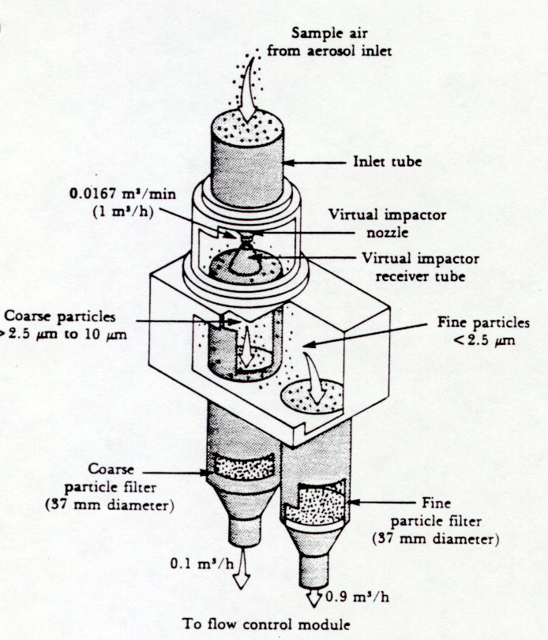
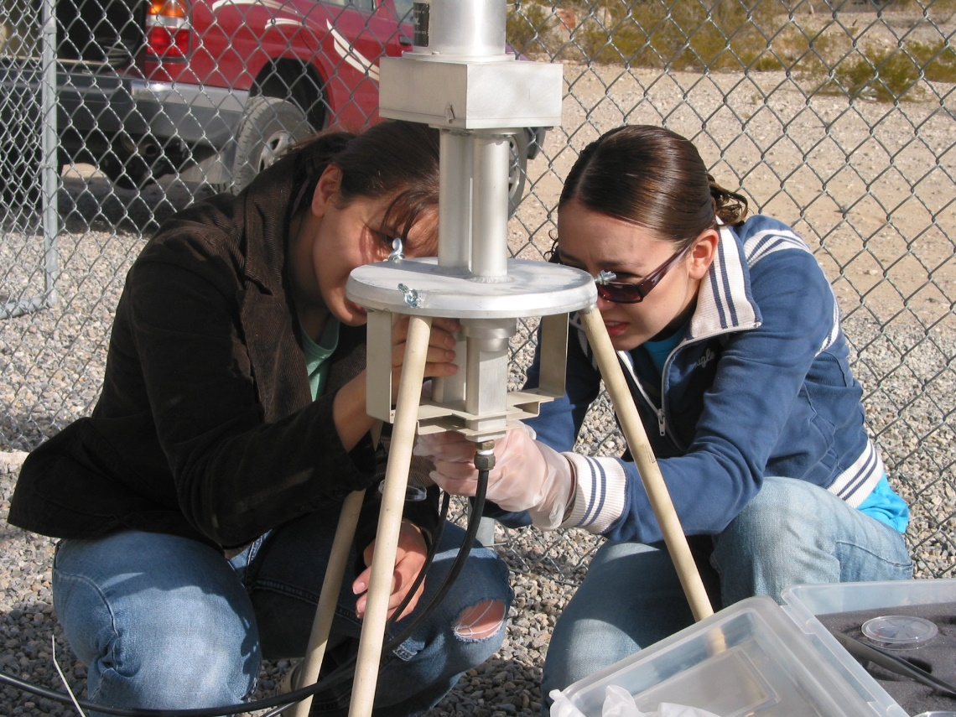
Sample Ambient PM Measurement Devices
Beta Attenuation PM Monitor
Dichotomous (Virtual Impaction)
PM Monitor
Tapered Element Oscillating
Microbalance PM Monitor
Notes:
Operation Principle
Large particles with greater inertia cannot follow the sharp turn made by the air steam and continue to move in their initial directions and therefore are separated from the air stream.
Virtual Impaction
The air stream is forced to make a turn not by physical obstruction but by the reduction of flow velocity, a virtual impaction.

Slide 12
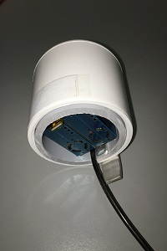
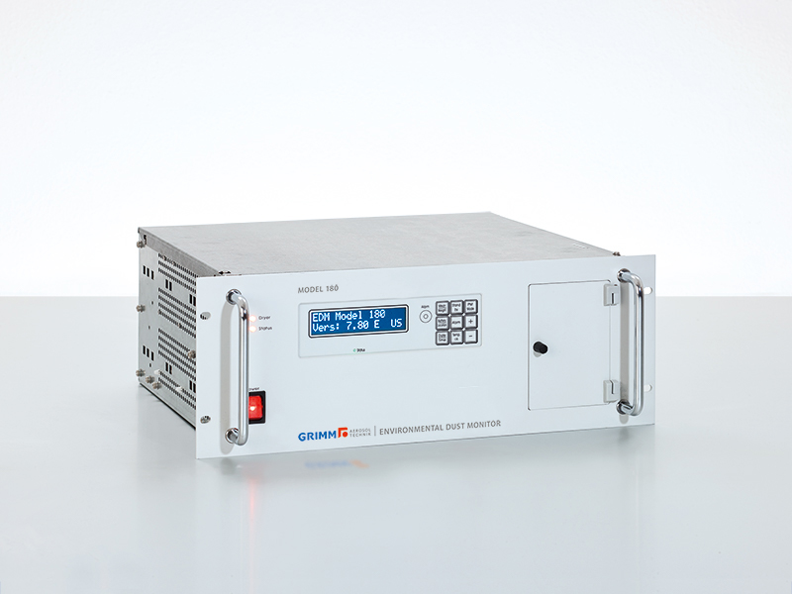
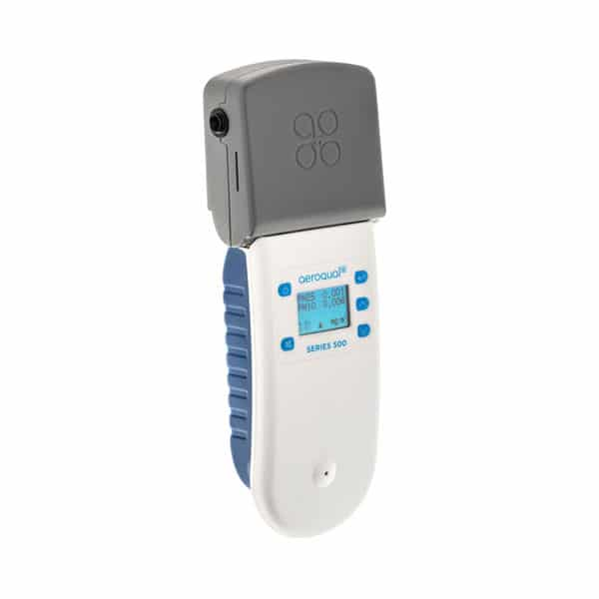
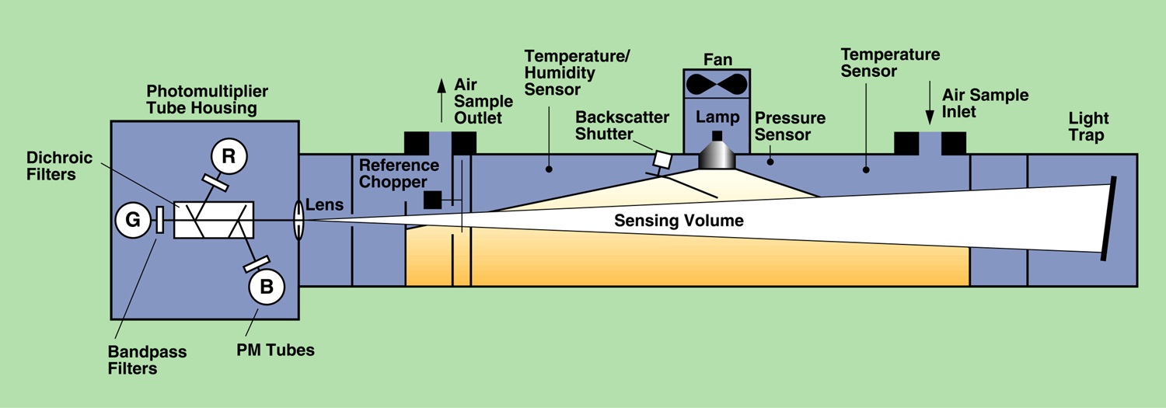
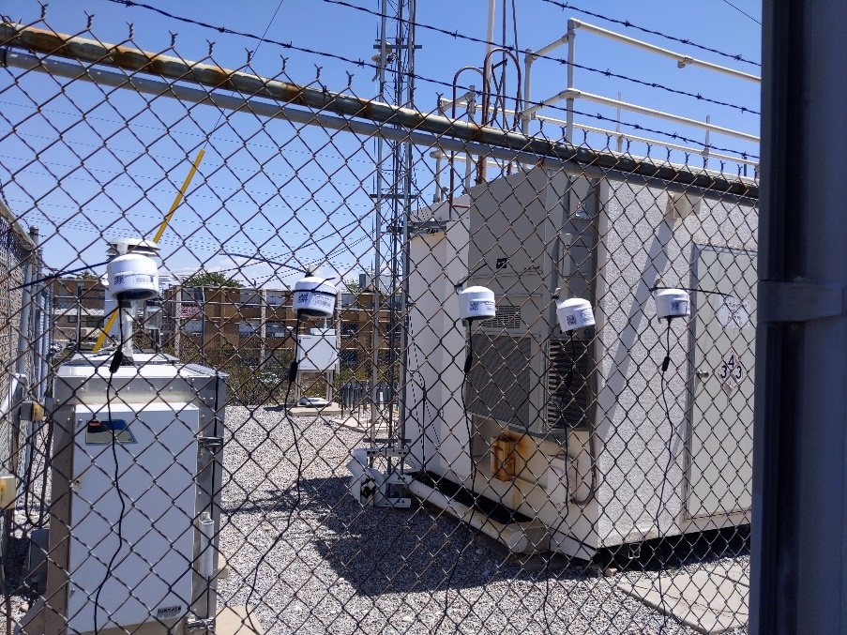
Sample Ambient PM Measurement Devices
Low-cost limited channels,
Light scattering Personal
Particle Counter PM
– Aeroqual
Multiple Size Channels
PM Monitor - GRIM
Low-cost limited channels
Particle Counter PM Monitor
– Purple Air
Light Scattering PM Monitor - TSI 3563 Nephelometer
Notes:
https://www2.purpleair.com/?gclid=EAIaIQobChMIhaOHjfnN6gIVSf3jBx0uEgIMEAAYASAAEgKjbPD_BwE
https://www.grimm-aerosol.com/products-en/environmental-dust-monitoring/approved-pm-monitor/edm180-the-proven/

Slide 13
Measurements of Gaseous Materials
Methods to collect gaseous materials depend strongly on the chemicals of concern
Different sampling media and techniques are required based on the laboratory procedures.
Instantaneous and integrated sampling for non-reactive, non-degrading, high concentration chemicals are typically done using a pre-calibrated, cleaned canister. Samples are brought back to a chemical laboratory for GC/MS analyses.
Other media are used to compensate low concentration and the requirements of various sampling times. Media commonly used are Tenex tube, silica gel, activated carbon, etc.

Slide 14
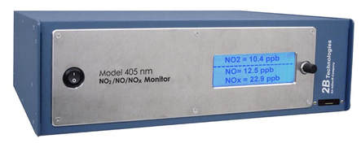
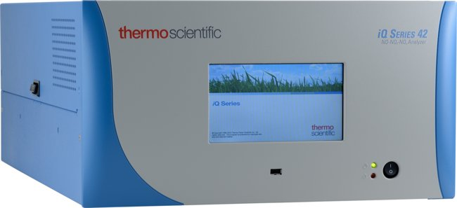
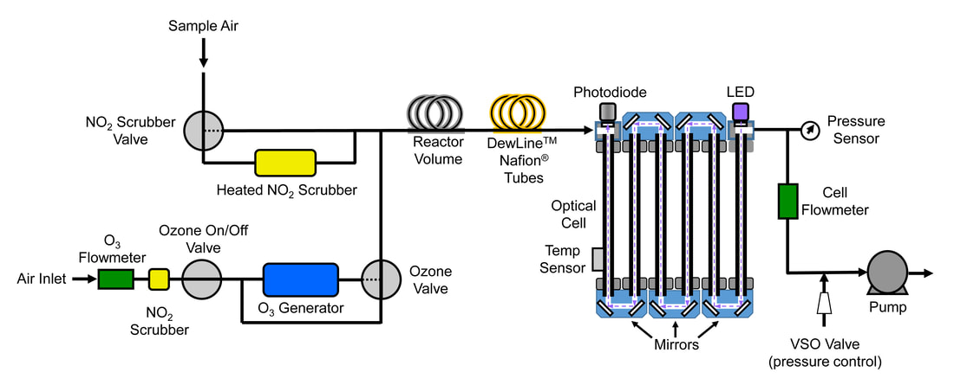
Sample Continuous Gas Monitors
FEM-approved direct measurement
NO2 Monitor – 2B Model 405
FRM-approved NO-O3 reaction
NO2 Monitor – Thermoscience 42iQ
Notes:
https://twobtech.com/model-405-nm-nox-monitor.html
Model 405 NOx Monitor measures directly by absorbance, analogous to an ozone monitor. Because NO2 has a much lower absorption cross section than ozone, a folded cell with corner mirrors is used to produce a long absorbance path of ~2 m to achieve approximately the same sensitivity for NO2 as we do for ozone in our UV-based-absorbance monitors. The wavelength of 405 nm was chosen because no other species found in ambient air has significant absorbance at that wavelength, making the Model 405 nm extremely selective for NO2.
https://www.thermofisher.com/order/catalog/product/42IQ#/42IQ
The Thermo Scientific™ 42iQ NO-NO2-NOx Analyzer is a chemiluminescence based instrument for nitrogen oxides measurements

Slide 15
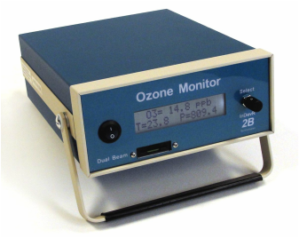
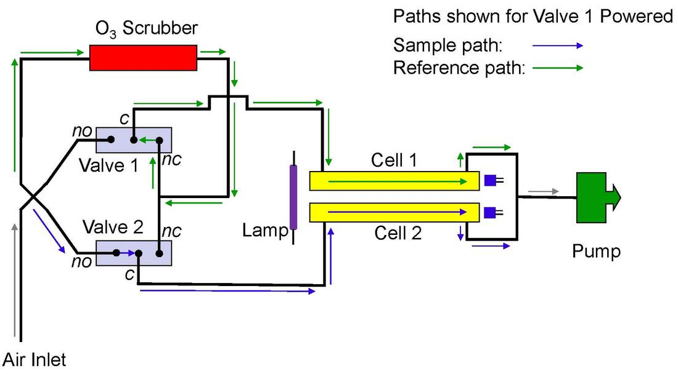
Sample Continuous Gas Monitors
FEM-approved direct measurement
Ozone Monitor – 2B Model 205
FRM-approved Ethylene-chemiluminescence Ozone Monitor – Bendix 8002 (obsolete)
Notes:
https://twobtech.com/model-205-ozone-monitor.html
The Model 205 Dual Beam Ozone Monitor makes use of two detection cells to improve precision, baseline stability, and response time. In the Dual Beam instrument, UV light intensity measurements Io (ozone-scrubbed air) and I (unscrubbed air) are made simultaneously. Combined with other improvements, this made it possible to reduce the time between ozone measurements to 2 seconds, making our instrument the fastest UV-based ozone monitor on the market, while still retaining the small size, weight, and power requirements of our popular Model 202 Ozone Monitor.
The chemiluminescence measurement method is based on the reaction of ozone (O3) with nitric oxide (NO) to form nitrogen dioxide (NO2) and oxygen (O2). The excited state nitrogen dioxide (NO2*) emits infrared light with an intensity proportional to the NO concentration.

Slide 16
Air Pollution Data Sources
U.S. Federal
Air Data: Air Quality Data Collected at Outdoor Monitors Across the US
https://www.epa.gov/outdoor-air-quality-data
Evaluation of Emerging Air Sensor Performance
https://www.epa.gov/air-sensor-toolbox/evaluation-emerging-air-sensor-performance
U.S. State (Texas for example)
https://www.tceq.texas.gov/airquality/monops/hourly_data.html
https://www17.tceq.texas.gov/tamis/index.cfm?fuseaction=home.welcome
Notes:
Air pollution data are readily available everywhere on the web. It is up to the users to decide where to get it based on the needs of the researchers.

Slide 17
Discussion
Process surface wind data and construct a time-averaged, duration-specific windrose
Determination of advantage and disadvantage of low-cost air sensor
QAPP for air pollution measurement
Uncertainties involved in the mass concentration developed from gravitational method vs Gravitational weighing light scattering
Notes:
EPA WindRose Model
Model: Wrplot
http://www.epa.gov/scram001/metobsdata_procaccprogs.htm/ or from consulting firms such as Lakes Environmental Inc. which offers user friendly window-version freeware for WRPLOT
Find WRPLOT to download the program for generating windroses using surface wind observations.
Save the program wrplot and unzip in a directory with a name of less than 8 characters. The wrplot was written in FORTEAN and can only be run on DOS. Therefore, some conveniences that come with WINDOW Environment won’t be applicable.

Slide 18
Research Gaps and Future Directions
Health effects associated with exposures to air pollution may not be directly related to the mass concentration of a pollutant. The constituents of air pollutants and sizes, surface areas of particles can all play an important role. How measurements can be improved to acquire such information in terms of timeliness and quality of the data?
Low-cost air sensors provide an economic way for network monitoring. However, the quality of the instrument needs to be improved.
Biological pollutants such as Covid-19 create pandemic health problem for mankind. New methods in identifying and quantifying biological pollutants are needed in the future.
Notes:
Use of DRONE in air monitoring.
Contemporary issues to be developed/updated later.
Proprietary, state-of-the-art materials shall be discussed based on new development in the fields.

Slide 19
Take-Home Messages
Air quality monitoring is an integrated component in air quality management and assessment of health effects
Determination of air pollution measurement methods depends on the purpose of monitoring, pollutants of interest, sampling time, best available knowledge, and science
Thanks to the internet, air quality data are readily available
Notes:
https://www.apti-learn.net/lms/register/display_document.aspx?dID=278
Contemporary issues to be developed/updated later.

Slide 20
References
Li, W-W, 2020. Chapter 2: Air pollution, air quality, vehicle emissions and environmental regulations, in Traffic-Related Air Pollution: Emissions, Human Exposures, and Health, edited by Khreis H. et al, Elsevier S&T Books.
De Nevers, Noel. 2017. Air Pollution Control Engineering, Waveland Press, Inc., ISBN 1-4786-2905-3.
Hinds, William C., 1999. Aerosol Technology, John Wiley & Sons, Inc., ISBN0-471-19410-7.
Kulkarni, P., Baron, P.A., Willeke, K., 2011, Aerosol Measurement: Principles, Techniques, and Applications, 3rd Edition, John Wiley & Sons, Inc., ISBN-13: 978-0470387412

Slide 21
Reading List
Khreis H. et al, 2020. Traffic-Related Air Pollution: Emissions, Human Exposures, and Health, Elsevier S&T Books.
Li, W-W, 2020. Chapter 2: Air pollution, air quality, vehicle emissions and environmental regulations, in Traffic-Related Air Pollution: Emissions, Human Exposures, and Health, edited by Khreis H. et al, Elsevier S&T Books.
De Nevers, Noel. 2017. Air Pollution Control Engineering, Waveland Press, Inc., ISBN 1-4786-2905-3.
U.S. EPA, 2009. Monitoring Compliance Test and Source Testing Observation, Air Pollution Training Institute Course #468, December 2009.
Hinds, William C., 1999. Aerosol Technology, John Wiley & Sons, Inc., ISBN0-471-19410-7.
Kulkarni, P., Baron, P.A., Willeke, K., 2011, Aerosol Measurement: Principles, Techniques, and Applications, 3rd Edition, John Wiley & Sons, Inc., ISBN-13: 978-0470387412,

Slide 22
Acknowledgements
This presentation is adapted from the class notes used in the class CE 5326: Air Pollution Control Engineering at UTEP and refers to several documents, in particular, “ Air Pollution Control Engineering’” by De Nevers , Waveland Press, Inc., ISBN 1-4786-2905-3, and “Monitoring Compliance Test and Source Testing Observation” by Air Pollution Training Institute Course #468, and U.S. EPA websites. The author does not endorse any instruments discussed in this presentation. They are merely examples of instruments available in the market. The information provided in this presentation is designed sole for discussion only and should not be cited or reproduced for any other uses without the consent of the author.

