Slide 1
www.carteeh.org

Slide 2
Lecture #18: Air Pollution Exposure Assessment Methods
Kirsten Koehler
Johns Hopkins Bloomberg School of Public Health
Kirsten.Koehler@jhu.edu (410) 955-7706
The author declares that there is no conflict of interest
Lecture Track(s): HT/TT
Notes:
Health Track (HT)—mainly targeted at urban planners, transportation planners, and engineers with limited knowledge of public health-related concepts;
Transportation Track (TT)—mainly targeted at environmental epidemiologists and public health professionals with limited knowledge of transportation-related concepts; and;
Planning and Policy Track (PPT)—mainly targeted at planners, civil servants, and policy and decision makers with particular interest in the science-policy link.

Slide 3
Introduction
Exposure to ambient air pollution is a top 10 risk for morbidity and mortality on a global scale.
Quantifying exposures to air pollutants is needed to ensure the public is protected from known risks and to better understand the relationships between exposure and health outcomes.
We are constantly exposed to a wide range of airborne pollutants. Some of them are regulated by the EPA (National Ambient Air Quality Standards), but other pollutants may also have health concerns (e.g. ultrafine particles, VOCs, etc.)
This lecture will not detail specific measurement strategies for any specific pollutant, but will instead provide an overview of the methodologies used.

Slide 4
What is Exposure?
Exposure: Concentration or amount of a particular agent that reaches a target organism, system, or (sub)population in a specific frequency for a defined duration.
Exposure Assessment: Evaluation of the exposure of an organism, system, or (sub)population to an agent (and its derivatives).
Exposure Scenario: Exposure scenario is a set of facts, assumptions, and inferences about how exposure takes place that aids the exposure assessor in evaluating or quantifying exposure.
Agent/stressor: any biological, chemical, or physical entity that can cause or induce an adverse response in a human or ecological receptor. For TRAP we are often concerned with particulate matter (PM), oxides of nitrogen (NOx), and other chemical contaminants.

Slide 5
Ecological vs. Individual Exposure Estimates
Individual exposure estimates using equipment that can be carried by an individual are often considered the gold standard, but individual level studies are expensive and can be unfeasible for large populations.
  Can limit the number of samples
  Can lead to high variability and attenuated estimates of the relationship between exposure and health outcome
  Estimates of the relationship between exposure and health tend to be more precise
Ecological estimates (exposure assessment for groups of people based on a common location/activity/source) may be better for large studies. (State-run monitoring is a good example)
  Estimates of the relationship between exposure and health are less precise
  However, these estimates are less prone to attenuation.

Slide 6
Measurement of National Ambient Air Quality Standard (NAAQS) Pollutants
EPA publishes methods for measuring each NAAQS. This lecture will detail methods used to assess exposures to PM as an example, but many of the methods have analogous methods for other pollutants.
For more information on EPA reference methods see:
https://www.epa.gov/sites/production/files/2019-08/documents/designated_reference_and-equivalent_methods.pdf

Slide 7
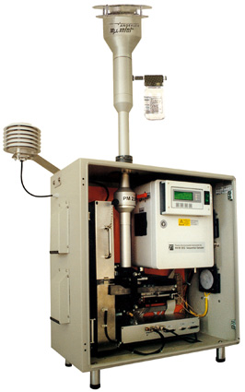
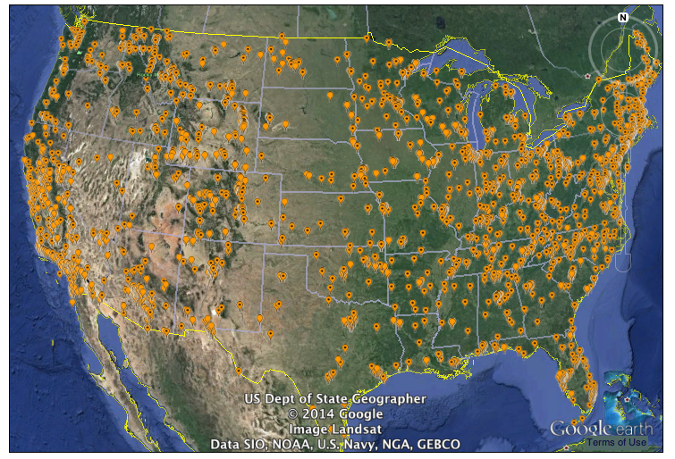
Typical Measurement Methods (PM)
Filtration with gravimetric analysis for daily or weekly PM mass concentration.
Beta Attenuation and Tapered element oscillating monitor (TEOM) are methods to provide hourly PM mass concentrations.
Monitors are located in every county in the U.S.
Notes:
Gravimetric analysis includes weighing the filter before and after sampling to determine the mass of particles collected.
Beta Attenuation monitors determine the attenuation of beta radiation as particles are sampled on a filter ribbon. The ribbon can be advanced at a specified time to give high resolution mass concentration measurements (1 hr or less).
TEOM monitors have particles deposit on an oscillating element. As particle mass is deposited, the oscillation frequency changes, which is proportional to particle mass.

Slide 8
Where Do We Site Monitors?
In the US, State and Local Air Monitoring Stations (SLAMS) network is designed to meet three basic monitoring objectives:
  Provide air pollution data to the general public in a timely manner.
  Support compliance with ambient air quality standards and emissions strategy development.
  Support for air pollution research studies.
Six general site types are allowed with different monitoring objectives:
  Determine the highest concentrations in the area.
  Measure typical concentrations in areas of high population density.
  Determine the impact of significant sources or source categories on air quality.
  Determine general background concentration levels.
  Determine the extent of regional pollutant transport.
  Measure impacts on visibility, vegetation damage, or other welfare-based impacts.

Slide 9
Is it Sufficient to Monitor Ambient Concentrations?
EPA (and other regulatory agencies) routinely monitors air quality, but it is expensive, so it can only be done at a relatively small number of locations – yet concentrations can vary over small scales.
Typically only outdoor air quality is regulated, so there is need to understand the associations between ambient and indoor pollution and health.
  People spend most of their time indoors.
If we are interested in preventing/controlling disease, way may need to consider indoor exposures, which can be much higher.

Slide 10
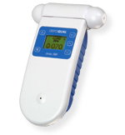
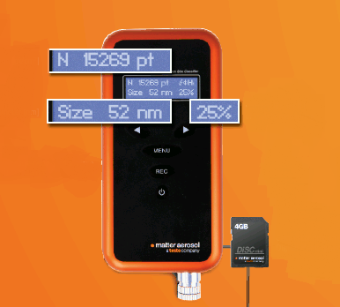
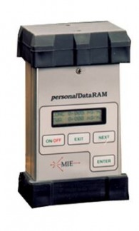
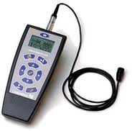
Does an EPA Monitor Represent MY Exposure?
However, small-scale variability in pollution is common due to proximity to sources. Thus, a central monitor may not provide a good estimate of personal exposure. The growing sensor technology provides opportunities to measure exposures on individuals.
Personal monitoring was pioneered in occupational studies, but rapid improvements in technology make monitoring feasible for many pollutants today. Some examples are shown.
Notes:
Small, portable, battery-operated devices can be used to measure exposures as people go about their daily activities. If the device can provide high resolution information, it may be possible to see how exposures vary between common microenvironments like home, work, transit, shopping, etc. Examples of exposures that can be measured with sensors include:
Noise
PM
Ultrafine particles
Many Gases and vapors
Radiation

Slide 11
Other Ways to Estimate Exposures
It is not always possible to measure exposures directly, or not possible at sufficiently high spatial resolution for the proposed study objectives. Instead, if spatial variability is systematic, we can model changes in exposure levels.
  If there is spatial and/or temporal dependence, we don’t have to measure concentrations everywhere and at every time to make estimates of concentrations everywhere.
Spatial scale of variability compared to distances people move can be important to ensure that estimates are representative. Ecological studies often consider large changes in exposure and neglect the smaller scale variability.

Slide 12
How can we use spatial dependency to predict exposures?
Distance based metrics
Deterministic interpolation
Geostatistical interpolation
Deterministic modeling
Land-use regression
Notes:
These topics are discussed further below.

Slide 13
Geographic Information Systems (GIS)
GIS is a computerized mapping system that integrates data into a common spatial form for mapping and calculation.
Can bring together data for many uses:
  Geographic
  Population
  Health
  Exposure
And include data of many types for a common usage:
  Point: locations of large sources
  Line: street locations
  Area: neighborhoods

Slide 14
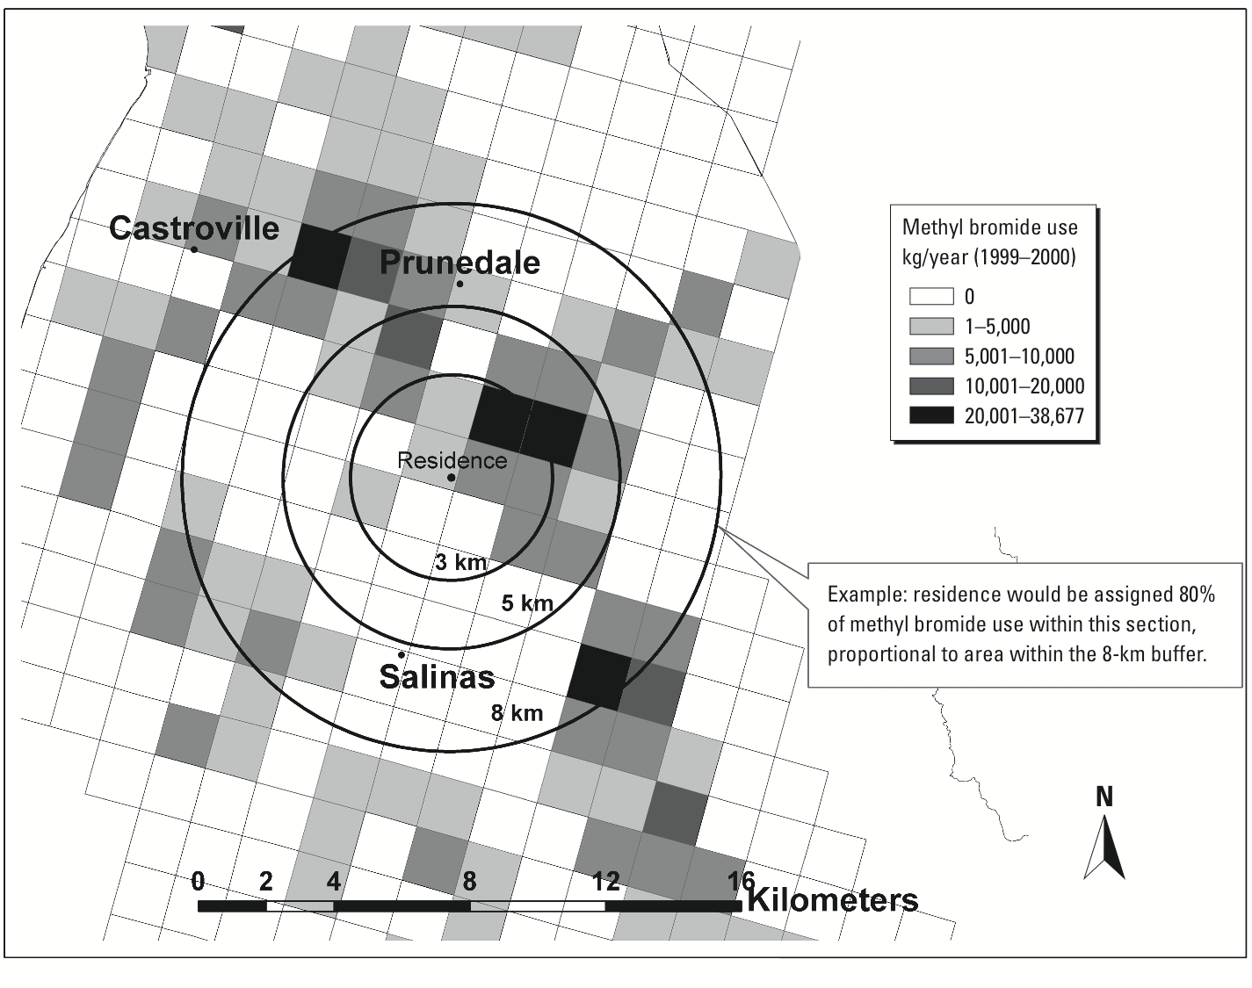
Simple Methods
Distance to a source: continuous or used to define exposed/ unexposed populations
Number/ density of sources in a buffer (can also be yes/no)
Environ Health Perspect; DOI:10.1289/ehp.1205682

Slide 15
Kriging: Geostatistical Interpolation
Provides a Best Linear Unbiased Estimate (BLUE)
Predicts both the value and the standard error at any unsampled location
  Gives us an indication where the interpolation is less reliable – and where more data is most useful to improve the interpolation
Requires quite a few measurements to adequately constrain the spatial dependence appropriately.
ArcGIS, R, Matlab software programs enable Kriging.

Slide 16
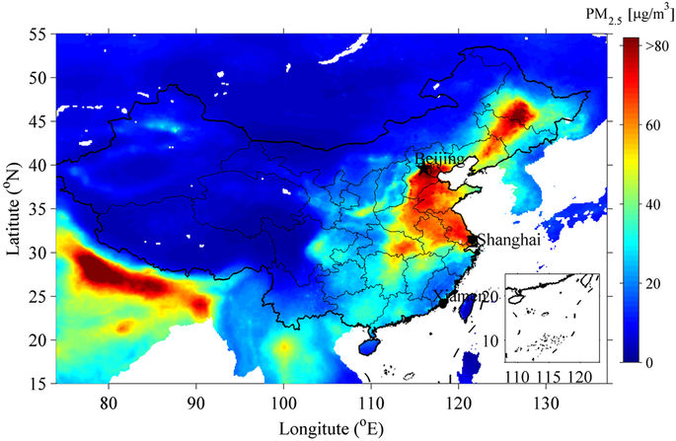
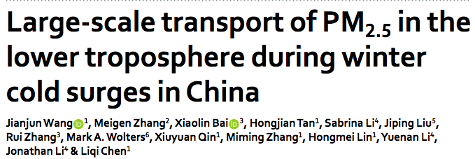
Dispersion models
Data needs:
  Source location and strength
  Dispersion properties (meteorology data for air, other transport info for water or soil)
  Locations of population of interest
At each grid cell the model accounts for
  Sources: emissions, advection into region, chemical reactions
  Sinks: deposition, advection out of region, chemical reactions
Notes:
Dispersion modeling is a mathematical simulation of how pollutants move through the atmosphere.

Slide 17
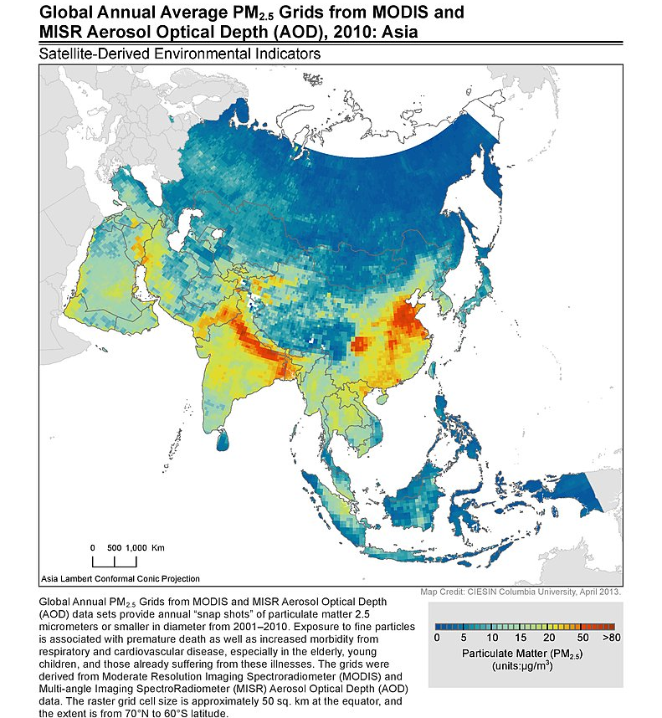
Other Measurement Strategies
Few measurement locations in many areas of the world have prompted the use of satellite data for exposure assessment.
Satellite derived data of aerosol optical depth to surface concentrations is a major area of research
Limitations
  Clouds!
  Estimates the aerosol concentration through the full atmosphere, but we are interested in concentrations at the ground level.
http://sedac.ciesin.columbia.edu/downloads/maps/sdei/sdei-global-annual-avg-pm2-5-2001-2010/asia-pm2-5-2010.jpg

Slide 18
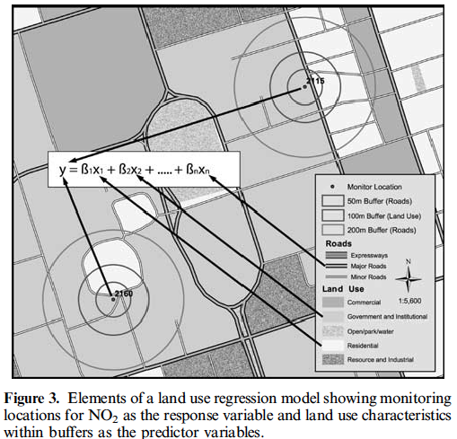

Land-Use Regression
Predict pollutant concentrations from land-use and traffic characteristics. Each characteristic is assumed to be linearly related to pollutant concentrations.
$Z_{j}=β_{o}+\sum_{i=1}^{n}{β_{i}}X_{i,j}+ε_{j}$

Slide 19
Strengths and Weaknesses
Measuring Ambient concentrations: Individual instruments will have their own strengths and weaknesses, but overall,
  PRO: measurements can provide highly accurate estimates of exposures for those who live nearby the measurements. The give high temporal resolution (hourly to weekly) and are deployed around the country and world.
  CON: they cannot account account for movement of people and may not give good estimates for people who do not live near a monitor. Furthermore, they cannot estimate exposures indoors, where people spend the majority of their time.
Personal Exposure Assessment:
  PRO: Provides highly time-resolved measures of exposure on individuals, accounting for all the places they spend time.
  CON: Expensive and time-consuming, which limits sample sizes.

Slide 20
Discussion
Spatial correlation does not imply causation.
Most sources will emit a variety of pollutants; it may be difficult to distinguish which is of most importance to a health effect.
The modeling methods described typically produce maps of concentration, not exposure. That is, they do not account for mobility of people. They assume people’s exposure is driven by the location of their home. Advanced methods may start to include GPS measurements for individuals to account for movement. However, understanding indoor exposures can still be challenging.
Few GIS-based methods account for variation over time, though these methods are improving.
Different methods will have better ability to capture spatial and temporal variability in pollution concentrations.

Slide 21
Research Gaps and Future Directions
Low-cost sensor technology has the potential to improve the spatial and temporal resolution of air pollution exposure assessment. These devices can be designed for long-term deployments, or to be used as personal monitors. However, more information is needed on the accuracy, precision, and bias of these devices.
A better understanding of the relative importance of indoor and outdoor sources may help us focus our efforts to reduce exposures.

Slide 22
Take-Home Messages
Exposures to air pollution are commonly measured ecologically, that is, using information about where people live to estimate their exposure. This is commonly completed with state-run air quality monitoring.
However, there can be important differences between ambient exposures and personal exposures. Small, battery-powered devices offer an opportunity to examine pollution exposures for individuals.
Modeling approaches can also be used to estimate exposures. These can vary dramatically in sophistication and data needs.
Many pollutants are emitted from the same sources, so it can be challenging to determine which pollutant is most important for a health outcome.

Slide 23
List of Abbreviations
Abbreviation | Definition
BLUE | Best Linear Unbiased Estimate
GIS | Geographic Information Systems
SLAMS | State and Local Air Monitoring Stations
TEOM | Tapered element oscillating monitor
NAAQS | National Ambient Air Quality Standard
VOCs | Volatile organic compounds
EPA | Environmental Protection Agency
PM | Particulate Matter
NO₂ | Nitrogen dioxide
NO_{x} | Oxides of nitrogen (NO + NO₂)

Slide 24
References
Jerrett, M., Arain, A., Kanaroglou, P., Beckerman, B., Potoglou, D., Sahsuvaroglu, T., et al. 2005. A review and evaluation of intraurban air pollution exposure models. Journal of Exposure Analysis and Environmental Epidemiology, 15(2), pp.185–204.
Center for International Earth Science Information Network - CIESIN - Columbia University. 2010. Global Annual Average PM2.5 Grids from MODIS and MISR Aerosol Optical Depth (AOD). http://sedac.ciesin.columbia.edu/downloads/maps/sdei/sdei-global-annual-avg-pm2-5-2001-2010/asia-pm2-5-2010.jpg
Gemmill, A., Gunier R.B., Bradman, A., Eskenazi, B., Harley, K.G., 2013. Residential proximity to methyl bromide use and birth outcomes in an agricultural population in California. Environmental Health Perspectives, 121(6), pp.737-743.

Slide 25
References
Wang, J., Zhang, M., Bai, X. et al., 2017. Large-scale transport of PM_{2.5} in the lower troposphere during winter cold surges in China. Scientific Reports, 7, 13238.
Jerrett, M., Arain, A., Kanaroglou, P., Beckerman, B., Potoglou, D., Sahsuvaroglu, T., Morrison, J., Giovis, C., 2005. A review and evaluation of intraurban air pollution exposure models. Journal of Exposure Analysis and Environmental Epidemiology, 15(2), pp.185-204.

Slide 26
Reading List
Koehler, K. A., & Peters, T. M. 2015. New Methods for Personal Exposure Monitoring for Airborne Particles. Current Environmental Health Reports, 2(4), 399–411.
Bekö, G., Kjeldsen, B. U., Olsen, Y., Schipperijn, J., Wierzbicka, A., Karottki, D. G., et al. 2015. Contribution of various microenvironments to the daily personal exposure to ultrafine particles: Personal monitoring coupled with GPS tracking. Atmospheric Environment, 110, 122–129.
Brauer, M., Freedman, G., Frostad, J., van Donkelaar, A., Martin, R. V., Dentener, F., et al. 2016. Ambient Air Pollution Exposure Estimation for the Global Burden of Disease 2013. Environmental Science & Technology, 50(1), 79–88.

Slide 27
Acknowledgements
Not applicable

