Slide 1
www.carteeh.org

Slide 2
Lecture #21: Land-Use Regression Modeling
Haneen Khreis
Texas A&M Transportation Institute
H-Khreis@tti.tamu.edu, (979) 317-2799 x42799
The author declares that there is no conflict of interest
Lecture Track(s): HT/TT
Notes:
Health Track (HT)—mainly targeted at urban planners, transportation planners, and engineers with limited knowledge of public health-related concepts;
Transportation Track (TT)—mainly targeted at environmental epidemiologists and public health professionals with limited knowledge of transportation-related concepts; and;
Planning and Policy Track (PPT)—mainly targeted at planners, civil servants, and policy and decision makers with particular interest in the science-policy link.

Slide 3
Introduction
It is neither practical nor feasible to measure personal exposure of individuals to (traffic-related) air pollution at all points and at all times
Different surrogates for the human exposure have been customarily employed in different studies as a compromise for actual measurements
Land use regression (LUR) models are becoming an increasingly popular method to estimate human exposure to air pollution
There has been a significant recent growth in the number of studies using LUR models
LUR models are being used in epidemiological studies as well as in burden of disease and health impact assessment studies
Notes:
Because it is neither practical nor feasible to measure the personal exposure of individuals to traffic-related air pollution at all points and at all times, different surrogates for the human exposure have been customarily employed in different studies as a reasonable compromise for actual measurements.
In the reviewed literature a wide variety of exposure assessment methods and metrics were employed to study the health effects of air pollution. These exposure methods and metrics included:
Proximity to a ‘freeway’ or a ‘major road’;
Land use regression models;
Dispersion models;
Mathematical and statistical interpolation;
Averaged measurements from fixed monitoring sites;
Personal monitors; and
Hybrid models

Slide 4
Overview and definitions
LUR models seek to predict air pollution concentrations at sites of interest based on previous monitoring data and surrounding land use, geographic and traffic characteristics (Jerrett et al., 2005)
Modeling is done through multiple regressions based on the relationship between the measured pollutants, and the land use and traffic characteristics which are called predictor variables
The modeling is typically done in a Geographical Information Systems (GIS) framework (Xie et al., 2017)
Typical predictor variables include traffic intensity, road type and/or length, land cover, population density and meteorological conditions (Xie et al., 2017)
Pollutant concentration is treated as the dependent variable while the predictor variables are treated as the independent variables
Pollutant concentrations can then be predicted in other locations based on the model containing the best identified predictor variables
Notes:
LUR models seek to predict air pollution concentrations at sites of interest based on previous monitoring data and the surrounding land use and traffic characteristics (Jerrett et al. 2004). LUR have recently gained considerable interest and have become more widely used to estimate the exposure to air pollution (Ryan and LeMasters 2007).

Slide 5
Examples of LUR models
The following slides show three LUR models which were developed for London/Oxford as part of the European-wide ESCAPE project (European Study of Cohorts for Air Pollution Effects, 2014)
These models were developed for Particulate Matter with a diameter less than 2.5 micrometers (PM_{2.5}), Particulate Matter with a diameter less than 10 micrometers (PM₁₀) and Black Carbon (BC) (and also for NO₂ and NO_{x} but these are not discussed here further)
PM_{2.5} and PM₁₀ samples were collected using Harvard impactors with Andersen 37 mm 2 mm pore size Teflon filters. PM2.5 and PM10 mass were measured whilst the BC calculations were done based on PM2.5 reflectance measurements (Eeftens et al., 2012a)

Slide 6
Examples of LUR models
All measurements were taken between 26 January 2010 and 18 January 2011
The measurement sites were classified as regional background (n = 1), urban background (n = 12) and traffic sites (n = 7)
At each site, measurements were made for three 14-days periods, with each period representing a different season namely the warm, cold and intermediate season
The measurements were adjusted for temporal variability using measurements obtained from a reference fixed-site monitoring station which was operated all year around (Eeftens et al., 2012a)
Notes:
The LUR models were developed from these measurements in combination with several GIS variables on traffic characteristics, land use, population density, and topography as shown in the next slide.

Slide 7

Examples of LUR models
Means and overall contrasts (total range/mean) of adjusted annual average concentrations of PM_{2.5}, PM_{2.5} absorbance/BC, and PM₁₀ in London/Oxford
Source: Khreis et al., 2019. Abbreviations: PM_{2.5}: Particulate Matter with a diameter less than 2.5 micrometers, PM₁₀: Particulate Matter with a diameter less than 10 micrometers, BC: Black Carbon
Notes:
The above table shows the summary statistics of the adjusted measurements made at the 20 sites, and used to build the LUR models.
The ratios between traffic and urban background site concentrations were 1.26 for PM2.5, 1.33 for PM10 and 1.77 for PM2.5 absorbance/BC.
The final LUR models for the three pollutants are shown in the next slide.
The cross-validation R2 for the PM2.5 model was 0.77; 0.88 for the PM10 model and 0.92 for the BC/PM2.5 absorbance model. The root-mean-square error (RMSE) for the PM2.5 model was 1.4 µg/m3; 1.5 µg/m3 for the PM10 model and 0.2 × 10−5 m−1 for the BC/PM2.5 absorbance model (Eeftens et al., 2012a).

Slide 8
Examples of LUR models
Pollutant | LUR model | Variable definitions | R² cross-validation
PM_{2.5} | 7.19 + 1.38 × 10⁻³ × INTMAJORINVDIST + 2.65 × 10⁻⁴ × ROADLENGTH_500 | INTMAJORINVDIST is the product of inverse of distance to the nearest major road and traffic intensity on this road (vehicles·day⁻¹ m⁻¹). ROADLENGTH_500 is the total length (m) of all road segments in a 500 m buffer. | 0.77
PM₁₀ | 11.40 + 76.99 × DISTINVMAJORC1 + 1.35⁻³ × HEAVYTRAFMAJOR + 1.30⁻⁵ × HLDRES_300 | DISTINVMAJORC1 is the inverse distance (m⁻¹) to the nearest major road in the central network HEAVYTRAFMAJOR is heavy traffic intensity on the nearest major road HLDRES_300 is the surface area (m²) of all residential land within a 300 m buffer | 0.88
BC/PM_{2.5 absorbance} | 0.81 + 1.12 × 10⁻⁷ × HEAVYTRAFLOAD_500 + 8.00 × 10⁻⁹ × HLDRES_5000 + 125.41 × DISTINVMAJORC2 | HEAVYTRAFLOAD_500 is the sum of (traffic intensity × the length of all road segments) within a 500 m buffer (vehicles·day⁻¹ m) for heavy traffic HLDRES_5000 is the surface area (m²) of all residential land within a 5000 m buffer DISTINVMAJORC2 is the inverse squared distance (m⁻²) to the nearest major road in the central network | 0.92
Source: Eeftens et al., 2012 b. Abbreviations: PM_{2.5}: Particulate Matter with a diameter less than 2.5 micrometers, PM₁₀: Particulate Matter with a diameter less than 10 micrometers, BC: Black Carbon
Notes:
The above slide shows three land use regression models which were developed for London/Oxford as part of the European-wide ESCAPE project (European Study of Cohorts for Air Pollution Effects, 2014). These models were used in the paper by Khreis et al. (2019) to estimate the burden of childhood asthma which may be attributable to the exposures to these three pollutants.

Slide 9
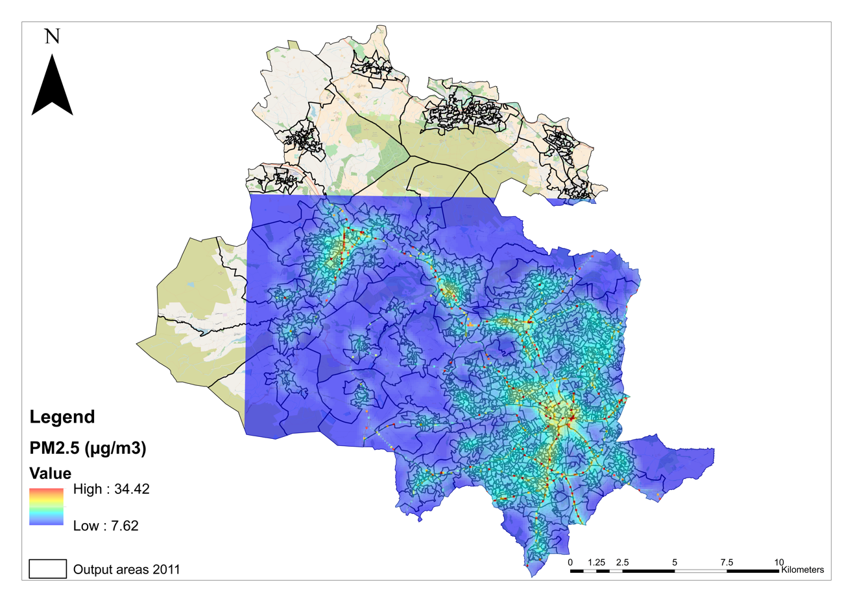
Examples of PM_{2.5} LUR model
Notes:
PM2.5 LUR model applied to Bradford in Khreis et al. (2019). Resolution of 100 m × 100 m.

Slide 10
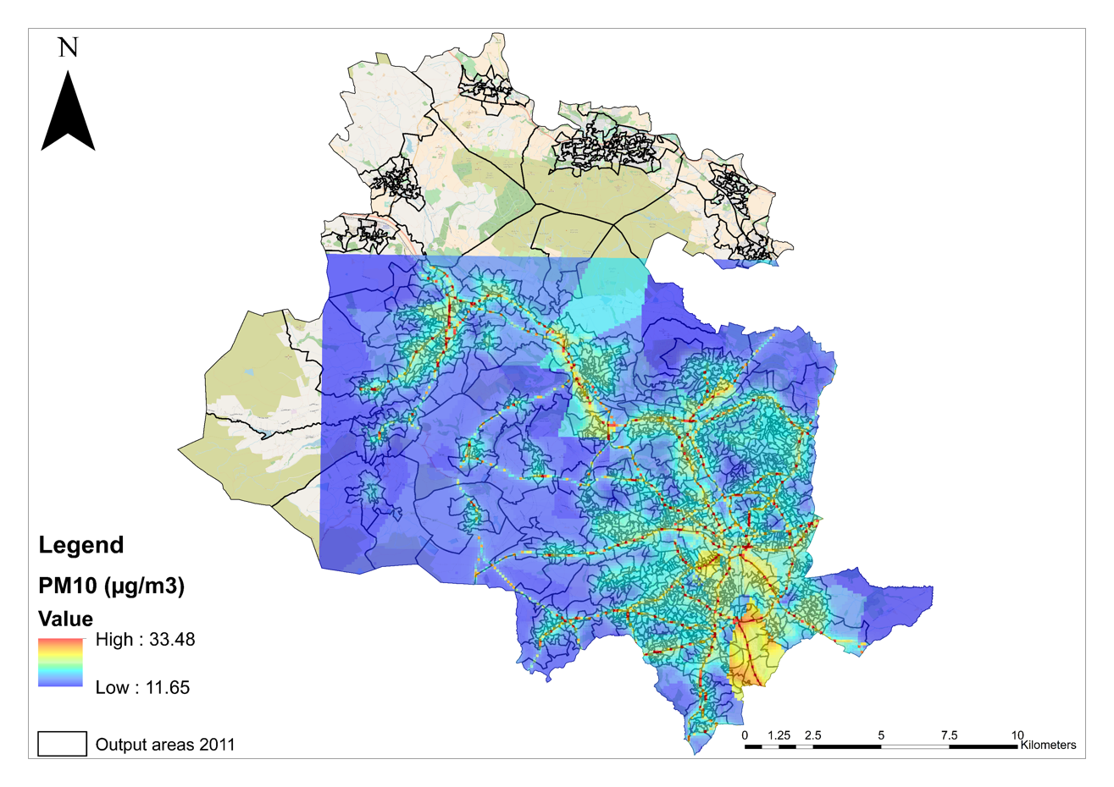
Examples of PM₁₀ LUR model
Notes:
PM10 LUR model applied to Bradford in Khreis et al. (2019). Resolution of 100 m × 100 m.

Slide 11
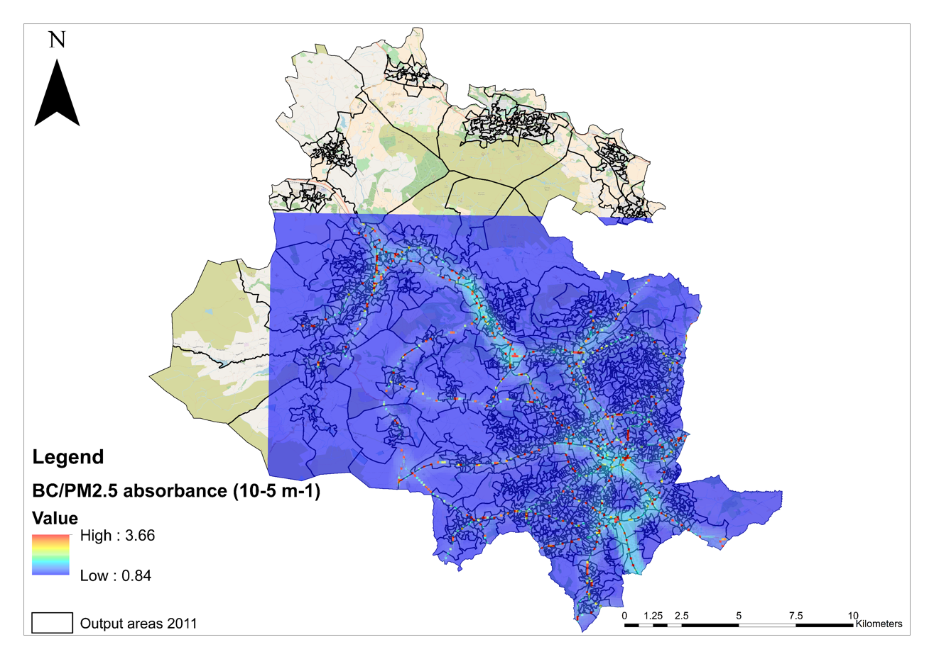
Examples of BC LUR model
Notes:
BC LUR model applied to Bradford in Khreis et al. (2019). Resolution of 100 m × 100 m.

Slide 12
Overview and definitions
LUR have recently gained considerable interest and have become more widely used to estimate exposure to air pollution (Ryan and LeMasters, 2007)
This increased popularity is may be because LUR models:
  Require relatively little time to establish and relatively low costs,
  Input data are easy to collate (pollutant concentration measurements and land use, geographic and traffic variables),
  The increasing availability of GIS-based data sets and tools allows researchers to quickly explore many (100+ in some cases) potential predictor variables,
  Show changes in spatial patterns of pollutants at relatively fine spatial resolution,
  Explain a large fraction of spatial variance in the measured pollution concentrations, as measured by R²,
  Models shown temporal stability and can remain valid for 10 years, maybe more,
  LUR models have been used for local scale predictions up to national scale models e.g. Hystad et al. 2011 for Canada. The latest Canadian LUR model produced by Hystad’s team provides national coverage at 30 m resolution
  LUR models can be developed using stationary measurements, mobile measurements and satellite data, and thus are quite flexible
Notes:
These models are often used in epidemiological studies because of their relative practicality and ability to better characterize finer scale variation in air pollution, which are important for accurate exposure assessment and the minimization of exposure misclassifications (Ryan & Lemasters, 2007). Similar to the other methods, LUR can be limited from low input data, such as limited pollutant concentration measurements and land-use variables. Additionally, and the developed models are often location specific and are difficult to apply to other study areas. Another limitation is that LUR also assumes that observations are independent of each other; however, this is not the case as observations are usually similar in nearby areas . (Ryan & Lemasters, 2007; Xie et al., 2017).

Slide 13
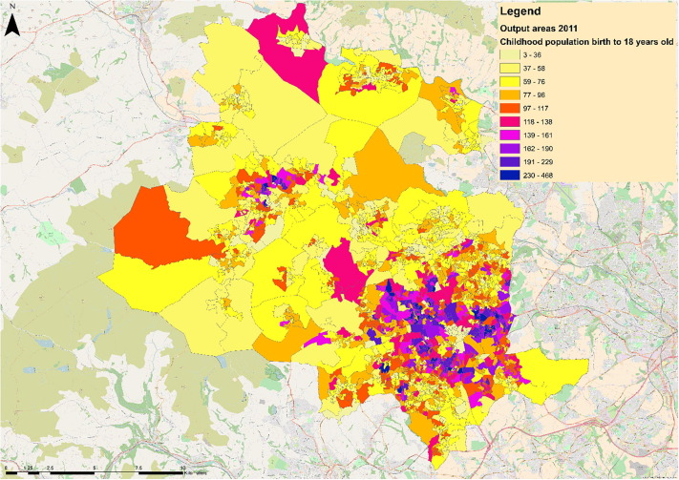
Use in Exposure Assessment
The most common method for using LUR models in exposure assessment is by using the models to estimate exposures at specific residential addresses of participants in epidemiological studies or overlaying the resulting air quality maps from the LUR model with population maps, usually obtained from census data
The population map used would relate to the population of interest in the study area of interest
An example is to overlay the LUR maps shown in the slides above on population maps of children aged 0-18 in Bradford (figure on this slide)
Notes:
Resolution of LUR models is 100 m × 100 m.
Resolution of population census maps is differing. The example above shows Bradford's childhood population distributed in census “output areas”.
The number of total output areas in the study area in this example was 1528.
The total number of children in all output areas (birth – 18 y.o.) was 143,472 children.
The zverage number of children in all output areas (birth – 18 y.o.) was 94 children.
The minimum number of children in an output area (birth – 18 y.o.) was 3 children.
The maximum number of children in an output area (birth – 18 y.o.) was 468 children.
The average area of all output areas (m2) was 239,802.
The minimum area of an output area (m2) was 3,817.
The maximum area of an output area (m2) was 15,395,650.
To assign the exposure for children living in each output area, each output area was intersected with the underlying raster air pollution surfaces, for PM2.5, PM10 and BC. The 100 m × 100 m underlying raster cell values contained within each census output area were averaged, resulting in one annual average air pollution exposure estimate at each output area. This annual average air pollution exposure estimate was then applied to all children living in the corresponding output area. This process was undertaken in Geospatial Modelling Environment suite version 0.7.4.0. using the ‘isectpolyrst’ tool (Intersect Polygons with Raster).

Slide 14
Model Validation
Modeled exposure estimates need to be validated against measurements in the same study area
Examples of statistical measures used for model validation/ evaluation are shown in the next slide
LUR models’ validation is typically done using two common evaluation approaches (Wang et al., 2013):
  The internal “leave-one-out-cross-validation (LOOCV)”, and
  The external “hold-out-evaluation (HEV)” against independent measurements set aside for model evaluation
  R² is the typical performance measure reported in these evaluations
  HEV is preferable, though not always feasible if the measurements data sets are too small to split up between model building and model validation
Notes:
Extracted from Askariyeh et al. (2020):
“While air quality models have several advantages, there is an essential need to validate these models by comparing their estimates with real world air quality observations. In order to compare predictions from a model with observational measurements, several statistical performance measures can be used. These measures generally indicate three qualities in predicted values compared to observations: accuracy, precision, and bias. Accuracy refers to how predicted values are close to observations quantified by error as the difference between predicted and observed values. Precision refers to how predicted results are reproducible and close to each other for comparable observations. Bias shows inaccuracy of predicted values in a systematic way. In other words, bias shows how a model may tend to shift predicted values in one direction from observations and it is also called the systematic error.”
Extracted from Wang et al. (2013):
“1. Leave-one-out-cross-validation (LOOCV), which successively left out one site from the training data set and estimated models based on the remaining N-1 sites. In this procedure, the variables in the model were the same as identified using the full training data set; only the coefficients of the model changed.
2. Hold-out evaluation (HEV). For NO2 this was straightforward as we compared NO2 model predictions with measured NO2 concentrations at test sites. True
HEV for PM components was infeasible as training sets for PM were too small to split up for model building and validation. As an alternative, we evaluated PM models by investigating the correlations between the predicted values of PM metrics and the measured NO2 at the test sets (HEV R2).”

Slide 15
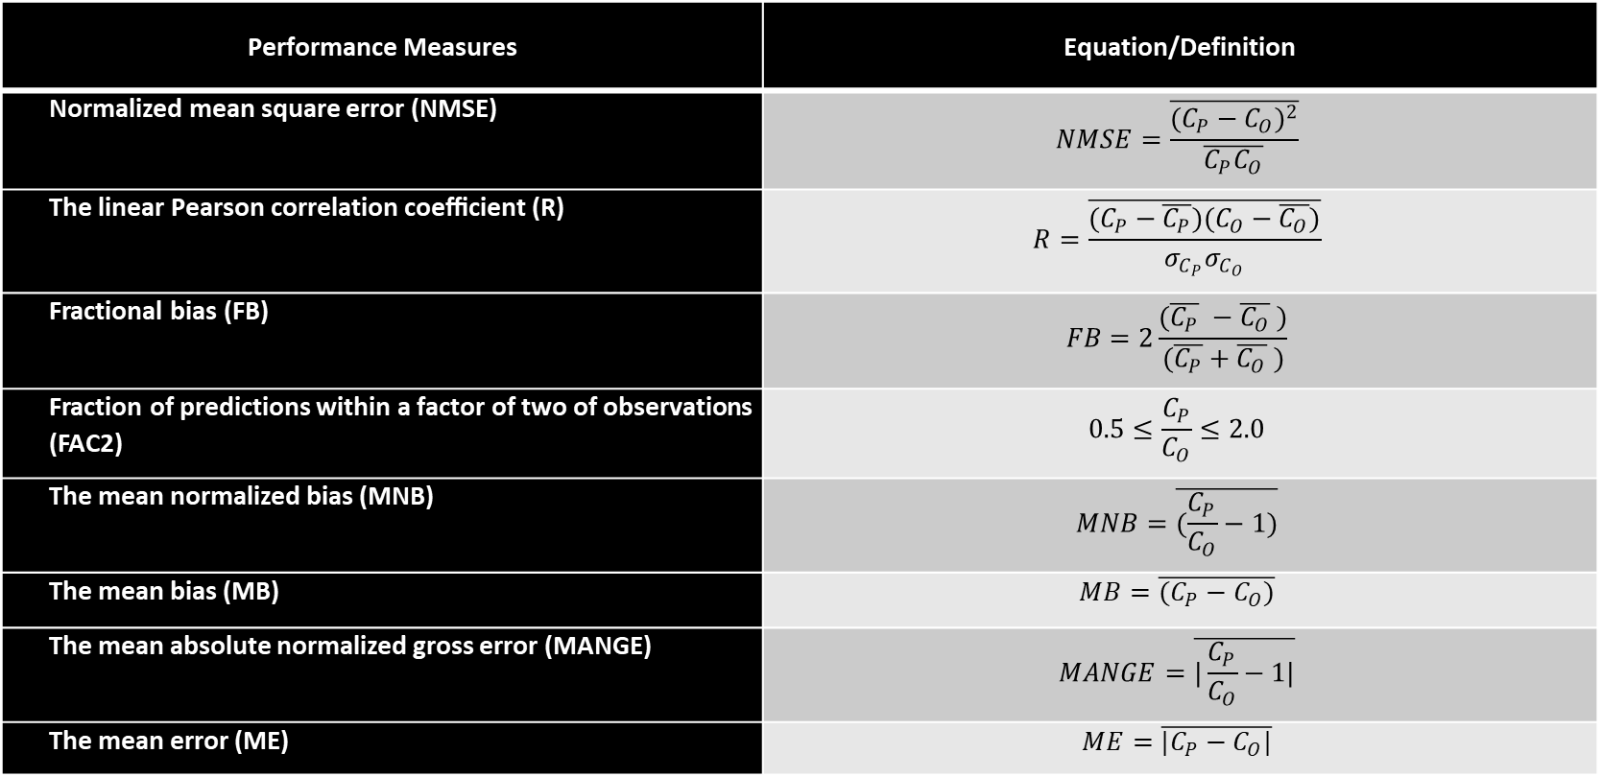
Performance Measures for Models’ Validation
Performance Measures for Model-to-Monitor Comparison, Source: (Askariyeh et al., 2020)
($C_{P}$ denotes “Predicted Concentrations”, $C_{O}$ denotes “Observed Concentrations”, and $σ$ stands for standard deviation)
Performance Measures | Equation/Definition
Normalized mean square error (NMSE) | $$NMSE=\frac{\overline{{(C_{P}−C_{O})}^{2}}}{\overline{C_{P}C_{O}}}$$
The linear Pearson correlation coeﬃcient (R) | $$R=\frac{\overline{(C_{P}−\overline{C_{P}})(C_{O}−\overline{C_{O}})}}{σ_{C_{P}}σ_{C_{O}}}$$
Fractional bias (FB) | $$FB=2\frac{(\overline{C_{P}} −\overline{C_{O}} )}{(\overline{C_{P}}+\overline{C_{O}} )}$$
Fraction of predictions within a factor of two of observations (FAC2) | $$0.5≤\frac{C_{P}}{C_{O}}≤2.0$$
The mean normalized bias (MNB) | $$MNB=\overline{(\frac{C_{P}}{C_{O}}−1)}$$
The mean bias (MB) | $$MB=\overline{(C_{P}−C_{O})}$$
The mean absolute normalized gross error (MANGE) | $$MANGE=\overline{|\frac{C_{P}}{C_{O}}−1|}$$
The mean error (ME) | $$ME=\overline{|C_{P}−C_{O}|}$$
Notes:
Extracted from Askariyeh et al. (2020):
“In addition to the abovementioned statistical measures, visual evaluation of the model-to-monitor can be highly useful to evaluate the overall performance and identify any correlations between influential parameters like time, space, and air pollutants concentration. Examples of visual evaluation include comparing the predicted and observed paired concentrations with factor of two and 1:1 line, residual plots and time series of modeled and measured concentrations etc.”

Slide 16
Comparison to Personal Exposures
Despite their popularity, little is known about how well LUR models predict personal exposures. This limitation is a challenge for all exposure assessment methods.
One study assessed the agreement of LUR models with measured personal exposures in Helsinki, Utrecht, and Barcelona, following 15 volunteers (Montagne et al., 2013)
BC, NO₂, NO_{x} and PM_{2.5} exposures were assessed
Per participant, six 96 h outdoor, indoor, and personal measurements spread over three seasons were conducted
The BC LUR models explained 39%, 44%, and 20% of personal exposure variability (R²) in Helsinki, Utrecht, and Barcelona
The correlations with the other pollutants were much poorer (Montagne et al., 2013)
Notes:
Extracted from Montagne et al. (2013):
“Land use regression (LUR) models are often used to predict long-term average concentrations of air pollutants.
Little is known how well LUR models predict personal exposure.
In this study, the agreement of LUR models with measured personal exposure was assessed.
The measured components were particulate matter with a diameter smaller than 2.5 μm (PM2.5), soot (reflectance of PM2.5), nitrogen oxides (NOx), and nitrogen dioxide (NO2).
In Helsinki, Utrecht, and Barcelona, 15 volunteers (from semiurban, urban background, and traffic sites) followed prescribed time activity patterns. Per participant, six 96 h outdoor, indoor, and personal measurements spread over three seasons were conducted.
Soot LUR models were significantly correlated with measured average outdoor and personal soot concentrations. Soot LUR models explained 39%, 44%, and 20% of personal exposure variability (R2) in Helsinki, Utrecht, and Barcelona.
NO2 LUR models significantly predicted outdoor concentrations and personal exposure in Utrecht and Helsinki, whereas NOx and PM2.5 LUR models did not predict personal exposure.
PM2.5, NO2, and NOx models were correlated with personal soot, the component least affected by indoor sources.
LUR modeled and measured outdoor, indoor, and personal concentrations were highly correlated for all pollutants when data from the three cities were combined. This study supports the use of intraurban LUR models for especially soot in air pollution epidemiology.”

Slide 17
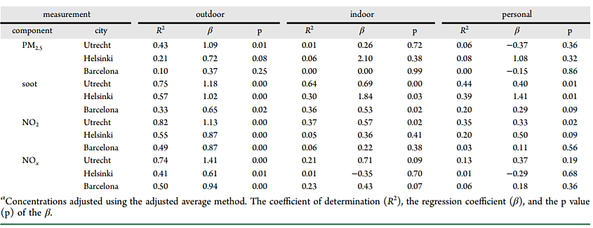
Comparison to Personal Exposures
Relationship between LUR-Modeled Outdoor Concentrations and Measured Average Outdoor/Indoor/Personal Concentrations (N = 15)ª , Source: (Montagne et al., 2013)
Notes:
Extracted from Montagne et al. (2013):
“For all pollutants, the R2 of the regression models of modeled versus measured outdoor concentration was lower than the model and cross-validation R2 of the LUR models.
This is consistent with recent studies on NO2, showing that the model R2 overestimates the predictive ability of the model in independent data sets.”

Slide 18
Specificity to Traffic
While LUR models include traffic-related variables, they cannot provide specific quantification to the contribution of traffic to the modeled exposure estimates
The true contribution of traffic to the regression is not always known or reported
However, the models provide a good method to capture intraurban variations in air pollution, typically driven by traffic
Depending on the pollutant, LUR models may also be sensitive to a specific segment of the vehicle fleet rather than total traffic. For example, BC and ultra-fine particles may be more indicative of diesel traffic under some conditions (Bai et al. 2018a, Bai et al. 2018b, Henderson et al. 2007)

Slide 19
Strengths of LUR modeling
Relatively practical method for modeling air pollution, relatively easy to collate input data, low costs
Good agreement between measured and estimated averages of BC and NO₂, less agreement with other pollutants especially PM and PM components
Ability to better characterize finer scale variation in air pollution, which are important for accurate exposure assessment
Modelling based on measurements and information around measurement points
Medium need for updated data (Khreis and Nieuwenhuijsen, 2017)

Slide 20
Limitations of LUR modeling
Only reflect the predictors used in the model
Elevated number of air pollutant measurements and predictor variable (e.g. land use, geographic, traffic) data required for adequate model development and validation
Subject to varying uncertainties amongst different pollutants
The true contribution of traffic to the regression is not always known or reported
Difficult to take into account street canyon effects; meteorology and atmospheric chemistry
The quality of the data representing ‘meaningful’ predictors may be an issue and will affect the overall accuracy of the model
The model’s outputs are sensitive to the locations and density of the sampling sites
Generally disregards exposure variability due to mobility/individual activity
Assume independence between sampled locations
Location specific and may not be applicable to other locations (Khreis and Nieuwenhuijsen, 2017)

Slide 21
Discussion
LUR modeling is an increasingly popular method used in exposure assessment in epidemiological, health impact and burden of disease assessment studies
The method is practical but has important limitations mainly related to the input data and the sampling density of the monitoring sites
The validation of LUR models is a critical part of the development and application of this method
Certain validation methods might result in artificially high R² and the use of independent measurements for validation, which have not been used in model development, is recommended
BC and NO₂ LUR models seem to capture the variability of these pollutants better than PM_{2.5} and PM₁₀ models

Slide 22
Research Gaps and Future Directions
More information on how well LUR models agree with personal exposures is needed (applicable to other exposure assessment methods too)
More work to improve the accuracy of LUR models is needed, especially in the case of PM pollutants
Proper validation of LUR models needs to be done using an independent measurements data set that was not used in model development
The application of LUR in assessing personal exposures is still in its infancy
The integration of LUR models with other models or measurements (hybrid models) may improve the overall accuracy of the models’ predictions (Medeiros and Khreis, 2020)

Slide 23
Take-Home Messages
LUR models are becoming an increasingly popular to estimate human exposure to air pollution with a significant recent growth in the number of studies using these models
These models are practical, relatively inexpensive and can capture intra-urban variations of air pollution at a relatively fine spatial resolution and stable temporal predictions
However, these models have many limitations and their quality differs significantly across different pollutants and different locations
They are also incapable of source apportionment and tracing the air pollution concentrations back to their sources

Slide 24
List of Abbreviations
BC: Black Carbon
ESCAPE: European Study of Cohorts for Air Pollution Effects
GIS: Geographical Information Systems
HEV: Hold-Out-Evaluation
LOOCV: Leave-One-Out-Cross-Validation
LUR: Land Use Regression
NO₂: Nitrogen Dioxide
NO_{x}: Nitrogen Oxides
PM₁₀: Particulate Matter with a diameter less than 10 micrometers
PM_{2.5}: Particulate Matter with a diameter less than 2.5 micrometers

Slide 25
References
Askariyeh, M.H., H. Khreis, and S. Vallamsundar, Air Pollution Monitoring and Modeling, in Traffic-Related Air Pollution, H. Khreis, et al., Editors. 2020, Elsevier.
Bai L; Chen H; Hatzopoulou M; Jerrett M; Kwong JC; Burnett RT; van Donkelaar A; Copes R; Martin RV; Van Ryswyk K; Lu H; Kopp A; Weichenthal S (2018a). Exposure to ambient ultrafine particles and nitrogen dioxide and incident hypertension and diabetes. Epidemiology 29: 323–332.
Bai L; Weichenthal S; Kwong JC; Burnett RT; Hatzopoulou M; Jerrett M; van Donkelaar A; Martin RV; Van Ryswyk K; Lu H; Kopp A; Chen H (2018b). Associations of long-term exposure to ultrafine particles and nitrogen dioxide with increased incidence of congestive heart failure and acute myocardial infarction. American J Epidemiol 188(1): 151–159.
Eeftens, M., Tsai, M.Y., Ampe, C., Anwander, B., Beelen, R., Bellander, T., Cesaroni, G., Cirach, M., Cyrys, J., de Hoogh, K. and De Nazelle, A., 2012 a. Spatial variation of PM2. 5, PM10, PM2. 5 absorbance and PMcoarse concentrations between and within 20 European study areas and the relationship with NO2–results of the ESCAPE project. Atmospheric Environment, 62, pp.303-317.
Eeftens, M., Beelen, R., de Hoogh, K., Bellander, T., Cesaroni, G., Cirach, M., Declercq, C., Dedele, A., Dons, E., de Nazelle, A. and Dimakopoulou, K., 2012 b. Development of land use regression models for PM2. 5, PM2. 5 absorbance, PM10 and PMcoarse in 20 European study areas; results of the ESCAPE project. Environmental science & technology, 46(20), pp.11195-11205.
European Study of Cohorts For Air Pollution Effects, E., 2014. ESCAPE – European Study of Cohorts for Air Pollution Effects [Online] Available: https://cordis.europa.eu/project/id/211250.
Jerrett, M., Arain, A., Kanaroglou, P., Beckerman, B., Potoglou, D., Sahsuvaroglu, T., Morrison, J. and Giovis, C., 2005. A review and evaluation of intraurban air pollution exposure models. Journal of Exposure Science & Environmental Epidemiology, 15(2), pp.185-204.
Henderson SB; Beckerman B; Jerrett M; Brauer M (2007). Application of land use regression to estimate long-term concentrations of traffic-related nitrogen oxides and fine particulate matter. Environ Sci Technol 41: 2422–27428.

Slide 26
References
Hystad P; Setton E; Cervantes A; Poplawski K; Deschenes S; Brauer M; van Donkelaar A; Lamsa L; Martin R; Jerrett M; Demers P (2011). Creating national air pollution models for population exposure assessment in Canada. Environ Health Perspect 119(8): 1123–1129.
Khreis, H. and Nieuwenhuijsen, M.J., 2017. Traffic-related air pollution and childhood asthma: recent advances and remaining gaps in the exposure assessment methods. International journal of environmental research and public health, 14(3), p.312.
Khreis, H., Ramani, T., de Hoogh, K., Mueller, N., Rojas-Rueda, D., Zietsman, J. and Nieuwenhuijsen, M.J., 2019. Traffic-related air pollution and the local burden of childhood asthma in Bradford, UK. International Journal of Transportation Science and Technology, 8(2), pp.116-128.
Medeiros, J. and H. Khreis, How Emerging Technology and its Integrations is Advancing Our Understanding of Urban and Traffic Related Air Pollution, in Traffic-Related Air Pollution, H. Khreis, et al., Editors. 2020, Elsevier.
Montagne, D., Hoek, G., Nieuwenhuijsen, M., Lanki, T., Pennanen, A., Portella, M., Meliefste, K., Eeftens, M., Yli-Tuomi, T., Cirach, M. and Brunekreef, B., 2013. Agreement of land use regression models with personal exposure measurements of particulate matter and nitrogen oxides air pollution. Environmental science & technology, 47(15), pp.8523-8531.
Ryan, P.H. and LeMasters, G.K., 2007. A review of land-use regression models for characterizing intraurban air pollution exposure. Inhalation toxicology, 19(sup1), pp.127-133.
Wang, M., Beelen, R., Basagana, X., Becker, T., Cesaroni, G., de Hoogh, K., Dedele, A., Declercq, C., Dimakopoulou, K., Eeftens, M. and Forastiere, F., 2013. Evaluation of land use regression models for NO2 and particulate matter in 20 European study areas: the ESCAPE project. Environmental science & technology, 47(9), pp.4357-4364.
Xie, X., Semanjski, I., Gautama, S., Tsiligianni, E., Deligiannis, N., Rajan, R.T., Pasveer, F. and Philips, W., 2017. A review of urban air pollution monitoring exposure assessment methods. ISPRS International Journal of Geo-Information, 6(12), p.389.

Slide 27
Reading List
Basagaña, X., Rivera, M., Aguilera, I., Agis, D., Bouso, L., Elosua, R., Foraster, M., de Nazelle, A., Nieuwenhuijsen, M., Vila, J. and Künzli, N., 2012. Effect of the number of measurement sites on land use regression models in estimating local air pollution. Atmospheric environment, 54, pp.634-642.
Beelen, R., Hoek, G., Vienneau, D., Eeftens, M., Dimakopoulou, K., Pedeli, X., Tsai, M.Y., Künzli, N., Schikowski, T., Marcon, A. and Eriksen, K.T., 2013. Development of NO2 and NOx land use regression models for estimating air pollution exposure in 36 study areas in Europe–the ESCAPE project. Atmospheric Environment, 72, pp.10-23.
Beckerman BS; Jerrett M; Serre M; Martin RV; Lee SJ; van Donkelaar A; Ross Z; Su J; Burnett RT (2013). A hybrid approach to estimating national scale spatiotemporal variability of PM2.5 in the contiguous United States. Environ Sc. Technol 47: 7233–7241.
de Hoogh, K., Korek, M., Vienneau, D., Keuken, M., Kukkonen, J., Nieuwenhuijsen, M.J., Badaloni, C., Beelen, R., Bolignano, A., Cesaroni, G. and Pradas, M.C., 2014. Comparing land use regression and dispersion modelling to assess residential exposure to ambient air pollution for epidemiological studies. Environment international, 73, pp.382-392.
de Hoogh, K., Wang, M., Adam, M., Badaloni, C., Beelen, R., Birk, M., Cesaroni, G., Cirach, M., Declercq, C., Dedele, A. and Dons, E., 2013. Development of land use regression models for particle composition in twenty study areas in Europe. Environmental science & technology, 47(11), pp.5778-5786.
Jedynska, A., Hoek, G., Wang, M., Eeftens, M., Cyrys, J., Keuken, M., Ampe, C., Beelen, R., Cesaroni, G., Forastiere, F. and Cirach, M., 2014. Development of land use regression models for elemental, organic carbon, PAH, and hopanes/steranes in 10 ESCAPE/TRANSPHORM European study areas. Environmental science & technology, 48(24), pp.14435-14444.
Khreis, H., de Hoogh, K., Zietsman, J. and Nieuwenhuijsen, M.J., 2018. The impact of different validation datasets on air quality modeling performance. Transportation Research Record, 2672(25), pp.57-66.
Wang, M., Beelen, R., Eeftens, M., Meliefste, K., Hoek, G. and Brunekreef, B., 2012. Systematic evaluation of land use regression models for NO2. Environmental science & technology, 46(8), pp.4481-4489.

Slide 28
Acknowledgements
The author acknowledges constructive and thoughtful comments from Mathieu Rouleau at Health Canada which enabled this lecture.

