Slide 1
www.carteeh.org

Slide 2
Lecture #22: Exposure Surrogates
Haneen Khreis
Texas A&M Transportation Institute
H-Khreis@tti.tamu.edu, (979) 317-2799 x42799
The author declares that there is no conflict of interest
Lecture Track(s): HT/TT
Notes:
Health Track (HT)—mainly targeted at urban planners, transportation planners, and engineers with limited knowledge of public health-related concepts;
Transportation Track (TT)—mainly targeted at environmental epidemiologists and public health professionals with limited knowledge of transportation-related concepts; and;
Planning and Policy Track (PPT)—mainly targeted at planners, civil servants, and policy and decision makers with particular interest in the science-policy link.

Slide 3
Introduction
It is neither practical nor feasible to measure personal exposure of individuals to (traffic-related) air pollution at all points and at all times
Different surrogates for the human exposure have been customarily employed in different studies as a compromise for actual measurements
These surrogates aim to represent human exposure as exposed versus non-exposed or in other different categories of exposures or as continuous exposures
Exposure surrogates have been used in epidemiological studies as well as in burden of disease and health impact assessment studies but have been more recently replaced with more sophisticated exposure assessment methods such as those discussed in lectures #20, 21, 23, and 24
Notes:
Because it is neither practical nor feasible to measure the personal exposure of individuals to traffic-related air pollution at all points and at all times, different surrogates for the human exposure have been customarily employed in different studies as a reasonable compromise for actual measurements.
In the reviewed literature a wide variety of exposure assessment methods and metrics were employed to study the health effects of air pollution. These exposure methods and metrics included:
Proximity to a ‘freeway’ or a ‘major road’;
Land use regression models;
Dispersion models;
Mathematical and statistical interpolation;
Averaged measurements from fixed monitoring sites;
Personal monitors; and
Hybrid models
This curriculum covers most of these methods in lectures # 18 to 24

Slide 4
Overview
Multiple exposure surrogates have been used in the literature including, but not limited to:
Proximity to the nearest major road, freeway, highway, arterial road or road of a certain traffic volume (e.g. in meters, kilometers) (McConnell et al., 2006; McConnell et al., 2010; Venn et al., 2001)
Living within a certain distance/ buffer (e.g. 50 or 100 meters) from a major road (yes or no) (Sahsuvaroglu et al., 2009)
Traffic density to road distance ratio (vehicle/day)/m) within a certain buffer from residence or school location (e.g. 300 meters) (Zmirou et al., 2004 )
Number of vehicles traveling in the vicinity of residence, school, etc. (McConnell et al., 2010)
continued on next slide...

Slide 5
Overview
Road with the heaviest traffic intensity within 100 meters of residence (e.g. in cars/day) (Lindgren et al., 2013)
Number of kilometers traveled (VKT) per day within a 300 m buffer around each home (Batterman et al., 2014)
Roadway density (e.g. in km roadways/ km² land area) (Patel et al., 2011)
Novel exposure surrogates such as truck route density (km truck routes/km² land area), four-way street intersection density (# intersections/km² land area), number of transit bus stops (Patel et al., 2011)
These surrogates are often objectively established and analyzed in a geographical information system (GIS) framework and combined with each other or with other exposure assessment methods (Khreis and Nieuwenhuijsen, 2017; Jerret et al., 2005)
They have become less used in recent studies and replaced with pollutant exposure estimates as generated by e.g. land-use regression and dispersion models
These surrogates have the potential to introduce exposure misclassification (Batterman et al., 2014), and are often not validated and/or compared to more sophisticated exposure assessment methods
Notes:
Extracted from Batterman et al., 2014:
“Vehicles are major sources of air pollutant emissions, and individuals living near large roads endure high exposures and health risks associated with traffic-related air pollutants. Air pollution epidemiology, health risk, environmental justice, and transportation planning studies would all benefit from an improved understanding of the key information and metrics needed to assess exposures, as well as the strengths and limitations of alternate exposure metrics. This study develops and evaluates several metrics for characterizing exposure to traffic-related air pollutants for the 218 residential locations of participants in the NEXUS epidemiology study conducted in Detroit (MI, USA). Exposure metrics included proximity to major roads, traffic volume, vehicle mix, traffic density, vehicle exhaust emissions density, and pollutant concentrations predicted by dispersion models. Results presented for each metric include comparisons of exposure distributions, spatial variability, intraclass correlation, concordance and discordance rates, and overall strengths and limitations. While showing some agreement, the simple categorical and proximity classifications (e.g., high diesel/low diesel traffic roads and distance from major roads) do not reflect the range and overlap of exposures seen in the other metrics. Information provided by the traffic density metric, defined as the number of kilometers traveled (VKT) per day within a 300 m buffer around each home, was reasonably consistent with the more sophisticated metrics. Dispersion modeling provided spatially- and temporally-resolved concentrations, along with apportionments that separated concentrations due to traffic emissions and other sources. While several of the exposure metrics showed broad agreement, including traffic density, emissions density and modeled concentrations, these alternatives still produced exposure classifications that differed for a substantial fraction of study participants, e.g., from 20% to 50% of homes, depending on the metric, would be incorrectly classified into “low”, “medium” or “high” traffic exposure classes. These and other results suggest the potential for exposure misclassification and the need for refined and validated exposure metrics. While data and computational demands for dispersion modeling of traffic emissions are non-trivial concerns, once established, dispersion modeling systems can provide exposure information for both on- and near-road environments that would benefit future traffic-related assessments.”

Slide 6
Use in exposure assessment
Perhaps the most common exposure surrogate and the most basic approach in differentiating traffic-related air pollution (TRAP) exposure is proximity to the nearest major road
The underlying assumption of this method is that nearness to the traffic emission sources proxies for human exposure (Jerret et al., 2005)
Typical road buffers which might be used to assign exposures to human populations include 50, 100, 150, >300 meters which is based on the knowledge that TRAP drops to background levels at distances above 300 meters downwind from the source of emissions (see next slides)

Slide 7
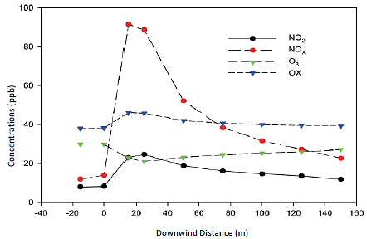
Use in exposure assessment
Typical fall-off in pollutants concentration from a road, source: (Tate 2013)

Slide 8
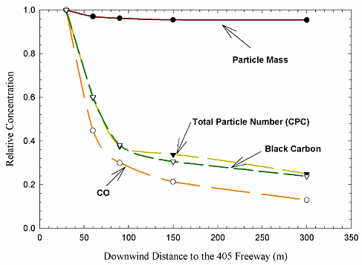
Use in exposure assessment
Relative Particle Number, Mass, Black Carbon, Carbon Monoxide (CO) Concentration versus Downwind Distance from a freeway, source: (Zhu et al. 2002)

Slide 9
Use in exposure assessment
This exposure surrogate has been used in health effects analyses of respiratory disease, lung cancer, neurological disease and stroke mortality among others (Jerret et al., 2005; Chen et al., 2017)
In general, adverse health effects have been associated with living near major roads and these effects are most pronounced in the buffers closest to the roads (e.g. within 50 meters)
These associations, however, are inconsistent as discussed in Jerrett et al. (2005) and Khreis and Nieuwenhuijsen (2017)
Some of the same studies which found no association between roadway proximity and adverse health effects, found increased risks when employing more refined exposure models such as pollutant estimates from LUR models (Khreis and Nieuwenhuijsen, 2017)
We found no studies that attempt to compare and validate exposures using this metric to personal exposures but some studies compared it to other exposure surrogates (Batterman et al., 2014)

Slide 10
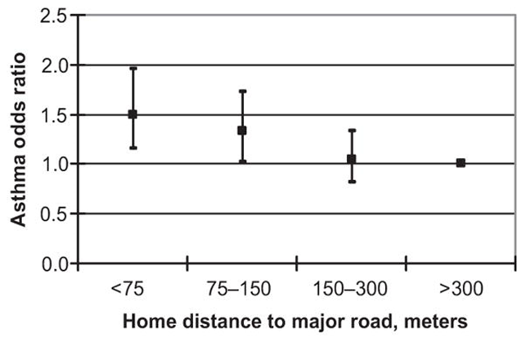
Use in exposure assessment
Trafﬁc proximity and risk of asthma in the Children Health Study, source: (McConnell et al., 2006)
Notes:
An odds ratio of 1 suggests that there is no increase in risk with proximity in that category (e.g. >300 meters, the increased risk of asthma in association with living near a major road disappears)
An odds ratio larger than 1 suggests that the risk increases with proximity in that category and as shown in the figure above, the highest risk exists for children living <75 meters from a major road
This risk decreases with the increasing distance between homes and major roads until no risk is observed at > 300 meters distance
Although this cannot be established by solely using proximity to roads, the observed localized effect when using this metric may speak to which pollutant(s) is more likely to be responsible for the observed effect(s), as the composition of fresh vehicular exhaust is different than that of the aging exhaust, and the different dispersion manners for different pollutants can cause them to vary significantly in concentrations between the roadside and further away as shown in the two figures in slides 7 and 8

Slide 11
Surrogates Comparison
Batterman et al. (2014) explored alternate metrics for characterizing exposure to TRAP including metrics based on proximity to major roads, traffic volume and density, traffic type, traffic emissions density, and pollutant concentrations from dispersion modeling
The authors established multiple evaluation and comparison metrics for these exposure surrogates including intraclass correlations, and concordance rates at a sample size of 218 homes in Detroit, Michigan for children participating in the NEXUS epidemiological study
Notes:
The evaluation of the exposure metrics presented in Batterman et al. (2014) includes a comparison of exposure distributions, spatial variability using maps coded by exposure group, intraclass correlations, and concordance rates.

Slide 12
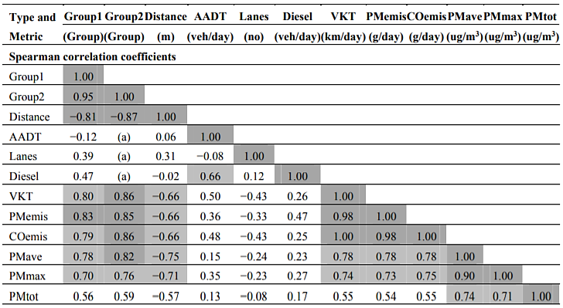
Surrogates Comparison
Comparison of exposure metrics at the NEXUS homes using Spearman correlation coefficients. Shaded numbers show absolute value of correlations above 0.6 and 0.8, source: (Batterman et al., 2014)
Notes:
Extracted from Batterman et al. (2014):
“Comparison of exposure metrics at the NEXUS homes using Spearman correlation coefficients. Shaded numbers show absolute value of correlations above 0.6 and 0.8.
Variables: Group1 = LDLT (low diesel/low traffic), LDHT (low diesel/high traffic) and HDHT (high diesel/high traffic ) assigned 1, 2, 3, respectively
Where, high diesel/high traffic (HDHT), defined as homes within 175 m of roads with >6000 commercial vehicles/day (commercial annual average daily traffic; CAADT) and >90,000 total vehicles/day (annual average daily traffic; AADT); low diesel/high traffic (LDHT), defined as homes within 175 m of roads with >90,000 AADT and <4500 commercial vehicles/day; and low diesel/low traffic (LDLT) homes located >300 m from roads with >25,000 AADT and greater than 500 m from roads with >90,000 AADT. In the initial groups, the designation of commercial
vehicles was used as a surrogate for diesel vehicles
Group2 = LDLT, LDHT and HDHT assigned 1, 2, 2, respectively
Distance = distance to nearest major highway (LDHT and HDHT only)
AADT = traffic volume on nearest major road (LDHT and HDHT only)
Lanes = number of lanes on nearest major road (LDHT and HDHT only)
Diesel = diesel vehicles volume on nearest major road (LDHT and HDHT only)
VKT = traffic density as vehicles-km-traveled/day in 300 m buffer around home
PMemis = PM2.5 emissions in 300 m buffer
COemis = CO emissions in 300 buffer
PMave = 2010 annual average PM2.5 concentration due to local traffic
PMmax = 2010 maximum 24-h average PM2.5 concentration from local traffic
PMtot = 2010 annual average PM2.5 concentration from all sources.
Sample size is n = 218, except for comparisons involving AADT, Lanes, and Diesel metrics where n = 116 since only high traffic homes are considered. (a) not calculated due to
variable definition
The table above compares the exposure metrics using Spearman’s correlation coefficients. To include the original categorical proximity classifications in this analysis, LDLT, LDHT and HDHT groups were coded two ways: as 1, 2 and 3 respectively in the “Group1” variable, with the assumption that exposures were ranked as HDHT > LDHT > LDLT; and as 1, 2 and 2 in the “Group2” variable
with the assumption that exposures were HDHT ≈ LDHT > LDLT, as suggested by most metrics.
The table colors the higher (>0.6 and >0.8, absolute value) correlation coefficients. For the Spearman coefficients, absolute values above 0.17 (n = 96 for comparisons involving only high traffic groups) or 0.12 (n = 198 to 218 for other comparisons) are statistically significant (p < 0.05, 1-sided test).
The original proximity classifications (“Group1” and “Group2”) are related to distance to the nearest highway (defining variables), to traffic density (VKT/day in the 300 m buffer around
each home), and to PM2.5 and CO emissions density metrics using the same buffers. While maximum 24-h and annual average PM2.5 concentrations from local traffic were closely correlated,
predicted PM2.5 concentrations had only modest agreement with most of the other exposure metrics, although correlations with the traffic density and distance metrics might be viewed as reasonable.
Differences among the metrics can occur for a number of reasons. Metrics that depended on a single road, i.e., the original groups, distance to, traffic volume on, and number of lanes on the nearest major road, fared poorly in comparisons since these metrics excluded the influence of other roads, among other reasons. Still, these simple metrics have some value. Second, traffic density and emissions density are very strongly related, and may yield equivalent spatial patterns.
Third, predicted concentrations (e.g., annual average and 24-h maxima) were not as strongly related to the two density metrics, most likely a result of the dispersion modeling accounting for meteorological influences, e.g., directional effects.
Fourth, while concentrations of different pollutants and concentrations using different averaging times and statistics (e.g., average vs. peak) show differences, the long term spatial patterns are relatively similar and a single metric may be sufficient for many applications. (In contrast, short-term patterns, e.g., daily levels, will vary considerably due to both the influence of meteorology and traffic patterns.) In health effects studies such as NEXUS, it is also useful to understand the relative ranking of exposures, discussed next.”

Slide 13
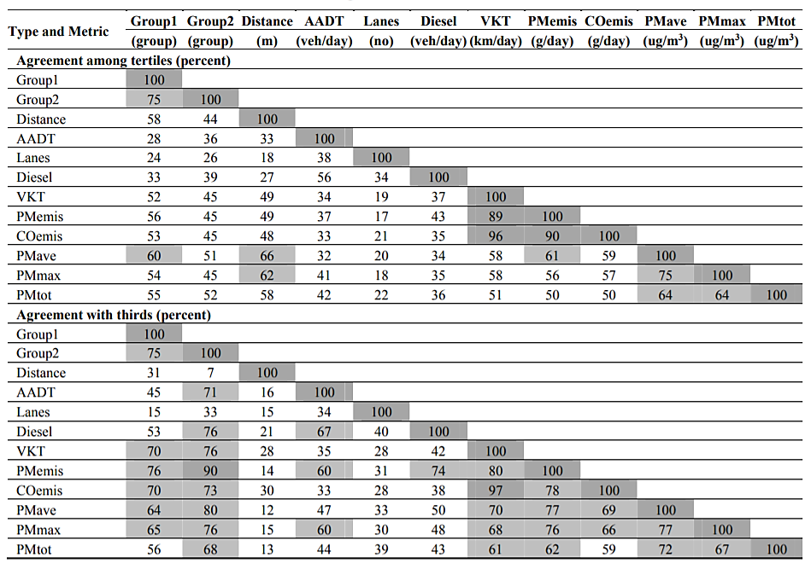
Surrogates Comparison
Comparison of exposure metrics at the NEXUS homes showing concordance with classifications using tertiles and “thirds”. Shaded numbers show percentage agreement above 60 and 80% , source: (Batterman et al., 2014)
Notes:
Extracted from Batterman et al. (2014):
“The table above presents results of the concordance analysis related to exposure misclassification (assuming that one of the metrics in the pairwise comparison reflects the true exposure). Metrics with higher (>60% and >80%) agreement are highlighted. The concordance measures estimate the misclassification relevant for comparison to the three original groups (HDHT, LDHT, LDLT). As discussed next, concordance measures can be sensitive to the metric’s distribution and the bin cutoffs used.
The original proximity classification for NEXUS homes (“Group1”) matched the tertiles and thirds groupings for PM2.5 concentrations predicted by the dispersion model for 54% to 65% of
homes. Considering only the low and high traffic categories (“Group2”), the percentage of homes that matched PM2.5 concentration tertiles was lower (45% to 52%), but higher for thirds (60% to 80%).
The same five metrics that were highly correlated (traffic density, emissions density for CO and PM2.5, annual average and peak 24-h average PM2.5 concentrations from traffic, Table on slide 12), and sometimes the total PM2.5 (including all sources) had higher agreement, e.g., 50% to 96% using tertiles, and 59% to 97% using thirds.
Very high concordance was found (and expected) for traffic density and CO emissions density. Overall, the concordance measures in the table above and the correlations in the table on slide 12 produced similar patterns among the metrics. While over half of the homes were similarly placed into “low”, “medium” or “high” traffic exposure classes using either the original groups or one of the other metrics discussed, 20% to 50% of homes, depending on the metric, were categorized differently.
The authors also examined rates of “severe” discordance using both tertiles and third, but considering homes placed in the high exposure group by one metric, but in the low exposure group by the second metric (Table S1 in the original paper). Paralleling the analysis above, severe discordance rates among five more comprehensive metrics (traffic density, CO and PM2.5 emissions densities, and annual average and 24-h peak concentration) were low (0%–6%).”

Slide 14
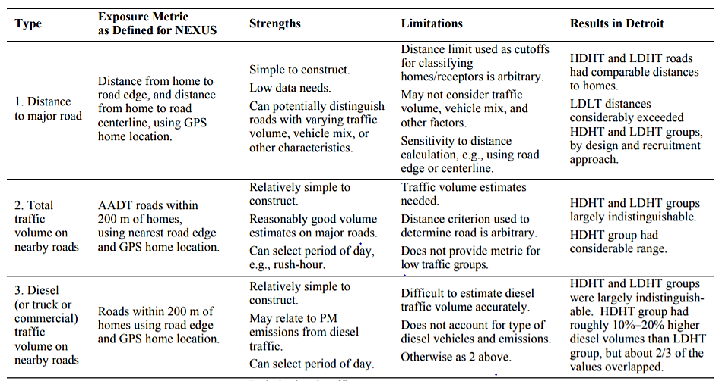
Surrogates Comparison
Summary of metrics used for exposure to traffic-related air pollutants in NEXUS, source: (Batterman et al., 2014)
Notes:
Extracted from Batterman et al. (2014):
“The table above summarizes the exposure metrics, describing their strengths, limitations, data requirements, and key results in NEXUS. Each metric provides different information (noted in the table and not repeated here). Several additional points are noteworthy. First, traffic-related exposures should be viewed as a continuum, and exposure groups are not “homogeneous.” For example, most of exposure metrics for the NEXUS homes in each of the three initial groups (LDLT, LDHT and HDHT) typically spanned a 3-fold range, with considerable overlap between groups. Second, exposures result from multiple emission sources, and concentrations depend on source characteristics (e.g., emission rate) and dispersion (e.g., wind direction and stability), factors that vary in time. While an emphasis on nearby sources (e.g., major roads) makes analyses more tractable, such simplifying assumptions can be inaccurate, and the choice of a distance cut-off is arbitrary. As examples, concentrations of traffic-related pollutants at NEXUS homes near major highways varied greatly from day-to-day, and homes that were distant (>500 m) from highways sometimes still received considerable levels of traffic-related pollutants. Third, the minimum information needed to evaluate spatial variability (typically using the long term average) of traffic-related exposure includes the distance-to-road and traffic volume for the larger and nearby roads.”

Slide 15
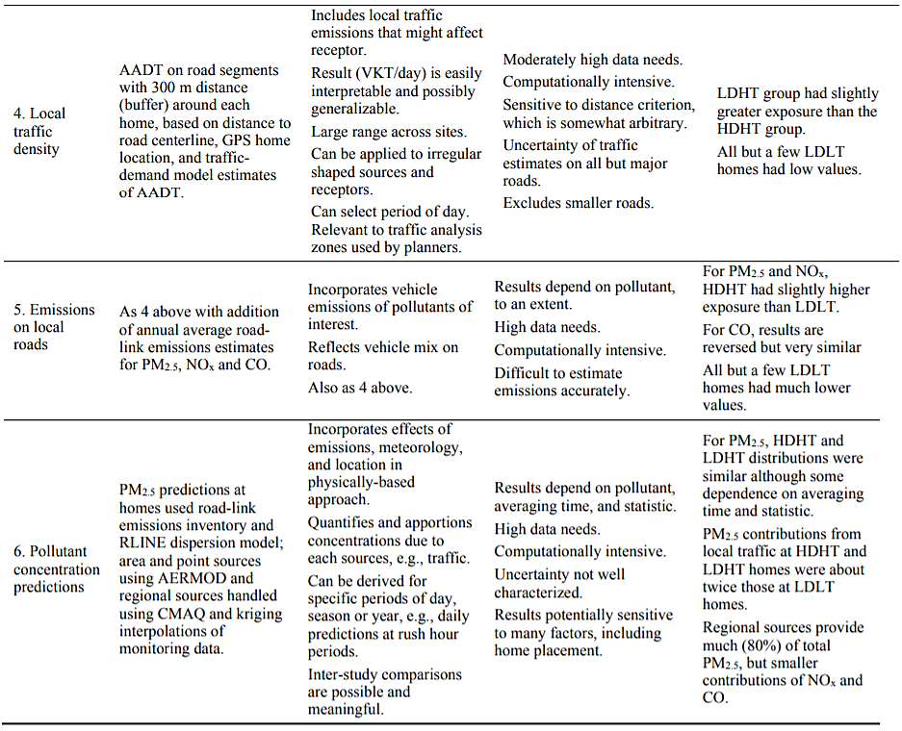
Surrogates Comparison
Summary of metrics used for exposure to traffic-related air pollutants in NEXUS, source: (Batterman et al., 2014)
Notes:
Extracted from Batterman et al. (2014):
“The suggested minimum information, distance-to-road and traffic volume, can be expressed in the relatively simple traffic density metric, which correlated reasonably well with predicted PM2.5 concentrations (r = 0.78 for annual averages, r = 0.74 for 24-h peaks). Traffic density has been identified as one of the strongest predictor variables in recent land-use regression (LUR) models of traffic related air pollutants. However, traffic density metrics do not provide concentrations and, even if incorporated into LUR models, results may be limited in terms of comparability across cities and time. The dispersion models provided spatial and temporal concentration predictions as well as source apportionment information, e.g., the PM2.5 share due to traffic. While data and computationally intensive, such models have a strong physical basis and also are amenable to forecasting and scenario analysis.”

Slide 16
Strengths
The below are some of the key pros of using the exposure surrogates discussed in this lecture:
Intuitive
Simple and cost effective
Can be insightful when complemented with vehicle counts and composition
Low need for updated data
Specific to TRAP

Slide 17
Limitations
The below are some of the key cons of using the exposure surrogates discussed in this lecture:
Assumes a road of a certain type or size corresponds to a certain amount of traffic
Sometime uses self-reported traffic intensity (collected via questionnaires) which can be subjective
Assumes all pollutants disperse similarly (limited directional dependence)
Cannot consider street canyon effects or meteorology
Generally does not consider compounded effects of proximity to multiple roads
Disregards exposure variability due to mobility/individual activity
Notes:
Improved estimates will minimize exposure misclassification

Slide 18
Discussion
Because it is neither practical nor feasible to measure personal exposure of individuals to TRAP at all points and at all times, different surrogates have been used in different studies as a compromise for measurements
More recently, exposure surrogates as those overviewed in this lecture, have been replaced with more sophisticated exposure assessment methods such as those discussed in lectures #20, 21, 23, and 24
While relatively simple to construct, interpret and specific to traffic, these surrogates have many limitations which are likely to result in exposure misclassification
Such exposure misclassification can bias results of epidemiology studies towards the null, incorrectly predict risks in health impact studies, and misidentify affected populations in environmental justice studies (Batterman et al., 2014)

Slide 19
Research Gaps and Future Directions
There are very few studies that validate and compare exposure surrogates to personal air pollution exposures or to estimates resulting from other exposure assessment methods
The impact of using exposure surrogates versus other more sophisticated exposure assessment methods on the effect estimates in epidemiological studies is not fully understood
The impact of using exposure surrogates versus other more sophisticated exposure assessment methods on burden of disease estimates in burden of disease or health impact assessment studies is not fully understood
The impact of confounding when using such exposure surrogates in health effects analyses is not fully understood

Slide 20
Take-Home Messages
Exposure surrogates have been used in epidemiological studies investigating the associations between TRAP and various health outcomes
More recently, these surrogates have become less common and were replaced by more sophisticated exposure assessment methods which provide higher spatial and temporal resolution of TRAP, and which is better validated may suffer from less residual confounding
The availability and development of GIS and associated datasets enabled the use of such surrogates and later the use of more sophisticated methods such as land-use regression
Indeed, many of these surrogates are and can be used in land-use regression modeling to predict levels of air pollution at the intra-urban scale

Slide 21
List of Abbreviations
AADT: Annual Average Daily Traffic
CO: Carbon Monoxide
GIS: Geographical Information Systems
HDHT: High Diesel/High Traffic
LDHT: Low Diesel/High Traffic
LDLT: Low Diesel/Low Traffic
TRAP: Traffic-Related Air Pollution
VKT: Vehicle Kilometers Traveled

Slide 22
References
Batterman, S., Burke, J., Isakov, V., Lewis, T., Mukherjee, B. and Robins, T., 2014. A comparison of exposure metrics for traffic-related air pollutants: Application to epidemiology studies in Detroit, Michigan. International journal of environmental research and public health, 11(9), pp.9553-9577.
Chen, H., Kwong, J.C., Copes, R., Tu, K., Villeneuve, P.J., Van Donkelaar, A., Hystad, P., Martin, R.V., Murray, B.J., Jessiman, B. and Wilton, A.S., 2017. Living near major roads and the incidence of dementia, Parkinson's disease, and multiple sclerosis: a population-based cohort study. The Lancet, 389(10070), pp.718-726.
Jerrett, M., Arain, A., Kanaroglou, P., Beckerman, B., Potoglou, D., Sahsuvaroglu, T., Morrison, J. and Giovis, C., 2005. A review and evaluation of intraurban air pollution exposure models. Journal of Exposure Science & Environmental Epidemiology, 15(2), pp.185-204.
Khreis, H. and Nieuwenhuijsen, M.J., 2017. Traffic-related air pollution and childhood asthma: recent advances and remaining gaps in the exposure assessment methods. International journal of environmental research and public health, 14(3), p.312.
Lindgren, A., Stroh, E., Björk, J. and Jakobsson, K., 2013. Asthma incidence in children growing up close to traffic: a registry-based birth cohort. Environmental Health, 12(1), p.91.
McConnell, R., Berhane, K., Yao, L., Jerrett, M., Lurmann, F., Gilliland, F., Künzli, N., Gauderman, J., Avol, E.D., Thomas, D. and Peters, J., 2006. Traffic, susceptibility, and childhood asthma. Environmental health perspectives, 114(5), pp.766-772.

Slide 23
References
McConnell, R., Islam, T., Shankardass, K., Jerrett, M., Lurmann, F., Gilliland, F., Gauderman, J., Avol, E., Künzli, N., Yao, L. and Peters, J., 2010. Childhood incident asthma and traffic-related air pollution at home and school. Environmental health perspectives, 118(7), pp.1021-1026.
Patel, M.M., Quinn, J.W., Jung, K.H., Hoepner, L., Diaz, D., Perzanowski, M., Rundle, A., Kinney, P.L., Perera, F.P. and Miller, R.L., 2011. Traffic density and stationary sources of air pollution associated with wheeze, asthma, and immunoglobulin E from birth to age 5 years among New York City children. Environmental research, 111(8), pp.1222-1229.
Sahsuvaroglu, T., Jerrett, M., Sears, M.R., McConnell, R., Finkelstein, N., Arain, A., Newbold, B. and Burnett, R., 2009. Spatial analysis of air pollution and childhood asthma in Hamilton, Canada: comparing exposure methods in sensitive subgroups. Environmental Health, 8(1), p.14.
Tate (2013) 'Atmospheric Chemistry ', Transport and Urban Pollution Notes 7, available: Transport and Air Pollution Course TRAN5691M, attended at the Institute for Transport Studies.
Yifang, Z., Hinds, W.C., Seongheon, K., Si, S. and Sioutas, C., 2002. Study of ultrafine particles near a major highway with heavy-duty diesel traffic. Atmospheric Environment (1994), 36(27), pp.4323-4335.
Zmirou, D., Gauvin, S., Pin, I., Momas, I., Sahraoui, F., Just, J., Le Moullec, Y., Bremont, F., Cassadou, S., Reungoat, P. and Albertini, M., 2004. Traffic related air pollution and incidence of childhood asthma: results of the Vesta case-control study. Journal of Epidemiology & Community Health, 58(1), pp.18-23.

Slide 24
Reading List
Nieuwenhuijsen, M.J., 2009. Exposure assessment in occupational and environmental epidemiology. Oxford University Press.
Ryan, P.H., LeMasters, G.K., Biswas, P., Levin, L., Hu, S., Lindsey, M., Bernstein, D.I., Lockey, J., Villareal, M., Khurana Hershey, G.K. and Grinshpun, S.A., 2007. A comparison of proximity and land use regression traffic exposure models and wheezing in infants. Environmental health perspectives, 115(2), pp.278-284.

