Slide 1
www.carteeh.org

Slide 2
Lecture #30: Systematic Reviews and Meta-Analyses
Haneen Khreis
Texas A&M Transportation Institute
H-Khreis@tti.tamu.edu, (979) 317-2799 x42799
The author declares that there is no conflict of interest
Lecture Track(s): HT/PPT
Notes:
Health Track (HT)—mainly targeted at urban planners, transportation planners, and engineers with limited knowledge of public health-related concepts;
Transportation Track (TT)—mainly targeted at environmental epidemiologists and public health professionals with limited knowledge of transportation-related concepts; and;
Planning and Policy Track (PPT)—mainly targeted at planners, civil servants, and policy and decision makers with particular interest in the science-policy link.

Slide 3
Introduction and Definitions
A systematic review involves a detailed and comprehensive plan and search strategy derived a priori, with the goal of reducing bias by identifying, appraising, and synthesizing all relevant studies on a particular topic/ research question (Uman, 2011)
Often, systematic reviews include a meta-analysis
A meta-analysis is a quantitative, formal, epidemiological study design used to systematically assess the results of previous research to derive conclusions about that body of research (Haidich, 2010) and to synthesize the data from several studies into a single quantitative estimate or summary effect size (Uman, 2011)
Systematic reviews need not contain a meta-analysis: there are times when it is not appropriate or possible
Notes:
Systematic reviews, as the name implies, typically involve a detailed and comprehensive plan and search strategy derived a priori, with the goal of reducing bias by identifying, appraising, and synthesizing all relevant studies on a particular topic (Uman, 2011)
Systematic reviews differ from traditional narrative reviews in several ways. Narrative reviews tend to be mainly descriptive, do not involve a systematic search of the literature, and thereby often focus on a subset of studies in an area chosen based on availability or author selection. Thus narrative reviews while informative, can often include an element of selection bias. They can also be confusing at times, particularly if similar studies have diverging results and conclusions. (Uman, 2011)
A systematic review attempts to collate empirical evidence that fits prespecified eligibility criteria to answer a specific research question. The key characteristics of a systematic review are a clearly stated set of objectives with predefined eligibility criteria for studies; an explicit, reproducible methodology; a systematic search that attempts to identify all studies that meet the eligibility criteria; an assessment of the validity of the findings of the included studies (e.g., through the assessment of risk of bias); and a systematic presentation and synthesis of the attributes and findings from the studies used. Systematic methods are used to minimize bias, thus providing more reliable findings from which conclusions can be drawn and decisions made than traditional review methods (Haidich, 2010)
Outcomes from a meta-analysis may include a more precise estimate of the effect of treatment or risk factor for disease, or other outcomes, than any individual study contributing to the pooled analysis (Haidich, 2010)
Identifying sources of variation in responses; that is, examining heterogeneity of a group of studies, and generalizability of responses can lead to more effective treatments or modifications of management. Examination of heterogeneity is perhaps the most important task in meta-analysis (Haidich, 2010)

Slide 4
Methods
There are 8 main stages of a systematic review and meta analysis (Uman, 2011)
Formulate a focused review question
Define inclusion and exclusion criteria (PICOC framework: for population, intervention, comparison, outcomes, context)
Develop search strategy and locate studies
The above information gets prepared, peer-reviewed, and published in a Protocol format first, which is replaced with the full Review once completed
Select studies (title, abstract and full-text screening, at least 2 reviewers)
Extract data (at least 2 reviewers)
Assess study quality and risk of bias (ideally 2 reviewers)
Analyze and interpret results (can include a meta-analysis)
Disseminate findings
There is an expectation that reviews should be regularly updated to ensure they are always up-to-date and relevant
Notes:
The below text is extracted from Uman, 2011
1. Formulate the review question
The first stage involves defining the review question, forming hypotheses, and developing a review title. It is often best to keep titles as short and descriptive as possible, by using the following formula: Intervention for population with condition (e.g., Dialectical behavior therapy for adolescent females with borderline personality disorder). Reviews published with the Cochrane Collaboration do not need to be identified as such, but reviews published in other sources should also indicate in the title that they represent a systematic review and/or meta-analysis. If authors chose to conduct their review through the Cochrane Collaboration, they will also be required to register their title to the appropriate review group, which in essence “saves their spot” for this topic and provides access to further Cochrane support (e.g., assistance running search strategies).
2. Define inclusion and exclusion criteria
The Cochrane acronym PICO (or PICOC) which stands for population, intervention, comparison, outcomes (and context) can be useful to ensure that one decides on all key components prior to starting the review. For example, authors need to decide a priori on their population age range, conditions, outcomes, and type(s) of interventions and control groups. It is also critical to operationally define what types of studies to include and exclude (e.g., randomized controlled trials-RCTs only, RCTs and quasi-experimental designs, qualitative research), the minimum number of participants in each group, published versus unpublished studies, and language restrictions. For Cochrane Reviews, this information gets prepared, peer-reviewed, and published in a Protocol format first, which is then replaced with the full Review once it is completed.
3. Develop search strategy and locate studies
This is the stage where a reference librarian can be extremely helpful in terms of helping to develop and run electronic searches. Generally, it is important to come up with a comprehensive list of key terms (i.e., “MeSH” terms) related to each component of PICOC to be able to identify all relevant trials in an area. For example, if the age range is 13–18 year old females, search terms may need to include any of the following: adolescents, teenagers, youth, female, women, girls, etc. The key in developing an optimal search strategy is to balance sensitivity (retrieving a high proportion of relevant studies) with specificity (retrieving a low proportion of irrelevant studies). Searches generally include several relevant electronic databases but can also include checking article reference lists, hand-searching key journals, posting requests on listservs, and personal communication with experts or key researchers in the field.
4. Select studies
Once a comprehensive list of abstracts has been retrieved and reviewed, any studies appearing to meet inclusion criteria would then be obtained and reviewed in full. This process of review is generally done by at least two reviewers to establish inter-rater reliability. It is recommended that authors keep a log of all reviewed studies with reasons for inclusion or exclusion, and it may be necessary to contract study authors to obtain missing information needed for data pooling (e.g., means, standard deviations). Translations may also be required.
5. Extract data
It can be helpful to create and use a simple data extraction form or table to organize the information extracted from each reviewed study (e.g., authors, publication year, number of participants, age range, study design, outcomes, included/excluded). Data extraction by at least two reviewers is important again for establishing inter-rater reliability and avoiding data entry errors.
6. Assess study quality
There has been a movement in recent years to better assess the quality of each study included in systematic reviews. Although there are brief check-lists available such as the 5-point Oxford Quality Rating Scale (Jadad et al., 1996) commonly used in Cochrane reviews, this measure is heavily influenced by double-blinding which is appropriate for drug trials but generally not for psychological or non-pharmacological interventions. There are other more comprehensive recommended guidelines and standards available such as the Consolidated Standards of Reporting Trials (CONSORT Statement; http://www.consort-statement.org/), as well as articles providing recommendations for improving quality in RCTs and meta-analyses for psychological interventions (e.g., Uman et al., 2010).
7. Analyze and interpret results
There are various statistical programs available to calculate effects sizes for meta-analyses, such as the Review Manager (RevMan) program endorsed by the Cochrane Collaboration. Effect sizes are stated along with a 95 % confidence interval (CI) range, and presented in both quantitative format and graphical representation (e.g., forest plots). Forest plots visually depict each trial as a horizontal diamond shape with the middle representing the effect size (e.g., SMD) and the end points representing both ends of the CI. These diamonds are presented on a graph with a centre line representing the zero mark. Often the left side of the graph (< zero) represents the side favoring treatment, while the right side (> zero) represents the side favouring the control condition. At the bottom of the graph is a summary effect size or diamond representing all of the individual studies pooled together. Ideally, we would like to see this entire diamond (effect size and both anchors of the CI) falling below zero, indicating that the intervention is favoured over the control. In addition, most programs also calculate a heterogeneity value to indicate whether the individual studies are similar enough to compare. In this case, it is preferable to have non-significant findings for heterogeneity. It is still possible to pool studies when significant heterogeneity exists, although these results should be interpreted with caution or reasons for the heterogeneity should be explored. As with all papers, the last step in the writing process involves summarize the findings, and providing recommendations for clinical work (e.g., which interventions are efficacious, for whom, and under what conditions) and research (e.g., what areas/topics/interventions require further research.
8. Disseminate findings
Although reviews conducted through the Cochrane Collaboration get published in the online Cochrane Database of Systematic Reviews, they are often quite lengthy and detailed. Thus, it is also possible and encouraged to publish abbreviated versions of the review in other relevant academic journals, as long as they are clearly indicated as such (e.g., Uman et al., 2008). Plain language summaries for families and patients are also commonly provided, and there is an expectation that reviews should be regularly updated to ensure they are always up-to-date and relevant. Indeed, participating in a review update or joining a well-established review team, can be a helpful way of getting involved in the systematic review process.

Slide 5
Assessment of Study Quality
Study quality assessment is an essential component of systematic reviews and meta-analyses although some reviews disregard it
There are multiple quality assessment tools available although some are simple checklists or have issues for assessing quality (Lam et al., 2020)
There is no guidance on selection of appropriate quality assessment tools but systematic review teams should give this careful thought
In 2007, 86 tools were reviewed and described in Sanderson et al. (20017)
Notes:
Information on the Newcastle-Ottawa Scale (NOS) tool is available from: http://www.ohri.ca/programs/clinical_epidemiology/oxford.asp
Information on the National Toxicology Program (NTP) Office of Health Assessment and Translation systematic review framework is available from: https://ntp.niehs.nih.gov/ntp/ohat/pubs/handbookmarch2019_508.pdf
Information on the Strengthening the Reporting of Observational Studies in Epidemiology (STROBE) is available from: https://www.bmj.com/content/335/7624/806
Information on the Critical Appraisal Skills Program (CASP) checklist is available from: https://casp-uk.net/casp-tools-checklists/
In 2020 for example, Lam et al. reviewed studies on the health effects of traffic-related air pollution and identified 58 relevant systematic reviews. Twenty-five of the 58 reviews reported on using a study quality, with the most commonly used tool (n=7) being the Newcastle-Ottawa Scale. The Newcastle-Ottawa Scale is a quality assessment tool jointly developed by the Universities of Newcastle (Australia) and Ottawa (Canada), used to evaluate nonrandomized studies included in systematic reviews, such as cohort and case-control epidemiology studies. Although widely used and endorsed by the Cochrane Collaboration, this tool has faced criticisms for low inter-rater reliability, difficulty in using, and lack of ability to accurately identify studies with biased results. Other reported quality assessment tools were also used to evaluate study quality, including the National Toxicology Program (NTP) Office of Health Assessment and Translation systematic review framework, the Strengthening the Reporting of Observational Studies in Epidemiology (STROBE) checklist, which is more of a clarity of reporting assessment tool, and the Critical Appraisal Skills Program (CASP) checklist
Lam et al., however, found that the majority of systematic reviews (n=33) either did not assess study quality or only informally assessed it without the use of a structured assessment tool. Consistency in evaluating study quality is important for ensuring that studies are evaluated in the same way, increasing confidence in the overall conclusions of the analysis. However, there is a lot of variation in how systematic reviews evaluate included studies, and this is a problem that is observed in systematic reviews in other fields (Lam et al., 2020)

Slide 6
Assessment of Study Quality
Examples of tools used in systematic reviews are the Newcastle-Ottawa Scale (NOS), the National Toxicology Program (NTP) Office of Health Assessment and Translation systematic review framework, the Strengthening the Reporting of Observational Studies in Epidemiology (STROBE) checklist, and the Critical Appraisal Skills Program (CASP) checklist
These tools faced criticisms, can be subjective and not directly applicable to study designs included in systematic reviews
STROBE for example should be used to asses clarity of reporting and not study quality, as practiced in the literature
Notes:
Information on the Newcastle-Ottawa Scale (NOS) tool is available from: http://www.ohri.ca/programs/clinical_epidemiology/oxford.asp
Information on the National Toxicology Program (NTP) Office of Health Assessment and Translation systematic review framework is available from: https://ntp.niehs.nih.gov/ntp/ohat/pubs/handbookmarch2019_508.pdf
Information on the Strengthening the Reporting of Observational Studies in Epidemiology (STROBE) is available from: https://www.bmj.com/content/335/7624/806
Information on the Critical Appraisal Skills Program (CASP) checklist is available from: https://casp-uk.net/casp-tools-checklists/
In 2020 for example, Lam et al. reviewed studies on the health effects of traffic-related air pollution and identified 58 relevant systematic reviews. Twenty-five of the 58 reviews reported on using a study quality, with the most commonly used tool (n=7) being the Newcastle-Ottawa Scale. The Newcastle-Ottawa Scale is a quality assessment tool jointly developed by the Universities of Newcastle (Australia) and Ottawa (Canada), used to evaluate nonrandomized studies included in systematic reviews, such as cohort and case-control epidemiology studies. Although widely used and endorsed by the Cochrane Collaboration, this tool has faced criticisms for low inter-rater reliability, difficulty in using, and lack of ability to accurately identify studies with biased results. Other reported quality assessment tools were also used to evaluate study quality, including the National Toxicology Program (NTP) Office of Health Assessment and Translation systematic review framework, the Strengthening the Reporting of Observational Studies in Epidemiology (STROBE) checklist, which is more of a clarity of reporting assessment tool, and the Critical Appraisal Skills Program (CASP) checklist
Lam et al., however, found that the majority of systematic reviews (n=33) either did not assess study quality or only informally assessed it without the use of a structured assessment tool. Consistency in evaluating study quality is important for ensuring that studies are evaluated in the same way, increasing confidence in the overall conclusions of the analysis. However, there is a lot of variation in how systematic reviews evaluate included studies, and this is a problem that is observed in systematic reviews in other fields (Lam et al., 2020)

Slide 7
Assessment of Strength of Evidence
Assessing or rating the overall body of evidence is sometimes absent from systematic review
This hinders the ability to come up with a clear, bottom-line statement regarding the body of evidence in relation to the research question presented (Lam et al., 2020)
The overall body evidence is rated by considering the strengths and weaknesses of studies with similar study design features (Lam et al., 2020)
Different frameworks utilize different approaches for this step, including rating the confidence or quality of studies, and level or strength of evidence (Lam et al., 2020)
GRADE (Grading of Recommendations, Assessment, Development and Evaluations) is an example of such a framework
Notes:
Lacking a clear and concise bottom-line conclusion regarding the strength of the evidence (i.e., concluding statements used by the U.S. Environmental Protection Agency (EPA) such as “known to be toxic”, “possibly toxic”, etc.) can hinder the utility of systematic reviews for decisions making as there is a lack of a bottom-line summary that helps make the science become actionable in further decision making (Lam et al., 2020)
An example of a tool to rate the overall body of evidence is GRADE (Grading of Recommendations, Assessment, Development and Evaluations)
GRADE is a transparent framework for developing and presenting summaries of evidence and provides a systematic approach for making clinical practice recommendations (https://bestpractice.bmj.com/info/us/toolkit/learn-ebm/what-is-grade/)
However, it is more appropriate for clinical rather than observational research
GRADE has four levels of evidence – also known as certainty in evidence or quality of evidence: very low, low, moderate, and high. Evidence from randomized controlled trials starts at high quality and, because of residual confounding, evidence that includes observational data starts at low quality. The certainty in the evidence is increased or decreased for several reasons, described in more detail below. GRADE is subjective
Table 1. GRADE certainty ratings
Certainty What it means
Very low The true effect is probably markedly different from the estimated effect
Low The true effect might be markedly different from the estimated effect
Moderate The authors believe that the true effect is probably close to the estimated effect
High The authors have a lot of confidence that the true effect is similar to the estimated effect

Slide 8
Meta-analysis
Meta-analyses can be used to
To establish statistical significance with studies that have conflicting results
To develop a more correct and precise estimate of effect magnitude by increasing statistical power
To examine potential reasons for variability or heterogeneity in study results
To examine subgroups with individual numbers that are not statistically significant
The final pooled effect estimate is the key outcome
The most common measures of effect used for dichotomous data are the risk ratio (also called relative risk) and the odds ratio
The dominant method used for continuous data are standardized mean difference (SMD) estimation
Notes:
Meta-analysis can be conducted for various purposes and can provide a final pooled effects estimate that is more precise and that would be the highest-level of evidence on the evidence hierarchy providing stronger conclusions
The key outcome of a meta-analysis is a pooled effect estimate (e.g. pooled odds ratio) and an indication of the statistical significance of this effect estimate

Slide 9
Meta-analysis
A key decision to be made at the outset of a meta-analysis is whether to conduct
A fixed effects meta-analysis → assuming that the effect expected from each study in the same
A random effects meta-analysis → assuming there is heterogeneity across study results
Comparing the fixed-effects and random-effect models can also yield insights to the data
Effect estimates from each study are typically weighted based on the inverse of the variance of their estimate (and the heterogeneity parameter in random effects meta-analysis)
Typically, smaller studies contribute less to the pooled estimate (Haidich, 2010)
Notes:
Extracted from Haidich 2010
“One of the foremost decisions to be made when conducting a meta-analysis is whether to use a fixed-effects or a random-effects model. A fixed-effects model is based on the assumption that the sole source of variation in observed outcomes is that occurring within the study; that is, the effect expected from each study is the same. Consequently, it is assumed that the models are homogeneous; there are no differences in the underlying study population, no differences in subject selection criteria, and treatments are applied the same way. Fixed-effect methods used for dichotomous data include most often the Mantel-Haenzel method and the Peto method (only for odds ratios). Random-effects models have an underlying assumption that a distribution of effects exists, resulting in heterogeneity among study results, known as τ2. Consequently, as software has improved, random-effects models that require greater computing power have become more frequently conducted. This is desirable because the strong assumption that the effect of interest is the same in all studies is frequently untenable. Moreover, the fixed effects model is not appropriate when statistical heterogeneity (τ2) is present in the results of studies in the meta-analysis. In the random-effects model, studies are weighted with the inverse of their variance and the heterogeneity parameter. Therefore, it is usually a more conservative approach with wider confidence intervals than the fixed-effects model where the studies are weighted only with the inverse of their variance. The most commonly used random-effects method is the DerSimonian and Laird method. Furthermore, it is suggested that comparing the fixed-effects and random-effect models developed as this process can yield insights to the data.”

Slide 10
Meta-analysis
Methods used in meta-analysis for post hoc analysis of findings include
Heterogeneity analysis
Sensitivity analysis, and
Evaluation of publication bias
Heterogeneity analysis is to determine statistical heterogeneity which might result from clinical or methodological heterogeneity
Clinical diversity → variability in the participants, interventions, and outcomes
Methodological diversity → variability in study design and risk of bias
Notes:
Extracted from Haidich 2010
“Variation among k trials is usually assessed using Cochran's Q statistic, a chi-squared (χ2) test of heterogeneity with k-1 degrees of freedom. This test has relatively poor power to detect heterogeneity among small numbers of trials; consequently, an α-level of 0.10 is used to test hypotheses.
Heterogeneity of results among trials is better quantified using the inconsistency index I 2, which describes the percentage of total variation across studies. Uncertainty intervals for I 2 (dependent on Q and k) are calculated using the method described by Higgins and Thompson. Negative values of I 2 are put equal to zero, consequently I 2 lies between 0 and 100%. A value >75% may be considered substantial heterogeneity. This statistic is less influenced by the number of trials compared with other methods used to estimate the heterogeneity and provides a logical and readily interpretable metric but it still can be unstable when only a few studies are combined.
Some of the ways to investigate the reasons for heterogeneity; are subgroup analysis and meta-regression. The subgroup analysis approach, a variation on those described above, groups categories of subjects (e.g., by age, sex) to compare effect sizes. The meta-regression approach uses regression analysis to determine the influence of selected variables (the independent variables) on the effect size (the dependent variable). In a meta-regression, studies are regarded as if they were individual patients, but their effects are properly weighted to account for their different variances”

Slide 11
Meta-analysis
Typically used heterogeneity metrics include the Cochran's Q statistic, a chi-squared (χ2) test of heterogeneity with k-1 degrees of freedom and the inconsistency index I², which describes the percentage of total variation across studies
Some ways to investigate reasons for heterogeneity are subgroup analysis and meta-regression
Sensitivity analyses can also examine effects of studies identified as being aberrant concerning conduct or result (Haidich, 2010)
Notes:
Extracted from Haidich 2010
“Variation among k trials is usually assessed using Cochran's Q statistic, a chi-squared (χ2) test of heterogeneity with k-1 degrees of freedom. This test has relatively poor power to detect heterogeneity among small numbers of trials; consequently, an α-level of 0.10 is used to test hypotheses.
Heterogeneity of results among trials is better quantified using the inconsistency index I 2, which describes the percentage of total variation across studies. Uncertainty intervals for I 2 (dependent on Q and k) are calculated using the method described by Higgins and Thompson. Negative values of I 2 are put equal to zero, consequently I 2 lies between 0 and 100%. A value >75% may be considered substantial heterogeneity. This statistic is less influenced by the number of trials compared with other methods used to estimate the heterogeneity and provides a logical and readily interpretable metric but it still can be unstable when only a few studies are combined.
Some of the ways to investigate the reasons for heterogeneity; are subgroup analysis and meta-regression. The subgroup analysis approach, a variation on those described above, groups categories of subjects (e.g., by age, sex) to compare effect sizes. The meta-regression approach uses regression analysis to determine the influence of selected variables (the independent variables) on the effect size (the dependent variable). In a meta-regression, studies are regarded as if they were individual patients, but their effects are properly weighted to account for their different variances”

Slide 12
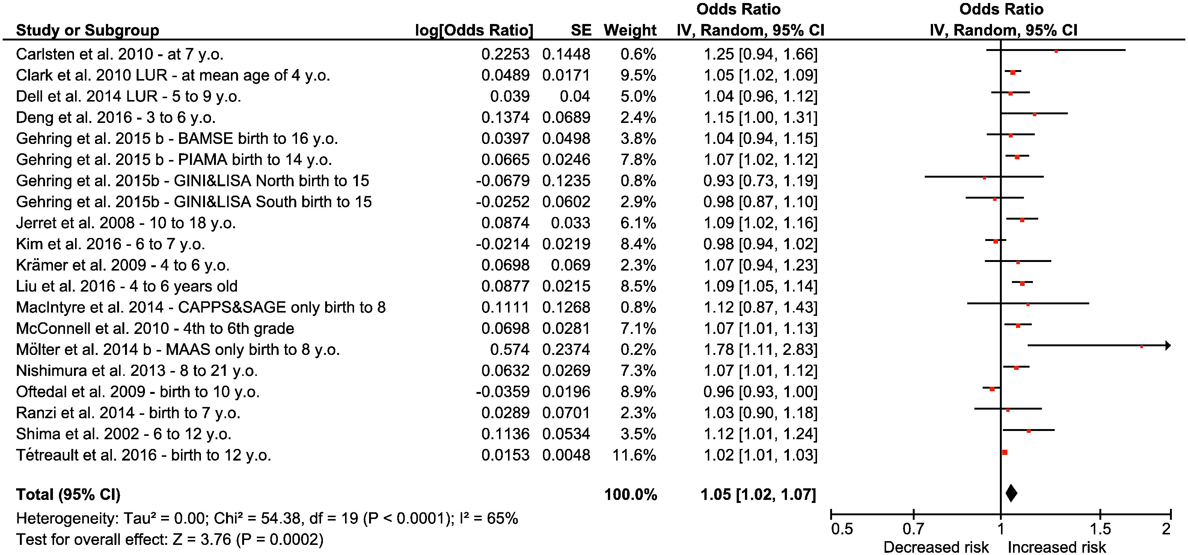
Meta-analysis
Random effects meta-analysis of studies of nitrogen dioxide exposure (per 4 μg/m³ NO₂) and new-onset asthma in children. Source: Khreis et al. (2017). CI = confidence interval; I² = percentage of variation across studies due to heterogeneity; IV = instrumental variable; SE = standard error.
Notes:
In the overall meta-analysis for NO2, the random-effects overall risk estimate for asthma development was statistically significantly increased (for 4 μg/m3 NO2, overall risk estimate = 1.05, 95% CI 1.02, 1.07) as highlighted in red in the figure on this slide
There was substantial and statistically significant heterogeneity
Random-effects overall risk estimate remained statistically significantly increased in all sensitivity analyses
Sensitivity analyses conducted were:
Excluding the study that contributed to the largest weight (the smallest standard error) to test the robustness of findings
excluding case-control and cross-sectional studies, where the potential for selection bias is higher,
and excluding studies with special characteristics that might compromise the generalizability of findings (e.g. high-risk birth cohorts)

Slide 13
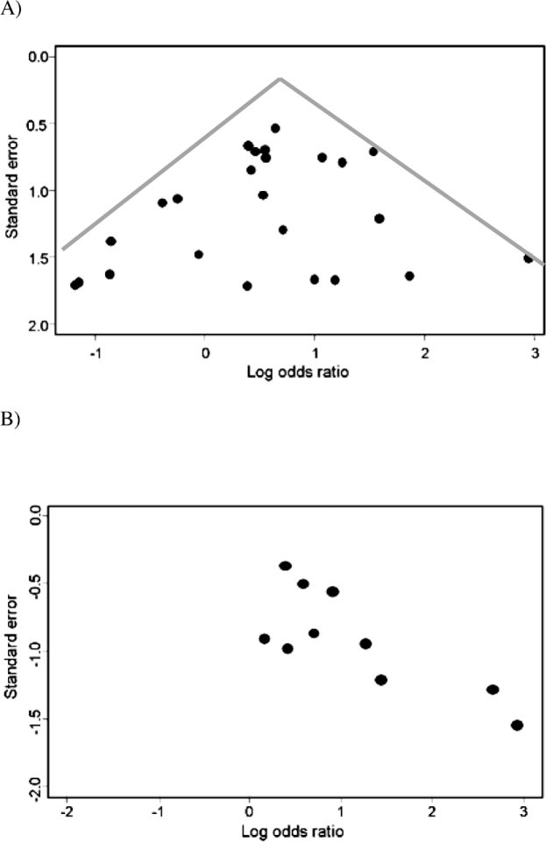
Meta-analysis
Publication bias may arise from only including published studies which show positive results while studies with non-significant or negative results are less likely to be published
The most commonly used method to examine publication bias is the funnel plot
The top panel of the let figure shows a symmetrical funnel plot which indicates no publication bias. The bottom panel shows an asymmetrical funnel plot where the small negative studies in the bottom left corner are missing (not published?)
Notes:
Extracted from Haidich 2010
“It is important to examine the results of each meta-analysis for evidence of publication bias. An estimation of likely size of the publication bias in the review and an approach to dealing with the bias is inherent to the conduct of many meta-analyses. Several methods have been developed to provide an assessment of publication bias; the most commonly used is the funnel plot. The funnel plot provides a graphical evaluation of the potential for bias and was developed by Light and Pillemer and discussed in detail by Egger and colleagues. A funnel plot is a scatterplot of treatment effect against a measure of study size. If publication bias is not present, the plot is expected to have a symmetric inverted funnel shape.
In a study in which there is no publication bias, larger studies (i.e., have lower standard error) tend to cluster closely to the point estimate. As studies become less precise, such as in smaller trials (i.e., have a higher standard error), the results of the studies can be expected to be more variable and are scattered to both sides of the more precise larger studies. The figure (on this slide) shows that the smaller, less precise studies are, indeed, scattered to both sides of the point estimate of effect and that these seem to be symmetrical, as an inverted funnel-plot, showing no evidence of publication bias. In contrast to the top figure, the bottom figure shows evidence of publication bias. There is evidence of the possibility that studies using smaller numbers of subjects and showing an decrease in effect size (lower odds ratio) were not published.”
.”

Slide 14
Key Examples
Lam et al. (2020) reviewed 58 systematic reviews indexed in PubMed, Embase, and Web of Science from inception to March 2019
The systematic reviews included investigated components of traffic-related air pollution (TRAP) exposures and reported on any health-related outcome
27 of them included a meta-analysis
There was significant heterogeneity in the included systematic reviews:
Study populations such as age, sex, occupation – stratification by these characteristics was often missing
TRAP definitions, exposure assessment and chemical components
Health outcomes
Review methodology including quality assessment
Formally assessing or rating the overall body of evidence (3/58 reviews)
Notes:
Extracted from Lam et al. (2020):
“Systematic reviews were identified from a broad search in PubMed, Embase, and Web of Science and screened to identify studies that: 1) were a systematic review; 2) investigated chemical components of traffic-related air pollution exposures; 3) reported on any health-related outcome. Our electronic search of the scientific literature (from the inception of the databases searched until March 2019) resulted in 58 systematic reviews relevant to TRAP exposures and human health outcomes. Systematic reviews were published between 2010-2019 but not all were identified as such by the study authors; the majority of studies were identified as being a systematic review (n=52) by the study authors, of which 27 also included a meta-analysis for quantitative synthesis of data. One study identified as only a meta-analysis without reporting that it was also a systematic review; another study identified as a “catalog and synthesis,” and 4 studies did not report what type of review they were but were considered eligible based on their methodology. ”

Slide 15
Key Examples
Health Outcomes Included in TRAP Systematic Reviews, Source: Lam et al. (2020)
Cardio-Respiratory (n=19): Lung cancer (n=3) Lung function (n=1) Cardiovascular disease or effects (n=5) Non-fatal myocardial infarction (n=1) Pregnancy-induced hypertensive disorders (n=1) Hypertension (n=1) Cardiorespiratory disease (n=1) Atherosclerosis (n=1) Cardiovascular hospital admissions (n=1) Heart failure (n=1) Ischemic heart disease and infarction (n=1) Mortality from all-causes, cardiovascular and respiratory disease (n=1) Morbidities of respiratory tract diseases (n=1)
Asthma (n=5)
General health effects (n=5)
Fertility (n= 4): Male fertility (n=2) Fertility reproductive health (n=1) Gestational fetal growth (n=1)
Notes:
Extracted from Lam et al. (2020):
“There was substantial diversity across the health outcomes reported in the included reviews. The most common were related to cardio-respiratory diseases and mortality (n=19), asthma (n=5), fertility (n=4), diabetes risk (n=4), childhood cancers (n=4) and cognition (n=3). This wide range of adverse health outcomes illustrates the severity of potential health effects related to TRAP. However, although several health outcomes were generally common across the reviews, the specific outcome measured varied quite a bit. For instance, although 19 studies measured cardio-respiratory health outcomes, breaking this down to more specific outcome resulted in five reviews measuring cardiovascular disease or effects, three reviews measuring lung cancer, and one review measuring the range of other health outcomes (such as lung function, non-fatal myocardial infarction, hypertension, heart failure, etc.). Thus, even considering a relatively large number of systematic reviews, comparability across the varied set of health outcomes is rather limited. This illustrates a common challenge with environmental health exposures where suspected links to a wide range of health outcomes requires a large body of evidence for sufficient investigation of each potential effect. However, it is not necessarily a limitation that few systematic reviews are available for specific health outcomes. A well-conducted systematic review that offers a robust and comprehensive evaluation of the existing body of evidence may be sufficient to support decision-making about environmental chemicals. To achieve this, the systematic review must be of high quality, with valid and consistent methodology applied to evaluate the body of evidence. ”

Slide 16
Key Examples
Health Outcomes Included in TRAP Systematic Reviews, Source: Lam et al. (2020)
Diabetes risk (n=4): Type 2 diabetes (n=3) Risk or either type 1, 2 or gestational (n=1)
Childhood cancer (n=4): Leukemia (n=3) Any cancer (n=1)
Cognition (n=3)
Congenital heart disease or abnormalities (n=2)
Morbidity, mortality and hospital admissions (n=3)
Genetic (n=3): DNA or oxidative damage (n=2) Immune response genes (n=1)
Other (n=6): Parkinson’s disease risk (n=1) Neuroimaging (n=1) Rheumatoid arthritis (n=1) Tuberculosis outcomes (n=1) Years of life expectancy (n=1) Autism spectrum disorder (n=1)
Notes:
Extracted from Lam et al. (2020):
“There was substantial diversity across the health outcomes reported in the included reviews. The most common were related to cardio-respiratory diseases and mortality (n=19), asthma (n=5), fertility (n=4), diabetes risk (n=4), childhood cancers (n=4) and cognition (n=3). This wide range of adverse health outcomes illustrates the severity of potential health effects related to TRAP. However, although several health outcomes were generally common across the reviews, the specific outcome measured varied quite a bit. For instance, although 19 studies measured cardio-respiratory health outcomes, breaking this down to more specific outcome resulted in five reviews measuring cardiovascular disease or effects, three reviews measuring lung cancer, and one review measuring the range of other health outcomes (such as lung function, non-fatal myocardial infarction, hypertension, heart failure, etc.). Thus, even considering a relatively large number of systematic reviews, comparability across the varied set of health outcomes is rather limited. This illustrates a common challenge with environmental health exposures where suspected links to a wide range of health outcomes requires a large body of evidence for sufficient investigation of each potential effect. However, it is not necessarily a limitation that few systematic reviews are available for specific health outcomes. A well-conducted systematic review that offers a robust and comprehensive evaluation of the existing body of evidence may be sufficient to support decision-making about environmental chemicals. To achieve this, the systematic review must be of high quality, with valid and consistent methodology applied to evaluate the body of evidence. ”

Slide 17
Advantages
Use explicit and predefined methods to limit bias
Use transparent and replicable methods that allow reproducibility
Draw more reliable and accurate conclusions based on the overall body of evidence
Deliver required information to healthcare providers, researchers, and policymakers
Help to reduce the time delay in research discoveries to implementation
Improve the generalizability and consistency of results
Generate new hypotheses about subgroups of the study population
Highlight research and knowledge gaps
Increase precision of the results (Gopalakrishnan and Ganeshkumar, 2013)

Slide 18
Disadvantages
The value of a systematic review or a meta-analysis depends on what was done, what was found, and the clarity of reporting.
Reporting quality varies, limiting ability to assess strengths and weaknesses
Inherent flaws include
The location and selection of studies
Heterogeneity
Loss of information on important outcomes
Inappropriate subgroup analyses
Conflict with new experimental data
Duplication of publication
Publication bias (Gopalakrishnan and Ganeshkumar, 2013)
Conflict of interest
Time consuming and resource intensive

Slide 19
Use in Policy Making
Policy makers are increasingly utilizing systematic reviews and meta-analyses for decision‐making
Systematic reviews offer additional benefits to policymakers
Having lower risk of bias than other studies
Offering more confidence in results than single studies
Barriers to using systematic reviews and meta-analyses in policy making include
Systematic reviews and meta-analyses are often written using technical language
They can lack important contextual information
They can be quite long
Summaries of the evidence may increase policymakers' use of the evidence (Petkovic et al., 2016)
Notes:
Extracted from Petkovic et al. (2016)
Little knowledge is available on how policymakers directly used evidence from systematic reviews in their decision making, but some studies found that there was little to no difference in how they used the summaries
Evidence summaries include policy briefs, briefing papers, briefing notes, evidence briefs, abstracts, summary of findings tables, and plain language summaries
It is likely that evidence summaries are easier to understand than complete systematic reviews. Whether these summaries increase the use of evidence from systematic reviews in policymaking is not clear

Slide 20
Use in Burden of Disease and Health Impact Assessments
Single quantitative estimate or summary effect size produced in meta-analyses can be used in quantitative burden of disease and health impact assessments
Pooled quantitative estimates are considered more reliable and more generalizable in the absence of local effect sizes from the population of interest
Quantitative burden of disease and health impact assessments
Provide numeric indices on the public health impact of different exposures
provide numeric indices on the impacts of interventions and different exposure and policy scenarios
Notes:
The generation and use of meta-analytical exposure-response functions to estimate the attributable morbidity and mortality cases due to a certain exposure is preferable
Meta-analytical exposure-response functions are recommended in quantitative burden of disease and health impact assessments as they are more precise than point estimates and are considered more generalizable and arguably preferable when no local exposure-response functions for the population of interest are available
An example of a quantitative burden of disease assessment using a summary effect estimate from a meta-analysis can be found in Khreis, H., de Hoogh, K. and Nieuwenhuijsen, M.J., 2018. Full-chain health impact assessment of traffic-related air pollution and childhood asthma. Environment international, 114, pp.365-375

Slide 21
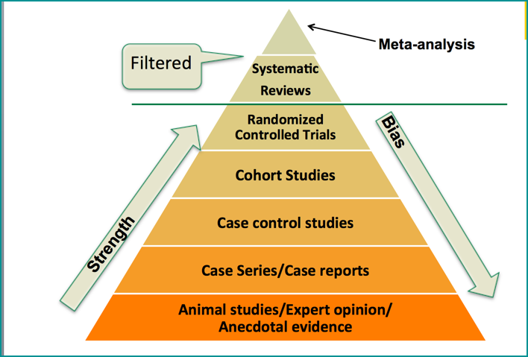
Discussion
Systematic reviews and meta-analyses are considered at the top of the hierarchy of evidence
They can provide invaluable information to healthcare providers, researchers, and policymakers given that they are conducted properly
The conduct of systematic reviews and meta-analyses requires multiple steps that need to be transparent, well documented and reproducible
Evidence pyramid. Source: The University of Alabama at Birmingham, available from: https://guides.library.uab.edu/ebd/evidencestrength

Slide 22
Research Gaps and Future Directions
Areas which need further strengthening in this field include
The registration and publication of protocols a priori
Quality assessment of individual studies using valid and consistent tools
The ranking or assessment of the overall body of evidence to produce succinct bottom-line summary
Publication bias assessment
Dissemination of findings in less technical and lengthy format and including contextual background and implications to increase policy utility
More research on how policymakers directly used evidence from systematic reviews in their decision making

Slide 23
Take-Home Messages
Systematic reviews and meta-analyses are at the top of the hierarchy of evidence and can provide invaluable insights and bottom-line conclusions, given that they are conducted properly
Not all systematic reviews and meta-analyses are equal
The name systematic review does not automatically mean that the review is of sufficient and high quality
A wealth of information on how to properly conduct systematic reviews and meta-analyses is available including numerous tools and checklists for assessing the quality of underlying studies, the overall body of evidence in addition to enhancing the clarity of reporting

Slide 24
List of Abbreviations
CASP: The Critical Appraisal Skills Program checklist
CI: Confidence Interval
GRADE: Grading of Recommendations, Assessment, Development and Evaluations
I2: percentage of variation across studies due to heterogeneity
IV: Instrumental Variable
NO2: Nitrogen Dioxide
NOS: Newcastle-Ottawa Scale
NTP: The National Toxicology Program
PICOC: Population, Intervention, Comparison, Outcomes, Context
SE: Standard Error
SMD: Standardized Mean Difference
STROBE: The Strengthening the Reporting of Observational Studies in Epidemiology
TRAP: Traffic-Related Air Pollution

Slide 25
References
Gopalakrishnan, S. and Ganeshkumar, P., 2013. Systematic reviews and meta-analysis: understanding the best evidence in primary healthcare. Journal of family medicine and primary care, 2(1), p.9.
Haidich, A.B., 2010. Meta-analysis in medical research. Hippokratia, 14(Suppl 1), p.29.
Khreis, H., Kelly, C., Tate, J., Parslow, R., Lucas, K. and Nieuwenhuijsen, M., 2017. Exposure to traffic-related air pollution and risk of development of childhood asthma: a systematic review and meta-analysis. Environment international, 100, pp.1-31.
Lam, J., Vesterinen, H., Woodruff, T., 2020. Systematic Reviews and Meta-Analyses of Air Pollution Epidemiological Studies. Book Chapter, Traffic-Related Air Pollution: Emissions, Human Exposures, and Health. Editors: Khreis, H., Nieuwenhuijsen, M., Ramani, T., Zietsman, J. Elsevier.
Petkovic, J., Welch, V., Jacob, M.H., Yoganathan, M., Ayala, A.P., Cunningham, H. and Tugwell, P., 2016. The effectiveness of evidence summaries on health policymakers and health system managers use of evidence from systematic reviews: a systematic review. Implementation Science, 11(1), p.162.
Sanderson, S., Tatt, I.D. and Higgins, J., 2007. Tools for assessing quality and susceptibility to bias in observational studies in epidemiology: a systematic review and annotated bibliography. International journal of epidemiology, 36(3), pp.666-676.
Uman, L.S., 2011. Systematic reviews and meta-analyses. Journal of the Canadian Academy of Child and Adolescent Psychiatry, 20(1), p.57.

Slide 26
Reading List
Centers for Disease Control and Prevention, 2019. Systematic Reviews. Available from: https://www.cdc.gov/library/researchguides/sytemsaticreviews.html
Egger, M., Smith, G.D. and Phillips, A.N., 1997. Meta-analysis: principles and procedures. BMJ, 315(7121), pp.1533-1537.
Moher, D., Shamseer, L., Clarke, M., Ghersi, D., Liberati, A., Petticrew, M., Shekelle, P. and Stewart, L.A., 2015. Preferred reporting items for systematic review and meta-analysis protocols (PRISMA-P) 2015 statement. Systematic reviews, 4(1), p.1.
Woodruff, T.J. and Sutton, P., 2014. The Navigation Guide systematic review methodology: a rigorous and transparent method for translating environmental health science into better health outcomes. Environmental health perspectives, 122(10), pp.1007-1014.

Slide 27
Acknowledgements
The author acknowledges substantial materials adapted from the chapter titled “Systematic Reviews and Meta-Analyses of Air Pollution Epidemiological Studies” by Juleen Lam, Hanna Vesterinen, and Tracey J. Woodruff

