Slide 1
www.carteeh.org

Slide 2
Lecture #46: Option Generation Tools
Haneen Khreis
Texas A&M Transportation Institute
H-Khreis@tti.tamu.edu, (979) 317-2799 x42799
The author declares that there is no conflict of interest
Lecture Track(s): HT/TT/PPT
Notes:
Health Track (HT)—mainly targeted at urban planners, transportation planners, and engineers with limited knowledge of public health-related concepts;
Transportation Track (TT)—mainly targeted at environmental epidemiologists and public health professionals with limited knowledge of transportation-related concepts; and;
Planning and Policy Track (PPT)—mainly targeted at planners, civil servants, and policy and decision makers with particular interest in the science-policy link.

Slide 3
Introduction
Option generation and policy selection was overviewed in lecture #45
The use of measure option generator tools or software can aid in policy option generation
Such tools or software allows the user to overview and consider a wide range of policy options which they might have overlooked and help overcome some of the weaknesses in policy option generation
This lecture will demonstrate the use of one such tool
KonSULT: The Knowledgebase on Sustainable Urban Land use and Transport, available from http://www.konsult.leeds.ac.uk/pg/

Slide 4
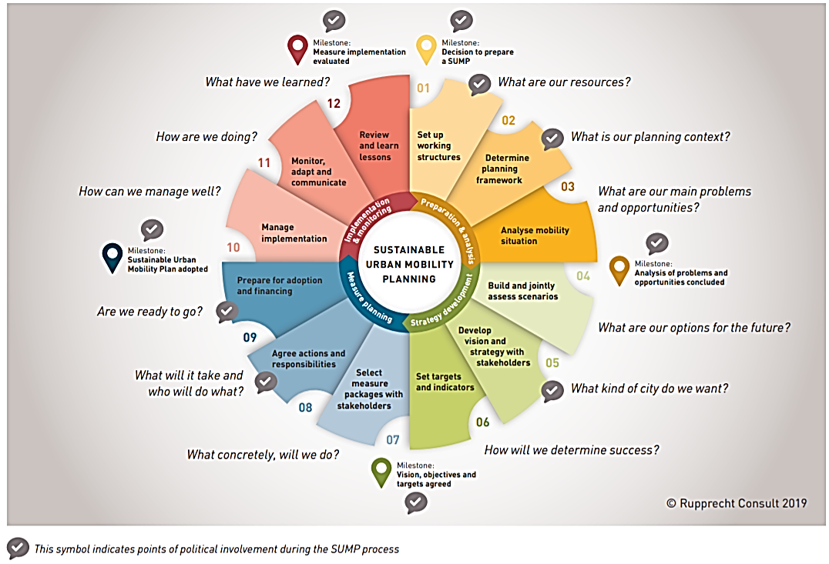
Introduction
The 12 Steps of Sustainable Urban Mobility Planning (2nd Edition) – A decision maker’s overview, Source: Rupprecht Consult, 2019
Notes:
In this lecture, we focus on one key element of the sustainable urban mobility planning process: the identification of the individual policy measures and packages which should be considered. This planning process is demonstrated in the above figure. We refer to this particular element as policy option generation and this was discussed in more detail in lecture 45.
Policy option generation is represented by Element 7 of the European Commission’s sustainable urban mobility planning cycle, shown in the figure above.
However, it will be influenced by the earlier elements of developing a vision and setting priorities, and will directly affect all subsequent elements in the sustainable urban mobility planning cycle and the performance of the sustainable urban mobility plan as a whole (May et al., 2018).

Slide 5
History of KonSULT
Knowledgebase on Sustainable Urban Land use and Transport (www.konsult.leeds.ac.uk)
Designed as a decision support tool and to help overcome weaknesses in option generation
Launched at the first workshop of the World Conference on Transport Research Society Special Interest Group on Urban Transport Policy in Leeds, 2002
Developed since with support from the European Commission, the United Kingdom Department for Transportation, the United Kingdom Engineering and Physical Sciences Research Council and the Rees Jeffreys Road Fund
Can assist policy makers, professionals and interest groups to:
Understand the challenges of achieving sustainability in urban transport
Identify appropriate policy measures and packages for their specific contexts

Slide 6

Structure of KonSULT
KonSULT has three levels
Measure Option Generator to identify suitable policy options and packages that fit the inputted user-defined criteria
From that, the user can access the second level: the Policy Guidebook to find out more about specific measures suggested by the Measure Option Generator
The third level is the Decision Makers’ Guidebook to seek further guidance on the concepts which the Policy Guidebook uses
Notes:
“In the Option Generator, users specify the area of concern, their policy objectives, and the strategy that they envisage adopting. This generates an ordered list of the measures in the Policy Guidebook in terms of their ability to contribute that this context. A package option generator then uses this list to identify complementary measures, and packages of measures, which reinforce one another through synergy, or help overcome the barriers to their implementation. The Policy Guidebook, which currently contains 64 policy measures, adopts a consistent approach to describing each measure, and uses a standard eleven-point scoring method, ranging from +5 (a highly positive contribution) to −5 (a highly negative contribution) to assess each measure in terms of its relevance to different areas of a city, its contribution to different policy objectives and strategies, and the barriers to its implementation. It is this scoring system which drives the option generation facilities. Each of the concepts used, Including objectives, problems, strategies and barriers, is more fully described in the Decision-Makers’ Guidebook.” (May et al., 2018)
The Measure Option Generator
User specifies area, objectives/problems/indicators, strategy
KonSULT offers an ordered list of possible measures, packages from (2)
Not to prescribe solutions but to encourage innovation
2. The Policy Guidebook
A consistent assessment of each measure
Based on a first principles assessment and results from case studies
3. The Decision-Makers’ Guidebook
Explains the underlying principles in (1), (2)
Based on the Logical Structure; precursor to SUMP guidance

Slide 7
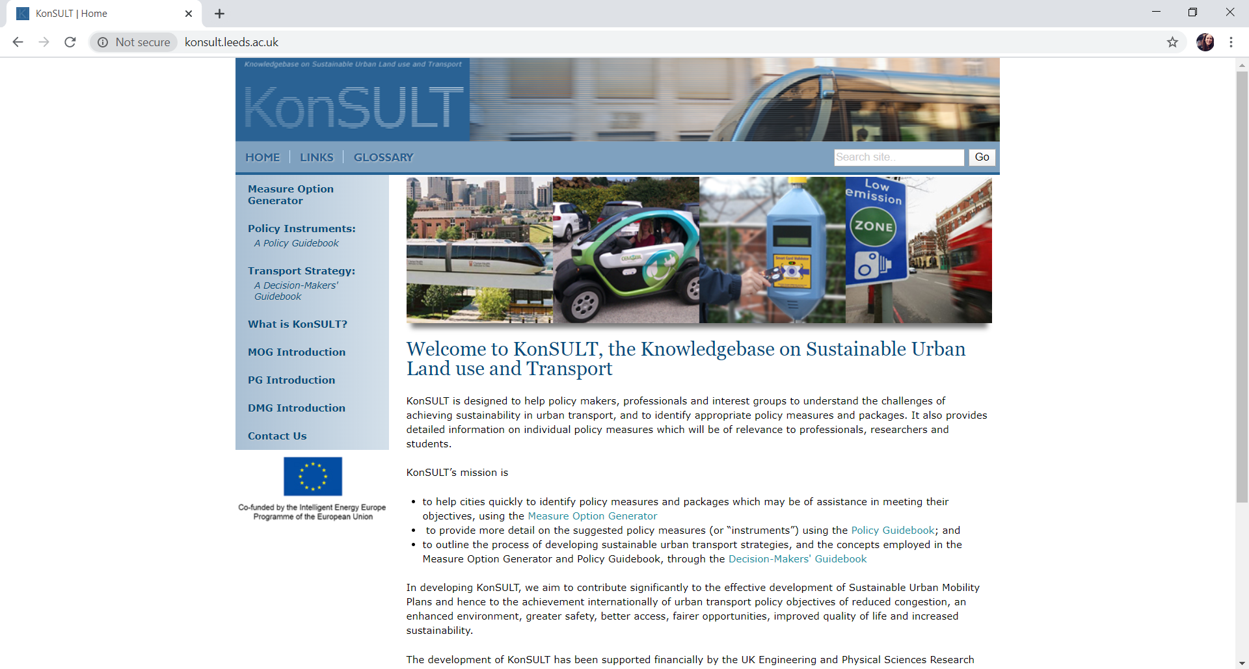
Demonstration of Measure Option Generator
Notes:
Go to www.konsult.leeds.ac.uk.
Click on the Measure Option Generator tab on the top left.

Slide 8
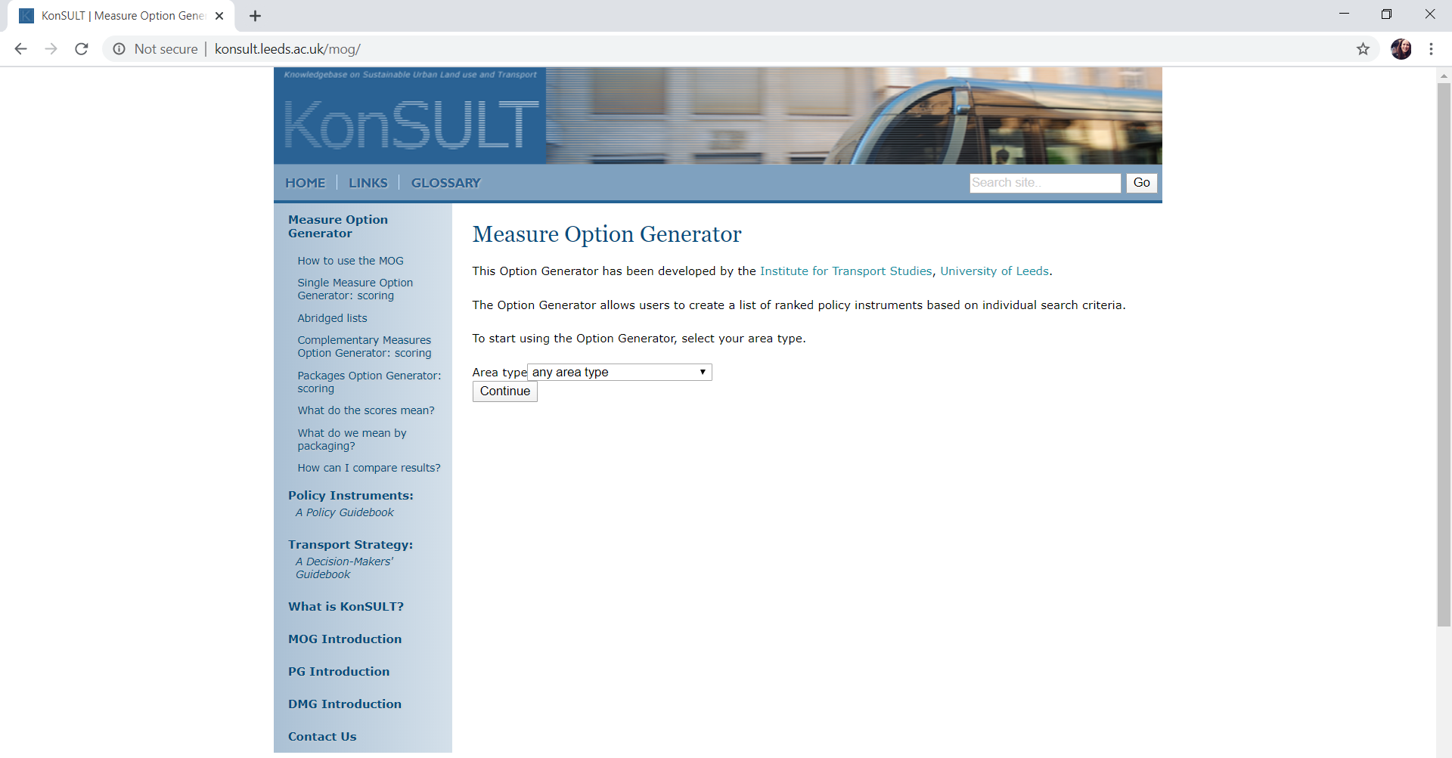
Demonstration of Measure Option Generator
Notes:
The use of the measure and the package option generators to create a list of ranked policy measures and packages for the single objective of local pollution reduction, for simplicity, is illustrated step by step in a worked example in this lecture. The following slides will show this demonstration.
The user begins this process by providing detail for the type of area they are concerned with. In this example “any area type” was chosen for illustration purposes. Click Continue.

Slide 9
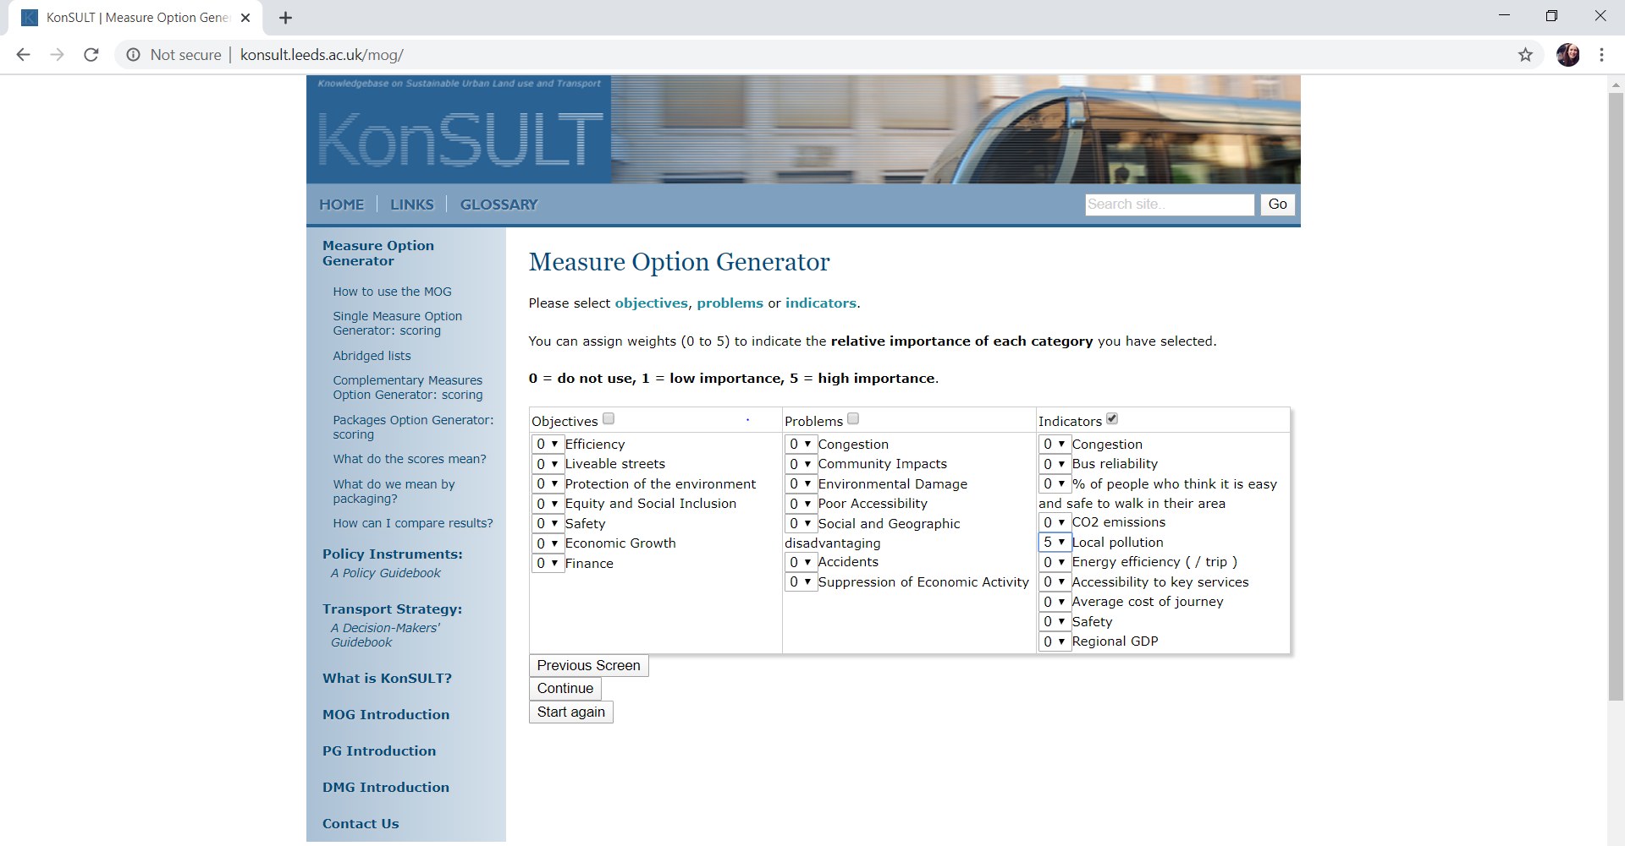
Demonstration of Measure Option Generator
Notes:
The next screen prompts the user to decide whether to base their search on either objectives (first column) or problems (second column) or indicators (third column), as shown above, whilst assigning weights (0 to 5) to the subcategories provided to indicate their relative importance in the user’s local context, 0 being the least important and 5 being the most important. “Local pollution” was chosen here as the single indicator and was assigned high importance at 5 points, as one can see above. This is for simple illustration purposes. Click Continue.

Slide 10
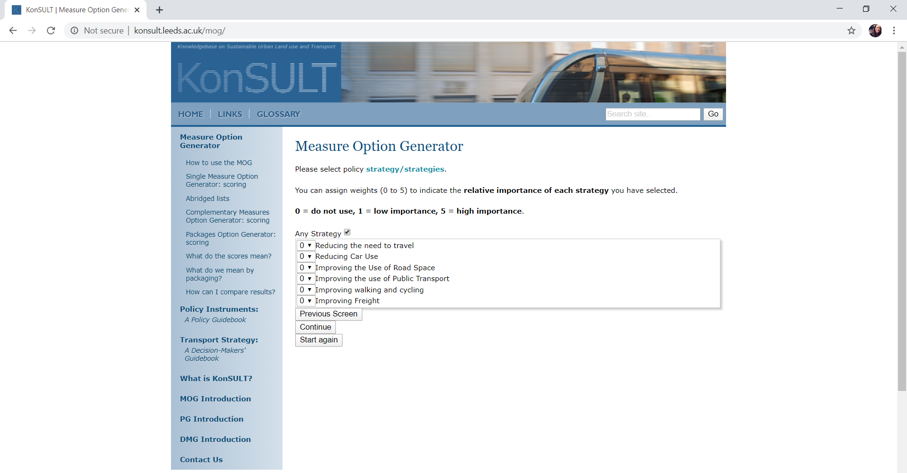
Demonstration of Measure Option Generator
Notes:
The third step is for the user to select the policy strategy/strategies they envisage adopting, whilst again assigning weights (0 to 5) to indicate the relative importance of each selected strategy. “Any strategy” was selected in this example as shown above. Click Continue.

Slide 11
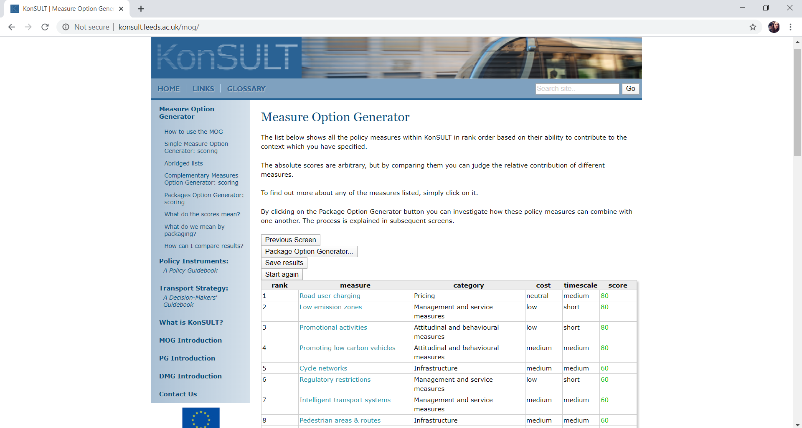
Demonstration of Measure Option Generator
Notes:
Based on these input values describing the context under consideration, KonSULT’s measure option generator produces a list of the 64 policy measures ranked according to their potential relevance and ability to contribute to the specified context and objective/problem/indicator. The first 8 ranked measures are shown above and most notably include rod user charging, low emission zones, promotional activities, and promoting low carbon vehicles. The right-hand column shows the absolute score, derived using the procedure described in Section 2 in the following paper: A.D. May, H. Khreis, C. Mullen, Option generation for policy measures and packages: the role of the KonSULT knowledgebase Proc 14th World Conference on Transport Research, Shanghai (2018), White Rose Research Online. eprints.whiterose.ac.uk. Although these absolute scores are arbitrary, they can aid the user to understand the relative potential contribution of the different generated measures in comparison to each other within the specified context. In this simple example, with any area type, only one chosen indictor, and any strategy, the scores are simply multiples of 20. A more complex context will produce a more finely graduated set of scores. Next, we will demonstrate the use of the Package Option Generator.

Slide 12
Packages Generator
A package is a combination of different measures which have been grouped together in a package to contribute more effectively to policy objectives or to the resolution of problems (see lecture 45)
The KonSULT Package Option Generator allows the user to consider packaging at one of two levels: 1. complementary measures or packages and 2. the use of barriers or synergy
The first involves taking a preferred policy measure (such as a low emission zone) and identifying other measures which might support it. These are referred to as complementary measures.
The second involves true packaging, where several measures are chosen which work well together
When packaging is done, it may reinforce the impacts of individual measures (synergy) and/or help overcome constraints on their implementation (barriers) (May, 2020)
Notes:
Extracted from May, 2020:
“Computationally, assessing packages of several measures from a long list can rapidly become complex, so the packaging option is limited to packages of up to five measures chosen from a list of up to ten measures. The Package Option Generator offers two approaches to packaging, as discussed above: to achieve synergy or to helping to overcome constraints. Users can choose either of these approaches in searching for complementary measures or packages. The calculation of synergy is based on detailed research using predictive models to assess the interaction of different pairs, and sets, of policy measures (May et al, 2016). The assessment of the overcoming of constraints is based on the scores for each measure against the constraints of governance, political acceptability, public acceptability and finance in the Policy Guidebook.”

Slide 13
Demonstration of Package Generator
Notes:
The subsequent steps are designed to allow the user to generate package options based on these output policy measures. The package option generator screen which is shown after pressing the Package Option Generator tab above, allows the user to combine measures; either by choosing a single measure and finding which others complement it best (“complementary”), or by identifying the best packages of measures from a selected list (“packages”).

Slide 14
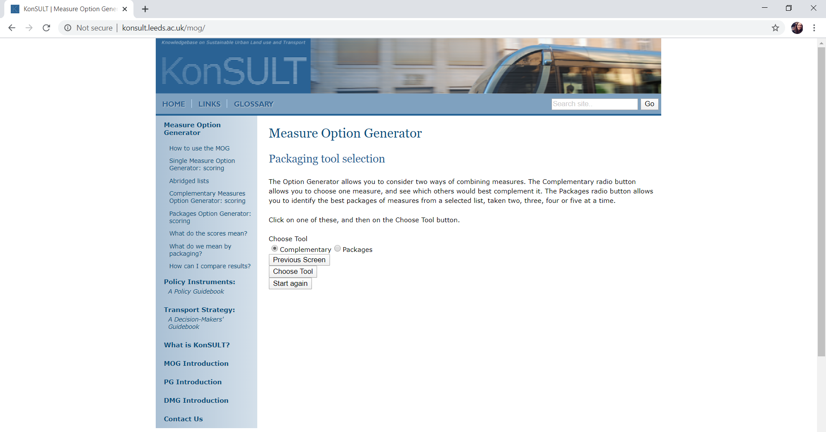
Demonstration of Package Generator
Notes:
In our example of achieving local pollution reduction, the complementary tool was chosen as shown above. After choosing this tool, the user is prompted to select the measure for which they wish to identify complementary measures. The first ranked measure of this example: “road user charging” was chosen for this purpose as shown in the next slide.

Slide 15
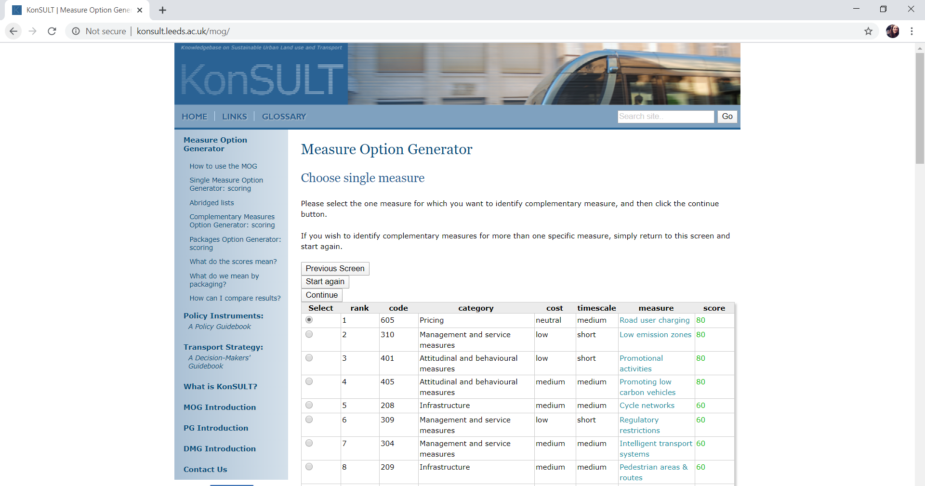
Demonstration of Package Generator
Notes:
Click Continue.

Slide 16
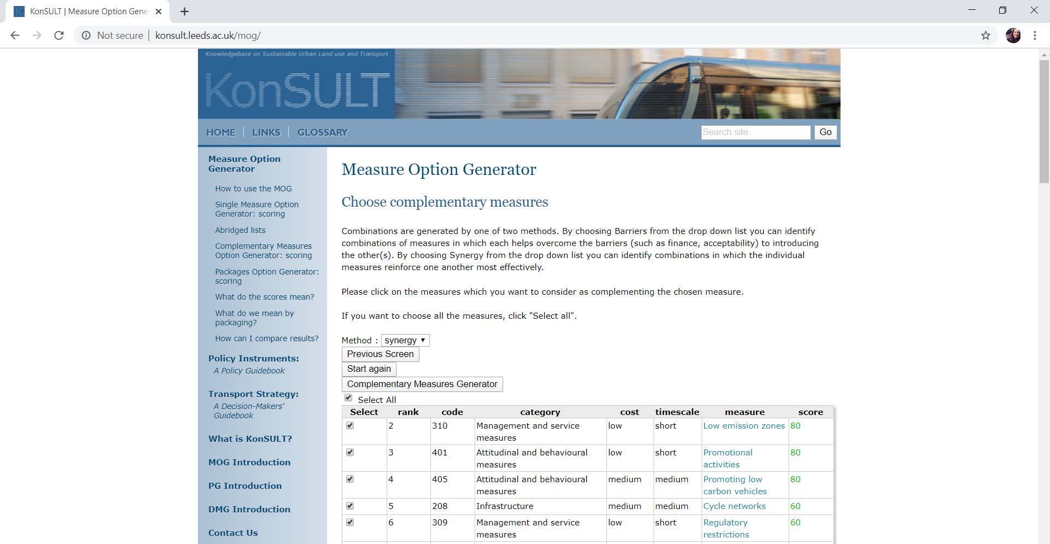
Demonstration of Package Generator
Notes:
The next screen prompts the user to choose one of two methods to generate combinations of policy measures in the final packages: “barrier” or “synergy”.
The result of these selections is that KonSULT will show all the other 63 policy measures in a ranked order based on their ability to complement the single chosen measure; road user charging in this case, in the most synergetic way. The user can select certain measures they wish to consider, or can “select all”, as selected in this example, and shown in the figure above.
Click Complementary Measures Generator.

Slide 17
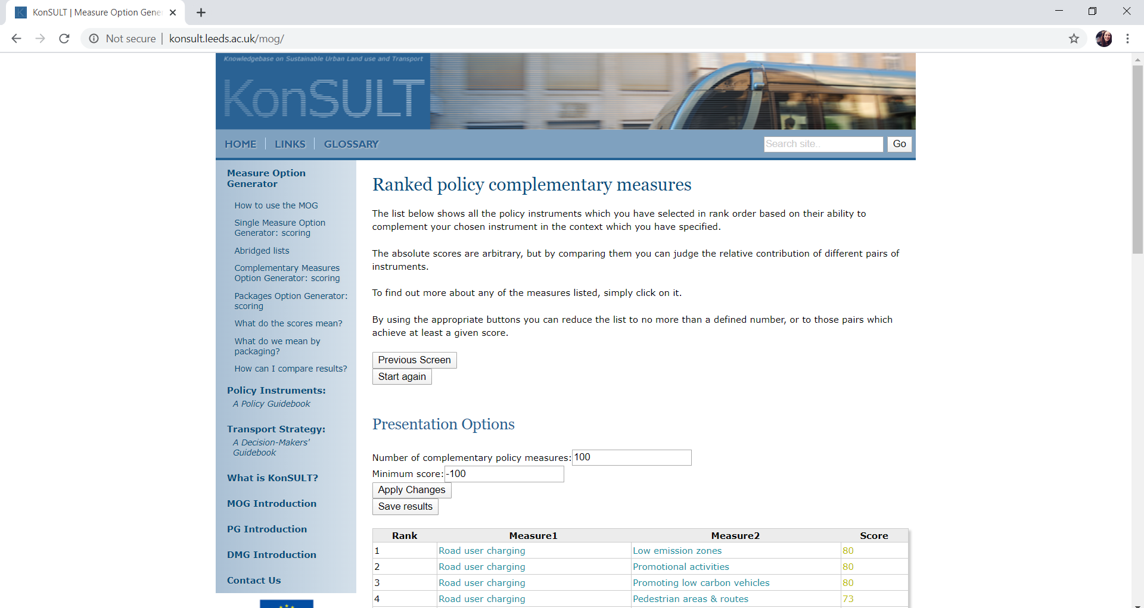
Demonstration of Package Generator
Notes:
This result is shown in the figure above the first 4 generated measures, and shows that low emission zones, followed by promotional activities, best complement road user charging to achieve synergy for the objective of reducing local pollution. The user can choose to save the results and download an excel sheet which outlines the ranked packages and their scores. The user can press on any of the measures to be taken to the Policy Guidebook which provides information on each of the policy measures available.

Slide 18

Demonstration of Package Generator
Notes:
Finally, the user can choose the “packages” tool rather than the “complementary” tool. This option will generate the best packages of measures from a selected list, taken 2, 3, 4 or 5 at a time. Select Packages. Click Choose Tool.

Slide 19
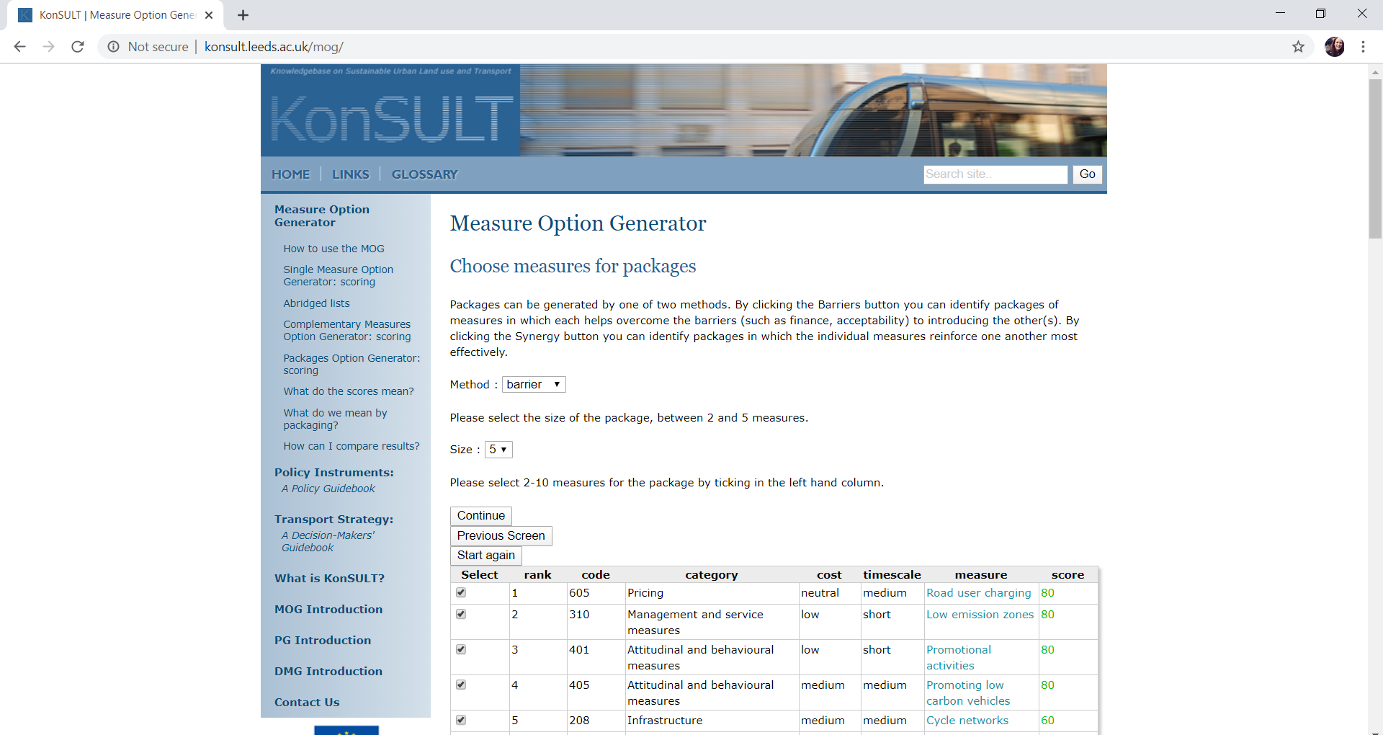
Demonstration of Package Generator
Notes:
When the user chooses this option, they will again be prompted to select either barrier or synergy to generate the output combinations. This time, barrier was selected, the size of the desired package was set to 5 measures (the maximum), and the first 10 measures were selected to be considered in the packaging as shown above. Click Continue.

Slide 20
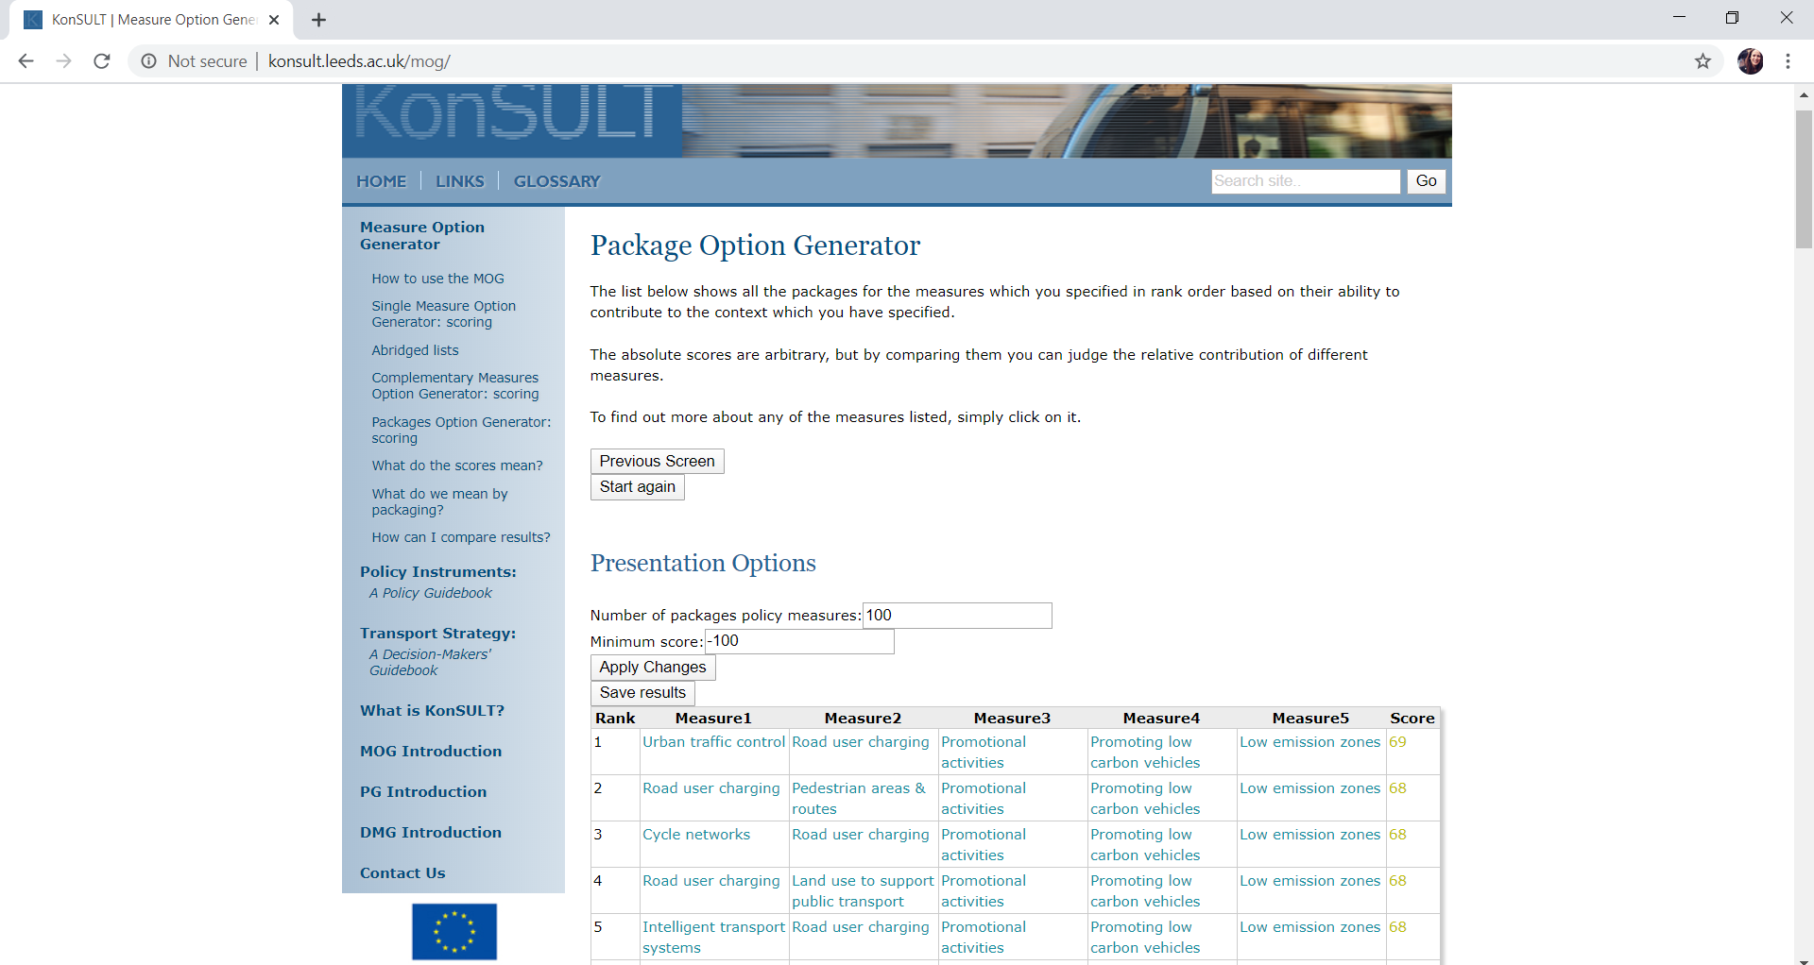
Demonstration of Package Generator
Notes:
The package option generator produced 100 ranked package of size 5 in this case; the first 5 of which are shown above. To find out more about any of the measures listed in these packages, the user can again simply click on it. In this simple example, with individual measure scores which are all multiples of 20, these first packages all have very similar or an identical performance score. However, it is interesting to note that the measures selected involve a mix of types of measures from four of KonSULT’s six categories: land use, management, attitudinal and pricing.

Slide 21
Health Impacts of Indexed Policies
As yet, KonSULT does not have an explicit public health objective, although the following indexed objectives are highly relevant
Liveable streets
Protection of the environment
Equity and social inclusion
Safety
Likewise the tool does not have explicit public health problems, although the following indexed problems are highly relevant
Community impacts
Environmental damage
Poor accessibility
Social and geographic disadvantaging
Accidents

Slide 22
Health Impacts of Indexed Policies
The tool also does not have explicit public health indicators, although the following indexed indicators are highly relevant
Bus reliability
% of people who think it is easy and safe to walk in their area
CO2 emissions
Local pollution
Accessibility to key services
Safety
This may reflect public health being a relatively recent focus of transportation planning and policy and an emerging area
However, there are plans to include public health as an objective and include specific problems and indicators relevant to health in the tool

Slide 23
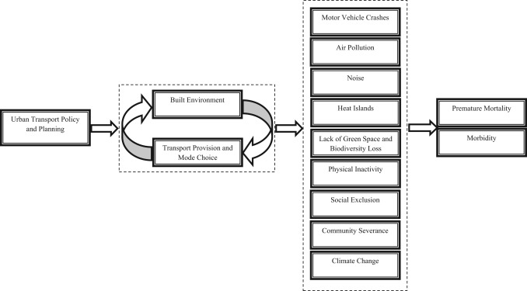
Health Impacts of Indexed Policies
Previous work has also attempted to qualitatively assess the health impacts of the 64 policy measures indexed in KonSULT (Khreis et al., 2017)
This work has provided an indication of the potential health impacts of the 64 policy measures, based on expert judgment
The health impacts were considered through 9 pathways:
Motor vehicle crashes
Traffic-related air pollution
Noise
Heat islands
Lack of green space
Physical inactivity
Climate change
Social exclusion
Community severance
Notes:
From the work conducted by Khreis et al. (2017), it appears that land use and pricing measures offer the greatest promise for enhancing public health by reducing the need to travel, enhancing green space and facilitating shorter distance travel by active modes.
More recent work reported in Khreis et al. (2019), available from https://www.carteeh.org/14-pathways-to-health-project-brief/ , shows that there are actually more pathways than the 9 outlined above: 14 in total.
The impacts of the 64 policy measures on health, assessed against those new 14 pathways, have been indicated in unpublished work that is to be integrated within the tool.
The 14 pathways are greenhouse gases, green space, physical activity, motor vehicle crashes, community severance, social exclusion, air pollution, noise, electromagnetic fields (EMF), mobility independence, stress, access, heat, and contamination. However, the KonSULT tool already accounts for several of these pathways: Accessibility is addressed under the “Problems” section as “poor accessibility” and the “Indicators” section as “accessibility to key services”; Social exclusion is considered under the “Objectives” section as “equity and social inclusion” as well as in the “Problems” column as “social and geographic disadvantaging”; Motor vehicle crashes are included in the tool under the “Problems” section as “accidents”; Greenhouse gases are accounted for by the KonSULT tool in the “Objectives” section as “Protection of the environment” and the “Indicators” section as “CO2 emissions”. We omitted those 4 pathways from our scoring procedure to avoid double counting. We also excluded electromagnetic fields (EMF) from our assessment due to a lack of literary evidence regarding EMFs influence on public health outcomes.

Slide 24
Discussion
This lecture focused on the use of the measure options and packages generator tool in KonSULT to aid in transport policy
The tool is simple, straight forward and easy to use and is a valuable resource to policy makers and planning professionals, in addition to students and other interest groups
The tool can help overcome some weaknesses in policy option generation
As it stands, the tool has multiple objectives, problems and indicators which are relevant to public health
However, it does not have “public health” as an explicit objective which is planned for its future development

Slide 25
Research Gaps and Future Directions
Future work needed to advance the state of knowledge and practice include:
Including explicit public health objectives, problems and indicators in the tool
The magnitude of both the positive and negative health impacts of each of the 64 policy measures remains largely unknown and warrants further research and synthesis
The use of policy option generation tools needs to be encouraged
New policy measures and technology options should be added as they emerge
The use of causal loop diagrams can help in the assessment of the health impacts of select policies

Slide 26
Take-Home Messages
Policy option generation is an essential step in the development of sustainable and healthy transportation plans
This step can be weak but measure option generators like the one presented in this lecture can overcome some of the weaknesses in this step
KonSULT is an easy to use and simple tool which can provide a list of measures or packages ranked in the order by which they contribute to user-specific contexts, objectives, problems and indicators
The tool may encourage innovation and present a wider range of policy measures which has not been considered

Slide 27
References
Khreis, H., May, A.D. and Nieuwenhuijsen, M.J., 2017. Health impacts of urban transport policy measures: A guidance note for practice. Journal of Transport & Health, 6, pp.209-227.
May, A.D., Khreis, H. and Mullen, C., 2018. Option generation for policy measures and packages: An assessment of the KonSULT knowledgebase. Case studies on transport policy, 6(3), pp.311-318.
Rupprecht Consult (editor), Guidelines for Developing and Implementing a Sustainable Urban Mobility Plan, Second Edition, 2019.

Slide 28
Reading List
Khreis, Haneen; Glazener, Andrew; Ramani, Tara; Zietsman, Josias; Nieuwenhuijsen, Mark J.; Mindell, Jennifer S.; Winfree, Gregory D.; Fox, Mary A.; Wunderlich, Robert; and Burke, Thomas A. (2019). Transportation and Health: A Conceptual Model and Literature Review. College Station, Texas: Center for Advancing Research in Transportation Emissions, Energy, and Health, May 2019. Available at: https://www.carteeh.org/14-pathways-to-health-project-brief/.
May, A.D., Khreis, H. and Mullen, C., 2016. Option generation for policy measures and packages: the role of the KonSULT knowledgebase, presented at the World Conference on Transport Research–WCTR 2016 Shanghai, 10–15 July 2016. Transportation Research Procedia.
Rupprecht Consult, 2013. Guidelines: developing and implementing a sustainable urban mobility plan. http://www.eltis.org/sites/eltis/files/guidelines-developing-andimplementing-a-sump_final_web_jan2014b.pdf (accessed 25th September 2015).

Slide 29
Acknowledgements
The author acknowledges substantial materials adapted from the chapter titled “Policy Option Generation and Selection” by Anthony May, and discussions with and mentoring by Professor May which enabled this lecture.

