Slide 1
www.carteeh.org

Slide 2
Lecture #11: Traffic Modeling Methods and Data Sources
Angshuman Guin, Ph.D.
Senior Research Engineer
School of Civil and Environmental Engineering
Georgia Institute of Technology
Atlanta, GA 30332
(Email: angshuman.guin@ce.gatech.edu Phone: 404.894.5830)
In addition to his academic affiliation, Dr. Guin is a co-founder of InstaData Systems LLC, Roswell GA 30076
The author has no known conflict of interest.
Lecture Track(s): TT
Notes:
Health Track (HT)—mainly targeted at urban planners, transportation planners, and engineers with limited knowledge of public health-related concepts;
Transportation Track (TT)—mainly targeted at environmental epidemiologists and public health professionals with limited knowledge of transportation-related concepts; and;
Planning and Policy Track (PPT)—mainly targeted at planners, civil servants, and policy and decision makers with particular interest in the science-policy link.

Slide 3
Introduction
A traffic model is a mathematical model of real-world traffic, usually, but not restricted to, road traffic. Traffic modeling draws heavily on theoretical foundations like network theory and certain theories from physics like the kinematic wave model - Wikipedia
Role of Traffic Analysis Tools – Use in Policy Decision Making
  Improve the decision making process
  Project potential future traffic
  Evaluate and prioritize planning/operational alternatives
  Improve design and evaluation time and costs
  Reduce disruptions to traffic
  Present/market strategies to the public/stakeholders
  Operate and manage existing roadway capacity
  Monitor performance
Notes:
Next few slides review Why we use Traffic Modeling. What are the Goals and Objectives. What can we do and what we cannot do (limitations)
Improve the decision making process. Traffic analysis tools help practitioners arrive at
better planning/engineering decisions for complex transportation problems. They are
used to estimate the impact of the deployment of traffic management and other
strategies, and to help set priorities among competing projects. In addition, they can
provide a consistent approach for comparing potential improvements or alternatives.
• Project potential future traffic. Traffic analysis tools can be used to project and
analyze future traffic conditions. This is especially useful for planning long-term
improvements and evaluating future impact.
• Evaluate and prioritize planning/operational alternatives. This typically involves
comparing “no build” conditions with alternatives, which include various types of
4
potential improvements. The impacts are reported as performance measures and are
defined as the difference between the no-build and alternative scenarios. The results
can be used to select the best alternative or prioritize improvements, increasing the
odds of having a successful deployment.
• Improve design and evaluation time and costs. Traffic analysis tools are relatively
less costly when compared to pilot studies, field experiments, or full implementation
costs. Furthermore, analytical tools can be used to assess multiple deployment
combinations or other complex scenarios in a relatively short time.
• Reduce disruptions to traffic. Traffic management and control strategies come in
many forms and options, and analytical tools provide a way to cheaply estimate the
effects prior to full deployment of the management strategy. They may be used to
initially test new transportation management systems concepts without the
inconvenience of a field experiment.
• Present/market strategies to the public/stakeholders. Some traffic analysis tools have
excellent graphical and animation displays, which could be used as tools to show
“what if” scenarios to the public and/or stakeholders.
• Operate and manage existing roadway capacity. Some tools provide optimization
capabilities, recommending the best design or control scenarios to maximize the
performance of a transportation facility.
• Monitor performance. Analytical tools can also be used to evaluate and monitor the
performance of existing transportation facilities. In the future, it is hoped that
monitoring systems can be directly linked to analytical tools for a more direct and realtime
analytical process.

Slide 4
Use Cases
Freeway Management
Arterial Intersections
Arterial Management
Incident Management
Emergency Management
Work Zones
Special Events
Advanced Public Transportation System (APTS)
Advanced Traveler Information System (ATIS)
Electronic Payment System
Rail Grade Crossing Monitors
Commercial Vehicle Operations (CVO)
Advanced Vehicle Control and Safety System (AVCSS)
Weather Management
Travel Demand Management (TDM)
Notes:
Freeway Management: Controls, guides, and warns traffic in order to improve the
flow of people and goods on limited-access facilities. Examples of freeway
management include the integration of surveillance information with freeway road
22
geometry; vehicle control, such as ramp metering; dynamic message signs (DMS); and
highway advisory radio (HAR).
• Arterial Intersections: Includes intersection or arterial operations, such as geometric
improvements, parking adjustments, and signal timing for individual intersections.
These improvements would typically involve capacity analysis, LOS analysis, and
unsignalized and signalized intersection studies.
• Arterial Management: Applies State and local planning, capital, and regulatory and
management tools to enhance and/or preserve the transportation functions of the
arterial roadway through the use of surveillance devices, advanced signal algorithms,
and coordination.
• Incident Management: Manages unexpected incidents so that the impact on the
transportation network and traveler safety is minimized. Includes incident detection
capabilities through roadway surveillance devices and incident response through
coordination with freeway service patrols and emergency response agencies.
• Emergency Management: Represents public safety and other agency systems that
support coordinated emergency response, including police, fire, emergency medical
services, hazardous materials (HazMat) response teams, Mayday service providers,
and security/surveillance services that improve traveler security in public areas.
• Work Zones: Uses traffic control devices (signs, channeling devices, barriers, etc.) and
traveler information to maximize the availability of roadways during construction or
maintenance while minimizing the impact on the traveling public and highway
workers.
• Special Events: Manages planned events so that the impact on the transportation
network and traveler safety is minimized through coordination with other traffic
management, maintenance and construction management, and emergency
management centers, and event promoters.
• Advanced Public Transportation System (APTS): Applies advanced technologies to
the operations, maintenance, customer information, planning, and management
functions for the transit agency. APTS includes advanced communications between
the transit departments and the public, personnel and other operating entities such as
emergency response services, and traffic management systems; automatic vehicle
locator (AVL); traffic signal priority; transit operations software; advanced transit
scheduling systems (ATSS); transit security; and fleet maintenance.
• Advanced Traveler Information System (ATIS): Ranges from simply providing fixed
transit schedule information to multimodal traveler information, including real-time
traffic conditions and transit schedules, and information to support mode and route
selection.
23
• Electronic Payment System: Allows travelers to pay for transportation services by
electronic means, including tolls, transit fares, and parking.
• Rail Grade Crossing Monitors: Manages traffic at highway-rail intersections where
operational requirements demand advanced features. Includes the capabilities from
the Standard Rail Crossing equipment package and augments these with additional
safety features, including positive barrier systems and wayside interface equipment
that detects or communicates with the approaching train.
• Commercial Vehicle Operations (CVO): Performs advanced functions that support
commercial vehicle operations, including communications between drivers, fleet
managers, and roadside officials; automates identification and safety processing at
mainline speeds; and timely and accurately collects HazMat cargo information after a
vehicle incident.
• Advanced Vehicle Control and Safety System (AVCSS): Includes vehicle safety
systems such as vehicle or driver safety monitoring; longitudinal, lateral, or
intersection warning control or collision avoidance; pre-crash restraint; and automated
highway systems.
• Weather Management: Includes automated collection of weather condition data and
the use of that data to detect hazards such as ice, high winds, snow, dense fog, etc.
This information can be used to provide road condition information and more
effectively deploy maintenance and construction resources.
• Travel Demand Management (TDM): TDM strategies are designed to maximize
person throughput or influence the need for or time of travel. They are typically
implemented in urban areas to reduce traffic congestion and air pollution, and to
increase the efficiency of the transportation system. TDM strategies include employer
trip reduction programs, vanpool programs, the construction of park-and-ride lots,
and alternative work schedules.
DTA
• Bottleneck removal studies;
• Active Transportation and Demand Management (ATDM) strategies;
• Integrated Corridor Management (ICM) strategies;
• Intelligent Transportation Systems (ITS) strategies;
• Operational strategies;
• Demand management strategies;
• Additional capacity;
• Incident management response scenarios;
• Special events;
• Work zone impacts and construction diversion; and
• Managed lanes and tolling projects.

Slide 5
Understanding the 3 Levels of Simulation
Macroscopic Simulation Models
  Macroscopic simulation models are based on the deterministic relationships of the flow, speed, and density of the traffic stream. The simulation in a macroscopic model takes place on a section-by-section basis rather than by tracking individual vehicles. Macroscopic simulation models were originally developed to model traffic in distinct transportation subnetworks, such as freeways, corridors (including freeways and parallel arterials), surface-street grid networks, and rural highways.
Microscopic Simulation Models
  Microscopic simulation models simulate the movement of individual vehicles based on car-following and lane-changing theories. These models are effective in evaluating heavily congested conditions, complex geometric configurations, and system-level impacts of proposed transportation improvements that are beyond the limitations of other tool types. However, these models are time consuming, costly, and can be difficult to calibrate.
Mesoscopic Simulation Models
  Mesoscopic models combine the properties of both microscopic and macroscopic simulation models. As such, mesoscopic models provide less fidelity than microsimulation tools, but are superior to the typical planning analysis techniques.
Ref: FHWA-HOP-13-015
Notes:
https://ops.fhwa.dot.gov/trafficanalysistools/type_tools.htm
https://ops.fhwa.dot.gov/trafficanalysistools/tat_vol2/sectapp_e.htm#top
Macroscopic Simulation Models: Macroscopic simulation models are based on the
deterministic relationships of the flow, speed, and density of the traffic stream. The
simulation in a macroscopic model takes place on a section-by-section basis rather
than by tracking individual vehicles. Macroscopic simulation models were originally
developed to model traffic in distinct transportation subnetworks, such as freeways,
corridors (including freeways and parallel arterials), surface-street grid networks, and
rural highways. They consider platoons of vehicles and simulate traffic flow in brief
time increments. Macroscopic simulation models operate on the basis of aggregate
speed/volume and demand/capacity relationships. The validation of macroscopic
simulation models involves replication of observed congestion patterns. Freeway
validation is based on both tachometer run information and speed contour diagrams
constructed for the analytical periods, which are then aggregated to provide a
“typical” congestion pattern. Surface-street validation is based on speed, queue, delay,
and capacity information. Macroscopic models have considerably fewer demanding
computer requirements than microscopic models. They do not, however, have the
ability to analyze transportation improvements in as much detail as microscopic
models, and do not consider trip generation, trip distribution, and mode choice in
their evaluation of changes in transportation systems.
• Mesoscopic Simulation Models: Mesoscopic models combine the properties of both
microscopic (discussed below) and macroscopic simulation models. As in microscopic
models, the unit of traffic flow for mesoscopic models is the individual vehicle. Similar
to microscopic simulation models, mesoscopic tools assign vehicle types and driver
behavior, as well as their relationships with roadway characteristics. Their movement,
however, follows the approach of macroscopic models and is governed by the average
speed on the travel link. Mesoscopic model travel prediction takes place on an
aggregate level and does not consider dynamic speed/volume relationships. As such,
8
mesoscopic models provide less fidelity than microsimulation tools, but are superior
to the typical planning analysis techniques.
• Microscopic Simulation Models: Microscopic simulation models simulate the
movement of individual vehicles based on car-following and lane-changing theories.
Typically, vehicles enter a transportation network using a statistical distribution of
arrivals (a stochastic process) and are tracked through the network over brief time
intervals (e.g., 1 second or a fraction of a second). Typically, upon entry, each vehicle is
assigned a destination, a vehicle type, and a driver type. In many microscopic
simulation models, the traffic operational characteristics of each vehicle are influenced
by vertical grade, horizontal curvature, and superelevation, based on relationships
developed in prior research. The primary means of calibrating and validating
microscopic simulation models are through the adjustment of driver sensitivity
factors. Computer time and storage requirements for microscopic models are
significant, usually limiting the network size and the number of simulation runs that
can be completed.
E.5 Macroscopic Simulation Models
Examples of macroscopic simulation traffic analysis tools:
BTS (Bottleneck Traffic Simulator)
FREQ12
KRONOS
METACOR/METANET
NETCELL
PASSER II-02: http://ttisoftware.tamu.edu/fraPasserII_02.htm
PASSER III-98: http://ttisoftware.tamu.edu/fraPasserIII_98.htm
PASSER IV-96: http://ttisoftware.tamu.edu/fraPasserIV_96.htm
SATURN: http://www.its.leeds.ac.uk/software/saturn/index.html
TRAF-CORFLO (Corridor Flow)
TRANSYT-7F: http://mctrans.ce.ufl.edu/store/description.asp?itemID=437
E.6 Mesoscopic Simulation Models
Examples of mesoscopic simulation tools:
CONTRAM (Continuous Traffic Assignment Model)
DYNAMIT-P, DYNAMIT-X, DYNASMART-P, DYNASMART-X
MesoTS: http://plan2op.fhwa.dot.gov/pdfs/Pdf2/mesoscopic.pdf
VISTA (Visual Interactive System for Transport Algorithms): http://www.vistatransport.com/ (revision date June 18, 2009)
E.7 Microscopic Simulation Models
Examples of microscopic traffic simulation models:
AIMSUN2 (Advanced Interactive Microscopic Simulator for Urban and Non-Urban Networks)
ANATOLL: http://www.its.leeds.ac.uk/projects/smartest/append3d.html#a4
AUTOBAHN: http://www.its.leeds.ac.uk/projects/smartest/append3d.html#a5
CASIMIR: http://www.its.leeds.ac.uk/projects/smartest/append3d.html#a6
CORSIM/TSIS (Traffic Software Integrated System): http://ops.fhwa.dot.gov/trafficanalysistools/corsim.htm
DRACULA (Dynamic Route Assignment Combining User Learning and Microsimulation): http://www.its.leeds.ac.uk/software/dracula
FLEXSYT-II: http://www.flexsyt.nl/informatieuk.htm
HIPERTRANS (High-Performance Transport)
HUTSIM (Helsinki University of Technology Simulator)
INTEGRATION: http://www.intgrat.com
MELROSE (Mitsubishi Electric Road Traffic Simulation Environment): http://www.its.leeds.ac.uk/projects/smartest/append3d.html#a14
MicroSim: http://www.its.leeds.ac.uk/projects/smartest/append3d.html
MICSTRAN (Microscopic Simulator Model for Traffic Networks): http://www.its.leeds.ac.uk/projects/smartest/append3d.html#a16
MITSIM (Microscopic Traffic Simulator)
MIXIC: http://www.its.leeds.ac.uk/projects/smartest/append3d.html#a18
NEMIS: http://www.its.leeds.ac.uk/projects/smartest/append3d.html#a19
PADSIM (Probabilistic Adaptive Simulation Model): http://www.its.leeds.ac.uk/projects/smartest/append3d.html#a21
PARAMICS: http://www.paramics-online.com
PHAROS (Public Highway and Road Simulator): http://www.its.leeds.ac.uk/projects/smartest/append3d.html#a23
PLANSIM-T: http://www.its.leeds.ac.uk/projects/smartest/append3d.html#a24
ROADSIM (Rural Road Simulator)
SHIVA (Simulated Highways for Intelligent Vehicle Algorithms): http://www.its.leeds.ac.uk/projects/smartest/append3d.html#a25
SIGSIM: http://www.its.leeds.ac.uk/projects/smartest/append3d.html#a26
SIMDAC: http://www.its.leeds.ac.uk/projects/smartest/append3d.html#a27
SIMNET: http://www.its.leeds.ac.uk/projects/smartest/append3d.html#a28
SimTraffic: http://www.trafficware.com
SISTM (Simulation of Strategies for Traffic on Motorways): http://www.its.leeds.ac.uk/projects/smartest/append3d.html#a29
SITRA B+: http://www.its.leeds.ac.uk/projects/smartest/append3d.html#a30
SITRAS: http://www.its.leeds.ac.uk/projects/smartest/append3d.html#a31
SmartPATH
TEXAS (Texas Model for Intersection Traffic)
TRANSIMS
TRARR
TWOPAS: https://www.fhwa.dot.gov/research/tfhrc/projects/safety/comprehensive/ihsdm/index.cfm
VISSIM http://www.ptvamerica.com/main.html
WATSim© (Wide Area Traffic Simulation): http://www.kldassociates.com/unites.htm

Slide 6
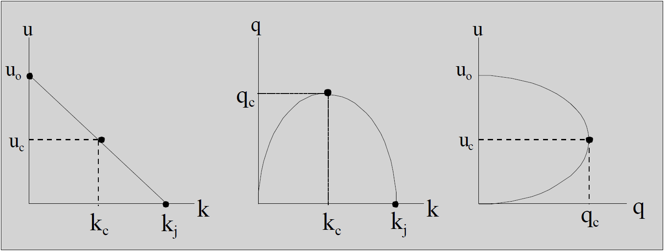
Theoretical Models
Macroscopic
  Lighthill-Whitham-Richards (LWR ) / Kinematic Wave
    Higher Order
    Cell Transmission
    Multi Class LWR
Microscopic
  Car Following
    Safe Distance
    Stimulus Response
    Action Point
    Two Regimes
    Simplified CF
    Multi Class
    Intelligent Driver Model
    Optimal Velocity
  Cellular Automata
Mesoscopic
  Cluster
  Headway Distribution
  Gas Kinetic
    Generic
    Improved
    Higher Order
Greenshields’ fundamental diagram
Notes:
Genealogy of Traffic flow models from:
https://doi.org/10.1007/s13676-014-0045-5
Fundamental diagram from:
https://ocw.tudelft.nl/wp-content/uploads/Chapter-4.-Fundamental-diagrams.pdf

Slide 7
Examples of Simulation Models
Macroscopic Simulation Models
  BTS
  FREQ12
  KRONOS
  METACOR/METANET
  NETCELL
  PASSER IV-96
  SATURN
  TRAF-CORFLO
  TRANSYT-7F
  VISTA
Mesoscopic Simulation Models
  CONTRAM
  DYNAMIT-P, DYNAMIT-X, DYNASMART-P, DYNASMART-X:
  MesoTS
Microscopic Simulation Models
  AIMSUN2
  ANATOLL
  AUTOBAHN
  CASIMIR
  CORSIM/TSIS
  DRACULA
  FLEXSYT-II
  HIPERTRANS
  HUTSIM
  INTEGRATION
  MELROSE
  MicroSim
  MICSTRAN
  MITSIM
  MIXIC
  NEMIS
  PADSIM
  PARAMICS
  PHAROS
  PLANSIM-T
  ROADSIM
  SHIVA
  SIGSIM
  SIMDAC
  SIMNET
  SimTraffic
  SISTM
  SITRA B+
  SITRAS
  SmartPATH
  TEXAS
  TRANSIMS
  TRARR
  TWOPAS
  VISSIM
  WATSim
Notes:
https://ops.fhwa.dot.gov/trafficanalysistools/type_tools.htm
https://ops.fhwa.dot.gov/trafficanalysistools/tat_vol2/sectapp_e.htm#top
Macroscopic Simulation Models
• BTS (Bottleneck Traffic Simulator):
http://mctrans.ce.ufl.edu/store/description.asp?itemID=287
• FREQ12: www.its.berkeley.edu/computing/software/FREQ.html
• KRONOS: www.its.umn.edu/labs/itslab.html
• METACOR/METANET: www.inrets.fr/ur/gretia/METACOR-Ang-H-HajSalem.htm
• NETCELL: www.its.berkeley.edu/computing/software/netcell.html
• PASSER II-02: http://ttisoftware.tamu.edu/fraPasserII_02.htm
• PASSER III-98: http://ttisoftware.tamu.edu/fraPasserIII_98.htm
• PASSER IV-96: http://ttisoftware.tamu.edu/fraPasserIV_96.htm
• SATURN: www.its.leeds.ac.uk/software/saturn/index.html
• TRAF-CORFLO (Corridor Flow):
http://mctrans.ce.ufl.edu/store/description.asp?itemID=441
• TRANSYT-7F: http://mctrans.ce.ufl.edu/store/description.asp?itemID=437
• VISTA (Visual Interactive System for Transport Algorithms):
http://its.civil.northwestern.edu/vista
Mesoscopic Simulation Models
• CONTRAM (Continuous Traffic Assignment Model): www.contram.com
• DYNAMIT-P, DYNAMIT-X, DYNASMART-P, DYNASMART-X:
www.dynamictrafficassignment.org
• MesoTS: http://plan2op.fhwa.dot.gov/pdfs/Pdf2/mesoscopic.pdf
Microscopic Simulation Models
• AIMSUN2 (Advanced Interactive Microscopic Simulator for Urban and Non-Urban
Networks): www.tss-bcn.com/aimsun.html
• ANATOLL: www.its.leeds.ac.uk/projects/smartest/append3d.html#a4
• AUTOBAHN: www.its.leeds.ac.uk/projects/smartest/append3d.html#a5
• CASIMIR: www.its.leeds.ac.uk/projects/smartest/append3d.html#a6
• CORSIM/TSIS (Traffic Software Integrated System): www.fhwa-tsis.com
• DRACULA (Dynamic Route Assignment Combining User Learning and
Microsimulation): www.its.leeds.ac.uk/software/dracula
• FLEXSYT-II: www.flexsyt.nl/informatieuk.htm
• HIPERTRANS (High-Performance Transport): www.cpc.wmin.ac.uk/~traffic
• HUTSIM (Helsinki University of Technology Simulator):
www.hut.fi/Units/Transportation/HUTSIM
• INTEGRATION: www.intgrat.com
• MELROSE (Mitsubishi Electric Road Traffic Simulation Environment):
www.its.leeds.ac.uk/projects/smartest/append3d.html#a14
• MicroSim: www.zpr.uni-koeln.de/GroupBachem/VERKEHR.PG
• MICSTRAN (Microscopic Simulator Model for Traffic Networks):
www.its.leeds.ac.uk/projects/smartest/append3d.html#a16
• MITSIM (Microscopic Traffic Simulator): http://web.mit.edu/its/products.html
• MIXIC: www.its.leeds.ac.uk/projects/smartest/append3d.html#a18
• NEMIS: www.its.leeds.ac.uk/projects/smartest/append3d.html#a19
• PADSIM (Probabilistic Adaptive Simulation Model):
www.its.leeds.ac.uk/projects/smartest/append3d.html#a21
• PARAMICS: www.paramics-online.com
• PHAROS (Public Highway and Road Simulator):
www.its.leeds.ac.uk/projects/smartest/append3d.html#a23
94
• PLANSIM-T: www.its.leeds.ac.uk/projects/smartest/append3d.html#a24
• ROADSIM (Rural Road Simulator): www.kldassociates.com/simmod.htm
• SHIVA (Simulated Highways for Intelligent Vehicle Algorithms):
www.its.leeds.ac.uk/projects/smartest/append3d.html#a25
• SIGSIM: www.its.leeds.ac.uk/projects/smartest/append3d.html#a26
• SIMDAC: www.its.leeds.ac.uk/projects/smartest/append3d.html#a27
• SIMNET: www.its.leeds.ac.uk/projects/smartest/append3d.html#a28
• SimTraffic: www.trafficware.com
• SISTM (Simulation of Strategies for Traffic on Motorways):
www.its.leeds.ac.uk/projects/smartest/append3d.html#a29
• SITRA B+: www.its.leeds.ac.uk/projects/smartest/append3d.html#a30
• SITRAS: www.its.leeds.ac.uk/projects/smartest/append3d.html#a31
• SmartPATH: www.path.berkeley.edu/PATH/Research
• TEXAS (Texas Model for Intersection Traffic):
http://mctrans.ce.ufl.edu/store/description.asp?itemID=449
• TRANSIMS: http://transims.tsasa.lanl.gov
• TRARR: www.engr.umd.edu/~lovell/lovmay94.html
• TWOPAS: www.tfhrc.gov/safety/ihsdm/tamweb.htm
• VISSIM: www.itc-world.com
• WATSim (Wide Area Traffic Simulation): www.kldassociates.com/unites.htm

Slide 8
Modeling process
Scoping
Define project scope
Performance criteria
Data Collection
Data availability
Data requirements
Base Model Development
Network coding
Error Checking
Calibration
Alternatives Analysis
Data Collection plan
Select approach and model
Field observations
Input data
Develop quality assurance
Check for coding errors/inputs
Stress test model to confirm underlying behavior
Review animation
Identify performance measures and locations to calibrate
Modify global, link, route choice, etc. parameters
Match performance measures
Forecast demand
Base case
Project alternatives
Compare performance measures
Notes:
Provide reference to the two diagrams from which this was created

Slide 9
Inputs
  Geometric (Data for Network Development)
    Number of lanes.
    Lane width.
    Link length.
    Grade.
    Curvature.
    Pavement conditions (dry, wet, etc.).
    Sight distance.
    Bus stop locations.
    Crosswalks and other pedestrian facilities.
    Bicycle lanes/paths.
    Others.
  Traffic Control Data at Intersections and Junctions
    No control.
    Yield signs.
    Stop signs.
    Signals (pretimed, actuated, real-time traffic adaptive).
    Ramp metering.
  Traffic Operations and Management Data for Links
    Warning data (incidents, lane drops, exits, etc.).
    Regulatory data (speed limits, variable speed limits, high-occupancy vehicles (HOVs), high-occupancy toll (HOT), detours, lane channelizations, lane use, etc.).
    Information (guidance) data (dynamic message signs and roadside beacons).
    Surveillance detectors (type and location).
Notes:
The link-node diagram is the blueprint for constructing the microsimulation model. The diagram identifies which streets and highways will be included in the model and how they will be represented.
The link-node diagram can be created directly in the microsimulation software or offline using various types of computer-aided design (CAD) software. If the diagram is created in the microsimulation software, then it is helpful to import a map or aerial photograph into the software over which the link-node diagram can be overlaid.
Nodes are the intersection of two or more links. Nodes are usually placed in the model using x-y coordinates and they can be at a place that represents an intersection or a location where there is a change in the link geometry.
Links are one-directional segments of surface streets or freeways.24 Links represent the length of the segment and usually contain data on the geometric characteristics of the road or highway between the nodes. Ideally, a link represents a roadway segment with uniform geometry and traffic operation conditions.

Slide 10
Inputs
Traffic demand
  Entry volumes by vehicle type and turning fractions at all intersections or junctions (random walk simulators).
  O-D/path-specific and vehicle data (path-specific simulators).
  Bus operations (routes and headways/schedules).
  Bicycle and pedestrian demand data.
Driver Behavior
  Driver’s aggressiveness (for minimum headway in car-following, gap acceptance for lane changing, response to yellow interval).
  Availability of (real-time) information for the driver.
  Driver’s response to information (for pretrip planning and/or en route switching).
Notes:
Events/Scenarios Data
Blockages and incidents.
Work zones.
Parking activity in curb lane.
Network events that can alter the network connectivity or movement characteristics, such as:
− Incidents;
− Work zones;
− Variable speed limits; and
− Reversible or peak-period HOV lanes.
Simulation Run Control Data
Length of simulation time.
Selected MOEs or output (e.g., reports, animation files, or both).
Resolution of simulation results (e.g., temporal and special resolution).
Other system parameters to run the model.
Review of Inputs
1. Link and node network:
a. Check basic network connectivity (are all connections present?).
b. Check link geometry (lengths, number of lanes, free-flow speed, facility type, etc.).
c. Check intersection controls (control type, control data).
d. Check for prohibited turns, lane closures, and lane restrictions at the intersections and on the links.
2. Demand:
a. Check vehicle mix proportions at each entry node/gate/zone.
b. Check identified sources and sinks (zones) for traffic.
c. Verify zone volumes against traffic counts.
Check vehicle occupancy distribution (if modeling HOVs).
e. Check turn percentages (if appropriate).
f. Check O-Ds of trips on the network.
3. Traveler behavior and vehicle characteristics:
a. Check and revise, as necessary, the default vehicle types and dimensions.
b. Check and revise the default vehicle performance specifications.

Slide 11
Sources of Input Data
Geometry (lengths, lanes, curvature)
  GIS / spatial databases
  Aerial Photography / Satellite Images
  On-ground Photography (Google Street View, etc.)
  Engineering Design plan sets
Controls (signal timing, signs).
  Signal timing sheets
  Signal controller database files
  Road characteristics databases
  Satellite Images
Existing demands (turning volumes, origin-destination (O-D) table).
  O-D Table from Travel Demand Model (typically based on Census data, probe vehicle data is recently being used by some organizations)
  Vehicle counts at intersections
  Vehicle counts from permanent count stations, annual average daily traffic (AADT)
Calibration data (capacities, travel times, queues).
  Field observation data
    Vehicle Counts
    Travel-time observations
    Delay measurements
Transit, bicycle, and pedestrian data.
  Field observations: counts
  Transit data from transit agencies
    schedule adherence
    ridership
Notes:
Discuss data collection

Slide 12
Research Data sources for Model Development
NGSIM
  Vehicle Trajectory Datasets over short roadway segments
    Freeways
    Arterials
  Useful for development and validation of Macroscopic and Microscopic models
  Free download from: https://catalog.data.gov/dataset/next-generation-simulation-ngsim-vehicle-trajectories
Naturalistic Driving Study (NDS)
  Part of FHWA’s SHRP 2 initiative & NHTSA
  Driver behavior and response information
    Eye tracking
    Acclerometer, GPS, forward radar, speed, turn-indicator, gear position, speed
  Detailed and accurate pre-crash information, including objective information about driving behavior
  Exposure information, including the frequency of behaviors in normal driving, as well as the larger context of contributing factors
  Data from 150-450 participants/vehicles per study (6 initial studies)
  IRB protection of personally identifiable information
  Useful for modeling driver behavior
  Processing costs for data download from https://insight.shrp2nds.us/
Notes:
Ref: https://insight.shrp2nds.us/documents/shrp2_background.pdf

Slide 13
Calibration
Calibration is a process whereby the base model is adjusted to ensure that the model performance measures are realistic and statistically representative of observed field data. Calibration tends to be the area of a modeling that requires some effort to complete. The typical steps are:
  Establish calibration objectives and identify the performance measures and critical locations against which the models are to be calibrated.
  Determine the statistical methodology and criteria.
  Determine the strategy for calibration (i.e., which model parameters are going to be adjusted and in what sequence?).
  Conduct model calibration runs following the strategy and conduct statistical checks; when statistical analysis falls within acceptable ranges, the model is calibrated.
  Test or compare the calibrated model with data set not used for calibration. If the model replicates the different data set, the model is validated.
Notes:
DTA Calibration
1. Calibrate traffic flow parameters (capacity and speed-flow relationships);
2. Calibrate route choice (software parameters, costs by link, travel time, driver preference, global driver behavior);
3. Calibrate temporal O-D matrices including time departure adjustments; and
4. Fine-tune (quantitative analysis – adjust local variables to match queues and operations).
Calibration is a process whereby the base model is adjusted to ensure that the model performance measures are realistic and statistically representative of observed field data. Calibration tends to be the area of a modeling that requires some effort to complete. Steps:
• Establish calibration objectives and identify the performance measures and critical locations against which the models are to be calibrated.
• Determine the statistical methodology and criteria.
• Determine the strategy for calibration (i.e., which model parameters are going to be adjusted and in what sequence?).
• Conduct model calibration runs following the strategy and conduct statistical checks; when statistical analysis falls within acceptable ranges, the model is calibrated.
• Test or compare the calibrated model with data set not used for calibration. If the model replicates the different data set, the model is validated.
Upon completion of the error-checking task, the analyst has a working model. However, without calibration, the analyst has no assurance that the model will correctly predict traffic performance for the project.
Calibration is the adjustment of model parameters to improve the model’s ability to reproduce local driver behavior and traffic performance characteristics. Calibration is performed on various components of the overall model.
Calibration is necessary because no single model can be expected to be equally accurate for all possible traffic conditions. Even the most detailed microsimulation model still contains only a portion of all of the variables that affect real-world traffic conditions. Since no single model can include the whole universe of variables, every model must be adapted to local conditions.
The following three-step strategy is recommended for calibration:
Capacity Calibration: An initial calibration is performed to identify the values for the capacity adjustment parameters that cause the model to best reproduce observed traffic capacities in the field. A global calibration is performed first, followed by link-specific fine-tuning. The HCM can be used as an alternative source of capacity target values if field measurements are not feasible.
1. Collect field measurements of capacity.
2. Obtain model estimates of capacity.
3. Select calibration parameters.
4. Set calibration objective function.
5. Perform search for optimal parameter value.
6. Fine-tune the calibration.
Route Choice Calibration: If the microsimulation model includes parallel streets, then route choice will be important. In this case, a second calibration process is performed, but this time with the route choice parameters. A global calibration is performed first, followed by link-specific fine-tuning.
Once the analyst is satisfied that the model reproduces as closely as possible the field-measured capacities, the next step is to then calibrate the route choice parameters in the model to better match the observed flows. The temporary demand adjustments used in the previous capacity calibration step are reversed. The model-predicted volumes are then compared to the field counts and the analyst adjusts the route choice algorithm parameters until the best volume fit is achieved.15
If the model network consists of only a single facility, then no route choice calibration is possible or needed. This step is skipped.16 This step is also skipped for microsimulation software that does not have route choice capabilities.
Route choice calibration proceeds in two phases: (1) global calibration and (2) link-specific fine-tuning.
System Performance Calibration: Finally, the overall model estimates of system performance (travel times and queues) are compared to the field measurements for travel times and queues. Fine-tuning adjustments are made to enable the model to better match the field measurements.
In this last step of the calibration, the overall traffic performance predicted by the fully functioning model is compared to the field measurements of travel time, queue lengths, and the duration of queuing. The analyst refines link free-flow speeds and link capacities to better match the field conditions. Since changes made at this step may compromise the prior two steps of calibration, these changes should be made sparingly.
Data for DTA model calibration
• Travel times;
• Travel speeds;
• Traffic counts (including temporal peaking);
• Lane utilization;
• Probe vehicle data;
• Number of queued vehicles;
• Number of stops;
• Observed congestion locations and extent of congestion; and
• Transit operations.

Slide 14
Calibration Challenges
Identification of necessary model calibration targets.
Allocation of sufficient time and resources to achieve calibration targets.
Selection of the appropriate calibration parameter values to best match locally measured street, highway, freeway, and intersection capacities.
Selection of the calibration parameter values that best reproduce current route choice patterns.
Calibration of the overall model against overall system performance measures, such as travel time, delay, and queues.

Slide 15
Outputs / Performance Measures
Level of Service (LOS)
Speed
Travel Time
Volume
Travel Distance
Ridership
Average Vehicle Occupancy (AVO)
Volume-to-Capacity (V/C) Ratio
Density
Vehicle-Miles of Travel (VMT)/Person-Miles of Travel (PMT)
Vehicle-Hours of Travel (VHT)/Person-Hours of Travel (PHT)
Delay
Queue Length
Number of Stops
Crashes
Incident Duration
Travel Time Reliability
Emissions
Fuel Consumption
Noise
Mode Split
Benefit/Cost
Notes:
Level of Service (LOS): Qualitative measure describing operational conditions within
a traffic stream, based on service measures such as speed and travel time, freedom to
maneuver, traffic interruptions, comfort, and convenience. Ranges from LOS A (best)
to LOS F (worst).
• Speed: Rate of motion (expressed in distance per unit of time).
• Travel Time: Average time spent by vehicles traversing a facility, including control
delay, in seconds or minutes per vehicle.
• Volume: Number of persons or vehicles passing a point on a roadway during some
time interval (expressed in vehicles, bicycles, or persons per hour).
• Travel Distance: Extent of the space between the trip origin and the destination,
measured along a vehicular route.
• Ridership: Number of passengers on the transit system being evaluated.
• Average Vehicle Occupancy (AVO): Average number of persons per vehicle,
including transit vehicles, on the transportation facility or system.
27
• Volume-to-Capacity (V/C) Ratio: Ratio of flow rate to capacity for a transportation
facility.
• Density: Number of vehicles on a roadway segment averaged over space (usually
expressed in vehicles per mile or vehicles per mile per lane).
• Vehicle-Miles of Travel (VMT)/Person-Miles of Travel (PMT): Total distance
traveled by all vehicles or persons on a transportation facility or network during a
specified time period (expressed in miles).
• Vehicle-Hours of Travel (VHT)/Person-Hours of Travel (PHT): Total travel time
spent by all vehicles or persons on a transportation facility or network during a
specified time period (expressed in hours).
• Delay: Additional travel time experienced by travelers at speeds less than the freeflow
(posted) speed (expressed in seconds or minutes).
• Queue Length: Length of queued vehicles waiting to be served by the system
(expressed in distance or number of vehicles).
• Number of Stops: Number of stops experienced by the section and/or corridor (based
on some minimum travel speed).
• Crashes: Number of crashes on a transportation facility or network.
• Incident Duration: Includes all crashes and vehicle incidents, such as running out of
gas and mechanical problems. It is calculated from the moment the vehicle or object
obstructs travel until the incident is cleared (expressed in minutes or hours).
• Travel Time Reliability: Travel time reliability is a quantification of the unexpected
non-recurring delay associated with excess travel demand, incidents, weather, or
special events. There are several methods for predicting reliability or variability in
travel times. Reliability of travel time is a significant benefit to travelers as individuals
are better able to predict their travel time and budget less time for their trip.
• Emissions: Predicted emissions for each pollutant type on a transportation facility or
network.
• Fuel Consumption: Fuel consumption rate associated with the use of a transportation
facility or network.
• Noise: Sound level produced by traffic (expressed in decibels).
• Mode Split: Percentage of travelers using each travel mode (SOV, HOV, transit,
bicycle, pedestrian, etc.).
28
• Benefit/Cost: Ratio of annualized, monetized benefits to total costs associated with
transportation improvement(s).

Slide 16
Alternatives Analysis:
1. Development of Baseline Demand Forecasts.
2. Generation of Project Alternatives for Analysis.
3. Selection of Measures of Effectiveness.
4. Model Application (Runs).
5. Tabulation of Results.
6. Evaluation of Alternatives.
Notes:
Project alternatives analysis is the sixth task in the
microsimulation analysis process. It is the reason for
developing and calibrating the microsimulation model.
The lengthy model development process has been
completed and now it is time to put the model to work.
The analysis of project alternatives involves the
forecasting of the future demand for the base case and
the testing of various project alternatives against this
baseline future demand. The analyst must run the
model several times, review the output, extract relevant
statistics, correct for biases in the reported results, and
perform various analyses of the results. These analyses
may include hypothesis testing, computation of
confidence intervals, and sensitivity analyses to further support the conclusions of the
analysis.

Slide 17
Alternatives Analysis: key issues
Forecasting realistic future demands.
Selecting the appropriate performance measures for evaluation of the alternatives.
Accurate accounting of the full congestion-reduction benefits of each alternative.
Properly converting the results to performance measures
Random variations between one alternative and the next
Changed demand
Changed congestion causing vehicles to take different paths (increased congestion may also reduce the number of vehicles that can complete their trip during the simulation period, also decreasing VMT).
Inability of the model to load the coded demand onto the network within the simulation period
Notes:
Stochasticity:
Random variations between one alternative and the next (use of the same random number seed in both runs can reduce or eliminate the variation).
Changed demand.
Changed congestion causing vehicles to take different paths (increased congestion may also reduce the number of vehicles that can complete their trip during the simulation period, also decreasing VMT).
Inability of the model to load the coded demand onto the network within the simulation period (increased congestion may force the model to store some of the vehicle demand off-network because of bottlenecks at loading points; in this situation, increased congestion may actually lower VMT since stored vehicles cannot travel any distance during the simulation period).

Slide 18
Considerations in choosing the modeling tool
Model Type
  Geographic Scope
  Facility Type
  Travel Mode
  Management Strategy/Application
  Traveler Response
  Performance Measures
  Tool/Cost-Effectiveness
Modeling Tool
  Tool Capital Cost
  Level of Effort (Cost/Training)
  Easy to Use
  Popular/Well Trusted
  Hardware Requirements
  Data Requirements
  Computer Run Time
  Post-Processing Requirements
  Documentation
  User Support
  Key Parameters Can Be User-Defined
  Default Values Are Provided
  Integration With Other Software
  Animation/Presentation
Notes:
a. Geographic Scope: If the study area consists of a 8-km-long (5-mi-long) freeway
segment with two parallel arterials on each side, plus all connecting streets, a
weight of 5 should be given to “Corridor/Small Network” and weights of 0 should
be given to all other subcriteria.
b. Facility Type: If the facility types in the study area are primarily a freeway, its
parallel arterials, and the connecting ramps and streets, but there are also auxiliary
lanes and HOV lanes and the impact on those is not as important, a weight of 5
should be given to “Freeway,” “Arterial,” and “Ramps,” while a weight of 3 might
be given to “HOV Lane” and “Auxiliary Lane.” Weights of 0 would be given to the
other facility-type subcriteria.
c. Travel Mode: The project involves ramp metering and data related to SOV, HOV,
and truck modes are available. However, the project focus is on the SOV mode. A
weight of 5 would be given to “SOV,” a 2 would be given to “HOV,” a 1 would be
given to “Truck,” and weights of 0 would be given to the other modes.
d. Management Strategy/Application: The project involves ramp metering only. A
weight of 5 would be given to “Freeway Management” and the other subcriteria
would be given weights of 0.
e. Traveler Response: It is anticipated that there will be some route diversion as a
result of ramp metering, so it should be given a high weight. There may be some
mode shift or departure time choice; however, they are not nearly as relevant for
the analysis. “Route Diversion” should be given a weight of 5, “Mode Shift” and
“Departure Time Choice” should each be given a 2, and the other traveler
responses should be given weights of 0.
f. Performance Measures: The stakeholders for this project are interested in travel
speed, volume, and the travel time changes anticipated from the ramp metering
project. A benefit/cost comparison is also desired for determining whether the
project is worthwhile to implement. The measures to be considered for the
benefit/cost comparison include mobility (delay), travel time reliability, safety
(crashes), emissions, and fuel consumption. Weights of 5 would be given to
“Speed,” “Volume,” “Travel Time,” “Delay,” “Travel Time Reliability,” “Crashes,”
“Emissions,” “Fuel Consumption,” and “Benefit/Cost.” Many of these measures
are based on VMT and VHT/PHT. Therefore, if some of the desired measures are
not available, “VMT/PHT” and “VHT/PHT” measures would each be given a
weight of 4. Because this is a ramp metering project, it would also be desirable to
35
know the queue length, but it is not required, so a weight of 2 would be given to
“Queue Length.” The other performance measure subcriteria would be given
weights of 0.
g. Tool/Cost-Effectiveness: There is an adequate budget for addressing all aspects of
the project, including the costs of acquiring the tool, staff training, hardware
requirements, and analytical runs. The high priorities for the project in this area
involve confidence in the results, the ability of the tool to be adjusted to local
conditions, and that the results can be easily produced and presented to the
stakeholders. In this case, weights of 5 would be given to “Popular/Well Trusted,”
“Post-Processing Requirements,” “Key Parameters Can Be User-Defined,” and
“Animation/Presentation Features.” Weights of 3 would be given to “Easy to
Use,” “Data Requirements,” and “Default Values Are Provided.” Weights of 2
would be given to “Low Tool Costs,” “Level of Effort/Training,”
“Documentation,” and “User Support.” In addition, a weight of 1 would be given
to “Hardware Requirements.” “Integration With Other Software” is not a concern
and would be given a weight of 0.
1. Ability to analyze the appropriate geographic scope or study area for the analysis,
including isolated intersection, single roadway, corridor, or network.
2. Capability of modeling various facility types, such as freeways, high-occupancy
vehicle (HOV) lanes, ramps, arterials, toll plazas, etc.
3. Ability to analyze various travel modes, such as single-occupancy vehicle (SOV),
HOV, bus, train, truck, bicycle, and pedestrian traffic.
4. Ability to analyze various traffic management strategies and applications, such as
ramp metering, signal coordination, incident management, etc.
5. Capability of estimating traveler responses to traffic management strategies, including
route diversion, departure time choice, mode shift, destination choice, and
induced/foregone demand.
6. Ability to directly produce and output performance measures, such as safety
measures (crashes, fatalities), efficiency (throughput, volumes, vehicle-miles of travel
(VMT)), mobility (travel time, speed, vehicle-hours of travel (VHT)), productivity (cost
savings), and environmental measures (emissions, fuel consumption, noise).
7. Tool/cost-effectiveness for the task, mainly from a management or operational
perspective. Parameters that influence cost-effectiveness include tool capital cost, level
of effort required, ease of use, hardware requirements, data requirements, animation,
etc.
Tool Capital Cost: What is the average capital cost to acquire the traffic analysis tool?
In this category, tools that cost, on average, less than $1,000 are considered to be
inexpensive, while tools that cost from $1,000 to $5,000 are considered to be mid-range.
Any tools that cost more than $5,000 are considered to be expensive. Inexpensive tools
are indicated in table 8 by a solid circle (●), mid-range tools are indicated by a null (or
neutral) symbol (∅), and expensive tools are indicated by an empty circle (○).
• Level of Effort (Cost/Training): Is the tool methodology type easy to learn? Does it
require expensive and/or lengthy training sessions? Tools requiring little or no training
are indicated by a ●, tools requiring a moderate amount of training are indicated by a
∅, and tools requiring expensive and lengthy training are indicated by an ○.
• Easy to Use: Is the tool generally user-friendly? (For example, Microsoft® Windows®-
based tools have drag-and-drop features, etc.) Easy-to-use and intuitive tools are
indicated by a ●. Tools requiring a significant amount of additional coding and/or
data input and analysis are cumbersome and are indicated by an ○. Those in between
are indicated by a ∅.
• Popular/Well Trusted: Is the tool popular and well regarded by current users? If yes,
the tool category is indicated by a ●. Tools that are frequently used, but the accuracy
30
of the results is highly constrained by data input and methodology constraints are
indicated by a ∅. Tools that are generally not used in practice at this time are indicated
by an ○.
• Hardware Requirements: How much computer power is necessary to adequately run
the analysis? Tools that can be used on older computers and require minimal
computing power are considered to have low hardware requirements (○), tools that
require a large amount of computing power (memory and hard-drive space) are
considered to have high hardware requirements (●), and tools that fall in between are
considered to have medium hardware requirements (∅).
• Data Requirements: What is the typical amount of input data required to perform the
analysis? The input data may include traffic volume, speed limit, traffic signal timing,
intersection/roadway geometric characteristics, the number of general-purpose and
HOV lanes, ramp metering locations and their timings, detector locations, O-D trip
tables, etc. Low data requirements are indicated by a ●, moderate data requirements
are indicated by a ∅, and data-intensive tools are indicated by an ○.
• Computer Run Time: Assuming that adequate computer hardware is available, how
long does the tool take to perform the analysis? Run times of less than 5 minutes are
considered minimal (●), run times averaging from 5 minutes to 1 hour are considered
moderate (∅), and run times lasting more than 1 hour per run are considered long (○).
• Post-Processing Requirements: Does the tool generally produce output in formats
that require no further post-processing or reformatting? Many tools cannot calculate
travel time directly; instead, users must invest additional time to generate this output
from speed and distance information. Tools requiring little or no post-processing or
reformatting are indicated by a ●, those with moderate amounts are indicated by a ∅,
and tools requiring a significant amount of post-processing and/or additional coding
are indicated by an ○.
• Documentation: Does the tool have a detailed and well-written user’s manual? Are
there articles and reports on past projects evaluated using this type of tool? Excellent
documentation is indicated by a ●, moderate documentation is indicated by a ∅, and
little or no documentation is indicated by an ○.
• User Support: Is technical support generally available for this tool? Are there mailing
lists, chat rooms, or newsgroups dedicated to this tool where users can communicate
with each other? Tools with a high level of user support are indicated by a ●,
moderate support is indicated by a ∅, and no support is indicated by an ○.
• Key Parameters Can Be User-Defined: Does the tool allow for customization of the
key analytical parameters? Is the tool flexible enough to allow for customization (e.g.,
many microsimulation tools are flexible enough to allow users to add custom
31
programming codes in addition to the standard package)? Available customization is
indicated by a ●, limited customization capabilities are indicated by a ∅, and lack of
customization is indicated by an ○.
• Default Values Are Provided: Does the tool generally provide default values for its
parameters, rates, or impact values? In some cases, there is not enough time and
resources to collect the appropriate values for all of the necessary parameters (e.g.,
average walking speed, average reaction time, etc.). Tools with defaults available for
most parameters are indicated by a ●, tools with some defaults are indicated by a ∅,
and tools with few or no defaults available are indicated by an ○.
• Integration With Other Software: Does the tool generally have export/import
features to/from other software (e.g., integration with Microsoft® Excel, Geographic
Information Systems (GIS) tools, other traffic analysis tools, etc.)? Simple
export/import features are indicated by a ●, tools with some or limited capabilities are
indicated by a ∅, and tools with no import/export capabilities are indicated by an ○.
• Animation/Presentation: Does the tool have animation/presentation features (e.g.,
animated, colorful, three-dimensional views, zoom-in/-out capabilities, detailed link
views as opposed to “stick figures,” ability to produce charts and tables, etc.)?

Slide 19
Discussion: Challenges and Limitations of using Modeling
Availability of quality data
Limited empirical data
Data input and the diversity and inconsistency of data
Lack of understanding of the limitations of analytical tools
Tools may not be designed to evaluate all types of impacts produced by transportation strategies/applications
Desire to run real-time solutions.
Tendency to use simpler analytical tools and those available in house, although they might not be the best tools for the job
Biases against models and traffic analysis tools
Long computer run times
Notes:
• Availability of quality data. If good data are not available, the user should consider a
less data-intensive tool category, such as a sketch-planning tool rather than
microsimulation. However, the results of the simpler tool categories are usually more
generalized, so the user should carefully balance the needs of a more detailed analysis
with the amount of data required.
• Limited empirical data. Data collection can often be the most costly component of a
study. The best approach is to look at the ultimate goals and objectives of the task and
focus data collection on the data that are crucial to the study.
• Limited funding. Limited funding for conducting the study, purchasing tools,
running analytical scenarios, and training users is often a consideration in
transportation studies. Traffic analysis tools can require a significant capital
investment. Software licensing and training fees can make up a large portion of the
budget. Also, the analysis of more scenarios costs money. When faced with funding
limitations, focus on the project’s goals and objectives, and try to identify the point of
diminishing returns for the investment.
• Training limitations. Traffic simulation tools usually have steep learning curves and,
as a result, some transportation professionals do not receive adequate modeling and
simulation training.
• Limited resources. Limitations in staffing, capabilities, and funding for building the
network and conducting the analysis should be considered. The implementation of
most traffic analysis tools is a resource-intensive process, especially in the model
coding and calibration (front-end) phases for simulation analyses. Careful scheduling
and pre-agreed upon acceptance criteria are necessary to keep the project focused and
on target.
• Data input and the diversity and inconsistency of data. Each tool uses unique
analytical methodologies, so the data requirements for analysis can vary greatly from
tool to tool and by tool category. In many cases, data from previous projects contribute
very little to a new analytical effort. Adequate resources must be budgeted for data
collection.
64
• Lack of understanding of the limitations of analytical tools. Often, limitations and
“bugs” are not discovered until the project is underway. It is important to learn from
experiences with past projects or to communicate with fellow users of a particular tool
or tool category in order to assess the tool’s capabilities and limitations. By researching
the experiences of others, users can gain a better understanding of what they may
encounter as the project progresses.
• Tools may not be designed to evaluate all types of impacts produced by
transportation strategies/applications. The output measures produced by each tool
vary, so the process of matching the project’s desired performance measures with the
tool’s output is important. In addition, there are very few tools that directly analyze
ITS strategies and the impacts associated with them (e.g., reduction in incident
duration, agency cost savings, etc.).
• Lack of features. Some analytical tools are not designed to evaluate the specific
strategies that users would like to implement. This is more prevalent in modeling ITS
strategies or other advanced traffic operations strategies. Often, “tricking” the tool into
mimicking a certain strategy is a short-term solution; however, there should be
flexibility so that advanced users may customize the tools.
• Desire to run real-time solutions. Many tools require a significant amount of time for
setup, modeling, and analysis. It is hoped that future tools will be able to be linked to
traffic management centers (TMCs) and detectors so that the analysis can be
implemented directly and in real time. This would allow transportation professionals
to respond to recurring and nonrecurring congestion using real-time solutions.
• Tendency to use simpler analytical tools and those available in house, although
they might not be the best tools for the job. Because of lack of resources, past
experience, or lack of familiarity with other available tools, many agencies prefer to
use a tool currently in their possession, even if it is not the most appropriate tool for
the project.
• Biases against models and traffic analysis tools. These biases are not only because of
the challenges listed above, but also because models are not always reliable and are
often considered “black boxes.” Some transportation professionals prefer to use “backof-
the-envelope” calculations, charts, or nomographs to estimate the results. This may
be adequate for simpler tasks; however, more complex projects require more advanced
tools.
• Long computer run times. Depending on the computer hardware and the scope of the
study (e.g., area size, data requirements, duration, analytical time periods, etc.), an
analytical run may range from a few seconds to several hours. The most effective
approaches to addressing this issue involve using the most robust computer
equipment available and/or carefully limiting the scope of the study to conform to the
analytical needs.

Slide 20
Discussion
Traffic Models help us understand traffic behavior, the capacities of road networks in serving demand, characteristics of demand and their relationship to changes in operational characteristics
Analytical models and traffic simulation helps us make data driven decisions and planning, incorporate future projections into the decision-making process and Evaluate/prioritize planning/operational alternatives before field implementation

Slide 21
Research Gaps and Future Directions
Flexibility of models to capture emerging scenarios (such as connected and autonomous vehicles or electric vehicles)
Calibration challenges of models
Ability of the theoretical models to capture transition between traffic flow states/regimes
Scalability of simulation models (run times)
Real-time / hybrid simulation

Slide 22
Take-Home Messages
Traffic modeling and simulation are resource and data intensive processes
Accurate scoping of the effort, commensurate with the goals and objectives of the decision making process are critical to the success
A wide variety of choices are available for modeling tools. Choice of modeling tools need to take into account the scope, resource availability, skillsets of human resources, etc.

Slide 23
Extras

Slide 24
Traveler Response
Route Diversions: Captures changes in travel routes, including pre-trip route diversion and en route diversion.
Mode Shifts: Captures changes regarding the selection of travel modes.
Departure Time Choices: Captures changes in the time of travel.
Destination Changes: Represents changes to travel destinations.
Induced/Foregone Demand: Estimates new trips (induced demand) or foregone trips resulting from the implementation of traffic management strategies.
Notes:
Route Diversions: Captures changes in travel routes, including pre-trip route
diversion and en route diversion.
• Mode Shifts: Captures changes regarding the selection of travel modes.
• Departure Time Choices: Captures changes in the time of travel.
• Destination Changes: Represents changes to travel destinations.
• Induced/Foregone Demand: Estimates new trips (induced demand) or foregone trips
resulting from the implementation of traffic management strategies.

Slide 25
Error checks
Network Connectivity
Link Speed Limits
Intersection Geometry
Traffic Control
Notes:
Network Connectivity
Common examples of network connectivity issues to be considered are as follows:
• Missing connections (e.g., a ramp interchange is missing);
• Link directionality (e.g., links coded opposite of the intended direction);
• Lane connectivity:
− Moving from a link with more lanes to a link with fewer lanes,
− Moving from a link with fewer lanes to a link with more lanes, and
• When GIS files are assembled from different sources to create one cohesive file for model development, the blending of the files may contain errors.
Intersection Geometry
• Link connectivity;
• Lane connectivity;
• Traffic control;
• U-turn restrictions;
• Turn/lane prohibitions; and
• Turn bay lengths.
Traffic Control
• Skipped signal phasing;
• Signal timings inconsistent with geometry;
• Incorrect cycle lengths, split times, and offsets;
• Missing approaches; and
• Incorrect timing, phasing, offset and coordination.

Slide 26
Calibration / Validation
Meaning of terms
Difference between terms/steps

Slide 27
Use in Policy Decision Making
Addressed in Introduction
Notes:
Improve the decisionmaking process. Traffic analysis tools help practitioners arrive at
better planning/engineering decisions for complex transportation problems. They are
used to estimate the impact of the deployment of traffic management and other
strategies, and to help set priorities among competing projects. In addition, they can
provide a consistent approach for comparing potential improvements or alternatives.
• Evaluate and prioritize planning/operational alternatives. This typically involves
comparing “no build” conditions with alternatives, which include various types of
potential improvements. The impacts are reported as performance measures and are
defined as the difference between the no-build and alternative scenarios. The results
can be used to select the best alternative or prioritize improvements, increasing the
odds of having a successful deployment.
• Improve design and evaluation time and costs. Traffic analysis tools are relatively
less costly when compared to pilot studies, field experiments, or full implementation
costs. Furthermore, analytical tools can be used to assess multiple deployment
combinations or other complex scenarios in a relatively short time.
• Reduce disruptions to traffic. Traffic management and control strategies come in
many forms and options, and analytical tools provide a way to cheaply estimate the
effects prior to full deployment of the management strategy. They may be used to
initially test new transportation management systems concepts without the
inconvenience of a field experiment.
• Present/market strategies to the public/stakeholders. Some traffic analysis tools have
excellent graphical and animation displays, which could be used as tools to show
“what if” scenarios to the public and/or stakeholders.
• Operate and manage existing roadway capacity. Some tools provide optimization
capabilities, recommending the best design or control strategies to maximize the
performance of a transportation facility.
• Monitor performance. Analytical tools can also be used to evaluate and monitor the
performance of existing transportation facilities. In the future, it is hoped that
monitoring systems can be directly linked to analytical tools for a more direct and realtime
analysis process.

Slide 28
Inputs
Geometry (lengths, lanes, curvature).
Controls (signal timing, signs).
Existing demands (turning volumes, origin-destination (O-D) table).
Calibration data (capacities, travel times, queues).
Transit, bicycle, and pedestrian data.

Slide 29
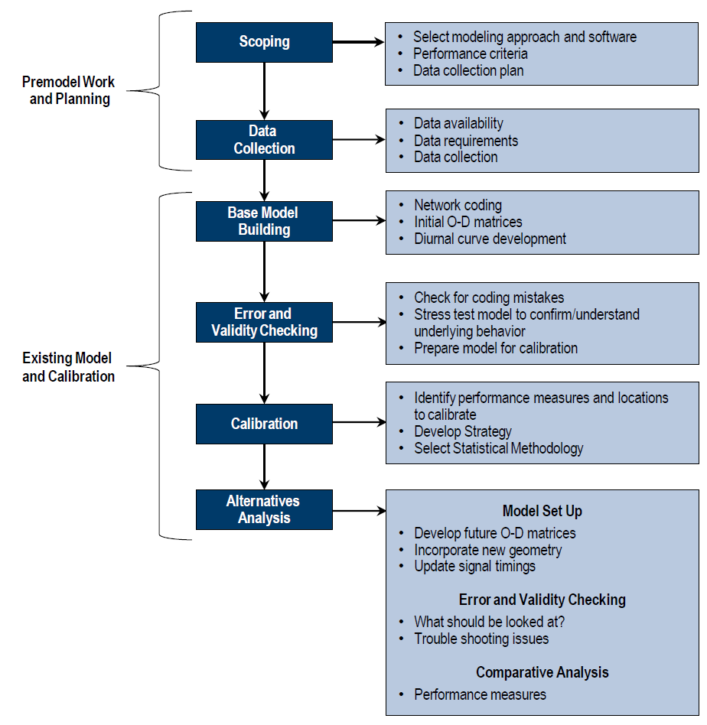
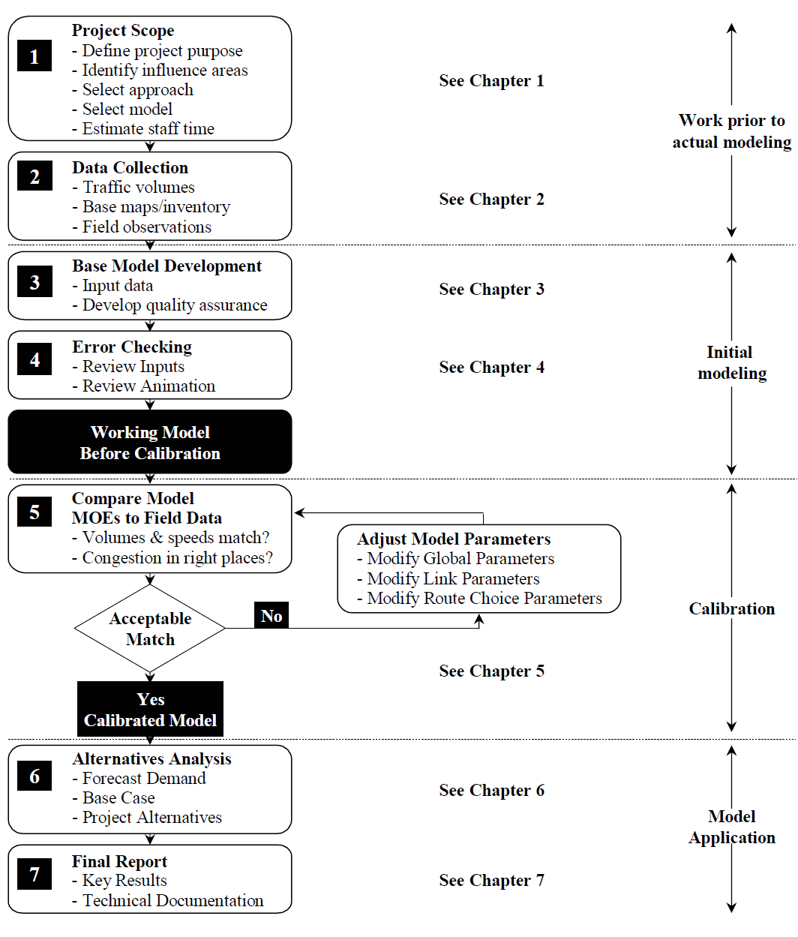
Modeling process

