Slide 1
www.carteeh.org

Slide 2
Lecture #20: Air Pollution Dispersion Modeling
Roger L. Wayson, Ph.D., P.E.
Senior Engineer- Noise and Air Quality
AECOM
Roger.Wayson@aecom.com
Michael O. Rodgers, Ph.D.
Regents Researcher
School of Civil and Environmental Engineering
Georgia Institute of Technology
Michael.Rodgers@ce.gatech.edu, (404) 385-0569
Although Dr. Wayson and Dr. Rodgers have conducted research with and evaluated many of the models described within they have no known specific conflicts of interest in presenting this information.
Lecture Track(s): HT/TT/PPT
Notes:
Health Track (HT)—mainly targeted at urban planners, transportation planners, and engineers with limited knowledge of public health-related concepts;
Transportation Track (TT)—mainly targeted at environmental epidemiologists and public health professionals with limited knowledge of transportation-related concepts; and;
Planning and Policy Track (PPT)—mainly targeted at planners, civil servants, and policy and decision makers with particular interest in the science-policy link.

Slide 3
Introduction
What is Air Pollution Dispersion?
  The dilution of pollutants within the atmosphere
  Atmospheric dispersion modeling is the mathematical simulation of how air pollutants disperse in the ambient atmosphere
What are the Important Parameters?
  Source: the emissions release
  Transport: the atmospheric motion and effects
  Receptor: a point in space where concentrations are predicted.
What does Dispersion Modeling provide?
  Comparison to measurements
  Estimations of concentrations for impacts and health analysis
  Ability to review emissions control strategies
Notes:
While historically a great deal of work on air pollution dispersion has focused on dilution of pollution from point sources (e.g. power plants or industrial facilities), especially using Gaussian or other plume models, this lecture will focus almost exclusively on line-source models that are typically used for analysis of the impacts of traffic-related air pollution.

Slide 4
Emissions Sources
Source= Emissions Release
  Source Geometries
    Point (e.g. a smokestack)
    Line (e.g. a highway)
    Area ( e.g. a parking lot)
    Volume (like an area source but air can flow through source)
  Emissions Factor = mass of specific pollutant / activity rate
    Point: mass/time (e.g. grams/second)
    Line: mass/time-length (e.g. grams/second/meter)
    Area: mass/time-area (e.g. grams/second/square meter)
    Others: normally energy consumption related (e.g. grams/gallon of gasoline, kilograms/kilowatt)
  Other Categories:
    Stationary
    Mobile
Notes:
Historically emissions rates for mobile sources were estimated by collection of the total volume of pollutants from a vehicle or engine operating on a dynamometer with a particular “driving cycle” thought to be typical for operations of this type of vehicle or engine. Since these “driving cycles” corresponded to an equivalent distance that the vehicle would have travelled if not attached to the dynamometer these emissions factors were normally expressed in grams/mile of operation. While this type of testing is still used for certification of vehicles, modern emissions models (e.g. U.S. EPA’s Motor Vehicle Emissions Simulator (MOVES)) make specific estimates of emissions based on the second-by-second operational characteristics (i.e. speed, acceleration, road grade, type of fuel, etc.) of each type of vehicle (“modal emissions”}. As a result, emissions are reported as grams of a pollutant emitted per second (grams/second). Since the vehicle speed is known, these grams/second emissions are “spread out” over the highway by the distance travelled by the vehicle in that second to produce a gram/second/meter estimate that can be used for dispersion modeling.

Slide 5
Why Not Just Consider Emissions?
Estimation of emissions provides information on source strength and total mass emitted
An Emission Inventory or summation of all similar pollutants provides information for an entire process or region (allows comparison of two alternatives)
But emission analysis does not provide an estimation of the impact of the air we breathe……we need dispersion modeling to predict ambient concentrations necessary for estimation of health effects
  Accounts for the influence of weather and climate
  Accounts for the influences of topography and the built environment
  Provides the concentration field for exposure modeling
Notes:
In our experience, many individuals who have not had previous exposure to lectures on air pollution and health tend to develop a rather over-simplified view of the interactions of emissions, transport, exposure and health effects as well as the overall control of emissions. Developing a firm understanding of these complex interactions is one of the primary objectives of this course. The individual lectures that have proceeded this one have introduced many of the individual concepts but some students may not have fully grasped the “big picture” and fully integrated and synthesized how these elements fit into the overall process. iThis slide is intended as an introduction of how dispersion modeling fits into the “overall picture” of air pollution control presented in the next slide.

Slide 6
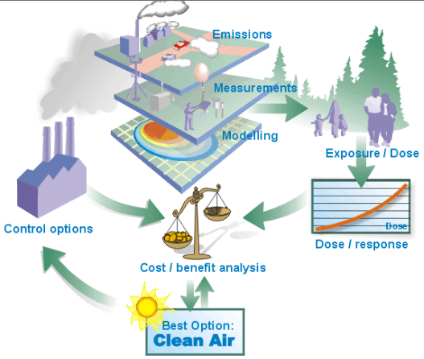
“The Big Picture” for Air Pollution
From slide share
Notes:
The time spent on this slides depends very much on the level of integration and synthesis that the students have developed in terms of the interaction of the processes that have been discussed in earlier portions of the course. In our own presentations and classes we tend to place a lot of emphasis on showing how the process of sources, emissions, transport/dispersion, exposure, dose, response and policy and control analysis flow together to produce cleaner air.

Slide 7
The Idea of Concentration
In air pollution concentration = a measure of pollutant amount in the ambient air we breath
  Nitrogen, oxygen make up the bulk of air
  Pollutants are trace amounts of the total
Descriptors include
  The mass per unit volume (e.g., µg/m³)
      or
  A ratio of volumes (e.g., parts-per-million, ppm)
  ppm is constant with temperature and pressure, while µg/m³ is not
  Standard air pollution atmosphere is sea level pressure and 25° Celcius
Notes:
Slide can be omitted if students are familiar with the concept of absolute concentration versus mixing ratio. The distinction can be significant at higher elevations.

Slide 8
Atmospheric Processes
Wind
  Pollutant transport
    Advection (Horizontal Transport)
    Convection (Vertical Transport)
  Mechanical turbulence (results in mixing)
Temperature Gradients
  Convection and large eddy motions
  Thermal turbulence (results in mixing)
Note that diffusion is a very slow process and not usually considered in mixing
Notes:
Most mechanical turbulence in the lower atmosphere is due to interactions with the Earth’s surface. These interactions can be on a large spatial scale, for example interactions with a mountain range, all the way down to the roughness of the Earth’s surface itself. These interactions result in turbulence (deviation from an ideal laminar flow) across a wide range of spatial scales. As a result, the mixing of pollutants into the background atmosphere occurs almost entirely as the result of turbulent mixing down to sub-millimeter scales where molecular diffusion begins to become important. For this reason, dispersion modeling is largely concerned with how “parcels” of air are moved along with the horizontal and vertical winds to other locations and how these parcels dissipate into the background atmosphere by mixing processes.

Slide 9
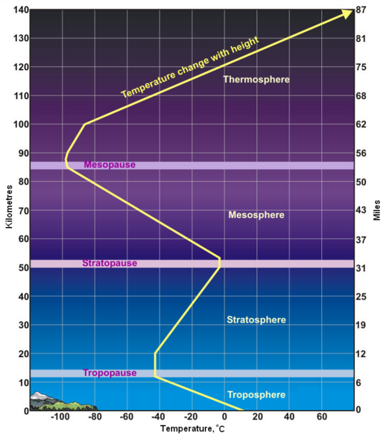
Atmospheric Temperatures
The atmosphere is like the skin of an apple relative to the size of the Earth
Dispersion modeling for air pollution deals with processes in the troposphere, the lowest portion of our atmosphere where weather occurs
Most processes occur primarily in an even thinner layer called the planetary boundary layer near the Earth’s surface
Diagram: NOAA and NWS
Notes:
This slide is aimed at describing the broad temperature structure of the atmosphere and may be deleted for students who already possess this knowledge. The diagram illustrates the degree to which the vertical temperature profile defines the regions of the atmosphere. In the Troposphere and Mesosphere the temperature decreases with height while the converse is true for the Stratosphere and Thermosphere. This temperature profile is determined by the regions in which the atmosphere is heated. Virtually all of the heating of the Earth’s atmosphere is due to the Sun. Most of the Sun’s radiation is absorbed at the Earth’s surface. In the Troposphere the temperature decreases as we move away from this heat source and this heat energy is gradually converted into gravitational potential energy (adiabatic lapse rate). While this process continues as we continue to move up in the atmosphere, at the top of the troposphere (tropopause) the temperature begins to increase with height due to absorption of solar ultraviolet light by atmospheric oxygen and ozone (Chapman mechanism) that supplies sufficient additional energy to overcome the adiabatic lapse rate and causes the temperature to rise with altitude (i.e. more radiation is absorbed higher in the atmosphere)) throughout the Stratosphere. In the Mesosphere, the density of the atmosphere has become sufficiently low that these heating mechanisms are less efficient and the temperature again decreases with height as in the Troposphere. In the Thermosphere absorption of even shorter wavelengths of light begin to increase temperature with height.

Slide 10
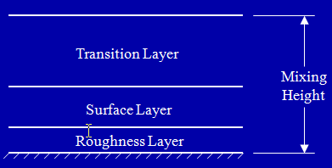
The Planetary Boundary Layer (PBL)
“The region in which the atmosphere experiences surface effects through vertical exchanges of momentum, heat and moisture” (Panofsky and Dutton, 1984)
The overall height of the Planetary Boundary Layer rarely exceeds 10% of the height of the Troposphere
Typically, higher mixing heights are associated with more rapid vertical mixing.
(Panofsky and Dutton, 1984)
Notes:
Typical mixing heights vary based on surface albedo (reflected fraction of incoming solar radiation), Bowen ratio (ratio of sensible heat flux to latent heat flux, latent heat flux represents how much of the incoming energy is being used to evaporate water), and surface roughness (determined topography and size of objects impacting the wind flow). Thus areas with high heat fluxes (e.g. desert areas) tend to have high mixing depths. The next slide represents the “climatological” mixing depth for larger regions. This will be impacted on smaller scales by the presence of cities and other human development.

Slide 11
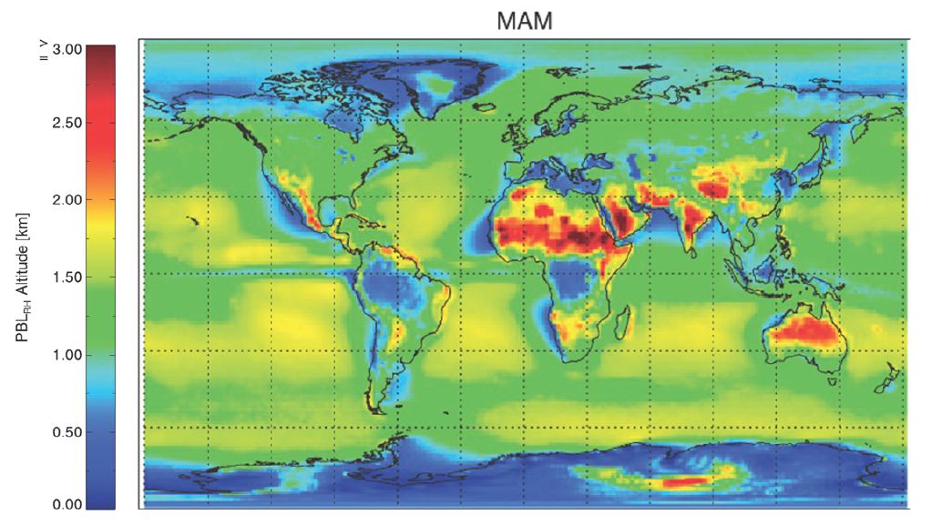
Climatological Planetary Boundary Layer Heights
von Engeln A and Teixeira J, A, 2013
Notes:
Data are derived from twenty-years of data from the European Center for Medium Range Weather Forecasts (ECMRF). The data resulted from a reanalysis of existing data to produce a consistent data set. The heights shown here are relative to mean-sea-level and not to heights above the ground.

Slide 12
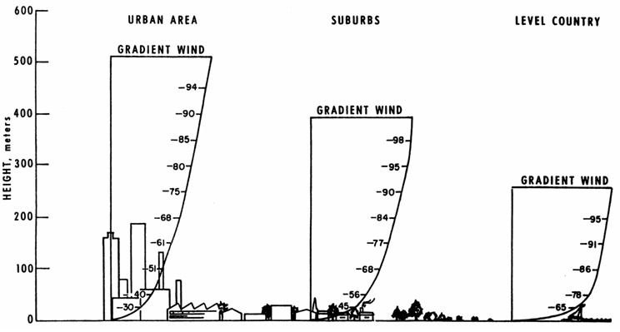
Urban Heat Islands and Wind Profiles
The Climatological Mixing Height can be altered by the presence of urban “heat islands” associated with cities and other “built up” areas that typically absorb greater amounts of solar radiation and have greater “surface roughness” than more natural areas.
This change in mixing height also tends to alter near surface wind speeds. (Stone and Rodgers (2007))
(Panofsky and Dutton, 1984)
Notes:
The relatively low albedo (high surface energy absorption) of pavements, roofs and other human structures tends to produce higher sensible heat fluxes in cities. Likewise, the human built infrastructure tend to represent a greater barrier to wind flows than the natural land coverings that they replace. Both of these conditions contribute to increasing mixing heights in cities compared to nearby rural areas. As shown in figure, suburban conditions represent an intermediate case. However, looking from a population basis, more compact development tends to reduce the overall effect of human development (Stone and Rodgers (2007)).

Slide 13
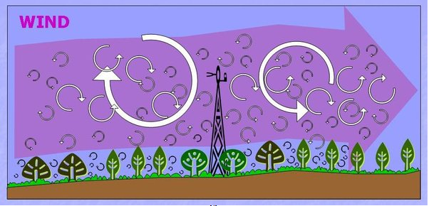
Wind is the Most Important Factor in Dispersion
Wind speed and direction determines pollutant transport
But wind is also is important in mixing
  Dilution
  Eddies
    Small
    large
Burba, G.G. and D.J. Anderson, 2010
Notes:
An important factor illustrated in this slide in the influence that wind has on the production of atmospheric “eddies” that are, in many ways, similar to the closed eddies that we see in our bathtubs. The size of these eddies is influenced by the local sensible heat flux, wind speed, and the presence of obstacles (e.g. buildings, trees, topographic features) that alter the wind flow. In the case of traffic-related air pollution dispersion, the movement of vehicles along the roadway can result in the transfer of vehicle momentum to air parcels as the flow over the vehicle. These “mechanically produced” disturbances can have a significant influence on near roadway dispersion of pollutants.

Slide 14
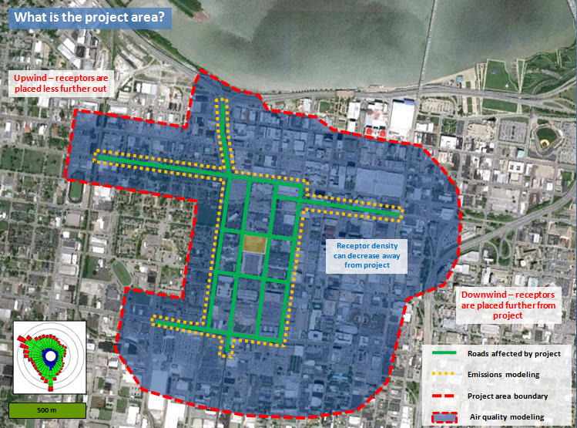
Scales of Dispersion Modeling
Synoptic or Macroscale: very large areas (e.g., a few hundred to 1000s of km)
  Example use: Determining Regional Background Concentrations
Mesoscale: regional or urban modeling (1 to a few 100 km)
  Example use: Distribution of Pollutants in a Large City
Microscale: local project level analysis (meters to a few km)
  Example use: Influence of traffic-related air pollution on neighboring areas
Microscale Modeling Application (Wayson)
Notes:
It is important to note that all numerical models must make certain assumption in order to make certain assumptions in order to make the calculations computationally tractable. The nature of these assumptions strongly influences both the spatial and temporal time scales that these models are designed to simulate. For example, synoptic scale models often assume that the atmosphere is in hydrostatic equilibrium (i.e. these models do not directly model convection). Whereas most microscale models will assume that the background concentration of pollutants is constant. For this reason, models tend to work in a “nested” fashion, where larger scale models provide the basic boundary conditions used by higher-resolution (smaller spatial scale) models for their computations. In their turn, these higher-resolution models can be used to develop useful parameterizations of small-scale processes (e.g. an estimate of convection conditions for use in a synoptic scale model) to improve the fidelity of larger-scale models. As shown in the slide, these models also have different uses in estimating population exposure to air pollutants.

Slide 15
The Gaussian Approach
Consider emissions coming from a point in space (source) that is adding additional pollutants above a fixed background concentration. If the emissions continue over time a series of air parcels containing these emissions will be produced (plume)
If these polluted air parcels are warmer than the surrounding air (e.g. a smokestack or tailpipe) then the air parcel will be buoyant and tend to rise until it is in equilibrium with the background air (plume rise)
The plume will also move downstream with the wind flow resulting in dilution and will begin to disperse due to the presence of turbulence
The degree of turbulence dictates the rate of spread of the plume and the mixing of pollutants both vertically and cross-wind although the degree of spreading will normally be different in each direction and vertical spread is partially constrained by contact with the surface of the Earth.
Example models: AERMOD, CALINE, ADMS (UK)
Notes:
This description is qualitative and is designed to give students with a limited mathematical background a qualitative understanding of how a Gaussian dispersion model works before providing the basic mathematical framework in the following slide.

Slide 16
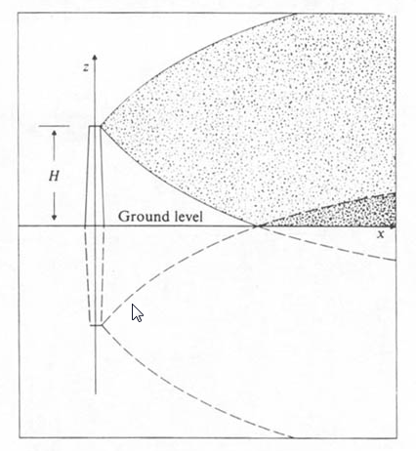
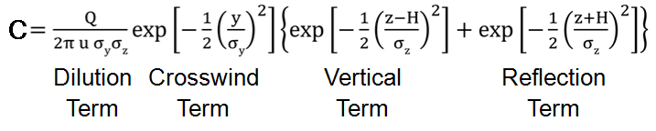
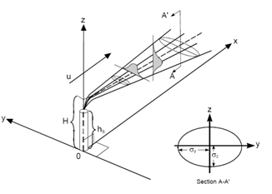
The Gaussian Equation
Where C is the concentration of the pollutant corresponding to the emissions rate (Q), wind speed (U) and plume rise (H) at a position in space x, y, z (along the wind, cross wind and vertical directions respectively).
The cross wind (σ_{y}) and vertical (σ_{z}) dispersion parameters must be determined empirically
Notes:
In this equation the first (dilution) term accounts for the dilution associated with the wind speed itself. That is, the emissions rate (given in grams/second or a similar unit) is being diluted by air travelling a wind speed U and thus the concentration within the plume is inversely proportional to the wind speed. The second (crosswind) and third (vertical )terms account for dispersion due to horizontal and vertical turbulence respectively. Horizontal turbulence is typically greater than that in the vertical direction due to atmospheric stability in the vertical direction (note that plume rise has already been considered). The exponential forms of each term arise from treating turbulence as a quasi-random process (i.e. equivalent to determining the average distance travelled from a fixed point due to a “random walk” of a fixed “step” length and a random direction for each step. The vertical coefficient is smaller because the observed “step length” is smaller for vertical movements) The last (Reflection) term accounts for the constraint of impacting (reflecting) from the surface and is modeled by considering an equivalent source at a height of –H as shown in the small figure in the upper right.

Slide 17
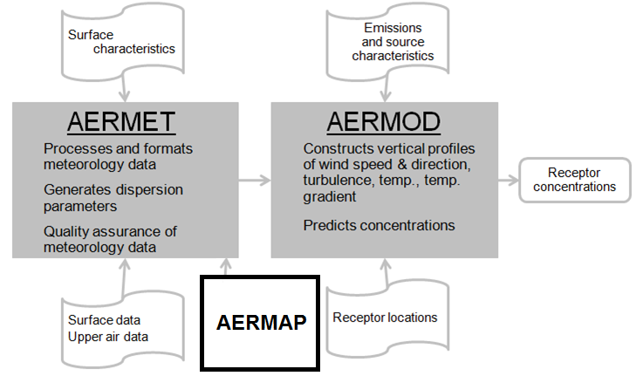
AERMOD OVERVIEW
AERMOD Components
  AERMET, a meteorological data preprocessor that incorporates air dispersion based on planetary boundary layer turbulence structure
  AERMAP processes commercially available Digital Elevation Data and creates a file suitable for use within AERMOD
  AERMOD is an advanced Gaussian plume model with improved algorithms of calculating complex plume behaviors and the influence of nearby obstacles on flows.
Developed by American Meteorological Society/EPA Regulatory Model Improvement Committee (AERMIC), AERMOD is the preferred dispersion model for U.S. EPA regulatory purposes
Notes:
AERMOD is actually a “double acronym” arising from AERMIC Model.
Developed by AMS/EPA Regulatory Model Improvement Committee (AERMIC)
Primary Features:
1) A Gaussian model that is an improved replacement of the older Industrial Source Model (ISC)
2) Uses a “Bi-Gaussian” approach in the vertical for the convective boundary layer (i.e. it uses a different assumed dispersion parameter for updrafts and down-drafts that results in a “skewed” plume movement that better simulates actual observations
3) Improved treatment of atmospheric stability
4) Improved plume theory (plume lofting, stable layer penetration, meander)
5) Better estimation of complex terrain effects
6) Allows estimation of point, area and volume sources

Slide 18
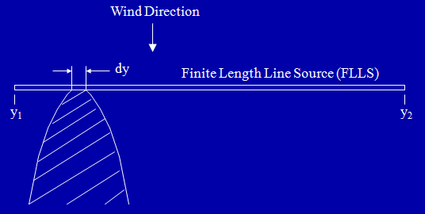

What About Line Sources Like Highways?
The Finite Length Line Source (FLLS) Approximation
  Line sources like roadways are modeled as a series of point sources separated by a distance (d_{y}) in the crosswind direction
  Note that we do not assume that the roadway is perpendicular to the wind as each “quasi point source” will have its own unique (x,y) location.
  The concentration modeled at a receptor site is the sum of the contribution for each of the “quasi point sources” that make up the roadway
Notes:
The most common point of confusion for students is in understanding the coordinate system in AERMOD is relative to the wind direction and not to a spatial grid. In its internal code AERMOD and other similar models translate the fixed physical locations relative to the source for each change in wind direction. And thus, while it may appear that the locations of source and receptor are “fixed”, in reality for computational purposes their relative positions are constantly changing.

Slide 19
What Models Can be Used for Transportation Line Sources?
AERMOD
  Point, Line, Area and Volume Sources
  Simplifications for each type
The CALINE series of models
  Older and easier to use
  Less sophisticated treatment of atmospheric stability
  CALINE 3,4 – no longer recommended
  CAL3QHC – Free flow or intersections, screening tool
  CAL3QHCR – Added strong meteorological routines to CAL3QHC
ADMS
  An advanced Gaussian model that is similar to AERMOD (from UK)
  Multiple components for various sources
    ADMS Urban
    ADMS Roads
    ADMS Airport
    ADMS Screen
There are multiple other models
  Most operate in much the same way
  Many were developed for specialized applications
Notes:
For US Applications, EPA prefers AERMOD although CAL3QHCR can also be used for regulatory purposes. A wide range of other models can also be used with approval from EPA. Most regulatory agencies outside the US have their own preferences for regulatory applications. There tends to be a much greater diversity of dispersion models than for either emissions or chemical transport models.

Slide 20
Discussion
Dispersion modeling is the crucial “intermediate step” that links emissions to predicted concentrations of pollutants at a particular location and time.
When coupled with models of human activity in space and time these predicted concentration fields can be used to estimate pollutant exposures for both individuals and for populations.
Importantly the predicted concentrations from dispersion modeling can be compared to both direct observations of pollutant concentrations and personal exposure monitoring to validate estimates of both emissions and dispersion.
Notes:
While emissions from point sources can usually be measured directly, emissions from mobile and area sources are more difficult to validate. Pollutant concentration and exposure monitoring are generally the only way to validate our modeling of both emissions and pollutant transport, chemistry and dispersion. These comparisons are difficult, especially for secondary air pollutants (e.g. ozone and some particulate matter) that are formed by atmospheric chemical processes that occur during transport, as any differences between observed and predicted concentrations could be due to errors in any of the modeled processes. Likewise, agreement between observations and predictions could be due to “cancellation of errors” among multiple models. For this reason, validation studies are normally conducted over multiple measurement sites and over significant periods of time as it is likely the natural shifts in wind speed and direction and other atmospheric parameters as well as fluctuations in traffic volumes and fleet composition at different times of day (e.g. a higher truck fraction at night) normally allows investigators to determine the degree to which predictions match observatioins.

Slide 21
Research Gaps and Future Directions
When first developed, dispersion models were often focused on estimating “average” pollutant concentrations rather than precisely determining the concentration at a particular point in space and time.
In order to improve the fidelity of these models to support more sophisticated models of human activity in urban areas these models must develop improved algorithms to deal with the complexities of both terrain and the human built environment.
As a consequence, there is an increased emphasis on directly coupling advanced emissions models with dispersion models to directly output concentration rather than emissions estimates.
Notes:
The concept of developing a system to estimate concentrations of air pollutants across an entire city with high time and spatial resolution is not a new one and has been the goal of modelers for many decades. However, the increased availability of real-time traffic and human position data as well as the vast increase in computational power available has, for the first time, made the development of such a system a reasonable objective.

Slide 22
Take Home Messages
Chemical Transport and Dispersion models convert emissions estimates into predicted concentrations of pollutants in locations where humans are active.
When coupled with estimates of human-activity these concentration measurements allow estimates of both individual and population exposures to air pollution and, ultimately, to estimated health consequences.
Future developments in these models are likely to allow a better understanding as to how the design of cities impacts human health.

Slide 23
List of Abbreviations
µg microgram
ADMS Acronym for a particular dispersion model
AERMOD Acronym for a particular dispersion model
CALINE Acronym for a particular dispersion model
CAL3QHC Acronym for a particular dispersion model
CAL3QHCR Acronym for a particular dispersion model
EPA U.S. Environmental Protection Agency
FLLS Finite length line source
km kilometer
m meter
PBL Planetary Boundary Layer
ppm parts-per-million by volume
UK United Kingdom

Slide 24
References
Burba, G.G., and Anderson, D., 2010. A Brief Practical Guide to Eddy Covariance Flux Measurements: Principles and Workflow Examples for Scientific and Industrial Applications. LI-COR Biosciences, Lincoln, USA, 211 pp.
Culverwell, I., 2013. The Calculation of Planetary Boundary Layer Heights in ROPP, ROM SAF Report 24, SAF/ROM/METO/REP/RSR/024, EUMETSAT Radio Occultation Meteorology project. Available at: https://www.romsaf.org/rsr.php
Liu, H., Xu, X., Rodgers, M.O., Xu, Y., and Guensler, R.G., 2017. MOVES-Matrix and Distributed Computing for Microscale Line Source Dispersion Analysis. Journal of the Air and Waste Management Association. DOI: 10.1080/109692247.2017.1287788.
Panofsky, H.A. and Dutton, J.A., 1984, Atmospheric Turbulence: Models and Methods for Engineering Applications, John Wiley and Sons, New York 424 pp.
Stone, B. and Rodgers, M.O., 2007, Urban Form and Thermal Efficiency: How the Design of Cities Influences the Urban Heat Island Effect. Journal of the American Planning Association, 67(2), 186-198.
von Engeln A and Teixeira J, A, 2013. Planetary Boundary Layer Height Climatology Derived from the ECMWF Reanalysis Data, Journal of Climate, 26, 6575–6590.

Slide 25
Reading List
U.S. Environmental Protection Agency, AERMOD Implementation Guide, Available at: https://www.epa.gov/scram/air-quality-dispersion-modeling-preferred-and-recommended-models#aermod
U.S. Environmental Protection Agency, CAL3QHCR Users Guide, Available at: https://www.epa.gov/scram/air-quality-dispersion-modeling-preferred-and-recommended-models#cal3qhc

Slide 26
Acknowledgements
Authors acknowledge and thank Drs. Randall Guensler (Georgia Institute of Technology), Haobing Liu (University of New Mexico) and Daijin Kim (Gangneung-Wonju National University) for assistance with materials for this presentation.

