Slide 1
www.carteeh.org

Slide 2
Lecture #36: Sensitive Subpopulations and Differential Health Effects in Sensitive Subpopulations
Georges Bou-Saab
Arcadis U.S., Inc.
Email: georges.bousaab@arcadis.com, Phone: 515-231-4525
I acknowledge that there is no conflict of interest while preparing the lecture
Lecture Track(s): HT/PPT
Notes:
Health Track (HT)—mainly targeted at urban planners, transportation planners, and engineers with limited knowledge of public health-related concepts;
Transportation Track (TT)—mainly targeted at environmental epidemiologists and public health professionals with limited knowledge of transportation-related concepts; and;
Planning and Policy Track (PPT)—mainly targeted at planners, civil servants, and policy and decision makers with particular interest in the science-policy link.

Slide 3
Introduction: Air Pollution and Health Effects
Air pollution is an environmental health hazard.
Air pollution was regarded primarily as a threat to respiratory health in 1970.
Public health concern broadened in recent years.
Air pollution is responsible for as many as 5 million premature deaths each year.
Notes:
Air pollution is a mix of hazardous substances from both human-made (vehicle emissions, power generation, fumes from chemical production, etc. ) and natural sources (ash and gases from volcanic eruptions, gases from decomposition). (National Institute of Environmental Health Sciences, 2018)
When the National Ambient Air Quality Standards were established in 1970, air pollution was regarded primarily as a threat to respiratory health. Over the next decades as air pollution research advanced, public health concern broadened to include cardiovascular disease; diabetes mellitus; obesity; and reproductive, neurological, and immune system disorders. (National Institute of Environmental Health Sciences, 2018)
Air pollution exposure is associated with oxidative stress and inflammation in human cells, which may lay a foundation for chronic diseases and cancer. In 2013, the International Agency for Research on Cancer of the World Health Organization (WHO) classified air pollution as a human carcinogen. (National Institute of Environmental Health Sciences, 2018)
Air pollution is now the biggest environmental risk for early death, responsible for as many as 5 million premature deaths each year from heart attacks, strokes, diabetes and respiratory diseases. That’s more than the deaths from AIDS, tuberculosis and malaria combined. (Environmental Defense Fund)

Slide 4
Introduction: Susceptible Population
Air pollution increases the risk of respiratory infections, heart disease and lung cancer.
Health risk from air pollution varies widely depending on age, where people live, their underlying health, and other factors.
Disproportionate effects are seen in individuals who have increased susceptibility to air pollution owing to individual- or community-level characteristics.
Notes:
Short- and long-term exposure to air pollutants have been associated with health impacts. More severe impacts affect people who are already ill. Children, the elderly and poor people are more susceptible. The most health-harmful pollutants – closely associated with excessive premature mortality – are fine PM2.5 particles that penetrate deep into lung passageways. (World Health Organization 2019)
Decades of research have shown that air pollutants such as ozone and particulate matter (PM) increase the amount and seriousness of lung and heart disease and other health problems. More investigation is needed to further understand the role poor air quality plays in causing detrimental effects to health and increased disease, especially in vulnerable populations. Children, the elderly, and people living in areas with high levels of air pollution are especially susceptible. Results from these investigations are used to support the nation's air quality standards under the Clean Air Act and contribute to improvements in public health. (United States Environmental Protection Agency 2020)
Most of the time, the amount we are exposed to is far less than the amount that can cause health problems. Some people cannot tolerate chemical exposure as well as others. We call these groups of people sensitive populations. They can include pregnant and nursing women, children, and older adults. (Agency for Toxic Substances and Diseases Registry part of the U.S. Department of Health and Human Services)
The concept of susceptibility, at both the individual and population levels, describes the characteristics that increase the risk of experiencing adverse health outcomes in response to air pollution exposure. (Hooper and Kaufman 2018)
Populations most at risk of health problems related to air pollution (Minnesota Pollution Control Agency):
People with lung diseases, such as asthma, chronic bronchitis, emphysema, and chronic obstructive pulmonary disease
Infants and young children
People who work or exercise outdoors
Adults over 65
People with a cardiovascular disease
People in poverty; people who lack access to health care
People who smoke or are exposed to second-hand smoke
People working in occupations where there is high exposure to contaminated air
People who spend a lot of time near busy roadways
Sensitive subpopulation refers to a smaller group within the general population that are particularly sensitive to certain exposures. In this presentation, we focus on children, elderly, pregnant women and lower socioeconomic class populations.
Children: Persons 2-12 years of age (Infants are persons <2 years of age, and adolescents are persons >12 years of age)
Elderly: Persons 65+ years of age
Pregnant women: pregnancy is the period from conception to birth when a woman carries a developing fetus in her uterus
Lower socioeconomic classes: Persons with low income or wealth. Low socioeconomic class typically correlates with low educational achievement, poverty, and poor health. (American Psychological Association, 2017)
(Note: These categories are NOT mutually exclusive. A person may fall under multiple “sensitive subpopulation” categories. For example, an asthmatic child may also be of low socioeconomic class.)
Why is it important to understand and consider sensitive subpopulations?
Sensitive subpopulations are more vulnerable to air pollution and its associated health effects than the general population. Sensitive populations are also disproportionately affected. For example, low socioeconomic class communities are disproportionately exposed to air pollution (Schweitzer and Valenzuela, 2004) meaning they experience greater exposure to air pollution compared to other populations.
Globally, 93% of all children live in environments with air pollution levels above the World Health Organizations (WHO) guidelines
Globally, the proportion of older persons aged 80 years or over (the oldest old) within the elderly population was 14% in 2013 and is projected to reach 19% in 2050. If this projection holds true, there will be 392 million persons aged 80 years or over by 2050, more than three times the present (Department of Economic and Social Affairs Population Division, 2013)
Important to understand these subpopulations from research, policy, and practice perspectives:
Research – can quantify exposures/health impacts/financial impacts for sensitive subpopulations; can also research the potential impacts of new, emerging technologies (e.g. what are the benefits and harms of autonomous vehicles on the elderly population?).
Policy – can implement policies and programs aimed to help sensitive subpopulations by reducing harmful exposures, improving health outcomes, etc.
Practice – can understand how to best advise and treat sensitive subpopulations.

Slide 5
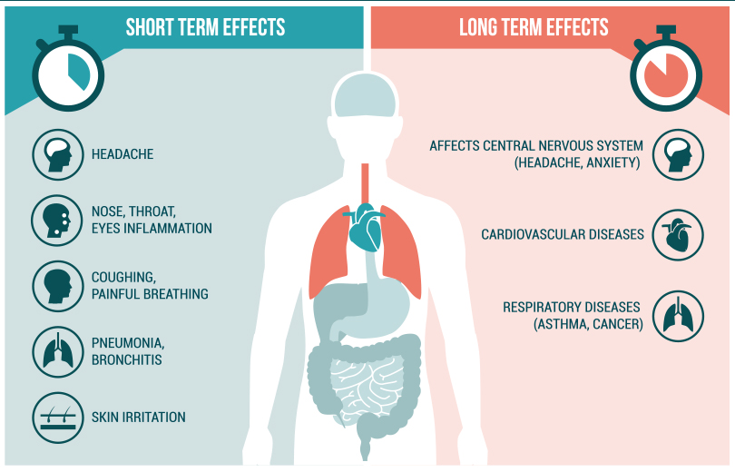
How Air Pollution Impacts Our Health?
Source: Lal PathLabs, 2018
Notes:
Respiratory Disease (National Institute of Environmental Health Sciences, 2018):
Air pollution can affect lung development and is implicated in the development of emphysema, asthma, and other respiratory diseases, such as chronic obstructive pulmonary disease (COPD).
PM and nitrogen oxide are linked to chronic bronchitis.
Cardiovascular Disease (National Institute of Environmental Health Sciences, 2018):
Fine particulate matter can impair blood vessel function and speed up calcification in arteries.
NIEHS researchers established links between short-term daily exposure by post-menopausal women to nitrogen oxides and increased risk of hemorrhagic stroke.
For a cross-section of older Americans, exposure to TRAP can result in lowered levels of high-density lipoprotein, sometimes called good cholesterol, increasing their risk for cardiovascular disease.
According to a National Toxicology Program (NTP) report, TRAP exposure also increases a pregnant woman’s risk for dangerous changes in blood pressure, known as hypertensive disorders, which are a leading cause of pre-term birth, low birth weight, and maternal and fetal illness and death.
Cancer (National Institute of Environmental Health Sciences, 2018):
A large study of more than 57,000 women found living near major roadways may increase a woman’s risk for breast cancer.
The NIEHS Sister Study found other airborne toxic substances, especially methylene chloride, which is used in aerosol products and paint removers, are also associated with increased risk of breast cancer.
Occupational exposure to benzene, an industrial chemical and component of gasoline, can cause leukemia and is associated with non-Hodgkin’s Lymphoma.
A long-term study, 2000-2016, found an association between lung cancer incidence and increased reliance on coal for energy generation.

Slide 6






Identifying Sensitive Populations
Biological Factors
Clinical Factors
Socioeconomic Factors
Lifestyle Factors
Cultural Factors
Environmental Factors
Notes:
There are intrinsic characteristics that increase risk. These characteristics might include not only the presence of underlying disease, age, and genetic background but also sex, race, ethnicity, epigenetic changes, socioeconomic position, nutritional status, and personal behaviors. Some elements of these susceptibility characteristics are dynamic over an individual’s lifetime. Coupled with variability in air pollution exposures, the risk assessment for an individual may be fluid and vary substantially over the course of the individual’s life. (Hooper and Kaufman 2018)
Factors to consider when identifying sensitive populations: biological, clinical, socioeconomic, lifestyle, and environmental (American Lung Association, 2001):
Biological factors include genetics, age, gender, and race/ethnicity
Clinical factors include pre-existing conditions which may be acute (short-term) or chronic (long-term) illness
Socioeconomic factors include income, education level, and occupation
Lifestyle factors include diet, smoking, alcohol, and physical activity
Cultural factors include: religion, beliefs, perceptions
Environmental factors include external physical, chemical, and biological factors (https://www.healthypeople.gov/2020/topics-objectives/topic/environmental-health#one)

Slide 7

Differential Health Effects in Children
Children are more sensitive to chemical exposure than adults.
Higher air pollution levels increase short-term respiratory infections.
Outdoor activity, living in high ozone areas and busy roads increases the risk of developing asthma.
Living in communities with higher pollution levels can cause lung damage.
Notes:
Children are particularly vulnerable to air pollution, especially during their development. (Manisalidis et al., 2020)
Children with asthma who were exposed to high levels of air pollutants were more likely to develop bronchitis symptoms. (National Institute of Environmental Health Sciences, 2021)
Breathing PM 2.5, even at relatively low levels, may alter the size of a child's developing brain, which may ultimately increase the risk for cognitive and emotional problems later in adolescence. (National Institute of Environmental Health Sciences, 2018)
Prenatal exposure to PAHs was associated with brain development effects, slower processing speed, attention-deficit and hyperactivity disorder (ADHD) symptoms, and other neurobehavioral problems in urban youth. (National Institute of Environmental Health Sciences, 2018)
In New York City, prenatal exposure to air pollution may play a role in childhood ADHD-related behavior problems. (National Institute of Environmental Health Sciences, 2018)
In Marietta, Ohio, home to a ferromanganese refinery, manganese concentrations in blood and hair, a biomarker of air pollution exposure, were associated with lower child IQ scores. (National Institute of Environmental Health Sciences, 2018)
Young females are at higher risk than young males for an increased rate of respiratory symptoms, a diminished level of lung function and a greater asthma medication use due to air pollution. Furthermore, young female asthmatics have a higher risk of air pollution effects than young female non-asthmatics. (Annesi-Maesano et al., 2003)

Slide 8
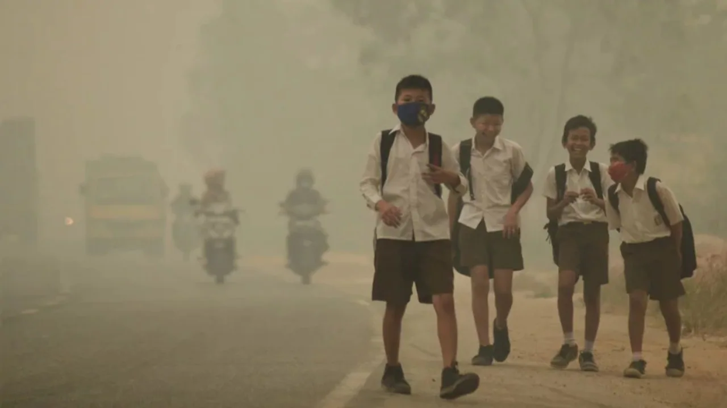
Reasons for Differential Health Effects in Children
Children are closer to the ground.
Chemicals may pass to a child when breast-feeding.
Their body is generating new tissue.
Source: Firstpost News, 2019
Notes:
Children breathe more than adults and are more sensitive to pollution. Their air passages are narrower, so it takes less inflammation or irritation to obstruct their airways. Children typically spend more time outdoors and are more active than adults. They also are more likely to have asthma or other respiratory illnesses, which are aggravated by air pollution. (Spare the Air Organization, 2019)
Children are more likely to breathe dust and some vapors because they are closer to the ground. (Agency for Toxic Substances and Diseases Registry part of the U.S. Department of Health and Human Services)
During the teenage years, the body is creating new tissue, particularly in the reproductive system. These tissues are especially sensitive to exposure to chemical substances. (Agency for Toxic Substances and Diseases Registry part of the U.S. Department of Health and Human Services)

Slide 9

Differential Health Effects in Elderly
Older adults with diabetes, heart or lung disease are at greater risk.
Older adults have a greater chance of developing several neurological disorders.
Long-term exposure to transportation related air pollution may accelerate physical disabilities.
PM 2.5 air pollution is also associated with accelerated memory problems.
Notes:
Older adults may have heart or lung disease or diabetes that puts them at greater risk. People with diabetes are at increased risk in part because they also have a higher risk of underlying cardiovascular disease. (Spare the Air Organization, 2019)
Air pollution was linked to a greater chance of developing several neurological disorders, including Parkinson's disease, Alzheimer's disease, and other dementias. Hospital admissions data from 63 million older adults in the U.S., obtained over 17 years (2000-2016), was analyzed along with estimated PM 2.5 concentrations by zip code to conduct the study. (National Institute of Environmental Health Sciences, 2018)
In older adults, long-term exposure to TRAP may significantly hasten physical disabilities. The risk is more pronounced among racial minorities and lower-income people. (National Institute of Environmental Health Sciences, 2018)
PM 2.5 air pollution is also associated with accelerated memory problems and Alzheimer’s-like brain declines, which was seen among women 65 years of age and older. (National Institute of Environmental Health Sciences, 2018)
Nutrients may counter some harmful effects from air pollution. A 2020 study found omega-3 fatty acids, obtained by eating certain fish, may protect against PM 2.5-associated brain shrinkage in older women. (National Institute of Environmental Health Sciences, 2018)
In 2016, a study published in The Lancet found that long-term exposure to air pollution contributes to the progression of heart disease by accelerating atherosclerosis, a major cause of heart attack and stroke. Older adults and those with hypertension are the most vulnerable to these health effects. (Kaufman et al., 2016)
In a review published in the Journal of Alzheimer's Disease, investigators analyzed 13 papers addressing airborne pollutants and dementia, and concluded that “evidence is emerging that greater exposure to airborne pollutants is associated with increased risk of dementia.“ (Ruth et al., 2019)

Slide 10
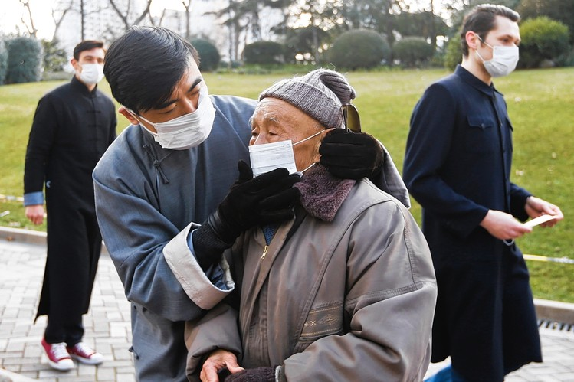
Reasons for Different Health Effects in Elderly
Chronic or other pre-existing disease
Decreased lung function
Old age
Source: Wall Street Journal, 2013
Notes:
Older adults may be sensitive to chemical exposure because (Agency for Toxic Substances and Diseases Registry part of the U.S. Department of Health and Human Services):
Their immune systems are often weaker
They tend to have more sensitive lungs, making fighting off health effects from breathing contaminants harder
They may socialize less and, therefore, be less aware of environmental emergencies
They may have trouble moving to a safer place if a spill or chemical release happens
They may suffer from poor nutrition, due to lack of appetite or less interest in cooking, which can impact the immune system

Slide 11
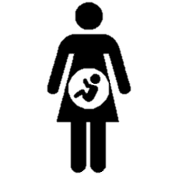
Differential Health Effects in Pregnant Women
Living in polluted areas increases the risk of preterm labor.
Correlation between exposure to air pollution and stillbirth.
Development of babies in the womb can be disrupted due to air pollution exposure.
Higher risk of pregnancy-related complications in the parent.
Notes:
Preterm labor increases the risk of other problems, such as low birth weight, underdeveloped lungs in the baby, and death of the baby during or shortly after birth. One study assessed the effects of common pollutants, such as ozone, sulfur dioxide, nitrogen oxide, and nitrogen dioxide. It found a correlation between air pollution and preterm labor. The risk was highest during a subsequent pregnancy. (Mendola et al., 2019)
A study in 2018 established a correlation between exposure to air pollution and stillbirth. The risk was highest during the third trimester of pregnancy. (Yang et al., 2018)
Low birth weight is a risk factor for developmental delays, numerous health issues, and death after birth. An analysis of 14 population-level studies found that a higher prevalence of certain pollutants, such as nitrogen dioxide, correlated with a higher risk of low birth weight. (Pedersen et al., 2013)
A study of birth outcomes in Allegheny County, PA, found that exposure to air pollution in the first trimester increased the risk of preeclampsia and high blood pressure. These complications can harm the parent and the baby, and this may necessitate an early birth. (Lee et al., 2013)
NIEHS-funded researchers from the University of California, Davis, Environmental Health Sciences Center are conducting the Bio-Specimen and Fire Effects (B-SAFE) Study. This ongoing project seeks to discover if and how recent wildfires and their smoke affected pregnant women and their babies. Begun in 2017, study participants are pregnant women who were living in Northern California when the 2018, 2019, or 2020 wildfires occurred there. (National Institute of Environmental Health Sciences, 2018)
Prenatal exposure to particulate matter was associated with low birth weight. (National Institute of Environmental Health Sciences, 2018)
Women exposed to high levels of fine particulate matter during pregnancy, particularly in the third trimester, may have up to twice the risk of having a child with autism. (National Institute of Environmental Health Sciences, 2018)
Second and third trimester exposure to PM 2.5 might increase the chance of those children having high blood pressure in early life. (National Institute of Environmental Health Sciences, 2018)
In California’s agricultural San Joaquin Valley, women who were exposed to high levels of carbon monoxide, nitrogen oxide, or nitrogen dioxide during their first 8 weeks of pregnancy were more likely to have a baby with neural tube defects. (National Institute of Environmental Health Sciences, 2018)

Slide 12
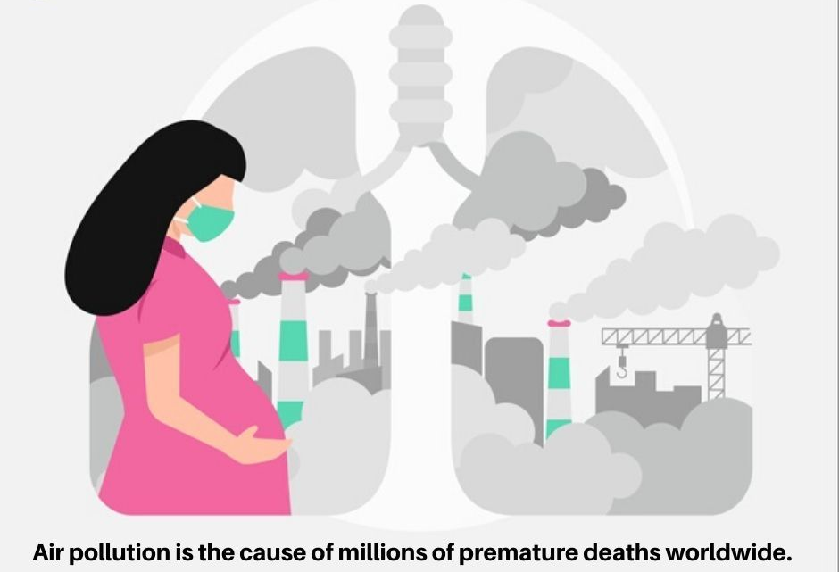
Reasons for Different Health Effects in Pregnant Women
Immune system working more than usual.
Substances pass through nutrients in womb and breast milk.
Source: Progenesis Fertility Center
Notes:
Pregnant and nursing women are especially sensitive to chemicals because (Agency for Toxic Substances and Diseases Registry part of the U.S. Department of Health and Human Services):
During pregnancy, a woman’s immune system has to work harder to protect both the mother and the baby. Exposure can affect the health of the unborn baby.
Anything the mother eats, drinks, or absorbs into her body while pregnant may affect her baby’s development and growth.
If breastfeeding, a mother can pass substances to her baby through her breast milk.

Slide 13

Differential Health Effects in Low Socioeconomic Class
Poverty exposes people to various stressors. Children in underserved communities are most vulnerable.
Higher exposure to PM2.5 in disadvantaged communities which increases risk of cardiovascular disease.
Infants in low socioeconomic communities are at an increased risk to die from air pollution.
Notes:
The concept of environmental injustice recognizes how underserved communities often suffer from higher air pollution concentrations in addition to other underlying risk factors for impaired health. This exposure then exerts larger effects on their health than it does in the average population, affecting the whole body, including the lungs and the brain. Children, whose organs and mind are still developing and who do not have the means of protecting themselves or creating change, are the most vulnerable to the detrimental effects of air pollution and environmental injustice. The adverse health effects of air pollution and environmental injustice can harm children well into adulthood and may even have transgenerational effects. (Mathiarasan and Huls, 2021)
Recent research suggests that neighborhood-level socioeconomic status may modify the health effects of particulate air pollution exposure. Living in socioeconomically disadvantaged communities appears to interact with PM2.5 exposure and synergistically increase the risk of cardiovascular disease. (Hooper and Kaufman, 2018)
Neighborhood-level socioeconomic status may modify the health effects of particulate air pollution exposure. Living in socioeconomically disadvantaged communities appears to interact with PM2.5 exposure and synergistically increase the risk of cardiovascular disease. This is consistent with earlier findings that living in a disadvantaged neighborhood is an independent risk factor for coronary artery disease, even after controlling for traditional coronary artery disease risk factors and independent markers of socioeconomic status, including income, occupation, and education. (Hooper and Kaufman, 2018)
In the US, evidence supports that many (but not all) low social economic status (SES) communities bear a disproportionate burden of air pollution. For these communities, it is plausible that differential exposure to air pollution may be a contributor to higher associations between air pollution and health than seen in better-off populations. In some European studies, however, higher air pollution concentrations were found among higher SES populations, but the health effects of air pollution were still distributed disproportionately among the poor. The observation that communities where high SES groups live have higher concentrations of air pollution does not necessarily mean that the residents are more exposed. (Hajat et al., 2016)
Disparities in NO2 exposure were larger by race-ethnicity than by other demographic characteristics (income, education, age) in 2000 and 2010, with higher exposures for race-ethnicity minorities. The estimated national mean nonwhite–white NO2 disparity decreased from 5.0 ppb in 2000 to 2.9 ppb in 2010. Most of this reduction in the national mean nonwhite–white NO2 disparity over time is attributable to reductions in outdoor NO2 concentrations, suggesting that existing efforts to reduce TRAP are also reducing TRAP exposure disparities by race-ethnicity over time. Despite these improvements in absolute exposures, relative exposure disparities persisted, with nonwhites remaining exposed to 37% more NO2 than whites on average in 2010, and 2.5 times more likely than whites to live in a block group with NO2 concentration above WHO guidelines in 2010. Overall, these findings suggest that continued improvements to air quality may further reduce TRAP exposure disparities by race-ethnicity. However, eliminating disparities may require additional policies and interventions that target the underlying causes of environmental injustice. (Clark et al., 2017)

Slide 14
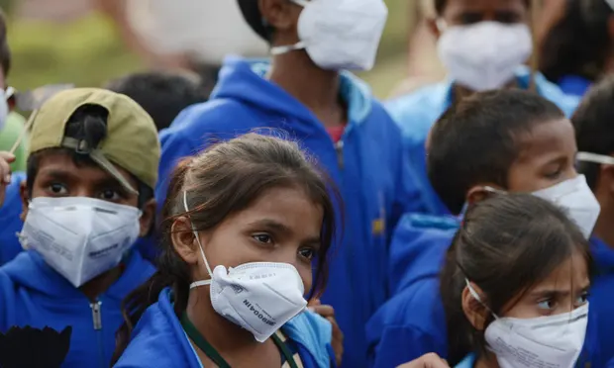
Reasons for Different Health Effects in Low Socioeconomic Class
Higher exposure to air pollutants.
Typically have poor baseline health status.
Limited access to health resources.
Source: The Guardian, 2018
Notes:
Apart from preexisting diseases and intrinsic factors such as age, ethnicity, race, genetic background, and sex, socioeconomic determinants contribute to the effects of air pollution on health. Individuals at the lowest end of the socioeconomic spectrum are burdened by the so-called triple jeopardy of environmental injustice; they are exposed to higher levels of air pollutants, have a susceptibility to poorer baseline health status, and lack access to the resources to cope with pollution threats. (Hooper and Kaufman, 2018)
Socioeconomic status is known to covary with the spatial distribution of air pollution, with poorer communities experiencing higher pollution exposure. This is compounded by the higher prevalence of preexisting disease that is linked to food insecurity, psychosocial stressors, built environments not conducive to health-promoting behaviors, educational disadvantage, and reduced access to medical care. This confluence of circumstances suggests that low socioeconomic status is best characterized as a state of increased susceptibility and vulnerability. (Hooper and Kaufman, 2018)
High social economic status individuals have access to more resources that can protect them from increased exposure, such as private transportation versus public, indoor versus outdoor work environments, better constructed housing and potentially, access to climate control, including filtration, for indoor environments. (Hajat et al., 2015)
It has been hypothesized that low social economic status (SES) communities with limited political power and influence are unable to stop locally undesirably land uses (LULU), such as factories and roads, from being built in their communities. That is, poor communities lack social capital, a prerequisite for mounting an effective campaign against placing a LULU in one’s community. On the other hand, it has been suggested that industry is motivated solely by economic factors: building a LULU on cheap land is economically prudent. The presence of a LULU will then result in the decline in property values which makes an area more accessible for low SES and minority populations. Both of these theories point to the importance of class- and race-based residential segregation in creating inequality in air pollution concentrations across space. It should be noted that much of the research about causes of environmental inequalities has focused on the U.S. context. Given the importance of historical, economic and social contexts in understanding inequality, other nations may have very different explanations for why environmental inequalities exist. (Hajat et al., 2015)
Deaths proximally caused by air pollution are more common on hot days that already stress an older or younger body. So economically disadvantaged people who cannot afford air conditioning, for instance, are more vulnerable. They may be exposed to more heat or even more pollution if they open a window to cool off. In general, poverty exposes people to various stressors, such as polluted water, that increase pollution susceptibility. (MacDonald, 2018)
Many aspects of a child’s physical health can be affected by their socioeconomic status. In addition, low socioeconomic status can also affect a child’s emotional and mental health, as they may face discrimination which could add to the stress that they feel. The lack of mental health resources could increase the chances of developing mental health issues and social and psychological stress are associated with increased oxidative stress levels in the body. Proper nutrition and sleep could combat oxidative stress; however, children of lower socioeconomic status are less likely to receive proper nutrition and they can develop sleep problems due to many different factors, including air pollution. Other social determinants, such as race, are associated with lower socioeconomic status and can affect children’s health. Socioeconomic status and race are closely tied together, and they account for the disproportionate levels of disease in populations of color and many of the disparities in access to healthcare due to racism. The lack of access to healthcare as well as a lack of adequate care for people of color can create many negative health outcomes, such as higher rates of morbidity and mortality. Children of lower socioeconomic status can face disadvantages, due to many other reasons and social determinants. These issues can compound to create many different detrimental health effects in their future. (Mathiarasan and Huls, 2021)

Slide 15

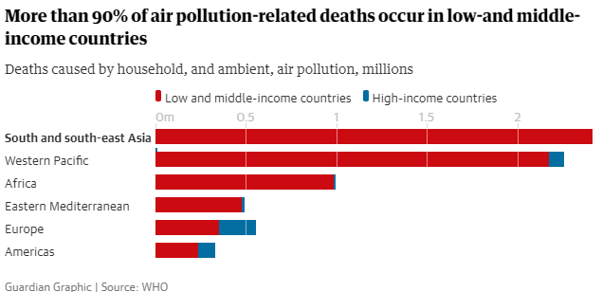
Example 1: Air pollution inequality widens between rich and poor nations
Notes:
Article by Jonathan Watts, Global Environment Editor at The Guardian, 2018:
https://www.theguardian.com/environment/2018/may/01/air-pollution-inequality-widens-between-rich-and-poor-nations

Slide 16

Example 2: Polluted air killing half a million babies a year across globe
Notes:
Article by Fiona Harvey, an Environment Correspondent at The Guardian, 2020:
https://www.theguardian.com/environment/2020/oct/21/polluted-air-killing-half-a-million-babies-a-year-across-globe#:~:text=At%20least%206.7%20million%20deaths,below%20smoking%20and%20poor%20diet.

Slide 17
Use in Policy Decision Making
Reducing emissions to control health effects is everyone’s responsibility:
  National governments
  Cities and local communities
  Individuals
Notes:
Ambient Air Pollution and Clinical Implications for Susceptible Populations - Hooper and Kaufman, 2018:
Abundant evidence supports the relationship between reductions in air pollution and improved health outcomes, including reductions in mortality. Regulations that target emission reductions are the mainstay of current efforts to curb the health effects of air pollution. The singular importance of government-level policies to limit emissions and reduce exposures for the population at large is indisputable. However, given the broad spectrum of susceptible subgroups with ubiquitous ambient pollution exposure, a framework is needed that incorporates individual- and community-level strategies for harm reduction. Such a framework would acknowledge the primary role of government-level regulatory policies with community and individual measures seen as complementary but not sufficient.
Government-Level Policies
With the passage of the Clean Air Act and the subsequent implementation of National Ambient Air Quality Standards, aggregate emission of and population exposure to criteria pollutants in the United States have declined dramatically despite population and economic growth over the same period. Current emission reduction policies regulate existing energy production processes while promoting cleaner fuel sources and energy technologies.
Efforts to address climate change represent an important opportunity for simultaneously reducing key sources of air pollution. Measures to reduce air pollution and limit climate change exist in overlapping spheres. Fossil fuel combustion is the primary source of both greenhouse gas emissions and the air pollutants most strongly linked to adverse health outcomes, particulates, oxides of nitrogen, and SO2. Action to slow climate change will have ancillary public health benefits derived from reductions in air pollution, with the reverse also being true: two sides of the same coin. For many, the future benefits of reducing climate impacts may resonate less than the near-term personal health gains that will be achieved with air pollution reduction. Opinion leaders and policymakers need to understand the short- and long-term public health co-benefits associated with policies designed to reduce emissions from fossil fuel combustion, both to address the public’s concerns and to achieve improved public health.
Community-Level Interventions
Concurrent with broader efforts to reduce emissions, rethinking land use could reduce air pollution exposures for particularly susceptible populations. Typical urban design tends to locate residential developments and key community resources (i.e., schools, hospitals) along transit corridors. This has the net effect of collocating the primary sources of traffic-related air pollution and the populations with increased susceptibility to air pollution health effects. The State of California, a national leader in air quality initiatives, has made formal distance recommendations for the siting of sensitive land uses such as healthcare facilities, daycare centers, schools, and playgrounds. Forethought in city planning exercises that incorporate knowledge of exposure sources (i.e., transit corridors and railway yards) and community susceptibility profiles might promote physical separation of susceptible subpopulations from pollution sources.
Smarter urban planning relies on balancing the relative benefits and hazards of active travel (e.g., walking, cycling) with increased urban density and traffic-related pollution exposure. Minimizing sprawl to decrease vehicle travel dependence must be evaluated in the context of increasing urban density whereby active travel tends to locate in close proximity to high-traffic streets. Physical activity remains a mainstay of the recommendations to improve public health. For the general population, except in the most extreme circumstances of high levels of ambient pollution, the benefits of physical activity seem to outweigh the health risks related to pollution exposure (36). It is unknown where the risk–benefit balance lies for the most susceptible subgroups; however, urban planning efforts that increase walkability and endeavor to reduce traffic-related pollution through improved public transportation will undoubtedly benefit communities as a whole.
Individual Measures
Individual interventions are not the primary solution, but certain highly susceptible subgroups may benefit from short-term personal risk reduction measures. In China, where average pollution levels routinely exceed the World Health Organization’s recommendations, members of the general populace routinely turn to face masks to filter the polluted air. Particulate respirators designed to filter 95% of particulates may reduce the health effects of urban pollution. However, ineffective and flimsy surgical-style masks are perhaps the most widely used as a result of availability, knowledge gaps, and cost. This highlights a key challenge of shifting responsibility to the individual; personal harm reduction measures that require knowledge and resources may have reduced efficacy when implemented in the most vulnerable populations.
Evidence suggests that indoor particulate matter concentrations, from both indoor and outdoor sources, can be decreased by the use of high-efficiency air cleaners and confer potential health benefits. It is premature to recommend air cleaners as a strategy to reduce air pollution health effects in the general population, and the cost-to-benefit ratio is unlikely to be favorable in this broad context. However, for the most susceptible subgroups and the most polluted areas, it is reasonable to conclude that the potential benefit of this low-risk and relatively low-cost intervention favors early adoption rather than waiting for definitive data.
Borne out of the mechanistic literature, dietary and pharmacologic interventions to modify the health effects of air pollution exposure are intriguing but inconclusive. Inhalation of air pollutants triggers a local and systemic inflammatory cascade. Statins have been investigated in animal models and may attenuate the inflammatory effects of particulates, but evidence in humans is limited. Similarly, supplementation with dietary antioxidants has shown mixed results in attenuating the vascular effects of PM2.5 and diesel exhaust exposure.
Although outdoor exercise is overwhelmingly encouraged because of its known health benefits, short-term episodes of high pollution can challenge the clinician to provide evidence-based guidance on limiting outdoor activity. The Air Quality Index is a standardized measure of air quality based on the Environmental Protection Agency’s National Ambient Air Quality Standards. As a tool, the index is imperfect but clinically useful because it takes into account the potential health effects of daily pollution levels on increasingly vulnerable subgroups in the general population. More data are needed to risk stratify various susceptible subgroups and tailor their appropriate response to peak pollution days.
What can citizens do to protect themselves? World Health Organization, 2019
Fighting air pollution is everybody’s responsibility. We all need to do more, a lot more. Swiftly and proactively to reduce air pollution. Concerted and coordinated efforts with active involvement of all the sectors is imperative. This includes the Government (national, state and local governments), cities, community at large and individuals.
To national governments: reduce emissions and set national standards that meet WHO air quality guidelines. Invest in research and education around clean air and pollution – they are an essential tool.
To cities and local communities: Public policies across sectors must factor in public health from the beginning, followed up with sufficient data and tools to assess them.
To individuals: Continue to stand up for your right to healthy and sustainable environments. Hold your governments accountable.
All of us – in government, business, and individual – we are all accountable. Think and rethink, about the way you live and consume and make sustainable choices for yourself, your children and your children’s children.

Slide 18
Discussion
Air pollution can lead to respiratory and cardiovascular diseases as well as cancer.
Air pollution mostly impacts children, pregnant women, older adults. Low socioeconomic status and pre-existing health conditions.
There is a need for governments, municipalities and citizens to work together to improve air quality.
Notes:
Evidence indicates that the risk of fine particle-related health effects varies throughout a lifetime. Risk is generally higher during childhood, lower in young adulthood, and greater in middle age through old age as the incidence of heart and lung disease, hypertension, and diabetes increases. Therefore, certain life stages (e.g., children, older adults) and populations (e.g., people with pre-existing respiratory and cardiovascular disease) should be particularly diligent about limiting exposure to wildfire smoke. (U.S. EPA, 2019)
Susceptible or at-risk population include (U.S. EPA, 2019):
People with asthma and other respiratory diseases: Rationale - Underlying respiratory diseases result in compromised health status that can result in the triggering of severe respiratory responses by environmental irritants. Potential health effects - Breathing difficulties (e.g., coughing, wheezing, and chest tightness) and exacerbations of chronic lung diseases (e.g., asthma and COPD), leading to increased medication usage, emergency department visits, and hospital admissions.
People with cardiovascular disease: Rationale - Underlying circulatory diseases result in compromised health status that can result in the triggering of severe cardiovascular events by environmental irritants. Potential health effects - Triggering of ischemic events, such as angina pectoris, heart attacks, and stroke; worsening of heart failure; or abnormal heart rhythms could lead to emergency department visits, hospital admissions, and even death.
Children (< 18 years of age): Rationale - Children’s lungs are still developing, and there is a greater likelihood of increased exposure to wildfire smoke resulting from more time spent outdoors, engagement in more vigorous activity, and inhalation of more air per pound of body weight compared to adults. Potential health effects - Coughing, wheezing, difficulty breathing, chest tightness, decreased lung function in all children. In children with asthma, worsening of asthma symptoms or heightened risk of asthma attacks may occur.
Pregnant women: Rationale - Pregnancy-related physiologic changes (e.g., increased breathing rates) may increase vulnerability to environmental exposures. In addition, during critical development periods, the fetus may experience increased vulnerability to these exposures. Potential health effects - Limited evidence shows air pollution-related effects on pregnant women and the developing fetus, including low birth weight and preterm birth.
Older adults: Rationale - Higher prevalence of pre-existing lung and heart disease and decline of physiologic process, such as defense mechanisms. Potential health effects - Exacerbation of heart and lung diseases can lead to emergency department visits, hospital admissions, and even death.
Low socioeconomic status: Rationale - Less access to health care, could lead to higher likelihood of untreated or insufficient treatment of underlying health conditions (e.g., asthma, diabetes), and greater exposure to wildfire smoke resulting from less access to measures to reduce exposure (e.g., air conditioning). Potential health effects - Greater exposure air pollution resulting from less access to measures to reduce exposure, along with higher likelihood of untreated or insufficiently treated health conditions could lead to increased risks of experiencing the health effects.
Many communities throughout the United States face challenges in providing advice to residents about how best to protect their health when they are exposed to elevated concentrations of air pollutants from motor vehicle and industrial emissions and other sources of combustion, including wildland fire smoke. Researchers are studying intervention strategies to reduce the health impacts from exposure to air pollution as well as ways to effectively communicate these health risks. To translate the science for use in public health communication and community empowerment, EPA is collaborating with other federal agencies, such as the Centers for Disease Control and Prevention (CDC) and the National Heart, Lung, and Blood Institute (NHLBI), and state and local agencies and tribes. The objectives are to identify ways to lower air pollution exposure or mitigate the biological responses at individual, community or ecosystem levels, and ultimately evaluate whether such interventions have benefits as measured by indicators of health, well-being or economics. Studies are evaluating the interactions between behavior and social and economic factors to more thoroughly understand how these factors may influence health and well-being outcomes, which can inform effective and consistent health risk messaging. (U.S. EPA, 2020)

Slide 19
Research Gaps and Future Directions
Important to study the impact of contributing factors of air pollution on health at the individual level.
Bridge the gap between studies on short-term and long-term effects of air pollution with appropriate epidemiological studies.
Examine changes in inequality overtime to understand if unequal distribution of air pollution is widening or narrowing.
More research needed to better understand how to protect susceptible population from air pollution.
Notes:
The data for individual-level interventions provide insufficient evidence to support guideline-quality recommendations. However, for certain susceptible subgroups, the question for the scientific community is what degree of certainty is required before reasonable exposure mitigation strategies should be endorsed? The lung transplant population provides an instructive example. The societal investment in prolonging survival in this population is substantial. Lung transplant recipients are susceptible to environmental pollutants, and the current state of the science would suggest that in-home air purifiers reduce pollutant concentrations, but data supporting this intervention in this population do not exist. In this unique population, an intervention with a favorable risk–reward relationship is a prudent recommendation even in the absence of trial-supported care guidelines. More widely prevalent lung diseases may also benefit from similar recommendations based on imperfect but suggestive evidence. However, recommending interventions on the basis of imperfect evidence must be approached with caution if applied more broadly to increasingly less susceptible populations who may experience diminishing benefits relative to the personal burden of adopting the intervention. (Hooper and Kaufman, 2018)
Successful national efforts to reduce air pollution levels are generating important public health gains. However, it is unknown how deleterious to the lungs are the lower concentrations of pollutants now typical in North America: Is there a threshold level below which respiratory health effects will not occur? For the most vulnerable groups, it is conceivable that such a threshold - if present - is below the current level of regulatory concern. As the evidence builds for a causal relationship between air pollution exposure and harmful respiratory health effects, data supporting specific intervention strategies are still needed, particularly for the most susceptible groups. Identifying and prioritizing these susceptible communities to guide clinician and public health practitioner recommendations should be a focus of future research. (Hooper and Kaufman, 2018)
The mechanisms by which community-level disadvantages may increase susceptibility to particulate air pollution health effects need further study. Theories include food scarcity, leading to reduced antioxidant intake; limited access to medical care, including preventive services; and exposure to pollutants. This area of research challenges the traditional view attributing increased susceptibility to specific intrinsic or acquired individual factors and suggests that recognition of exposure to disadvantaged socioeconomic circumstances may identify broader subgroups with elevated susceptibility to air pollution’s harmful effects. (Hooper and Kaufman, 2018)
Several open research areas and knowledge gaps exist. First, very few studies have examined changes in inequality over time. Since levels of air pollution have declined over time, particularly in North America, it is of interest to understand if the unequal distribution of air pollution is widening or narrowing. Specifically, as air pollution policies and regulations (both related and unrelated to inequality) are put into place, it is important to understand if these policies impact inequality. Another policy relevant issue is that of which sources or components are most unequally distributed. Although a few studies have begun to examine this question, inequalities may be driven by local sources of pollution, thus necessitating more research. Finally, although this review did not specifically address race/ethnicity, understanding how these factors relate to socioeconomic factors in terms of location-based variability in air pollution concentrations is important for environmental justice (Hajat et al., 2015)
More research is needed in order to effectively recommend what steps must be taken to better protect marginalized communities from the effects of air pollution. Large projects, like the PINCHE project, have been funded in Europe; however, these projects do not take sociocultural factors, such as socioeconomic status, into consideration. Socioeconomic status is also not the only social determinant that can affect health. Intersectional research on aspects, like gender and race, must also be done to better understand and help marginalized populations and their unique circumstances. Action must be taken through an interdisciplinary approach that combats air pollution and environmental injustice in order to ensure the health and safety of future generations. (Mathiarasan and Huls, 2021)
The bulk of the observational studies carried out on the health effects of air pollution have considered large populations in order to detect small relative risks associated with exposure to air pollutants. However, to determine the relevant social, biological, physiological and clinical characteristics that increase the risk of pollution-related health effects requires detailed information at the individual level that are difficult to find. It is also the time to bridge the gap between studies on short-term and long-term effects of air pollution with appropriate epidemiological studies, which include among others: 1) The cohort approach, in which a large data set (including disease registries) are explored to enroll patients with specific characteristics or conditions to be followed in a prospective study. Various outcomes can then be evaluated in relation to the changes (short-term or long-term) of air pollution as long as there are complete ascertainment procedures (e.g. biological parameters, mediations). This approach permits the evaluation of the size of the risk in the “diseased population” in comparison to the general one, as well as the study of further specific characteristics of the subjects within the frail group. The cohort approach is also the first step in order to evaluate survival of patients in relation to air pollution exposure. 2) A new and elegant study design, the case-crossover approach, originally developed to study triggers of myocardial infarction, has recently been applied to air pollution epidemiology. In the study, each subject is their own control during a relevant reference period. The design, in particular the time-stratified approach 15, offers unbiased estimates of the association. The case-crossover approach seems to be particularly suitable to explore the characteristics of the subjects and the susceptibility factors when it is nested within a cohort. The possibility to explore several outcome entities is counterbalanced by loss in statistical power. These designs will allow the role played by sex/“gender” in human susceptibility to be investigated. (Annesi-Maesano et al., 2003)

Slide 20
Take-Home Messages
Susceptible populations experience greater risks of adverse health effects from air pollution.
Several factors contribute to differential health effects.
Important to study the impact of air pollution on at-risk population for better guideline-quality recommendations.
Governments are encouraged to work with scientists, researchers and citizens to help tackle issues related to air pollution.

Slide 21
List of Abbreviations
Abbreviation | Meaning
ALRI | Acute lower respiratory infection
CO | Carbon monoxide
COPD | Chronic obstructive pulmonary disease
ERR | Excess relative risk
NO2 | Nitrogen dioxide
NOx | Nitrogen oxides
O3 | Ozone
PM | Particulate matter
PM2.5 | Particulate matter with a diameter less than 2.5 micrometers
PM10 | Particulate matter with a diameter less than 10 micrometers
SO2 | Sulfur dioxide
WHO | World Health Organization
SES | Socioeconomic Status

Slide 22
References
National Institute of Environmental Health Sciences. (2018). Air Pollution. [online] Available at: https://www.niehs.nih.gov/health/topics/agents/air-pollution/index.cfm.
Environmental Defense Fund. (2018). Health impacts of air pollution. [online] Available at: https://www.edf.org/health/health-impacts-air-pollution.
Spare the Air Organization. Who’s at Risk - Air Pollutants and Health Effects. [online] Available at: https://www.sparetheair.org/understanding-air-quality/air-pollutants-and-health-effects/whos-at-risk#:~:text=Poor%20air%20quality%20can%20irritate.

Slide 23
References
US EPA (2019). Which Populations Experience Greater Risks of Adverse Health Effects Resulting from Wildfire Smoke Exposure? [online] US EPA. Available at: https://www.epa.gov/wildfire-smoke-course/which-populations-experience-greater-risks-adverse-health-effects-resulting.
Annesi-Maesano, I., Agabiti, N., Pistelli, R., Couilliot, M-F. and Forastiere, F. (2003). Subpopulations at increased risk of adverse health outcomes from air pollution. European Respiratory Journal, 21(Supplement 40), pp.57S63s.
US EPA (2020). Research on Health Effects from Air Pollution. [online] US EPA. Available at: https://www.epa.gov/air-research/research-health-effects-air-pollution#health-effects-vulnerable-pops.

Slide 24
References
Agency for Toxic Substances and Disease Registry Division of Health Assessment and Consultation Sensitive Populations and Chemical Exposure. (n.d.). [online] . Available at: https://www.atsdr.cdc.gov/emes/public/docs/Sensitive%20Populations%20FS.pdf.
World Health Organization. Health consequences of air pollution on populations. [online] Available at: https://www.who.int/news/item/15-11-2019-what-are-health-consequences-of-air-pollution-on-populations.
Minnesota Pollution Control Agency. (2018). Who is at risk from air pollution? [online] Available at: https://www.pca.state.mn.us/air/who-risk-air-pollution#:~:text=The%20groups%20most%20affected%20by.

Slide 25
References
Hajat, A., Hsia, C. and O’Neill, M.S. (2015). Socioeconomic Disparities and Air Pollution Exposure: a Global Review. Current Environmental Health Reports, [online] 2(4), pp.440–450. Available at: https://www.ncbi.nlm.nih.gov/pmc/articles/PMC4626327/
Hooper, L.G. and Kaufman, J.D. (2018). Ambient Air Pollution and Clinical Implications for Susceptible Populations. Annals of the American Thoracic Society, [online] 15(Suppl 2), pp.S64–S68. Available at: https://www.ncbi.nlm.nih.gov/pmc/articles/PMC5955035/
Manisalidis, I., Stavropoulou, E., Stavropoulos, A. and Bezirtzoglou, E. (2020). Environmental and Health Impacts of Air Pollution: a Review. Frontiers in Public Health, 8(14).

Slide 26
References
Watts, J. (2018). Air pollution inequality widens between rich and poor nations. [online] the Guardian. Available at: https://www.theguardian.com/environment/2018/may/01/air-pollution-inequality-widens-between-rich-and-poor-nations.
Harvey, F. (2020). Polluted air killing half a million babies a year across globe. The Guardian. [online] 21 Oct. Available at: https://www.theguardian.com/environment/2020/oct/21/polluted-air-killing-half-a-million-babies-a-year-across-globe#:~:text=At%20least%206.7%20million%20deaths

Slide 27
References
Mendola, P., Nobles et al. (2019). Air Pollution and Preterm Birth: Do Air Pollution Changes over Time Influence Risk in Consecutive Pregnancies among Low-Risk Women? International Journal of Environmental Research and Public Health, 16(18), p.3365.
Kaufman, J.D. et al. (2016). Association between air pollution and coronary artery calcification within six metropolitan areas in the USA (the Multi-Ethnic Study of Atherosclerosis and Air Pollution): a longitudinal cohort study. Lancet, [online] 388(10045), p.696.
Yang, S. et al. (2018). Ambient air pollution the risk of stillbirth: A prospective birth cohort study in Wuhan, China. International Journal of Hygiene and Environmental Health, 221(3), pp.502–509.

Slide 28
References
Pedersen, M. et al. (2013). Ambient air pollution and low birthweight: a European cohort study (ESCAPE). The Lancet Respiratory Medicine, [online] 1(9), pp.695–704.
Clark, L.P., Millet, D.B. and Marshall, J.D. (2017). Changes in Transportation-Related Air Pollution Exposures by Race-Ethnicity and Socioeconomic Status: Outdoor Nitrogen Dioxide in the United States in 2000 and 2010. Environmental Health Perspectives, 125(9), p.097012.
Mathiarasan, S. and Hüls, A. (2021). Impact of Environmental Injustice on Children’s Health—Interaction between Air Pollution and Socioeconomic Status. International Journal of Environmental Research and Public Health, [online] 18(2).

Slide 29
References
Lee, P.-C., Roberts, J.M., Catov, J.M., Talbott, E.O. and Ritz, B. (2013). First trimester exposure to ambient air pollution, pregnancy complications and adverse birth outcomes in Allegheny County, PA. Maternal and Child Health Journal, [online] 17(3), pp.545–555.

Slide 30
Reading List
Factors affecting susceptibility: https://www.epa.gov/expobox/exposure-assessment-tools-lifestages-and-populations-highly-exposed-or-other-susceptible

Slide 31
Acknowledgements
These lecture slides were created with support from the Texas A&M Transportation Institute’s Center for Advancing Research in Transportation Emissions, Energy, and Health, a U.S. Department of Transportation’s University Transportation Center, College Station, TX. The grant number is 69A3551747128. More information about the Center for Advancing Research in Transportation Emissions, Energy, and Health is available at: https://www.carteeh.org/.
Notes:
Does not count towards slide number limit

