Slide 1
www.carteeh.org

Slide 2
Lecture #53: Co-Benefits
Haneen Khreis and Kristen Sanchez
Texas A&M Transportation Institute
H-Khreis@tti.tamu.edu, (979) 317-2799 x42799
K-Sanchez@tti.tamu.edu, (979) 317-2816
The author declares that there is no conflict of interest
Lecture Track(s): HT/TT/PPT
Notes:
Health Track (HT)—mainly targeted at urban planners, transportation planners, and engineers with limited knowledge of public health-related concepts;
Transportation Track (TT)—mainly targeted at environmental epidemiologists and public health professionals with limited knowledge of transportation-related concepts; and;
Planning and Policy Track (PPT)—mainly targeted at planners, civil servants, and policy and decision makers with particular interest in the science-policy link.

Slide 3
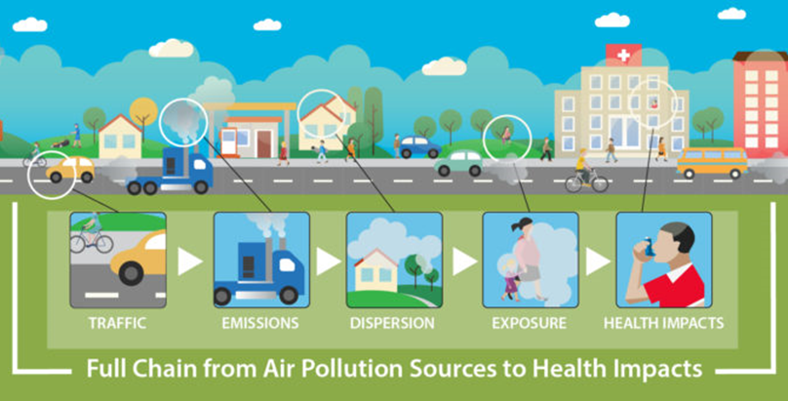
Introduction
Co-benefits: direct or indirect benefits from traffic-related air pollution (TRAP) reduction policies beyond those included in the full-chain
Why is this important?
Source: www.carteeh.org
Notes:
The figure (source: www.carteeh.org) displays the full-chain from traffic to health impacts. Traffic activity releases exhaust and non-exhaust emissions which are dispersed into the ambient air as traffic-related air pollution (TRAP). Humans are exposed to TRAP and risk negative health effects. For example, humans exposed to TRAP are at higher risk of developing adverse health effects, such as asthma (Khreis, de Hoogh and Nieuwenhuijsen, 2018).
In this context, we define co-benefits as benefits apart from those that occur down the full-chain (i.e. other direct or indirect benefits that can be achieved from policies aimed at TRAP reduction). These are an important consideration that can make policies more “sellable” to stakeholders or demonstrate that there are “win-wins” to be had in efforts to reduce TRAP.

Slide 4
Background and Definitions
The term “co-benefits” most likely stems from the literature on climate change mitigation
The third Assessment Report (AR3) of the Intergovernmental Panel on Climate Change (IPCC) was published in 2001 and distinguished co-benefits as the intended positive side effects of a policy from ancillary benefits or unintended positive side effects
In the climate change mitigation literature, co-benefits may be defined as “the added benefits we get when we act to control climate change, above and beyond the direct benefits of a more stable climate” (http://www.theclimatebonus.org/cobenefits.php)
Notes:
The term “co-benefits” most likely stems from the climate change literature, especially the climate change mitigation literature, and is common there
IPCC’s definition is shown above
Co-benefits have other terms which have been used interchangeably to connote similar concepts such as “side benefits”, “secondary benefits”, “collateral benefits”, “associated benefits”, “multiple benefits”, and “synergies” (IPCC, 2001; Smith, 2013)
There are many potential co-benefits of climate change mitigation action and these include:
Cleaner air: cutting fossil fuel pollution
Sustainable forests, food and farming
Safer and more secure energy supplies
Less waste: a resource-efficient economy
Stronger economy: long-term stability and prosperity
Health and well-being: benefits of a low-carbon lifestyle
Considering and assessing co-benefits in the climate change mitigation discussions and actions are extremely important. When and if policy makers and the general public look at issues such as climate change in isolation, they might not grasp its importance, seriousness and urgency and might also get a false sense that the cost of action is too high and higher than the benefits expected. However, if all the co-benefits are taken into account, there is usually a far stronger case for climate change mitigation action, as these actions usually results in positive impacts in other sectors and in relation to other objectives which may seem more urgent such as poor air quality, the economy, public health and social issues. These co-benefits should be assessed in the specific context and location of interest as they are context-specific and expected to differ greatly from a location and time to another.

Slide 5
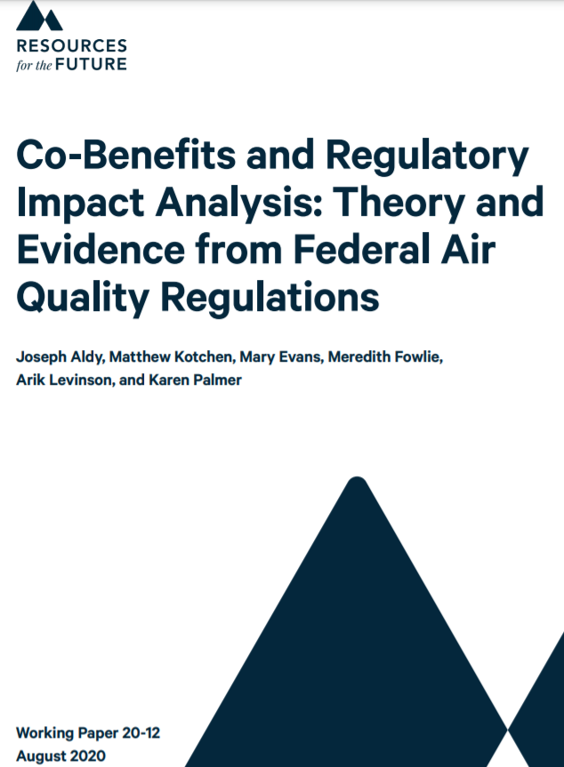
Background and Definitions
While the term “co-benefits” has not been used commonly in the air pollution mitigation literature, this presentation will do so
This is appropriate as when a policy has positive effects beyond its stated goals, these effects may be referred to as co-benefits
We will specifically focus on TRAP
  We expect that a substantial amount of clean air benefits is indirect and relates to other sectors and objectives, similar to the case of climate change action, and that these co-benefits have important weight in the monetization exercise (Aldy et al., 2020)
  Climate change and clean air benefits of certain actions may also be synergetic
Notes:
The paper by Aldy et al. (2020) considered the treatment of co-benefits in the cost-benefit analysis of federal air quality regulations by U.S. Environmental Protection Agency (EPA). The authors used the term co-benefits in a similar way to what we propose.
They investigated Clean Air Act Rules issued by the EPA between 1997 and 2019 and showed that:
Co-benefits make up a significant share of the monetized benefits
Among the categories of co-benefits, those associated with reductions in fine particulate matter (PM) are the most significant; and
Co-benefits have been pivotal to the quantified net benefit calculation in nearly half of cases
These findings indicate that the inclusion of co-benefits has been critical in EPA analyses to determine the cost-effectiveness of a policy and whether it promotes economic efficiency
The most significant co-benefits were those related to reductions in health effects due to particulate matter exposure
The authors also highlighted a methodological issue that requires more attention and methods development which is the prospect of double-counting benefits across regulations

Slide 6

“Co-benefits are simply a semantic category of benefits that should be included in benefit-cost analyses in order to make an appropriate determination about whether a given policy promotes economic efficiency compared with a baseline status quo” (Aldy et al., 2020)

Slide 7
Range of co-benefits
Economic growth
Increased accessibility
Increased active transportation
Increased equity
Increased green space access or provision
Increased public transportation use
Increased safety
Job growth
Reduced energy consumption
Reduced greenhouse gas (GHG) emissions (i.e. climate change mitigation)
Reduced stress
Reduced traffic congestion
Reduced traffic noise (Sanchez et al., 2020)
Notes:
In this context, co-benefits will refer to other benefits beyond reductions in traffic-related emissions or traffic-related air pollution as a result of an intervention/policy/strategy.
Description of selected co-benefits is below:
Energy/GHG reduction benefits – It is important to note that TRAP reduction and health benefits can be a co-benefit of GHG reduction policies (Maizlish et al., 2013). Actions to reduce greenhouse gas (GHG) emissions by reducing vehicle miles traveled (VMT) will reduce fuel use overall, thereby reducing both GHGs (primarily CO₂) and TRAP emissions. Similarly, actions to reduce fuel use through fuel efficiency improvements will result in reduced TRAP. There are several examples of articles discussing co-benefits of GHGs (Woodcock et al., 2009; Gao et al., 2018). However we cannot generalize that all GHG reduction strategies for transportation will reduce all pollutants across the board, especially in the case of strategies that affect vehicle emissions as opposed to vehicle activity (i.e. where vehicle combustion is involved) (Kite, 2019).
Health benefits from active transportation modes – Active transportation includes modes that produce less emissions and promote physical activity (i.e. walking and biking). Active transportation contributes to a more physically active lifestyle and lower body mass index (BMI) (Martin et al., 2015; Flint and Cummins, 2016). Physical activity can also substantially improve public health and reduce the risk of premature mortality and a wide range of chronic diseases (Khreis et al., 2019). Overall, there is evidence that the benefits of a model shift from private vehicles to active transportation modes overweigh the risks which may result from increased adverse exposures such as to air pollution and injury risk (Mueller et al., 2015).
Safety benefits - From reduced vehicle miles of travel. Higher traffic volume is associated with higher risk of injury for pedestrians (Wier et al., 2009).
Benefits to improving public transportation systems – Some strategies that promote alternative modes can reduce VMT and TRAP and have related benefits from an equity and accessibility perspective (Manaugh and El- Geneidy, 2012). Also, increased availability of public transit was associated with more walking for transportation providing more opportunity for active transportation (McCormack, Giles-Corti and Bulsara, 2008).
Congestion reduction - The United States has a whole program, the Congestion Mitigation and Air Quality Improvement (CMAQ) program, focused on advancing transportation projects that reduce congestion and emissions (U.S. Department of Transportation Federal Highway Administration, 2020).
Economic benefits – For the most part discussions are centered around cost-effectiveness, healthcare cost savings (both associated with the full-chain effect and beyond), or the general economic benefits associated with investing in alternatives to nonmotorized travel. One exception is if there are carbon targets with cost penalties associated with it - in which case TRAP reduction policies may pay for themselves. One example is (Markandya et al., 2018) which is a global case study looking at financial benefits of air quality improvements to compensate climate change mitigation costs.

Slide 8
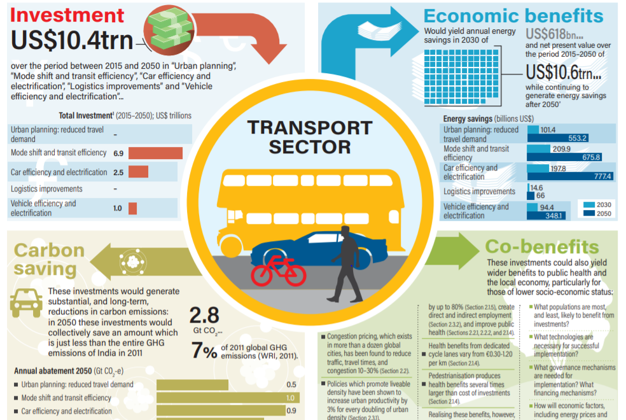
Co-benefits of Climate Mitigation Action in the Transportation Sector
Source: Gouldson et al. (2018)
Notes:
The figure above shows the economic and co-benefits of climate mitigation action in the transportation sector from an analysis published by Gouldson et al. (2018).
Extracted from Gouldson et al. (2018):
“Some co-benefits of climate mitigation actions in the transport sector have been extensively researched, including improved outdoor air quality, increased physical activity, and reduced congestion and travel time. Others do not have such extensive evidence, including improved indoor air quality, reduced ambient noise, and motor vehicle crashes.
Generally, there is a lack of costing estimates in the literature and few studies monetize the value of co-benefits.
Overall, the climate actions explored in this work were almost always associated with positive health and economic co-benefits. The breadth of literature on these co-benefits is in part a reflection of their scale. For example, our review’s findings suggest that the benefits from cycling investments can be as much as five times the cost and that switching the public from car to active travel modes walking and cycling would consistently result in a positive benefit to cost ratio associated ranging from 2 to 360 (median = 9).
Based on the literature, the most important co-benefits relate to impacts on physical activity. Investments in urban planning, public transit, and non-motorized transit infrastructure are some of the ways in which policy-makers can generate modal shift to cycling and walking, thereby increasing physical activity and improving health. The scale of
impacts, across all co-benefits identified, depend on many factors.
Technical considerations related to the increases in vehicle weight due to electrification and the sources of electricity generation emerged as important factors that could have an impact on air quality improvements expected from fleet electrification and vehicle efficiency improvements. Geographical factors, such as baseline air pollution and exposure levels, and population density can also affect the scale of the co-benefits identified. The age and efficiency of current fleets has an effect on the cost-effectiveness of some of the proposed measures, such as taxi fleet or freight renovation.
And positive impacts from increasing the diversity of land use may be offset by increases in active commuters who are at higher crash risks, if diversification policies are not accompanied by road safety measures and increasing the share of playgrounds, recreation, parks, and open space in urban areas.
Integrated approaches are therefore critical for the development of transport policies that yield the largest benefits.
The existing literature covers a variety of countries and regions, lending more confidence to the individual study findings and conclusions (which were generally consistent). However, research in African regions is completely missing.
The existing literature tends to focus on single co-benefit types, such as benefits to health or congestion, and ignores the potential for policies to support multiple objectives, or for multiple policies to have synergistic impacts. In most cases, this likely leads to significant understatement of total benefits; however, there is also an underappreciated scope for conflict between objectives.
Measures to increase green space and improve air quality, for example, can raise housing prices and feasibly introduce an additional way by which wealthy neighborhoods deviate and become more fragmented from poorer areas. Systematic approaches and working across sectors are recommended to avoid the flawed sector-centric planning and decision-making”.

Slide 9
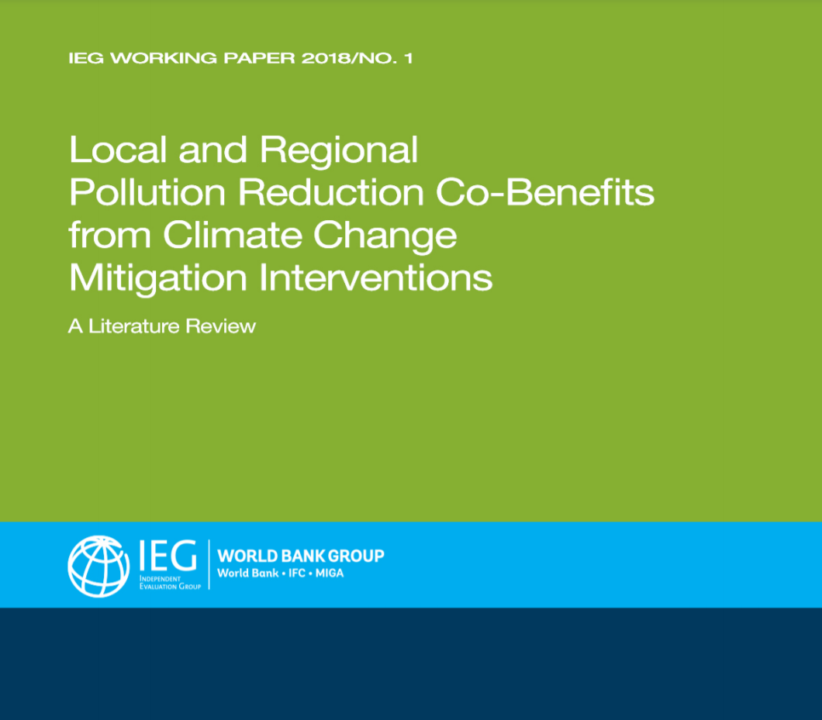
Documented co-benefits
Local and Regional Pollution Reduction Co-Benefits from Climate Change Mitigation Interventions: A Literature Review – the focus of this report is on developing countries
Notes:
GHG reduction as described in (World Bank, 2018):
“A 2016 paper surveyed co-benefit modeling studies that estimated quantitative environmental and health co-benefits for scenarios that encouraged mode shifts to public transport. Using a set of criteria to select from papers published from 2004 to 2015, a total of 153 transport-air quality–related articles were identified for further study; about half were qualitative, only nine satisfied all selection criteria, and only five included air quality issues involving developing countries. Those five studies are noted below to illustrate the kinds of results available from co-benefits studies in the transport sector.
• Delhi—An extension of the Delhi Metro was proposed to increase ridership. An analysis using a “first-order screening tool” determined potential co-benefits in terms of carbon dioxide (CO₂) reductions and cuts in local air pollution. Assuming all anticipated mode shifts took place, potential co-abatement rates were: 1.99 kg particulate matter with a diameter less than or equal to 10 micrometers (PM₁₀)/t CO₂, 80.4 kg carbon monoxide (CO)/t CO₂, 17.7 kg nitrogen oxides (NO_{x})/t CO₂, and 23.9 kg hydrocarbon/t CO₂.
• Indonesia—An analysis of co-benefits associated with proposed improvements in the quality of the Trans-Jogja bus system in Yogyakarta Special Region Province, Indonesia used conventional transportation air-quality analysis procedures and assumptions about emission factors associated with projected system changes. Potential co-abatement rates for 2010–24 were as follows: 2.58 kg PM₁₀/t CO2, 47.2 kg CO/t CO₂, 15.1 kg NO_{x}/t CO₂, and 1.09 kg sulfur dioxide/ t CO₂.
• Malaysia—Information on the national automotive fleet in Malaysia (for example, fuel consumption, and average speed for several vehicle categories) was used to analyze four emission reduction strategies. They involved changes of 10 percent in users of: passenger cars shifting to public transport, motorcycles shifting to public transport, and passenger cars shifting to natural gas vehicles. The fourth scenario assumed that 10 percent of vehicle renewals would meet Euro 4 emission standards. The following is a typical form of the results: “With renewal of 10 percent in the oldest [passenger] cars, the CO, NO_{x}, and hydrocarbon emissions can be reduced to 88.5 percent, 89 percent and 89.4 percent, respectively from the baseline [year, 2007].”
• Mexico City—Two studies involved Mexico City. One assessed a baseline scenario and two climate change mitigation scenarios. Results showed a decrease in both conventional air pollutants and CO₂ emissions if a bus rapid transit system is introduced along with strict standards for vehicle emission controls and fuel economy. A second Mexico City assessment relied on prior air quality management studies to evaluate five pollution reduction options, three of which involved transport: taxi fleet renovation, extension of the metro network and introduction of hybrid buses. Implementation of all three transport measures was projected to cut PM₁₀ exposure by almost 1 percent (0.52 µg/m³ ), maximum ozone exposure by nearly 3 percent (4.02 µg/m³ ), and CO₂e emissions by more than 620,000 tons per year.”
“Health impacts receive considerable attention in the transport co-benefits literature. Three main sources of transport-related health co-benefits have been identified: improvements in air quality; increased physical activity from “active travel” (that is, walking and cycling); and reduced traffic injury. Only the first category is considered here because the others have not been tied directly to conventional air pollutants. In general, evidence exists that public health and associated economic co-benefits related to GHG mitigation strategies are substantial and probably underestimated because of difficulties in quantifying health impacts.
Typical approaches to estimating health co-benefits (but not generalizable findings) are illustrated by a comparative risk assessment of ground transport scenarios in London and Delhi. For each city, a BAU 2030 scenario (which lacked policies to cut GHGs) was compared with alternative scenarios: lower-carbon-emission motor vehicles, increased active travel, and a combination of the two. Mathematical modeling was used to link changes in air pollution with the transport scenarios. A strategy that combined active travel and lower-emission motor vehicles was found to give the largest benefits (7,439 disability-adjusted life-years in London, and 12,995 in Delhi). The health burden from urban outdoor air pollution would decrease if lower-emission vehicles were used in both cities, but reductions in distance traveled by motor vehicles were expected to have a greater effect. Several articles provide additional examples of this type of study; many analyses of transport GHG reductions emphasize the health-related co-benefits of active travel.
A 2014 literature review examined empirically-based ex post studies of health co-benefits of urban transport GHG mitigation interventions. Notwithstanding that the review used keywords in 12 standard databases for papers published from January 1992 to March 2011, the authors found only 13 studies that provided empirical evidence for co-benefits (as opposed to assertions based on ex-ante modeling studies of the type described above). They found 12 of the 13 studies to be seriously flawed.
The only study that the 2014 review considered valid involved the “The Stockholm Trial,” a set of changes in Stockholm during six months in 2006 that consisted of: new bus lines, a congestion tax, and more park-and-ride sites. The main empirical work involved counting vehicles to measure traffic flow and calculating the number of vehicle-km traveled in affected areas before, during, and after the trial changes. Account was taken of traffic increases outside the congestion tax zone when calculating emission reductions. Emissions were calculated based on emission factors. Dispersion models were used to compute concentrations, and these were checked against field measurements. Overall, in the inner city, traffic-related CO₂ emissions dropped by about 14 percent during the trial, and annual average cuts in population-weighted concentrations were 10 percent and 7.6 percent for NO_{x} and PM₁₀, respectively. It was estimated that “206 years of life would
be gained over 10 years per 100,000 people following the trial if the effects on exposures were to persist.”

Slide 10
Documented co-benefits
Health benefits are perhaps the single most important category of benefits from TRAP mitigation policies or strategies
Health benefits are also associated with economic benefits as it relates for example to
  Reducing the cost of illness
  Preventing premature mortality or deaths from air pollution which have high values due to the high value of statistical life in monetary evaluations
Wider benefits as it relates to for example the reduction in traffic noise, crashes, job growth etc. are much less studied in the air pollution mitigation literature and there are few examples, often presented as secondary analyses
Notes:
Many air pollution/TRAP mitigation policies or strategies are pursued for the protection of human health
Health benefits are therefore perhaps the single most important benefit category from air pollution abetment in the transportation, and other sectors
Health benefits are also important because they have high costs whether it is the cost of chronic or acute illness, but more influential is the cost of premature deaths as derived from the value of statistical life, commonly used in cost-benefit analysis
However, there are wider benefits for air pollution/TRAP mitigation policies or strategies which extend beyond air pollution and adverse health impacts reductions and can touch on the economy, equity, social inclusion and cohesion, climate change, noise, and crashes, and some of these categories have their own health effects
The literature on air pollution/TRAP mitigation policies or strategies and these potential wider benefits is scarce and the discussions seem to be yet limited to the climate change mitigation co-benefits literature, which is still relevant
For example, Gouldson et al. (2018) summarized the following in their report, which relates to the wider co-benefits of climate mitigation actions in the transportation sector:
“Low-carbon transport can produce co-benefits in the following sectors:
Public health:
The value of health benefits from investments in cycling infrastructure can amount to more than five times the investment needs. Extrapolating across Europe, this suggests that the health benefits from cycling could be worth US $35–136 billion (2017 prices) annually.
Motor vehicle crashes are responsible for 1.3 million global deaths each year and over 78 million injuries. Where public transport networks are well developed, transport-related injuries are more than 80% lower.
Congestion and travelling time:
Congestion costs, through lost time and wasted fuel, amount to more than 1% of global domestic product (GDP) in most developed cities, and figures as high as 10% of GDP in developing cities
Congestion charges, planned or implemented across more than a dozen global cities, have been found to reduce traffic, travel times, and congestion by 10–30%.
More roads often lead to even slower travel times. Conversely, public transit can provide a dramatic reduction in travel times, in some cases reducing them by more than 50%.
Employment:
Investments in expanding public transport and improving vehicle efficiency could lead to the creation of more than 3 million net jobs annually in Organisation for Economic Co-operation and Development (OECD) cities, and between 3 million and 23 million net jobs annually in non-OECD cities, in the period to 2050.
Inclusivity:
People from lower income brackets typically spend more time commuting. Improving accessibility therefore disproportionately benefits the urban poor.
Vulnerable populations often have poorer health than the average. They may also be more likely to live and work in polluted areas. As a result, marginalized groups benefit disproportionately from interventions that improve air quality.”

Slide 11
Implications to policy and cross-disciplinary collaboration
Effective communication is needed between scientific researchers and policymakers
Cross-disciplinary expertise is needed when looking at different co-benefits of TRAP reduction policies
Considering the wider co-benefits across different sectors can help with achieving the following:
  More accurately assessing the economic efficiency of policies and strategies to mitigate traffic emissions and TRAP
  Facilitate better communication to the public, stakeholders, and policy makers, for example, Congress
Notes:
“Integrating public health professionals as part of the team involved in the design and planning of a transportation infrastructure project provides a competitive advantage not only from a market perspective, but more importantly in terms of strategic decision-making. This cross-disciplinary approach eliminates miscommunication of priorities by partnering transportation, public health, urban planning and other professionals so that innovative problem solving can take place. The emphasis is on practical solutions achieved through two-way communication, capacity building, and working within existing networks. The result is a cultural shift in transportation project design and planning based on the systematic evidence-based method in which challenges become opportunities.” (Warsow, 2015)

Slide 12
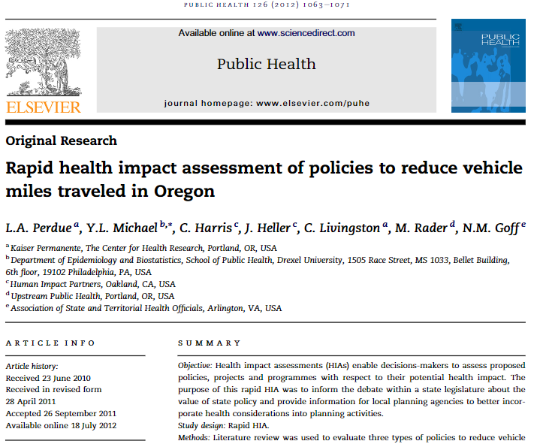
Examples/
Case Studies
Rapid health impact assessment of policies to reduce vehicle miles traveled in Oregon
Notes:
From (Perdue et al., 2012):
“Objective
Health impact assessments (HIAs) enable decisions-makers to assess proposed policies, projects and programmes with respect to their potential health impact. The purpose of this rapid HIA was to inform the debate within a state legislature about the value of state policy and provide information for local planning agencies to better incorporate health considerations into planning activities.
Study design
Rapid HIA.
Methods
Literature review was used to evaluate three types of policies to reduce vehicle miles traveled: improving the built environment, increasing the costs of individual driving, and strengthening public transit.
Results
Select features of the built environment were found to be associated with increased physical activity, reduced collisions, and decreased air pollution. Increasing the cost of driving was not consistently found to reduce air pollution, increase physical activity, or reduce collisions. Strengthening public transit was associated with increased levels of physical activity.
Conclusions
This rapid HIA provides a framework and focus for future HIAs in this topic area.”

Slide 13
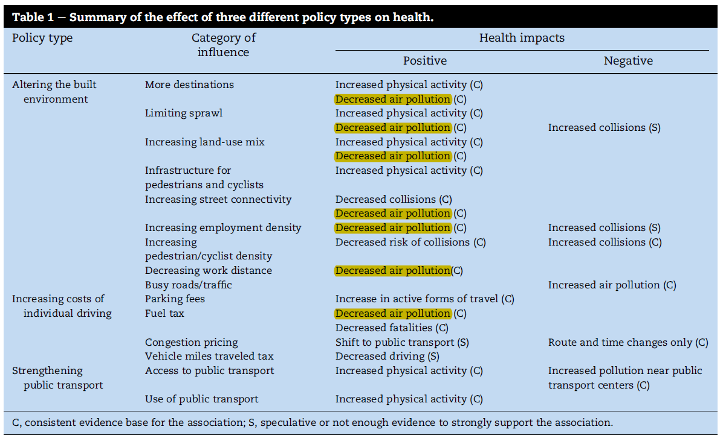
Source: Perdue et al. (2012)
Notes:
The results of the rapid health impact assessment conducted by Purdue et al. (2020) is shown in the table above, which summarizes the literature review findings
A take away from the above table is that all policies or strategies do not just affect one aspect or sector but have wider benefits and harms
It is also important to note from the table above that the harms are identified, not just the benefits or co-benefits
These harms are sometimes treated as co-costs, especially in the cost-benefit analysis context, and are also important to consider, just like co-benefits are important
As discussed in Aldy et al. (2020), co-benefits (or co-costs) arise when compliance with a regulation leads to benefits (or costs) that are not directly tied to a regulation’s intended target
The careful consideration and assessment of co-costs would also allow minimizing unintended negative consequences, which may be argues common in transportation policies

Slide 14
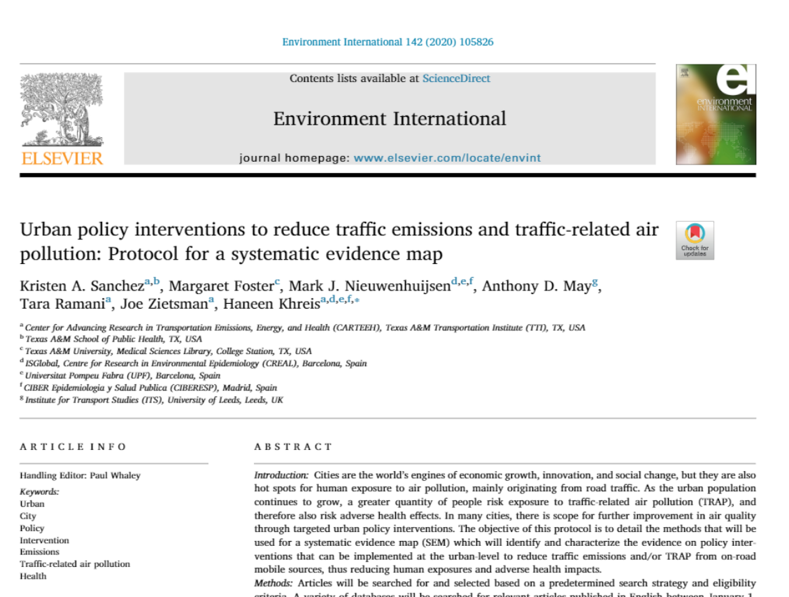
Examples/
Case Studies
Urban policy interventions to reduce traffic emissions and traffic-related air pollution: Protocol for a systematic evidence map
Notes:
This protocol details the aims and methods that will be used for the paper: Urban policy interventions to reduce traffic emissions and TRAP: a systematic evidence map.
From (Sanchez et al., 2020):
“This will be the first peer-reviewed systematic evidence map (SEM) focused on compiling international evidence on urban-level policy interventions to reduce traffic emissions and/or TRAP from on-road mobile sources in the context of human exposure and health effects…the idea behind conducting this SEM stems from TRAP’s adverse impact on health and wanting to unite this disparate literature with emphasis on highlighting where knowledge is clustered and where gaps exist. Understanding this information is of increasing value as new policy interventions and technologies (e.g. autonomous and electric vehicles (EVs), which may have unintended consequences, continue to emerge…A final and key distinction of our review is that it is the only review that will house its results in an open access database” that will take the form of a Microsoft Excel sheet.
In this SEM, “The primary outcomes include traffic emissions and/or TRAP. Secondary outcomes include human exposures and health impacts…Secondary items of interest include enablers and barriers to intervention implementation and co-benefits, if any.” While co-benefits are not a primary outcome of interest, this SEM will document any co-benefits identified in the literature of included studies. In this SEM, co-benefits “will refer to other benefits beyond reduction in traffic emissions and TRAP as a result of the interventions.”

Slide 15
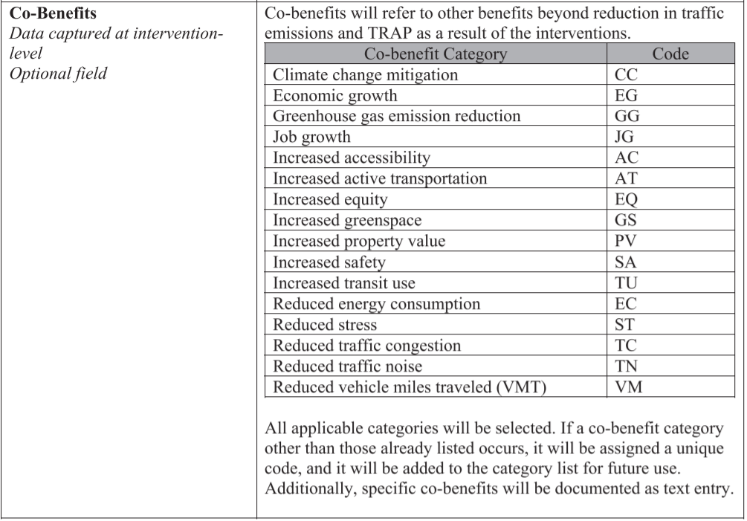
Source: Sanchez et al. (2020)
Notes:
This excerpt of Table A3 (Sanchez et al. 2020) lists potential co-benefits that may be identified in the literature on urban policy interventions to reduce traffic emissions and TRAP, along with how it will be coded into an open-access database.
Co-benefit categories include (but are not limited to):
Climate change mitigation
Economic growth
Greenhouse gas emission reduction
Job growth
Increased accessibility
Increased active transportation
Increased equity
Increased greenspace
Increased property value
Increased safety
Increased transit use
Reduced energy consumption
Reduced stress
Reduced traffic congestion
Reduced traffic noise
Reduced vehicle miles traveled
In the SEM, we will document any co-benefits identified in the included studies when available. Researchers, practitioners, and policymakers (specifically, urban authorities) will be able to use the information in the open-access database to “facilitate the identification of relevant trends and gaps in the evidence base and serve as the foundation for future research recommendations.”

Slide 16
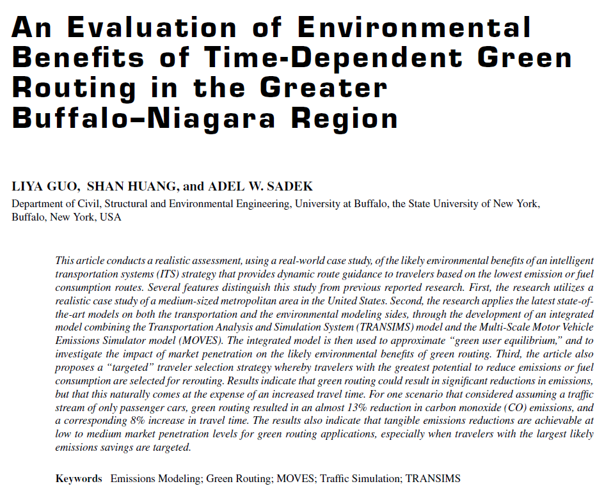
Examples/Case Studies
Co-costs are another important consideration
For example, Guo et al. (2013) found that green routing strategies can reduce vehicle emissions, but at the expense of travel time
  The average travel times for the different assignments were as follows
  Least travel time assignment = 6.7 minutes
  Least CO assignment = 7.3 minutes (7.9% increase)
  Least NOx assignment = 7.7 minutes (13.5% increase)
  Least gasoline assignment = 7.4 minutes (8.8%)

Slide 17
Examples/ Case Studies
Hirte, G. and Nitzsche, E. (2013). Evaluating policies to achieve emission goals in urban road transport.
  This study evaluates the effectiveness of different instruments for achieving emission goals on the urban level, and also investigates their impacts on other externalities: accidents, CO₂, noise, and travel time
Satiennam et al. (2006). A study on the introduction of bus rapid transit system in Asian developing cities: A case study on Bangkok Metropolitan Administration Project.
  This study tests different scenarios for a BRT system development in Bangkok, for the reduction of pollutant emissions, but also investigates traffic conditions and how they change because of these scenarios (total travel distance, total travel time, and average speed)
Notes:
Abstract from Hirte and Nitzsche (2013): “We explore and evaluate different ways to achieve emission goals in urban transport by applying a spatial simulation approach for a metropolitan area. The policies we consider are: a general speed limit in the city, a cordon toll, a cordon toll only on passenger travel, a cordon toll only on freight transport, a highway toll on passenger travel and a highway toll on freight transport. As a control scenario we examine a raise in fuel prices on the market. We find that, except for highway tolls and a cordon toll on freight transport, all other policies as well as the increase in fuel prices are effective with respect to a strong emission goal. However, a toll only on freight transport is ineffective. The welfare analysis shows that both the speed limit and the fuel price increase are very costly for society. In contrast, a cordon toll on passenger travel and a general cordon toll even generate social net benefits. Hence, a cordon toll is an efficient and effective instrument for achieving emission goals on the urban level.”
Abstract from Satiennam et al. (2006): “Bus Rapid Transit (BRT) has increasingly become an attractive urban transit alternative in many Asian developing cities due to its cost-effective and flexible implementation. However, it still seems to be difficult to introduce BRT to these cities because almost all of their city structures have been developed under solely a road transport development city plan and weakness of land use control gives rise to many problems, such as urban sprawl, traffic congestion, and air pollution. The purpose of this study was to introduce several strategies to support BRT implementation in Asian developing cities, such as a strategy to appropriately integrate the paratransit system into BRT system as being a feeder along a BRT corridor to supply demand. These proposed strategies were evaluated by applying demand forecasting and emission models to the BRT project plan of Bangkok Metropolitan Administration (BMA) in Thailand. It was demonstrated that the proposed strategies could effectively improve the BRT ridership, traffic conditions, and air pollution emission of the entire system in Bangkok. This study could be further extended to include strategy recommendation if a BRT system were to be introduced to other Asian developing cities.”

Slide 18
Examples/ Case Studies
Rotaris et al. (2010). The urban road pricing scheme to curb pollution in Milan, Italy: Description, impacts and preliminary cost–benefit analysis assessment.
  This study evaluates the impacts of the Milan Ecopass scheme, and presents a preliminary cost–benefit analysis, showing that the scheme didn’t only curb emissions but also traffic congestion and accidents.
Santi et al. (2014). Quantifying the benefits of vehicle pooling with shareability networks.
  This study evaluates the impacts of sharing taxi trips on passenger discomfort as determined by longer travel times, in addition to cumulative trip length, service cost and emissions.
Notes:
Abstract from Rotaris et al. (2010): “Starting from January 2008 Milan implemented a charging scheme to enter an 8 km2 area of the city centre. The term used to denote the scheme is Ecopass, conveying the stated political objective of the scheme: a pass to improve the quality of the urban environment (ECO). The charge depends on the Euro emission standard of the vehicle. The paper illustrates the main features and impacts of the Milan Ecopass scheme, and presents a preliminary cost–benefit analysis. The scheme has been effective in curbing not only pollution
emissions, but also congestion, and the result has been achieved with low implementation costs and without major political opposition. The cost–benefits analysis presents an overall
net benefit. The identification of the winners and losers of the policy is conditioned by penalty ayments. Without including the penalties, the surface public transport users and the
society at large are the main winners, whereas car and especially freight vehicle users are net losers”.
Significance and abstract from Santi et al. (2014): “Recent advances in information technologies have increased our participation in “sharing economies,” where applications that allow networked, real-time data exchange facilitate the sharing of living spaces, equipment, or vehicles with others. However, the impact of large-scale sharing on sustainability is not clear, and a framework to assess its benefits quantitatively is missing. For this purpose, we propose the method of shareability networks, which translates spatio-temporal sharing problems into a graph-theoretic framework that provides efficient solutions. Applying this method to a dataset of 150 million taxi trips in New York City, our simulations reveal the vast potential of a new taxi system in which trips are routinely shareable while keeping passenger discomfort low in terms of prolonged travel time.
Abstract: Taxi services are a vital part of urban transportation, and a considerable contributor to traffic congestion and air pollution causing substantial adverse effects on human health. Sharing taxi trips is a possible way of reducing the negative impact of taxi services on cities, but this comes at the expense of passenger discomfort quantifiable in terms of a longer travel time. Due to computational challenges, taxi sharing has traditionally been approached on small scales, such as within airport perimeters, or with dynamical ad hoc heuristics. However, a mathematical framework for the systematic understanding of the tradeoff between collective benefits of sharing and individual passenger discomfort is lacking. Here we introduce the notion of shareability network, which allows us to model the collective benefits of sharing as a function of passenger inconvenience, and to efficiently compute optimal sharing strategies on massive datasets. We apply this framework to a dataset of millions of taxi trips taken in New York City, showing that with increasing but still relatively low passenger discomfort, cumulative trip length can be cut by 40% or more. This benefit comes with reductions in service cost, emissions, and with split fares, hinting toward a wide passenger acceptance of such a shared service. Simulation of a realistic online system demonstrates the feasibility of a shareable taxi service in New York City. Shareability as a function of trip density saturates fast, suggesting effectiveness of the taxi sharing system also in cities with much sparser taxi fleets or when willingness to share is low”.

Slide 19
Discussion
What other co-benefits may arise from policies targeting TRAP reduction?
What impact will emerging technology (e.g. autonomous vehicles) have on co-benefits?
What is impact of strategies and policies aimed at mitigating TRAP on climate change? What do these impacts depend on?
How important is the local context in defining co-benefits and co-costs of policies and strategies?
Under what circumstances does the inclusion of co-benefits result in double counting? How do we methodologically deal with this potential issue?
Notes:
What other co-benefits may arise from policies targeting TRAP reduction? – Potential for noise reductions from reduced traffic. Noise level is dependent on transportation-related factors like road networks, junctions, traffic flow and speed, acoustics, and meteorological conditions (Khreis et al., 2019). Noise has not been studied in the context, and there are many other exposures or pathways which could be impacted by policies and strategies targeted at reducing traffic emissions and TRAP.
What impact will emerging technology (e.g. autonomous vehicles) have on co-benefits? – Potential for reduced noise levels. “When comparing an EV to an internal combustion engine vehicle (ICEV), there is less overall noise due to the absence of engine noise. However, as speed increases, the noise levels of the two vehicle types become increasingly similar due to tire-on-road sounds…While EVs may not be the cure for busy highway traffic noise, the implementation of EVs may potentially provide relief for busy residential roads in neighborhoods with lower traffic speeds” (Khreis et al., 2019). -- This is just one (positive) example of many ways emerging technology may impact co-benefits.

Slide 20
Research Gaps and Future Directions
Consistent data and reporting
Account for confounding factors
Account for the wider range of co-benefits
Account for the wider range of co-costs
Avoid double counting
Monetize the co-benefits and co-costs
Better geographical coverage and analysis
More interdisciplinary collaboration
Notes:
As described in (World Bank, 2018):
“A major complexity in comparing results from different studies concerns the use of varying units to report outcomes. The Malaysia study reported results in the form of percent of emission reductions for conventional pollutants. The Mexico City studies reported results in terms of percentage of reduced exposure to conventional pollutants and changes in pollutant concentration in µg/m³ . Results of studies in India and Indonesia were in the form of co-abatement rates (kg of conventional pollutants decreased/t of CO₂ reduced). Comparisons among study outcomes are also made complicated by variations in local context, data available, modeling methods used and assumptions made.
Numerous studies have emphasized the reductions in morbidity and mortality linked to changes in transport systems, including health benefits of local air pollution reductions that accompany efforts to cut GHG emissions by improving mass transit systems. Estimates of health benefits from decreased air pollution associated with transportation are often difficult to isolate, however, because air pollution in cities results from many causes, not just transportation…while some of the health co-benefits are a result of reduced conventional air pollution, others are linked to land use/transportation system changes that encourage walking and cycling instead of relying on motor vehicles.”
Other research gaps are similar to research gaps which have been identified in the climate change mitigation literature, as discussed in Gouldson et al. (2018).
The thematic focus of the evidence base is highly variable. Some co-benefits have been heavily researched, and others have been largely overlooked.
Evidence on the pathways that connect low-carbon actions with different co-benefits is highly variable. Air pollution as a pathway to improved public health is widely described in literature, but other pathways received significantly less attention.
The majority of high-quality transport modelling has occurred in North America and Europe.
The literature tends to estimate the potential benefits rather than evaluate the actual benefits.
There is a lack of common methods, metrics, measures, and indicators and little monetization.

Slide 21
Take-Home Messages
Reducing traffic emissions reduces TRAP, exposures, and health impacts associated with TRAP exposure. This reduction may also result in other co-benefits and potentially co-costs (or unintended negative consequences).
Co-benefits include energy and GHG emission reduction, active transportation, safety, improved public transport systems, congestion reduction, noise reduction, and economic benefits.
These co-benefits, and importantly the co-costs, are not well researched.
However, they are important considerations that can make policies more “sellable” to stakeholders or demonstrate that there are “win-wins” to be had in efforts to reduce TRAP.

Slide 22
List of Abbreviations
AR3 ……………………………………………….…………………… Third Assessment Report
BMI……………………………………………………………..………….………. Body Mass Index
CMAQ …..………………….. Congestion Mitigation and Air Quality Improvement
CO…………………………………......…………………………………………..Carbon Monoxide
CO₂ ……………………………….........……………………………………….......Carbon Dioxide
EPA………………………………………….………..U.S. Environmental Protection Agency
EV……………………………………………………………………….……………...Electric Vehicles
GDP ……………………………………………………………….….... Gross Domestic Product
GHG………….………………………………………………………………………. Greenhouse Gas

Slide 23
List of Abbreviations
HIA………………………………………………………………………………….Health Impact Assessment
ICEV ………..…………………………..…………………………..Internal Combustion Engine Vehicle
IPCC …………………………………………...…….. Intergovernmental Panel on Climate Change
NO_{X} ………………………………………………………………………………………………..Nitrogen Oxides
OECD.……………………………Organisation for Economic Co-operation and Development
PM…………………………..………………………………………………………………….Particulate Matter
PM₁₀………Particulate Matter with a Diameter Less Than or Equal to 10 Micrometers
SEM………………………………………………………………………………….Systematic Evidence Map
TRAP………………………….…………………………...……….…………. Traffic-Related Air Pollution
VMT……………………………….…………………………..………………………. Vehicle Miles Traveled

Slide 24
References
Aldy, J.E., Kotchen, M., Evans, M.F., Fowlie, M., Levinson, A. and Palmer, K., 2020. Co-Benefits and Regulatory Impact Analysis: Theory and Evidence from Federal Air Quality Regulations (No. w27603). National Bureau of Economic Research.
Flint, E. and Cummins, S. (2016) ‘Active commuting and obesity in mid-life: cross-sectional, observational evidence from UK Biobank’, The Lancet Diabetes & Endocrinology. Elsevier, 4(5), pp. 420–435. doi: 10.1016/S2213-8587(16)00053-X.
Gao, J. et al. (2018) ‘Public health co-benefits of greenhouse gas emissions reduction: A systematic review’, Science of The Total Environment, 627, pp. 388–402. doi: 10.1016/j.scitotenv.2018.01.193.
Guo, L., Huang, S. and Sadek, A.W., 2013. An evaluation of environmental benefits of time-dependent green routing in the greater Buffalo–Niagara region. Journal of Intelligent Transportation Systems, 17(1), pp.18-30.

Slide 25
References
Gouldson, A., Sudmant, A., Khreis, H. and Papargyropoulou, E., 2018. The economic and social benefits of low-carbon cities: a systematic review of the evidence. Coalition for Urban Transitions: Washington, DC, USA.
Hirte, G. and Nitzsche, E., 2013. Evaluating policies to achieve emission goals in urban road transport. Zeitschrift für Verkehrswissenschaft, 84(2), pp.112-137.
IPCC (2001): Climate Change 2001: The Scientific Basis. Contribution of Working Group I to the Third Assessment Report of the Intergovernmental Panel on Climate Change [Houghton, J.T., Y. Ding, D.J. Griggs, M. Noguer, P.J. van der Linden, X. Dai, K. Maskell, and C.A. Johnson (eds.)]. Cambridge University Press, Cambridge, United Kingdom and New York, NY, USA, 881pp.
Khreis, H. et al. (2019) Transportation and Health: A Conceptual Model and Literature Review. College Station, Texas. Available at: https://www.carteeh.org/14-pathways-to-health-project-brief/.

Slide 26
References
Khreis, H., de Hoogh, K. and Nieuwenhuijsen, M. J. (2018) ‘Full-chain health impact assessment of traffic-related air pollution and childhood asthma’, Environment International. Elsevier, 114(November 2017), pp. 365–375. doi: 10.1016/j.envint.2018.03.008.
Kite, C. (2019) ‘Emissions Impacts of Electrifying Passenger Cars in Texas’, in U.S. Environmental Protection Agency 2019 International Emissions Inventory Conference. Dallas, Texas.
Maizlish, N. et al. (2013) ‘Health Cobenefits and Transportation-Related Reductions in Greenhouse Gas Emissions in the San Francisco Bay Area’, American Journal of Public Health, 103(4), pp. 703–709. doi: 10.2105/AJPH.2012.300939.
Manaugh, K. and El- Geneidy, A. (2012) ‘Who benefits from new transportation infrastructure? Using accessibility measures to evaluate social equity in public transport provision’, in Accessibility Analysis and Transport Planning. Edward Elgar Publishing, pp. 211–227. doi: 10.4337/9781781000113.00021.
Markandya, A. et al. (2018) ‘Health co-benefits from air pollution and mitigation costs of the Paris Agreement: a modelling study’, The Lancet Planetary Health, 2(3), pp. e126–e133. doi: 10.1016/S2542-5196(18)30029-9.

Slide 27
References
Martin, A. et al. (2015) ‘Impact of changes in mode of travel to work on changes in body mass index: evidence from the British Household Panel Survey’, Journal of Epidemiology and Community Health, 69(8), pp. 753–761. doi: 10.1136/jech-2014-205211.
McCormack, G. R., Giles-Corti, B. and Bulsara, M. (2008) ‘The relationship between destination proximity, destination mix and physical activity behaviors’, Preventive Medicine, 46(1), pp. 33–40. doi: 10.1016/j.ypmed.2007.01.013.
Mueller, N. et al. (2015) ‘Health impact assessment of active transportation: a systematic review’, Preventive medicine, 76, pp.103-114. doi: 10.1016/j.ypmed.2015.04.010
Perdue, L. A. et al. (2012) ‘Rapid health impact assessment of policies to reduce vehicle miles traveled in Oregon’, Public Health, 126(12), pp. 1063–1071. doi: 10.1016/j.puhe.2011.09.026.
Rotaris, L., Danielis, R., Marcucci, E. and Massiani, J., 2010. The urban road pricing scheme to curb pollution in Milan, Italy: Description, impacts and preliminary cost–benefit analysis assessment. Transportation Research Part A: Policy and Practice, 44(5), pp.359-375.
Sanchez, K. A. et al. (2020), ‘Urban policy interventions to reduce traffic emissions and traffic-related air pollution: Protocol for a systematic evidence map’, Environment International, 142, pp.105826. doi: 10.1016/j.envint.2020.105826.
Santi, P., Resta, G., Szell, M., Sobolevsky, S., Strogatz, S.H. and Ratti, C., 2014. Quantifying the benefits of vehicle pooling with shareability networks. Proceedings of the National Academy of Sciences, 111(37), pp.13290-13294.

Slide 28
References
Smith, A. (2013). The climate bonus: co-benefits of climate policy. Routledge.
Satiennam, T., Fukuda, A. and Oshima, R., 2006. A study on the introduction of bus rapid transit system in Asian developing cities: A case study on Bangkok Metropolitan Administration Project. IATSS research, 30(2), pp.59-69.
U.S. Department of Transportation Federal Highway Administration (2020) Congestion Mitigation and Air Quality Improvement (CMAQ) Program. Available at: https://www.fhwa.dot.gov/environment/air_quality/cmaq/.
Warsow, K. M. (2015) ‘Transportation public health link: Changing perspectives…Changing a culture through cross-disciplinary collaboration’, Journal of Transport & Health, 2(2), pp. S2–S4. doi: 10.1016/j.jth.2015.04.194.
Wier, M. et al. (2009) ‘An area-level model of vehicle-pedestrian injury collisions with implications for land use and transportation planning’, Accident Analysis & Prevention, 41(1), pp. 137–145. doi: 10.1016/j.aap.2008.10.001.
Woodcock, J. et al. (2009), ‘Public health benefits of strategies to reduce greenhouse-gas emissions: urban land transport’, The Lancet, 374(9705), pp.1930-1943. doi: 10.1016/S0140-6736(09)61714-1
World Bank (2018) Local and Regional Pollution Reduction Co-Benefits from Climate Change Mitigation Interventions: A Literature Review. Washington, DC.

Slide 29
Reading List
Boardman, A.E. et al. (2017) Cost-benefit analysis: concepts and practice. Cambridge University Press. Available at: https://www.cambridge.org/us/academic/subjects/economics/public-economics-and-public-policy/cost-benefit-analysis-concepts-and-practice-5th-edition?format=PB
Gao, J., Kovats, S., Vardoulakis, S., Wilkinson, P., Woodward, A., Li, J., Gu, S., Liu, X., Wu, H., Wang, J. and Song, X., 2018. Public health co-benefits of greenhouse gas emissions reduction: a systematic review. Science of the Total Environment, 627, pp.388-402.
Khreis, H. et al. (2019) ‘Transport policy measures for climate change as drivers for health in cities’ in Nieuwenhuijsen, M. & Khreis, H. (eds.) Integrating Human Health into Urban and Transport Planning. Springer, pp. 583-608. Available at: https://link.springer.com/book/10.1007/978-3-319-74983-9
Maizlish, N., Woodcock, J., Co, S., Ostro, B., Fanai, A. and Fairley, D., 2013. Health cobenefits and transportation-related reductions in greenhouse gas emissions in the San Francisco Bay area. American journal of public health, 103(4), pp.703-709.
Rojas-Rueda, D., de Nazelle, A., Teixidó, O. and Nieuwenhuijsen, M.J., 2012. Replacing car trips by increasing bike and public transport in the greater Barcelona metropolitan area: a health impact assessment study. Environment international, 49, pp.100-109.

Slide 30
Reading List
Sarigiannis, D.A., Kontoroupis, P., Nikolaki, S., Gotti, A., Chapizanis, D. and Karakitsios, S., 2017. Benefits on public health from transport-related greenhouse gas mitigation policies in Southeastern European cities. Science of the Total Environment, 579, pp.1427-1438.
Sudmant, A. et al. (2020) ‘The social, environmental, health, and economic impacts of low carbon transport policy: A review of the evidence’ in Khreis, H., Nieuwenhuijsen, M., Zietsman, J., & Ramani, T. (eds.) Traffic-Related Air Pollution. Elsevier, pp. 471-493. Available at: https://www.sciencedirect.com/book/9780128181225/traffic-related-air-pollution#book-info
Schraufnagel, D. E. et al. (2019) ‘Health benefits of air pollution reduction’, Annals of the American Thoracic Society, 16(12), pp.1478-1487. doi: 10.1513/AnnalsATS.201907-538CME
Thurston, G. D. & M. L. Bell (2014) ‘The Human Health Co-benefits of Air Quality Improvements Associated with Climate Change Mitigation‘ in Pinkerton, K. E. & Rom, W. N. (eds.) Climate Change and Global Public Health. Humana, pp. 181-202. Available at: https://link.springer.com/book/10.1007/978-3-030-54746-2
Thompson, T.M., Rausch, S., Saari, R.K. and Selin, N.E., 2014. A systems approach to evaluating the air quality co-benefits of US carbon policies. Nature Climate Change, 4(10), pp.917-923.
U.S. Department of Transportation (2019) Traffic calming to slow vehicle speeds [Online]. Available at: https://www.transportation.gov/mission/health/Traffic-Calming-to-Slow-Vehicle-Speeds
U.S. Department of Transportation Federal Highway Administration (2017) Air Quality and Congestion Mitigation Measure Outcomes Assessment Study: Summary Report of Findings [Online]. Available at: https://www.fhwa.dot.gov/environment/air_quality/cmaq/research/outcomes_assessment/summary_report/chap00.cfm

Slide 31
Acknowledgements
These lecture slides were conducted with support from the Texas A&M Transportation Institute’s Center for Advancing Research in Transportation Emissions, Energy, and Health, a U.S. Department of Transportation’s University Transportation Center, College Station, TX. The grant number is 69A3551747128. More information about the Center for Advancing Research in Transportation Emissions, Energy, and Health is available at: https://www.carteeh.org/.
The authors acknowledge contribution from Tara Ramani, Assistant Director of CARTEEH.

