Slide 1
www.carteeh.org

Slide 2
Lecture #8: Environmental Justice
Haneen Khreis and Kristen Sanchez
Texas A&M Transportation Institute
H-Khreis@tti.tamu.edu, (979) 317-2799 x42799
K-Sanchez@tti.tamu.edu, (979) 317-2816
The authors declare that there is no conflict of interest
Lecture Track(s): HT/PPT
Notes:
Health Track (HT)—mainly targeted at urban planners, transportation planners, and engineers with limited knowledge of public health-related concepts;
Transportation Track (TT)—mainly targeted at environmental epidemiologists and public health professionals with limited knowledge of transportation-related concepts; and;
Planning and Policy Track (PPT)—mainly targeted at planners, civil servants, and policy and decision makers with particular interest in the science-policy link.

Slide 3
Introduction
Environmental Justice (EJ)
  United States Environmental Protection Agency (US EPA) definition: “The fair treatment and meaningful involvement of all people regardless of race, color, national origin, or income, with respect to the development, implementation, and enforcement of environmental laws, regulations, and policies.”
  European Environmental Bureau (EEB) definition: “Environmental benefits and burdens have to be shared fairly.”
Environmental injustice “places disproportionate health risks on people who are already the most vulnerable or susceptible to those risks” (Clark, Millet and Marshall, 2014) and occurs when “those with political or economic power exploit the planet’s resources to the detriment of poorer communities or the average citizen” (European Environmental Bureau, 2018)
Notes:
The United States Environmental Protection Agency (US EPA) defines environmental justice (EJ) as “the fair treatment and meaningful involvement of all people regardless of race, color, national origin, or income, with respect to the development, implementation, and enforcement of environmental laws, regulations, and policies” (United States Environmental Protection Agency, 2020a).
European Environmental Bureau (EEB) described EJ as “Environmental benefits and burdens have to be shared fairly.” (European Environmental Bureau, 2018)
The opposite of EJ is environmental injustice which “places disproportionate health risks on people who are already the most vulnerable or susceptible to those risks” (Clark, Millet and Marshall, 2014) and occurs when “those with political or economic power exploit the planet’s resources to the detriment of poorer communities or the average citizen” (European Environmental Bureau, 2018).
Evidence of environmental injustice arose in the 1980s, often related to the existence or siting of hazardous waste sites, landfills, industrial facilities, etc. (Bullard, 1990). Communities of color, in particular, as well as poor and immigrant neighborhoods, continue to be targeted
for the placement of industrial facilities such as chemical plants, oil refineries, and hazardous waste landfills (Fuller and Brugge, 2020).
Environmental injustice and related exposures are considered to contribute to health disparities along with racism, psychosocial stress, low socioeconomic status, and lack of health insurance and limited access to health care (Bullard et al, 2008; Committee on Environmental Justice, Institute of Medicine, National Academy of Sciences, 2000; Fox, Groopman, & Burke, 2002; Gee and Payne-Sturges, 2004).

Slide 4
Background and History
1964
Civil Rights Act of 1964
1987
United Church of Christ (UCC) study “Toxic Wastes and Race in the United States”
1990
“Dumping in Dixie: Race, Class, and Environmental Quality” is published
1994
Executive Order (EO) 12898 is signed
1991
First National People of Color Environmental Leadership Summit
1982
Hazardous waste landfill in Warren County, North Carolina
Notes:
1964 Civil Rights Act: Title VI of the Civil Rights Act of 1964 “prohibited discrimination on the basis of race, color or national origin in any program or activity that receives Federal financial assistance.” (United States Department of Justice, no date)
“A watershed moment in the formation of the EJ movement was the siting of a hazardous waste landfill in Warren County, North Carolina in 1982. The purpose of the site was to hold 32,000 cubic yards of polychlorinated biphenyl (PCB) contaminated soil that had been illegally spread across a large swath of roadways in the state (Bullard, 1994). Warren County was rural, predominately African American and poor, located in the far northern portion of the state. Community members, led by Dollie Burwell and Benjamin Chavis, organized against the landfill, staging multiple acts of nonviolent protest. Approximately 500 people were arrested during several weeks of direct action, including 94 children, which brought nationwide attention to the injustice. Despite efforts from the county’s residents, the landfill was opened in 1982; however, residents persisted in the face of adversity and continued to organize. Years later, the landfill suffered a breach contaminating nearby land and groundwater. The continued actions of the residents and supporters led to the eventual closure and cleanup of the site and surrounding contaminated areas. After many years of remediation, the site was declared clean in 2003, over 20 years after its initial construction” (Fuller and Brugge, 2020).
1987 United Church of Christ (UCC) study, Toxic Wastes and Race in the United States: In 1987, the United Church of Christ (UCC), headed by executive director Benjamin Chavis Jr., published a seminal report about the relationship of race and socioeconomic class to contaminated waste sites across the U.S. The UCC's assessment revealed that three out of every five black or Hispanic citizens lived in close proximity to an "uncontrolled" hazardous waste site. Although the report found both race and class to be significant factors, the results suggested that race carried greater weight (https://omeka.middlebury.edu/fyg/items/show/316). “The UCC study revealed that the most important factor in the siting of hazardous waste facilities was race (United Church of Christ, 1987). In all, 60% of African Americans lived in a community that had one or more hazardous waste sites. Socioeconomic status was the second most important factor related to the placement of hazardous waste facilities. The strength of these findings was surprising for some and validating to the lived experience of many people that had been subjected to environmental injustice” (Fuller and Brugge, 2020).
1990 Dumping in Dixie (Bullard, 1990) is published: It is widely regarded as the first book to fully articulate the concept of environmental justice.
“In October 1991, the First National People of Color Environmental Leadership Summit brought together communities from the United States
and across the globe to Washington, DC to discuss issues and draft a pathway to achieve justice. Through the work of the attendees, the EJ movement achieved identity and developed a list of 17 guiding principles that united them in their pursuit of a healthy, just, and equitable world. The Principles of Environmental Justice provide a framework, until this day, for activists engaged in the struggle.” (Fuller and Brugge, 2020).
1994 President Clinton signed Executive Order 12898: “Federal Actions to Address Environmental Justice in Minority Populations and Low-Income Populations”. The purpose of this EO is to “focus federal attention on the environmental and human health effects of federal actions on minority and low-income populations with the goal of achieving environmental protection for all communities”. EO 12898 directs federal agencies to: 1) identify and address the disproportionately high and adverse human health or environmental effects of their actions on minority and low-income populations, to the greatest extent practicable and permitted by law 2) develop a strategy for implementing environmental justice and 3) promote nondiscrimination in federal programs that affect human health and the environment, as well as provide minority and low-income communities access to public information and public participation (United States Environmental Protection Agency, 2020b).
“This order resulted in the creation of the US Environmental Protection Agency’s (EPA) Office of Environmental Justice. In compliance with EO 12898, the US Department of Transportation (DOT) published its own Environmental Justice Order on April 15, 1997 and updated the order in 2012. With the EO 12898 mandate in hand, communities, researchers and government agencies began to rigorously assess the distribution of environmental risks beyond hazardous waste sites to include power plants, industrial facilities, and transportation corridors”.

Slide 5
Environmental justice, traffic and/or transportation emissions, and health
Transportation → Emissions → Air Pollution → Exposure → Health Impacts
Low socioeconomic status (SES) and minority populations experience disproportionately greater exposure to traffic and air pollution causing greater risk for developing adverse health outcomes (Pratt et al, 2015)
Health outcomes associated with exposure to TRAP:
Respiratory Effects
Neurological and Cognitive Effects
Reproductive Effects
Metabolic Effects
Bone Effects
Cardiovascular Effects
Cancer
Cerebrovascular Effects
Premature Mortality
Notes:
The full-chain between transportation emissions and health includes: transportation, emissions, air pollution, exposures, and health impacts. Transportation activity results in exhaust and non-exhaust emissions which are then dispersed into the ambient air as traffic-related air pollution (TRAP) (Khreis, de Hoogh and Nieuwenhuijsen, 2018). Humans are exposed to air pollution putting them at risk for adverse health outcomes, including (but not limited to: premature mortality (Beelen et al., 2014), cancer (Raaschou-Nielsen et al., 2013), cardiovascular effects (Brook et al., 2010; Link and Dockery, 2010; Mustafić et al., 2012; Cesaroni et al., 2014), cerebrovascular effects (Stafoggia et al., 2014), respiratory effects (Lindgren et al., 2009; Gasana et al., 2012; MacIntyre et al., 2014; Khreis et al., 2017), reproductive effects (Vrijheid et al., 2011; Sapkota et al., 2012; Fleischer et al., 2014; Pedersen et al., 2014; Lafuente et al., 2016), neurological and cognitive effects (Raz et al., 2015; Power et al., 2016), metabolic effects (Jerrett et al., 2014; Eze et al., 2015), and bone effects (Prada et al., 2017).
Low socioeconomic status (SES) and minority populations experience disproportionately greater exposure to traffic and air pollution causing greater risk for developing adverse health outcomes (Pratt et al. 2015). “Exposures and risks, especially from on-road sources, were higher than the mean for minorities and low SES populations and lower than the mean for white and high SES populations. Owning multiple vehicles and driving alone were linked to lower household exposures and risks. Those not owning a vehicle and walking or using transit had higher household exposures and risks…populations on the lower end of the socio-economic spectrum and minorities are disproportionately exposed to traffic and air pollution and at higher risk for adverse health outcomes. A major source of disparities appears to be the transportation infrastructure. Those outside the urban core had lower risks but drove more, while those living nearer the urban core tended to drive less but had higher exposures and risks from on-road sources.” (Pratt et al. 2015)

Slide 6

Environmental Justice in the Transportation Context
Transportation encompasses four elements:
  Infrastructure
  Mode choice
  Land-use and the build environment
  Technologies and disruptors
The distribution of these elements across populations is unequal and therefore the distribution of transportation-related exposures is also unequal
Transportation has a long and negative history with low-income, immigrant and people of color communities that have been adversely impacted through many different pathways, studied to different extents
There is increasing focus on transportation and EJ
Notes:
Transportation has a long and negative history with low-income, immigrant and people of color communities that have been adversely impacted through many different pathways (Fuller and Brugge, 2020).
These pathways include air pollution and noise exposure, social exclusion, lack of access, lack of green space and physical activity opportunities, among others
There is increasing focus on transportation and EJ (Kingham, Pearce and Zawar-Reza, 2007). For example, environmental justice was required to be integrated into federally funded transportation planning decisions per EO 12898 (Kingham, Pearce and Zawar-Reza, 2007). Furthermore, “following the 1998 ‘Transportation Equity Act for the 21st Century’, an advisory board was established to develop a national agenda for environmental research in relation to transport, including a focus on environmental justice (Transportation Research Board, 2002). Multiple recommendations were made relating to transportation and EJ research that included the need for accurate air quality models and improved understanding of air pollution risks among sensitive populations.
Transportation encompasses four elements that influence health as described in Khreis et al. 2019:
1. Infrastructure: construction, maintenance, and rehabilitation of roads, parking spaces, cycling and pedestrian lanes, public transportation hubs, freight hubs, railways, electric grids, electricity generation stations, etc.
2. Mode choice: car, public transport, walking, cycling, freight, plane, boat, etc.
3. Land-use and the build environment: refers to urban design, development decisions, density, diversity, distance to public transportation, destination accessibility, distribution centers, etc.
4. Technologies and disruptors: connected, autonomous, shared, zero and near-zero emissions passenger/freight vehicles, 3-D printing, etc.
These four elements may help improve health outcomes for vulnerable populations when planned and implemented with EJ considerations.
Low socioeconomic status (SES) and minority populations typically live in areas with higher traffic and air pollution levels (Pratt et al, 2015). “Low SES and non-white populations tend to own fewer cars, drive less, and commute by walking or transit. Other work has shown that poor tend to live close to city centers in large part because of better access to public transportation (Glaeser, Kahn and Rappaport, 2008). Despite driving less, low SES and non-whites bear disproportionately high air pollution impacts from all sources—especially transportation sources. In contrast, both white and high SES populations tend to have higher rates of car ownership and to drive more while the air pollution impacts at their homes tend to be lower. The build-out of transportation systems facilitating motor vehicles has allowed sprawling development that contributes to the environmental inequities we describe. This infrastructure has roots in the history of social injustice and the legacy of decision-making in which transportation arteries were located in areas with low land values that were often occupied by minorities and low SES populations. In turn, the presence of busy roadways may constrain improvement of low SES neighborhoods.” (Pratt et al, 2015)

Slide 7
Environmental Justice in the Transportation Context
Transportation-related exposures are unequally distributed among populations due to the different placement of, proximity, and access to transportation facilities, services, infrastructure, and activities in different segments of society
Selected examples of this are given below:
  Rural populations have healthcare access issues as transportation infrastructure and services often do not extend to rural communities, and if they do, their cost may be higher and options may be limited
  Traffic-related air pollution (TRAP) and noise are often higher and more concentrated in lower SES and ethnic minority populations
  The distribution of (access to) public green spaces can be differential by socioeconomic status in favor with those with resources to move to greener (and healthier) areas
Notes:
Extracted from (Glazener et al, 2021):
“ … inequity, which refers to the unfair and inappropriate distribution of exposures related to transportation planning (Litman, 2019). Inequity factors can modify the exposure to each of the 14 pathways (linking transportation to health) at the population level due to the placement of, proximity, and access to transportation facilities, services, infrastructure, and activities.
In the context of equity, one important factor to consider is where populations live in reference to major transportation infrastructure. Worldwide, rural healthcare access is becoming an issue for patients, partly due to transportation inequities as transportation infrastructure and services often do not extend to rural communities (Scheil-Adlung, 2015). Even when transportation services or infrastructure are available, the financial cost of utilizing them may pose another barrier to receiving healthcare (Scheil-Adlung, 2015).
TRAP exposure and its associated adverse health effects tend to be higher and more concentrated in lower socioeconomic locales and ethnic minority communities. A wealth of studies, old and new, show that adverse exposure levels are often socially patterned with more socioeconomically deprived or ethnically diverse communities being disproportionately exposed. Inequalities in air pollution exposure in the United States were related to income and race-ethnicity between 2000 and 2010 (Clark et al, 2017). Notably, these disparities were larger by race-ethnicity than income (Clark et al, 2017).
In the United States, exposure to PM2.5 is disproportionate between ethnic groups when compared with their contribution to PM2.5 concentrations. Specifically, African Americans and Hispanics are exposed to more PM2.5 than they are responsible for producing, while non-Hispanic whites are exposed to less PM2.5 than they produce (Tessum et al, 2019).
This disparity occurs partly due to social, economic, and environmental factors that have resulted in minority neighborhoods living closer to high traffic volume roads, increasing their exposures to air pollution and other transportation-related exposures and adverse health effects (McAndrews and Marcus, 2014; Rowangould, 2013).
Finally, a national-level study in the United States found that students attending “high risk” (of exposure to ambient neurotoxicants) public schools were significantly more likely to be eligible for free/reduced price meals and to be Hispanic, Black, or Asian/Pacific Islander than White or another race (Grineski and Collins, 2018).”
Often, low-income groups and ethnic minorities are least able to relocate to protect themselves and little is done to mitigate the adverse impacts and protect vulnerable groups.

Slide 8
Intrinsic and Extrinsic Susceptibility Factors
The unequal and higher exposures in low SES communities and ethnic minorities is exacerbated by the greater susceptibility of these groups to the adverse impacts of a given exposure
This higher susceptibility may occur because of:
  A higher likelihood of pre-existing cardio-respiratory and other disease
  Ethnicity and genetics
  Exposure to stress (Salleh, 2008)
  Exposure to violence (Wright and Steinbach, 2001)
  Lack of antioxidant intakes (Barthelemy et al, 2020)
  Malnutrition (Walson and Berkley, 2018)
  The concentration or presence of co-exposures
Notes:
Intrinsic and extrinsic individual characteristics, such as sex, age, race/ethnicity, genetics, etc., which influence the susceptibility of individuals to transportation-related exposures and subsequently the severity of health outcomes experienced by each individual. These also factors include malnutrition (Walson and Berkley, 2018); and the lack of antioxidant intakes (Barthelemy et al, 2020), exposure to stress (Salleh, 2008), and exposure to violence (Wright and Steinbach, 2001), in addition to lack of access to health care, lack of insurance, limited routine assessments and limited access to health promoting opportunities like green space or physical activity. These factors can modify and often amplify the adverse health effects of transportation-related exposures.

Slide 9
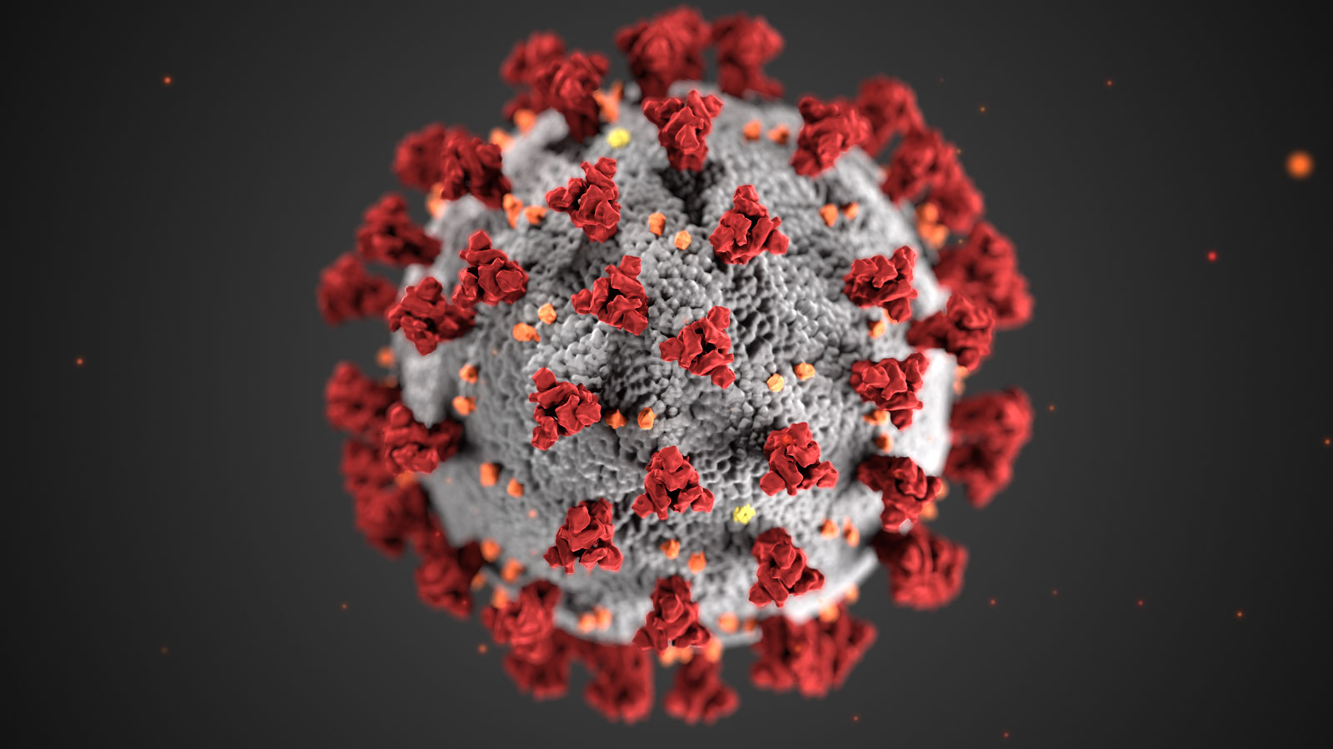
Contemporary Examples
  The differential health impacts of inequity and susceptibility factors have been highlighted by the coronavirus disease 2019 (COVID-19) pandemic
    COVID-19 cases are 2.5–3x greater among Native Americans, Hispanic, and Black or African American individuals compared to White, non-Hispanic individuals (Centers for Disease Control and Prevention, 2020)
    Hospitalization rates are roughly 5x greater among these racial minority groups compared to White, non-Hispanic Americans
    Public transportation ridership is higher among low-income and racial minority groups which increases risk of exposure for already disadvantaged communities (Chen et al, 2020)
    Reductions in public transportation service due to COVID-19 has limited health care access for transit-dependent populations (Chen et al, 2020)
    These populations are also exposed to higher air pollution levels which have been associated with higher COVID-19 death rates (Wu et al, 2020)
Notes:
Extracted from Glazener et al. 2021:
“The health impact of inequities and intrinsic and extrinsic factors has been spotlighted by the Coronavirus (COVID-19) pandemic (Millett et al., 2020). The number of COVID-19 cases are 2.5 – 3x greater among Native Americans, Hispanic, and Black or African American individuals in America compared to White, non-Hispanic individuals (Centers for Disease Control and Prevention, 2020).
Hospitalization rates are roughly 5x greater among these racial minority groups compared to White, non-Hispanic Americans and the risk of mortality for Black or African American individuals is double that of White, non-Hispanic Americans (Centers for Disease Control and Prevention, 2020).
The most common preexisting conditions among hospitalized COVID-19 patients are cardiovascular disease, diabetes, and chronic lung disease, morbidities that have been linked to transportation throughout this paper (Eze et al, 2015; Héritier et al, 2018; Raaschou-Nielsen et al, 2013).
Hospitalization and mortality rates are 6x higher for individuals with these preexisting conditions (Stokes et al, 2020).
Furthermore, lack of private vehicle ownership is a statistically significant indicator of increased likelihood of COVID-19 diagnosis and mortality in the United States (Karaye and Horney, 2020; Khazanchi et al, 2020).
Public transportation ridership is higher among low-income and racial minority groups which increases risk of exposure for already disadvantaged communities (Chen et al, 2020). Additionally, reductions in public transportation service due to COVID-19 has limited health care access for transit-dependent populations (Chen et al, 2020). ”

Slide 10
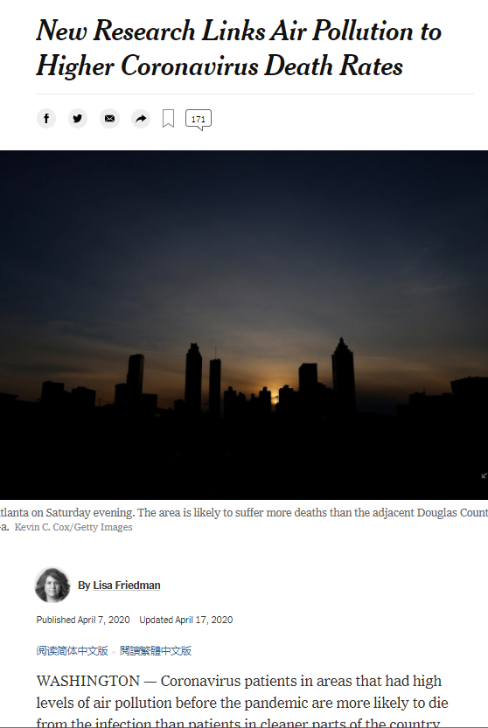
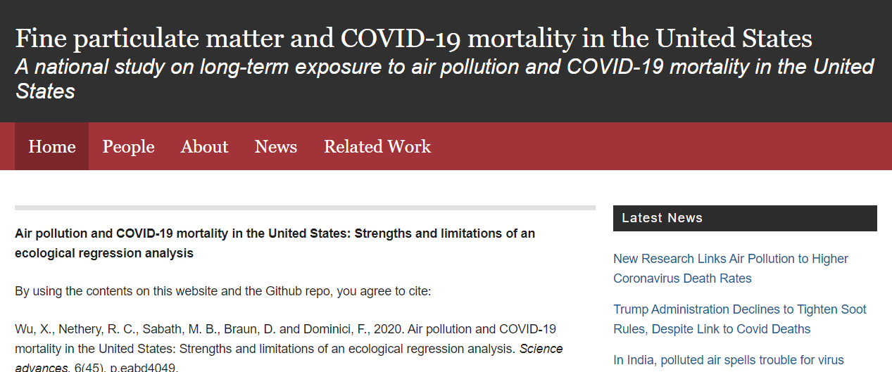
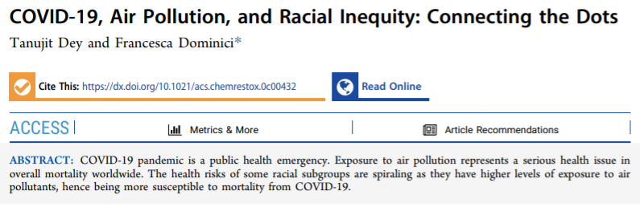
Contemporary Examples
Notes:
Summary of the analysis by (Wu et al, 2020):
“Background: United States government scientists estimate that COVID-19 may kill tens of thousands of Americans. Many of the pre-existing conditions that increase the risk of death in those with COVID-19 are the same diseases that are affected by long-term exposure to air pollution. We investigated whether long-term average exposure to fine particulate matter (PM2.5) is associated with an increased risk of COVID-19 death in the United States.
Design: A nationwide, cross-sectional ecological study using county-level data.
Data sources: COVID-19 death counts were collected for more than 3,000 counties in the United States (representing 98% of the population) from Johns Hopkins University, Center for Systems Science and Engineering Coronavirus Resource Center.
Methods: We fit negative binomial mixed models using county-level COVID-19 deaths as the outcome and county-level long-term average of PM2.5 as the exposure. In the main analysis, we adjusted by 20 potential confounding factors including population size, age distribution, population density, time since the beginning of the outbreak, time since state’s issuance of stay-at-home order, hospital beds, number of individuals tested, weather, and socioeconomic and behavioral variables such as obesity and smoking. We included a random intercept by state to account for potential correlation in counties within the same state. We conducted more than 80 additional sensitivity analyses.
Results: We found that higher historical PM2.5 exposures are positively associated with higher county-level COVID-19 mortality rates after accounting for many area-level confounders. The results were statistically significant and robust to secondary and sensitivity analyses.
Conclusions: A small increase in long-term exposure to PM2.5 leads to a large increase in the COVID-19 death rate. Despite inherent limitations of the ecological study design, our results underscore the importance of continuing to enforce existing air pollution regulations to protect human health both during and after the COVID-19 crisis. The data and code are publicly available so our analyses can be updated routinely.”
Excerpted from (Dey and Dominici, 2020):
“Recent studies have shown the connection between demographic, racial, and environmental factors and the increased severity of COVID-19 health outcomes. First, the elderly and people with multiple clinical conditions are at a higher risk of hospitalization and death due to COVID-19.1 Second, there is an increasing amount of evidence that short and long-term exposure to air pollution increases the risk of hospitalization and death due to COVID-19. Third, it has been widely documented that racial disparities play a major role in this pandemic, which is known as ‘the color of coronavirus’…the mortality risk associated with the same increase to long-term PM2.5 exposure is three times higher for African Americans. Furthermore, among zip codes with high levels of PM2.5, 90% were predominantly African American. In summary, African Americans are at higher risk of dying from exposure to air in air pollution, and African Americans consistently breath higher levels of air pollution.”
“In addition to the growing evidence that air pollution might increase vulnerability to COVID-19 resulting in hospitalization and/or death, there is another serious aspect revealed as the pandemic progresses−racial disparity. The APM Research Lab (apmresearchlab.org) reported that there are wide disparities by race; the COVID-19 mortality rates are higher among African Americans and Indigenous Americans compared to White Americans. However, when age-adjusted, the mortality rates for Latinos was much higher than any other groups…Underprivileged neighborhoods of Detroit, Chicago, and St. James Parish in Louisiana have experienced some of the country’s highest mortality rates from the virus. For example, in Louisiana, 70.5% of deaths have occurred among African Americans, although they only represent 32.2% of the state’s population.”
“This pandemic spotlighted racial disparities and the urgent need to address the causes underlying these inequities. First, racial/ethnic minority populations have a disproportionate burden of underlying comorbidities related to diabetes, cardiovascular disease, asthma, human immunodeficiency virus, morbid obesity, liver disease, and kidney disease. Second, racial/ethnic minorities in urban areas live in more crowded conditions and are more likely to be employed in public-facing roles (e.g., services, transportation, and construction), which limits physical distancing.”

Slide 11

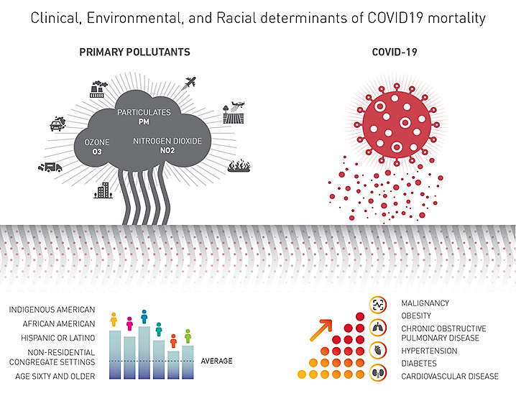
Contemporary Examples
Source: Dey and Dominici (2020)

Slide 12
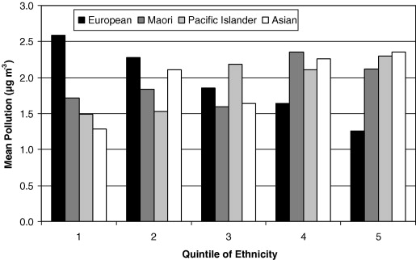
Environmental justice, traffic and/or transportation emissions, and health
Case Study: Driven to injustice? Environmental justice and vehicle pollution in Christchurch, New Zealand
From Kingham et al. (2007): The figure to the right shows the relationship between pollution and ethnicity. The mean vehicle pollution was calculated in census areas divided into quintiles according to ethnicity for European, Maori, Pacific Islander and Asian. There is a clear gradient from quintile 1 (lowest proportion European) to quintile 5 (highest proportion European) with increasing proportion of Europeans showing a decrease in level of vehicle pollution. For Maori, Pacific Islanders and Asians the pattern is less clear although pollution levels are generally higher in census areas with increased proportions of those populations.
Notes:
Case Study: Driven to injustice? Environmental justice and vehicle pollution in Christchurch, New Zealand (Kingham, Pearce and Zawar-Reza, 2007):
Introduction and scope of study:
“In this study we examine equity issues associated with levels of traffic-related air pollution, specifically PM₁₀, in Christchurch, New Zealand…The health effects of PM₁₀ in Christchurch have been assessed in a number of studies. For example, a time series study calculated that a rise of 10 μg m⁻³ in PM₁₀ leads to a 1% increase in all cause mortality and a 4% increase in mortality from respiratory causes (Hales et al., 2000). A similar approach but examining hospital admissions calculated that there is a 3.4% increase in respiratory hospital admissions and a 1.3% rise in cardiac admissions for each interquartile rise in PM₁₀ concentrations (interquartile value 14.8 μg m⁻³) (McGowan et al., 2002). Further, a national study using coarse exposure estimates found that in Christchurch particulate pollution results in the death of 142 people over the age of 30 each year; 41 of these from traffic pollution (Fisher et al., 2002). This paper does two things; first it examines whether disadvantaged groups in Christchurch were more likely to be exposed to higher levels of vehicle pollution; and second it estimates the extent to which people living in different areas contribute towards the levels of traffic-related air pollution.” (Kingham, Pearce and Zawar-Reza, 2007)
Results:
“This study uses geographically-detailed and accurate estimates of vehicle air pollution to examine whether there are inequities in exposure among different socioeconomic groups across the city of Christchurch, New Zealand. A key finding is that in more socially deprived neighbourhoods, and areas of the city with a greater proportion of low income households, mean levels of vehicle particulate pollution were significantly higher than in low deprivation and high income areas. In addition, areas with higher levels of traffic-related pollution have greater proportions of Maori, Pacific Islanders and Asians…” In addition to examining social differences in vehicle pollution exposure, this research has also identified that in areas with higher levels of car ownership, the level of traffic-related air pollution exposure is lower. In other words, those neighbourhoods with the highest levels of car ownership are exposed to the lowest levels of vehicle pollution…” (Kingham, Pearce and Zawar-Reza, 2007)
Conclusion:
“This work has considered issues of environmental justice and traffic-related air pollution in Christchurch, New Zealand. The results provide convincing evidence that exposure to traffic-related pollution is highest among the most disadvantaged groups in society. In addition, it has been shown that not only are people who live in more deprived areas exposed to higher levels of traffic pollution, but they also own proportionately less cars; the key source of traffic pollution. In combination, these results suggest clear social injustices in traffic-related air pollution exposure in Christchurch, New Zealand.” (Kingham, Pearce and Zawar-Reza, 2007)

Slide 13
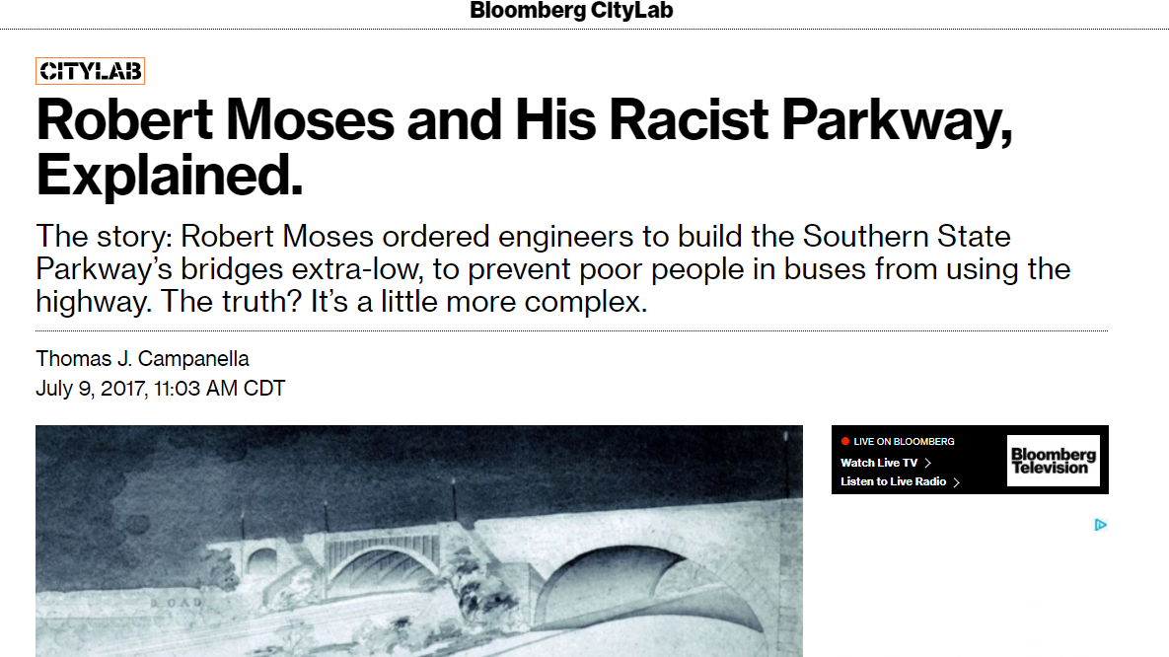
The national legacy of the transportation and EJ in urban areas
Notes:
Extracted from (Fuller and Brugge, 2020):
“Transportation has a long and negative history with low-income, immigrant and people of color communities that have been adversely impacted in the name of “urban renewal”. The leader and the most prominent purveyor of urban transportation development was Robert Moses; who over the course of 44 years redrew the map of New York City disrupting the lives of thousands of people (6, 7). Moses was never elected to any public office but held a number of government positions that he manipulated in order to refashion the city as he saw fit. Beginning in 1920, he built miles of highways throughout the boroughs of New York displacing approximately 250,000 people from their homes. Moses created a city for vehicles and not people, putting high-speed traffic corridors straight through formerly bustling areas of commerce, recreation and residences. Neither the physical health nor the economic health of the minority, working class and immigrant neighborhoods in the Bronx, Manhattan and Brooklyn were considered in his sweeping plans for regional transportation. Highways provided limited access for the communities through which they passed, leaving behind pollution, noise and crime. The public transit that was available, usually diesel-fueled buses, was unreliable and often serviced and housed in low-income, minority areas.
The strategy pioneered by Robert Moses became the de facto plan for other modernizing cities across the country. Cities such as Los Angeles, Milwaukee, and Atlanta, built highways leading from downtown jobs into affluent and predominantly white suburbs. Many times, well-utilized light rail systems were dismantled to make space for highways such as in Los Angeles. The pollution, noise and unsightliness of highways caused neighboring businesses and residents to flee leaving openings for crime and neglect. Those without sufficient resources to leave remained in the declining neighborhoods surviving as best they could. Many of these areas have remained in disrepair to this day and due to relative low-cost living have drawn additional people from marginalized segments of the population. Older European cities – like London, Paris and Barcelona – have also struggled with increased burden in air pollution due to vehicles. These cities were built for travel by foot and horse, before the development of the car and are now choked with traffic. In these cities as well, new highways were built through old neighborhoods in order to connect urban areas by car.”

Slide 14
Discussion
Transportation encompasses four elements impacting health
  How might these elements differ between different groups based on SES and ethnicity?
  What other factors are important in the context of EJ?
  What do these differences mean in terms of adverse or beneficial exposures and associated health effects?
Are EJ trends different in different countries and how might they differ between rural and urban communities?
Minority and low SES populations are disproportionately exposed to TRAP putting them at greater risk of developing adverse health effects
  What are the implications of disproportionate exposure beyond health effects?
  Confounding and co-exposure issues are also not fully understood and residual confounding may be an issue (Fuller and Brugge, 2020)
  These same populations might also be more susceptible due to their SES or ethnicity and genetics, in addition to other intrinsic and extrinsic factors
Notes:
Transportation encompasses four elements impacting health as described in Khreis et al. 2019: 1. Infrastructure: construction, maintenance, and rehabilitation of roads, parking spaces, cycling and pedestrian lanes, public transportation hubs, freight hubs, railways, electric grids, electricity generation stations, etc.; 2. Mode choice: car, public transport, walking, cycling, freight, plane, boat, etc.; 3. Land-use and the build environment: refers to urban design, development decisions, density, diversity, distance to public transportation, destination accessibility, distribution centers, etc.; 4. Technologies and disruptors: connected, autonomous, shared, zero and near-zero emissions passenger/freight vehicles, 3-D printing, etc.
How might these elements differ between countries? Consider the implications for EJ when discussing the differences?
Minority and low SES populations are disproportionately exposed to TRAP putting them at greater risk of developing adverse health effects
What are the implications of disproportionate exposure beyond health effects? – There is also economic impacts (Center for Disease Control and Prevention, 2011; Nurmagambetov et al., 2017):
Cost of medical visits, medication, missed work days, hospitalizations.
Issues of confounding are still not well understood, and are complicated due to the high correlations between SES, ethnic minorities, living near major roadways and a multitude of adverse environmental exposures such as TRAP and traffic-related noise. The aspect of the near highway environment that is causally responsible of the adverse health effects observed in those environments is not yet firmly established. The associations/ correlations between the factors above makes it hard to tease apart the relative effects of such factors.
Extracted from (Fuller and Brugge, 2020): “From an EJ perspective, correlation between measures of SES and/or minority status and exposure to environmental hazards is of interest and concern. However, even if these populations are differentially proximal to heavily trafficked corridors, and that would in and of itself constitute an injustice, this does not necessarily mean that their health problems are due solely to the traffic pollution exposure. This is because SES influences health in other ways such as the likelihood of smoking, poor diet and healthcare access, that could confound the effect of local air pollution exposure. Being a member of a minority group is also associated with daily chronic psychosocial stress, which is linked to mortality and chronic conditions like hypertension (27). SES and minority status can also modify exposure to TRAP. Many low-income residents, for example in public housing, might live in drafty buildings and must open windows for ventilation potentially increasing exposure to outdoor pollution (28). Even if ambient pollution levels are similar for low and high income residents, better ventilation systems in market rate and luxury housing likely results in disparate exposures along socioeconomic lines.”

Slide 15
Discussion
How can researchers, practitioners, and policymakers consider EJ to improve environmental quality and health equity?
  Consider perspectives from different fields – For example, how will considerations differ between a transportation planner and a public health policy advocate?
  A multitude of strategies exist and in the context of TRAP, can target reducing vehicle emissions, contact/exposure to these sources, and susceptibility
Notes:
How can researchers, practitioners, and policymakers consider EJ to improve environmental quality and health equity?
Consider perspectives from different fields – For example, how will considerations differ between a transportation planner and a public health policy advocate?

Slide 16
Research Gaps and Future Directions
Recommendations for transportation emissions, air quality, health, and EJ (Cohen and Shirazi, 2016; Kingham, Pearce and Zawar-Reza, 2007):
  High quality traffic-related air pollution exposure data
  Accurate air quality models
  Assessment of transportation impacts on EJ
  Improved understanding of air pollution risks among sensitive populations
  Increased data on the impact of emerging technologies (i.e. connected, shared, autonomous, and electric vehicles)
Notes:
We must think how to improve the current state of research/policy/practice of transportation emissions, air quality, and health with respect to EJ. We must also think about future directions to best prepare for the unknown impacts of emerging technologies. The following recommendations have been taken from (Cohen and Shirazi, 2016; Kingham, Pearce and Zawar-Reza, 2007):
Current state improvements include:
High quality traffic-related air pollution exposure data
Accurate air quality models
Assessment of transportation impacts on environmental justice
Improved understanding of air pollution risks among sensitive populations
Future considerations include:
Impact of emerging technologies, such as connected, shared, autonomous, and electric vehicles
These recommendations are necessary if we are to improve health equity and will require interdisciplinary collaboration among transportation, environmental, health, and EJ researchers, practitioners, and policymakers.

Slide 17
Research Gaps and Future Directions
Teasing apart the relative effects of different factors in the near-roadway environment
Considering and adjusting for confounders and effect modifiers
A better understanding of the U- or J-shaped association previously documented between adverse exposures and income is needed, including better understanding of local contexts and differences between countries and within cities and neighborhoods (Khreis et al., 2020; Mitchell and Dorling, 2003)
A better understanding of the other exposures, their variations and health effects and EJ concerns (e.g. traffic noise, urban heat, green space, contamination)
Notes:
We must think how to improve the current state of research/policy/practice of transportation emissions, air quality, and health with respect to EJ. We must also think about future directions to best prepare for the unknown impacts of emerging technologies.
Teasing apart the relative effects of different factors in the near-roadway environment
Considering and adjusting for confounders and effect modifiers
A better understanding of the U- or J-shaped association previously documented between adverse exposures and income is needed, including better understanding of local contexts and differences between countries and within cities and neighborhoods (Khreis et al, 2020; Mitchell and Dorling, 2003)
A better understanding of the other exposures, their variations and heath effects and EJ concerns (e.g. traffic noise, urban heat, green space, contamination)
These recommendations are necessary if we are to improve health equity and will require interdisciplinary collaboration among transportation, environmental, health, and EJ researchers, practitioners, and policymakers.

Slide 18
Take-Home Messages
Transportation has a long and negative history with low-income, immigrant and people of color communities
Transportation has adversely impacted those communities through many different pathways, including TRAP, which is relatively well-researched
TRAP is associated with a wide range of adverse health effects
Minority and low SES populations are disproportionately exposed to TRAP and other adverse transportation-related exposures (e.g. traffic noise, motor vehicle crashes, lack of green space)
An improved understanding of EJ is necessary to improve health equity and requires high-quality data and assessments and accounting for confounders and effect modifiers
Interdisciplinary collaboration is needed to improve research, practice, and policy
Notes:
TRAP is associated with a wide range of adverse health effects including (but not limited to: premature mortality (Beelen et al, 2014), cancer (Raaschou-Nielsen et al, 2013), cardiovascular effects (Brook et al, 2010; Link and Dockery, 2010; Mustafić et al, 2012; Cesaroni et al, 2014), cerebrovascular effects (Stafoggia et al, 2014), respiratory effects (Lindgren et al, 2009; Gasana et al, 2012; MacIntyre et al, 2014; Khreis et al, 2017), reproductive effects (Vrijheid et al, 2011; Sapkota et al, 2012; Fleischer et al, 2014; Pedersen et al, 2014; Lafuente et al, 2016), neurological and cognitive effects (Raz et al, 2015; Power et al, 2016), metabolic effects (Jerrett et al, 2014; Eze et al, 2015), and bone effects (Prada et al, 2017).
Minority and low SES populations are disproportionately exposed to TRAP. Interestingly, “despite driving less, low SES and non-whites bear disproportionately high air pollution impacts from all sources—especially transportation sources. In contrast, both white and high SES populations tend to have higher rates of car ownership and to drive more while the air pollution impacts at their homes tend to be lower” (Pratt et al, 2015).
An improved understanding of EJ is necessary to improve health equity and requires high-quality data and assessments. Specific recommendations to achieve this have been made (Cohen and Shirazi, 2016; Kingham, Pearce and Zawar-Reza, 2007).
Interdisciplinary collaboration is needed to improve research, practice, and policy (Carr, Loucks and Blöschl, 2018) across transportation, environmental, health, and EJ.

Slide 19
List of Abbreviations
Abbreviation | Meaning
COVID-19 | Coronavirus Disease 2019
EEB | European Environmental Bureau
EJ | Environmental Justice
EO | Executive Order
SES | Socioeconomic Status
TRAP | Traffic-related Air Pollution
UCC | United Church of Christ
US EPA | United States Environmental Protection Agency

Slide 20
References
Barthelemy, J. et al. (2020) ‘New Opportunities to Mitigate the Burden of Disease Caused by Traffic Related Air Pollution: Antioxidant-Rich Diets and Supplements’, International Journal of Environmental Research and Public Health, 17, pp. 630. Available at: https://doi.org/10.3390/ijerph17020630
Beelen, R. et al. (2014) ‘Effects of long-term exposure to air pollution on natural-cause mortality: an analysis of 22 European cohorts within the multicentre ESCAPE project’, The Lancet, 383(9919), pp. 785–795. Available at: https://doi.org/10.1016/S0140-6736(13)62158-3
Brook, R. D. et al. (2010) ‘Particulate Matter Air Pollution and Cardiovascular Disease’, Circulation, 121(21), pp. 2331–2378. Available at: https://doi.org/10.1161/CIR.0b013e3181dbece1
Bullard, R. D. (1990) Dumping in Dixie: Race, Class, and Environmental Quality. Boulder, CO: Westview Press.
Bullard, R. D. (1994). Dumping in Dixie: Race, class, and environmental quality. 2nd ed. Boulder: Westview Press.
Bullard, R. D. et al. (2008) ‘Toxic wastes and race at twenty: Why race still matters after all of these years’, Environmental Law, 38(2), pp. 371–411. Available at: https://www. jstor.org/stable/43267204.
Carr, G., Loucks, D. P. and Blöschl, G. (2018) ‘Gaining insight into interdisciplinary research and education programmes: A framework for evaluation’, Research Policy, 47(1), pp. 35–48. Available at: doi: 10.1016/j.respol.2017.09.010.
Center for Disease Control and Prevention (2011) Asthma in the US [Online]. Available at: https://www.cdc.gov/vitalsigns/asthma/index.html

Slide 21
References
Centers for Disease Control and Prevention (2020) Hospitalization and Death by Race/Ethnicity [Online]. Available at: https://www.cdc.gov/coronavirus/2019-ncov/covid-data/investigations-discovery/hospitalization-death-by-race-ethnicity.html#footnote01
Cesaroni, G. et al. (2014) ‘Long term exposure to ambient air pollution and incidence of acute coronary events: prospective cohort study and meta-analysis in 11 European cohorts from the ESCAPE Project’, BMJ, 348, pp. f7412–f7412. doi: 10.1136/bmj.f7412.
Chen, K.L. et al. (2020) ‘Transportation Access to Health Care During the COVID-19 Pandemic: Trends and Implications for Significant Patient Populations and Health Care Needs’. Available at: https://escholarship.org/uc/item/22b3b1rc
Clark, L. P., Millet, D. B. and Marshall, J. D. (2014) ‘National Patterns in Environmental Injustice and Inequality: Outdoor NO2 Air Pollution in the United States’, PLoS ONE, 9(4), pp. e94431. Available at: doi: 10.1371/journal.pone.0094431
Clark, L.P., Millet, D.B., Marshall, J.D. (2017) ‘Changes in Transportation-Related Air Pollution Exposures by Race-Ethnicity and Socioeconomic Status: Outdoor Nitrogen Dioxide in the United States in 2000 and 2010’, Environmental Health Perspectives, 125(9). Available at: https://ehp.niehs.nih.gov/doi/abs/10.1289/EHP959
Cohen, S. and Shirazi, S. (2016) ‘Can We Advance Social Equity with Shared, Autonomous and Electric Vehicles?’. Available at: https://www.transformca.org/transform-report/can-we-advance-social-equity-shared-autonomous-and-electric-vehicles
Committee on Environmental Justice, Institute of Medicine, National Academy of Sciences. (2000) ‘Toward environmental justice’. Washington, DC: National Academies Press. Available at: http://www.nap.edu/6034
Dey, T. and Dominici, F. (2020) ‘COVID-19, Air Pollution, and Racial Inequity: Connecting the Dots’, Chemical Research in Toxicology. Available at: https://doi.org/10.1021/acs.chemrestox.0c00432
European Environmental Bureau (2018) ‘Global and Regional Policies Environmental Justice’. Available at: https://eeb.org/global-and-regional-policies/environmental-justice/.

Slide 22
References
Eze, I. C. et al. (2015) ‘Association between Ambient Air Pollution and Diabetes Mellitus in Europe and North America: Systematic Review and Meta-Analysis’, Environmental Health Perspectives, 123(5), pp. 381–389. Available at: https://doi.org/10.1289/ehp.1307823.
Fleischer, N. L. et al. (2014) ‘Outdoor Air Pollution, Preterm Birth, and Low Birth Weight: Analysis of the World Health Organization Global Survey on Maternal and Perinatal Health’, Environmental Health Perspectives, 122(4), pp. 425–430. Available at: https://doi.org/10.1289/ehp.1306837.
Fox, M. A., Groopman, J. D., & Burke, T. (2002). Evaluating cumulative risk assessment for environmental justice: A community case study. Environmental Health Perspectives, 110(2), pp. 203–209. Available at: https://doi.org/sc271_5_1835
Fuller, C.H. and Brugge, D. (2020) ‘Environmental justice: Disproportionate impacts of transportation on vulnerable communities’ in Traffic-Related Air Pollution. Elsevier, pp. 495-510.
Gasana, J. et al. (2012) ‘Motor vehicle air pollution and asthma in children: A meta-analysis’, Environmental Research, 117, pp. 36–45. Available at: https://doi.org/10.1016/j.envres.2012.05.001
Glaeser, E. L., Kahn, M. E. and Rappaport, J. (2008) ‘Why do the poor live in cities? The role of public transportation’, Journal of Urban Economics, 63(1), pp. 1–24. Available at: https://doi.org/10.1016/j.jue.2006.12.004.
Grineski, S.E., Collins, T.W. (2018) ‘Geographic and social disparities in exposure to air neurotoxicants at U.S. public schools’, Environmental Research, 161, pp. 580-587. Available at: https://doi.org/10.1016/j.envres.2017.11.047
Gee, G. C., and Payne-Sturges, D. C. (2004) ‘Environmental health disparities: A framework integrating psychosocial and environmental concepts’, Environmental Health Perspectives, 112(17), pp. 1645–1653. Available at: https://doi.org/10.1289/ehp.7074

Slide 23
References
Glazener, A. et al. (2021) ‘Fourteen Pathways between Urban Transportation and Health: A Conceptual Model and Literature Review’, Journal of Transport and Health. Accepted.
Héritier, H. et al. (2017) ‘Transportation noise exposure and cardiovascular mortality: a nationwide cohort study from Switzerland’, European Journal of Epidemiology, 32(4), pp. 307-315. Available at: https://doi.org/10.1007/s10654-017-0234-2
Jerrett, M. et al. (2001) ‘A GIS–Environmental Justice Analysis of Particulate Air Pollution in Hamilton, Canada’, Environment and Planning A: Economy and Space, 33(6), pp. 955–973. Available at: https://doi.org/10.1068/a33137.
Jerrett, M. et al. (2014) ‘Traffic-related air pollution and obesity formation in children: a longitudinal, multilevel analysis’, Environmental Health, 13(1), pp. 49. Available at: https://doi.org/10.1186/1476-069X-13-49.
Karaye, I.M. and Horney, J.A., (2020) ‘The impact of social vulnerability on COVID-19 in the US: an analysis of spatially varying relationships’, American Journal of Preventive Medicine, 59(3), pp. 317-325. Available at: https://doi.org/10.1016/j.amepre.2020.06.006
Khazanchi, R. et al. (2020) ‘County-level association of social vulnerability with COVID-19 cases and deaths in the USA’, Journal of General Internal Medicine, 35(9), pp. 2784-2787. Available at: https://dx.doi.org/10.1007%2Fs11606-020-05882-3
Khreis, H. et al. (2017) ‘Exposure to traffic-related air pollution and risk of development of childhood asthma: A systematic review and meta-analysis’, Environment International, 100, pp. 1–31. Available at: https://doi.org/10.1016/j.envint.2016.11.012.
Khreis, H. et al. (2019) Transportation and Health: A Conceptual Model and Literature Review [Online]. Available at: https://www.carteeh.org/14-pathways-to-health-project-brief/.

Slide 24
References
Khreis, H., de Hoogh, K. and Nieuwenhuijsen, M. J. (2018) ‘Full-chain health impact assessment of traffic-related air pollution and childhood asthma’, Environment International, 114, pp. 365–375. Available at: https://doi.org/10.1016/j.envint.2018.03.008.
Khreis, H. et al. (2020). ‘The impact of baseline incidence rates on burden of disease assessment of air pollution and onset childhood asthma: analysis of data from the contiguous United States’, Annals of Epidemiology, 53, pp. 76-88. Available at: https://doi.org/10.1016/j.annepidem.2020.08.063
Kingham, S., Pearce, J. and Zawar-Reza, P. (2007) ‘Driven to injustice? Environmental justice and vehicle pollution in Christchurch, New Zealand’, Transportation Research Part D: Transport and Environment, 12(4), pp. 254–263. Available at: https://doi.org/10.1016/j.trd.2007.02.004.
Lafuente, R. et al. (2016) ‘Outdoor air pollution and sperm quality’, Fertility and Sterility, 106(4), pp. 880–896. Available at: https://doi.org/10.1016/j.fertnstert.2016.08.022.
Lindgren, A. et al. (2009) ‘Traffic-related air pollution associated with prevalence of asthma and COPD/chronic bronchitis. A cross-sectional study in Southern Sweden’, International Journal of Health Geographics, 8(1), pp. 2. Available at: https://doi.org/10.1186/1476-072X-8-2.
Link, M. S. and Dockery, D. W. (2010) ‘Air pollution and the triggering of cardiac arrhythmias’, Current Opinion in Cardiology, 25(1), pp. 16–22. Available at: https://doi.org/10.1097/HCO.0b013e32833358cd.
Litman, T. (2019). ‘Evaluating Transportation Equity’, Victoria Transportation Policy Institute. Available at: https://www.vtpi.org/equity.pdf

Slide 25
References
McAndrews, C., and Marcus, J. (2014), ‘Community-Based Advocacy at the Intersection of Public Health and Transportation: The Challenges of Addressing Local Health Impacts within a Regional Policy Process’, Journal of Planning Education and Research, 34(2), pp. 190-202. Available at: https://doi.org/10.1177%2F0739456X14531624
MacIntyre, E. A. et al. (2014) ‘Air Pollution and Respiratory Infections during Early Childhood: An Analysis of 10 European Birth Cohorts within the ESCAPE Project’, Environmental Health Perspectives, 122(1), pp. 107–113. Available at: https://doi.org/10.1289/ehp.1306755.
Millett, G.A. et al. (2020), ‘Assessing differential impacts of COVID-19 on Black communities’, Annals of Epidemiology, 47, pp. 37-44. Available at: https://dx.doi.org/10.1016%2Fj.annepidem.2020.05.003
Mitchell, G. and Dorling, D. (2003) ‘An environmental justice analysis of British air quality’, Environment and Planning A: Economy and Space, 35(5), pp. 909-929. Available at: https://doi.org/10.1068%2Fa35240
Mustafić, H. et al. (2012) ‘Main Air Pollutants and Myocardial Infarction’, JAMA, 307(7), pp. 713. Available at: https://doi.org/10.1001/jama.2012.126.
Nurmagambetov, T. et al. (2017) ‘State-level medical and absenteeism cost of asthma in the United States’, Journal of Asthma, 54(4), pp. 357–370. Available at: https://doi.org/10.1080/02770903.2016.1218013.
Pedersen, M. et al. (2014) ‘Ambient Air Pollution and Pregnancy-Induced Hypertensive Disorders’, Hypertension, 64(3), pp. 494–500. Available at: https://doi.org/10.1161/HYPERTENSIONAHA.114.03545.
Power, M. C. et al. (2016) ‘Exposure to air pollution as a potential contributor to cognitive function, cognitive decline, brain imaging, and dementia: A systematic review of epidemiologic research’, NeuroToxicology, 56, pp. 235–253. Available at: https://doi.org/10.1016/j.neuro.2016.06.004.
Prada, D. et al. (2017) ‘Association of air particulate pollution with bone loss over time and bone fracture risk: analysis of data from two independent studies’, The Lancet Planetary Health, 1(8), pp. e337–e347. Available at: https://doi.org/10.1016/S2542-5196(17)30136-5.

Slide 26
References
Pratt, G. et al. (2015) ‘Traffic, Air Pollution, Minority and Socio-Economic Status: Addressing Inequities in Exposure and Risk’, International Journal of Environmental Research and Public Health, 12(5), pp. 5355–5372. Available at: https://doi.org/10.3390/ijerph120505355.
Raaschou-Nielsen, O. et al. (2013) ‘Air pollution and lung cancer incidence in 17 European cohorts: prospective analyses from the European Study of Cohorts for Air Pollution Effects (ESCAPE)’, The Lancet Oncology, 14(9), pp. 813–822. Available at: https://doi.org/10.1016/S1470-2045(13)70279-1.
Raz, R. et al. (2015) ‘Autism Spectrum Disorder and Particulate Matter Air Pollution before, during, and after Pregnancy: A Nested Case–Control Analysis within the Nurses’ Health Study II Cohort’, Environmental Health Perspectives, 123(3), pp. 264–270. Available at: https://doi.org/10.1289/ehp.1408133.
Rowangould, G.M. (2013) ‘A census of the US near-roadway population: Public health and environmental justice considerations’, Transportation Research Part D: Transport and Environment, 25, pp. 59-67. Available at: https://doi.org/10.1016/j.trd.2013.08.003
Sapkota, A. et al. (2012) ‘Exposure to particulate matter and adverse birth outcomes: a comprehensive review and meta-analysis’, Air Quality, Atmosphere & Health, 5(4), pp. 369–381. Available at: https://doi.org/10.1007/s11869-010-0106-3.
Salleh, M.R. (2008) ‘Life event, stress and illness’, The Malaysian Journal of Medical Sciences, 15(4), pp. 9-18. Available at: https://pubmed.ncbi.nlm.nih.gov/22589633

Slide 27
References
Scheil-Adlung, X. (2015) ‘Global evidence on inequities in rural health protection - New data on rural deficits in health coverage for 174 countries’. International Labour Office, Social Protection Department, Geneva. Available at: http://www.social-protection.org/gimi/gess/RessourcePDF.action;jsessionid=CTG2X8-Kxshv8cBbEYlxEvMGLWdNwawOfVNn6rxb-A4h9N2VDU5P!-1866027263?id=51297
Stafoggia, M. et al. (2014) ‘Long-Term Exposure to Ambient Air Pollution and Incidence of Cerebrovascular Events: Results from 11 European Cohorts within the ESCAPE Project’, Environmental Health Perspectives, 122(9), pp. 919–925. Available at: https://doi.org/ 10.1289/ehp.1307301.
Stokes, E. et al. (2020) ‘Coronavirus Disease 2019 Case Surveillance - United States, January 22-May 30, 2020’, MMWR Morbidity and Mortality Weekly Report 2020, 69, pp. 759-765. Available at: https://www.cdc.gov/mmwr/volumes/69/wr/mm6924e2.htm?s_cid=mm6924e2_w#suggestedcitation

Slide 28
References
Tessum, C.W. et al. (2019) ‘Inequity in consumption of goods and services adds to racial–ethnic disparities in air pollution exposure’, Proceedings of the National Academy of Sciences, 116, pp. 6001-6006. Available at: https://www.pnas.org/content/pnas/116/13/6001.full.pdf
Transportation Research Board (2002) Surface Transportation Environmental Research: A Long-Term Strategy – Special Report 268. Washington, DC. Available at: https://www.nap.edu/catalog/10354/surface-transportation-environmental-research-a-long-term-strategy-special-report
Walson, J.L., and Berkley, J.A. (2018) ‘The impact of malnutrition on childhood infections’, Current Opinion in Infectious Diseases, 31. Available at: https://journals.lww.com/co-infectiousdiseases/Fulltext/2018/06000/The_impact_of_malnutrition_on_childhood_infections.5.aspx
Wright, R.J., and Steinbach, S.F. (2001) ‘Violence: an unrecognized environmental exposure that may contribute to greater asthma morbidity in high risk inner-city populations’, Environmental Health Perspectives, 109, pp. 1085-1089. Available at: https://ehp.niehs.nih.gov/doi/abs/10.1289/ehp.011091085

Slide 29
References
Wu, X. et al. (2020) ‘Air pollution and COVID-19 mortality in the United States: Strengths and limitations of an ecological regression analysis’, Science Advances, 6(45), pp. eabd4049. Available at: https://advances.sciencemag.org/content/6/45/eabd4049
United States Department of Justice (no date) Title VI of the Civil Rights Act of 1964 [Online]. Available at: https://www.justice.gov/crt/fcs/TitleVI.
United States Environmental Protection Agency (2020a) Environmental Justice [Online]. Available at: https://www.epa.gov/environmentaljustice.
United States Environmental Protection Agency (2020b) Summary of Executive Order 12898 - Federal Actions to Address Environmental Justice in Minority Populations and Low-Income Populations [Online]. Available at: https://www.epa.gov/laws-regulations/summary-executive-order-12898-federal-actions-address-environmental-justice.
Vrijheid, M. et al. (2011) ‘Ambient Air Pollution and Risk of Congenital Anomalies: A Systematic Review and Meta-analysis’, Environmental Health Perspectives, 119(5), pp. 598–606. Available at: https://doi.org/ 10.1289/ehp.1002946.

Slide 30
Reading List
Khreis, H. and Nieuwenhuijsen, M.J., 2019. The health impacts of urban transport: Linkages, tools and research needs. In Measuring Transport Equity (pp. 131-142). Elsevier.
US DOT Environmental Toolkit https://www.environment.fhwa.dot.gov/env_topics/environmental_justice.aspx
US DOT Environmental Justice https://www.transportation.gov/transportation-policy/environmental-justice#:~:text=Environmental%20Justice%20(EJ)%20is%20the,environmental%20laws%2C%20regulations%20and%20policies.
Transportation and Environmental Research Ideas (TERI) database is a central storehouse for tracking and sharing new transportation and environmental research ideas. https://environment.transportation.org/teri_database/view_ideas.aspx?focus_filter=4

Slide 31
Acknowledgements
These lecture slides were created with support from the Texas A&M Transportation Institute’s Center for Advancing Research in Transportation Emissions, Energy, and Health, a U.S. Department of Transportation’s University Transportation Center, College Station, TX. The grant number is 69A3551747128. More information about the Center for Advancing Research in Transportation Emissions, Energy, and Health is available at: https://www.carteeh.org/.
The authors acknowledge materials adapted from the chapter titled “Environmental justice: Disproportionate impacts of transportation on vulnerable communities” by Christina Fuller and Douglas Brugge (2020)

