Slide 1
www.carteeh.org

Slide 2
Lecture #9: Transportation and Land-Use Planning
Randall L. Guensler, Ph.D., Professor
School of Civil and Environmental Engineering
Georgia Institute of Technology
Randall.guensler@ce.gatech.edu
&
Michael O. Rodgers, Ph.D., Adjunct Regents’ Professor
School of Civil and Environmental Engineering
Georgia Institute of Technology
Michael.rodgers@ce.gatech.edu, (404) 385-0569
The authors have no known conflicts of interest in the presentation of these materials
Lecture Track(s): HT/TT/PPT
Notes:
Health Track (HT)—mainly targeted at urban planners, transportation planners, and engineers with limited knowledge of public health-related concepts;
Transportation Track (TT)—mainly targeted at environmental epidemiologists and public health professionals with limited knowledge of transportation-related concepts; and;
Planning and Policy Track (PPT)—mainly targeted at planners, civil servants, and policy and decision makers with particular interest in the science-policy link.

Slide 3
Introduction
Civilized society is based on the presence and maintenance of many interacting systems necessary to supply the population with the social, energy, material and information resources necessary for life.
Among the most important of these are:
Legal, cultural, educational and financial systems
Personal, and collective security
Energy, water, waste handling and communications systems
Health care
Food and Environmental Protection
Built environment
Transportation
Development and maintenance of these systems requires planning
Notes:
This introduction is designed to place the concept of transportation within the broader contest of the Urban Systems necessary to support human society. Transportation, broadly defined, makes up about one-sixth of the economy as is highly interactive with each of the other systems. With the exception of recreational travel, transportation is rarely the central element in any of these systems but rather plays a supporting role. As such, students often fail to realize how failures within the transportation system are likely to impact virtually every are of their lives from the availability of food and other goods to their ability to play online video games (construction and maintenance of internet requires the use of literally millions of vehicles). In the next slide we will begin the discussion of the transportation planning process developed from the concept of three “core values” of a good transportation system. One that provides mobility and accessibility for users; contributes to other systems (economic development), while ensuring environmental quality.

Slide 4
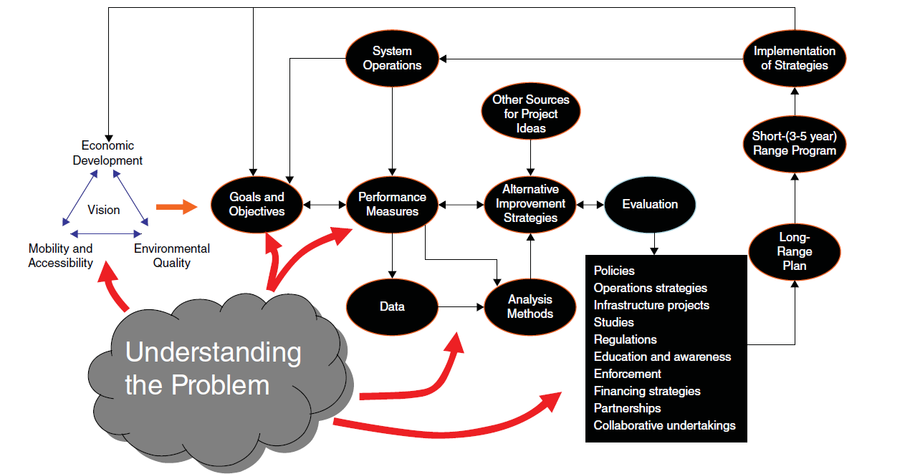
Transportation Planning
Institute of Transportation Engineers (2016)
Notes:
This slide is designed to show the numerous interactions between needs, objectives and tools available in the planning process. Beginning on the left, the Transportation “vision” seeks to balance the simultaneous interests of economic development, mobility and accessibility and preservation of the environment. This balance is a close approximation to, and derived from, the “three-legged stool” of sustainable development (i.e. economic sustainability, environmental sustainability, and social sustainability). For students not familiar with these concepts, adding additional materials regarding sustainable development may be desirable. Continuing through the diagram, this vision leads to particular goals and objectives within the transportation planning process. Evaluation of the current state of the transportation system, as well as current and future trends is based on particular “performance measures” selected to reflect the degree to which the systems performs relative to its objectives. These “performance measures” can range from objective measures, such as travel time and congestion delays, to more subjective measures such as degrees of customer satisfaction. Through collection and analysis of data from various sources as well other sources of project ideas (e.g. new technologies or potential economic development needs), planners can develop a range of potential improvement strategies for the transportation system that can be evaluated for both their desirability and potential effectiveness. The evaluation (planning process) will typically also include an evaluation of the various tools available for implementation of the projects/plans as well as the timing and scope of these projects/plans based on available resources. These evaluations are typically presented for both public comment and to decision makers for their approval and/or modifications. In the United States, these projects are required to be approved by designated authorities and organized into both long-range plans (regional transportation plan or RTP) and short-term plans (transportation improvement program or TIP) before implementation. The upper arrows on the diagram show the continuous feedback between implemented projects/plans and system operations and planning.

Slide 5
Transportation Needs
Mobility
and
Accessibility
Notes:
One of the “Value” cornerstones of the Transportation Planning process described in the previous slide is that of “Mobility and Accessibility”. This concept relates to all types of movements within the economy and involves the movements of people, goods and the delivery of services. Given this definition, transportation impacts virtually every aspect of life and economic activity. As a consequence, transportation is responsible for roughly one sixth of the world economy and the ability to effectively move people and goods and to efficiently deliver services is a major differentiator between economies. Very often, it is the lack of access to effective, reliable and efficient transportation that limits economic activity in developing countries. The transportation system itself is composed of three interacting systems. These are, vehicles, fuels and infrastructure. The transportation planning process described in this lecture is largely focused on ensuring the necessary infrastructure for the operation of vehicles and their fuel (energy) supply is available, reliable and effectively managed. In the next slides we will be discussing the different users of the transportation system and the mechanisms available to ensure that transportation infrastructure is adequate to meet societal needs.

Slide 6
Transportation Needs
People (Personal Mobility)
Mobility
and
Accessibility
Notes:
Personal mobility is a social good. Mobility allows individuals to move between locations for work (economic), shopping (both required and discretionary), social interactions, religious purposes, recreation and sight seeing, and a variety of other purposes. While transportation is often equated to mobility, the concept of accessibility is also important. Lack of access to transportation vehicles, fuels or infrastructure can be, and is, an important consideration for social equity. Populations with limited transportation access are at a significant economic and social disadvantage to groups with better access. Thus, transportation planning must consider both mobility and accessibility in developing an equitable allocation of transportation resources. That being said, there are often significant tradeoffs in considering both aspects together. For example, construction of transportation infrastructure (e.g. and interstate highway) may significant increase mobility for certain users with reducing access to those services for others.

Slide 7
Transportation Needs
People (Personal Mobility)
Goods Movement
Mobility
and
Accessibility
Notes:
Many individuals, especially in urban areas, often equate the transportation with personal mobility. However, from both an economic and human perspective the efficient movement of goods is an essential aspect of the transportation systems. From a human perspective, no large city is self sufficient in food, medicine, fuels and other goods and must be continually resupplied to allow city life to continue. One the first impacts of natural or man-made disasters that impact the transportation systems is a widespread shortage of goods.

Slide 8
Transportation Needs
People (Personal Mobility)
Goods Movement
Delivery of Services
Mobility
and
Accessibility
Notes:
In addition to people and goods, an effective transportation system must consider the need to deliver both essential and desirable services to locations where they are needed. Fire, police and ambulance services are well known examples but the actual usage of transportation for services is much greater than normally realized. Most home and commercial services (e.g. lawn and garden, plumbing, electrical) as well construction and maintenance (e.g. utility trucks) are other examples.

Slide 9
Planning to Meet Transportation Needs
Intelligent Transportation Systems
Transit Facilities and Services
Intermodal Facilities and Services
System Operations
Traffic Engineering
Bike and Pedestrian
Highway Capacity
SUPPLY MANAGEMENT
Mobility
and
Accessibility
Source: Meyer and Miller (2014)
Notes:
Transportation planners have a number of tools at their disposal to ensure that the transportation system can meet the needs for personal mobility, goods movement and service delivery. The first, and perhaps most obvious method, is in managing the supply (capacity) of the transportation system across all transportation modes. Some, but not all, of these methods are listed in the slide. Highway Capacity includes the number of roadways, the number of vehicle lanes on these roadways and their network interconnectivity. Highway capacity, perhaps more than any other area, demonstrates the tradeoffs between mobility and accessibility. Local roads have high accessibility (i.e. they are close to users and have many connections to other roads) but limited capacity, whereas interstate highways have limited access (i.e. only at dedicated locations) but can sustain high vehicle flows. Planners often try to balance these considerations by designing networks that take advantage of the best features of each roadway type. Bike and Pedestrian facilities provide energy efficient means to effectively provide personal mobility over smaller distances as well as providing recreational and sightseeing opportunities. Traffic Engineering ensures that signs, signals and other controls make the best and most productive use of roadway capacity while ensuring safe operations. System Operations aims to ensure that controllable interruptions in the transportation system are minimized including maintenance, incident response (e.g. removal of crashed or stalled vehicles), toll roads, and other activities. Intermodal Facilities and Services ensure that the goods movement systems operate as efficiently as possible. Transit Facilities and Services aim at using high-capacity vehicles to provide more efficient personal movements by reducing the number of roadway users and to provide an alternative means of personal mobility for those lacking access to vehicles. Intelligent Transportation Systems describe a range of technologies to improve vehicle movements by increasing the flow of information (e.g. variable message signs) to transportation system users.

Slide 10
Planning to Meet Transportation Needs
Intelligent Transportation Systems
Transit Facilities and Services
Intermodal Facilities and Services
System Operations
Traffic Engineering
Bike and Pedestrian
Highway Capacity
Growth Management
Planning & Zoning
Phasing/Adequacy
SUPPLY MANAGEMENT
LAND USE MANAGEMENT
Urban Design
Mobility
and
Accessibility
Mixed Use
Density
Source: Meyer and Miller (2014)
Notes:
Transportation demand is strongly associated with where we live, work, shop, socialize and recreate. Thus, the design of cities has a substantial impact of how often and how far we travel and consequently the demands that we place on the transportation system. Transportation planning is normally conducted by organizations that have far-reaching authority for city and/or regional planning and thus can influence the design of the cities that they represent. These metropolitan planning organizations (MPOs) or regional planning organization (for areas lacking an urbanized area of >50,000 population) often control, or strongly influence, planning and zoning for areas within their jurisdiction and potentially have access to a range of tools that influence land use and thereby transportation demand. For example, Growth Management refers to a range of tools that can control the rate and location where a city grows. These tools include urban growth boundaries beyond which city services will be provided or limitations on building permits that can control the rate of population growth to allow the transportation, and other urban systems, to “keep up” with this growth. Likewise, Planning and Zoning aims to separate certain types of land uses from each other. This tool can be very useful for concentrating goods movements (e.g. intermodal facilities) in certain locations within a city where they can be more effectively managed. Phasing/Adequacy is aimed at ensuring the all of the necessary elements of a project, including the transportation infrastructure, are in place and are of adequate capacity as the project is implemented. Urban Design and Mixed-Use Development aim to minimize travel distance by ensuring that shopping, recreational and educational facilities are located in close proximity to where people live or work. Density is an important consideration in effective mass transit systems by ensuring that a sufficient number of users can reach the transit system to be cost-effective.

Slide 11
Planning to Meet Transportation Needs
Intelligent Transportation Systems
Transit Facilities and Services
Intermodal Facilities and Services
System Operations
Traffic Engineering
Bike and Pedestrian
Highway Capacity
Growth Management
Planning & Zoning
Phasing/Adequacy
SUPPLY MANAGEMENT
LAND USE MANAGEMENT
Urban Design
Mobility
and
Accessibility
Mixed Use
Density
Source: Meyer and Miller (2014)
DEMAND MANAGEMENT
Alternative Work Schedules
Alternative Work Locations
Employer Programs
Alternative Modes
Pricing
Notes:
In most cities, roadways and other transportation systems have adequate capacity to carry the average demand that they face. Congestion of these systems, and the resulting economic and environmental cost of the resulting delays, is therefore mostly associated with the peak demand on these systems. Planners can therefore improve the performance of the transportation system by efforts to eliminate unnecessary trips and/or spreading these trips out in time to minimize the peak demand on the system. Alternative Work Schedules have proven to be effective in many areas by staggering the times in which employees are expected to arrive at their work locations. Similarly, Alternative Work Locations including telecommuting from the employee’s home on a periodic or permanent basis can reduce trips or minimize the distance between an employee’s residence and their work location. The COVID-19 pandemic has proven to be an excellent demonstration of how much alteration of work schedules or locations can impact urban congestion. Employer Programs are often used by employers to incentivize employees to carpool or use transit (Alternative Modes). For their part, many MPOs provide guaranteed ride home programs for employees enrolled in these Employer programs to ensure that these participants have the flexibility to meet unexpected transportation needs (e.g. needing to pick up a sick child from school). Some transportation and/or planning organizations may offer other Alternative Mode programs for persons without access to Employer programs. For example, many Departments of Transportation offer various forms of carpool/vanpool programs to residents that commute long distances into a city. One of the most potent tools for influencing demand is through Pricing programs. For example, many toll roads may charge a higher “peak hour” rate to encourage users to avoid these periods. Similarly, many cities offer reduced parking rates if a user arrives before (or after) a specified time.

Slide 12
Transportation and Economic Development
The presence of an effective transportation system is essential for the economic development of a region
Ability to obtain the necessary workforce
Ability to obtain equipment and supplies necessary for operations
Ability to obtain services necessary for operations
Presence of major transportation facilities was a primary influence of the development of cities in both the U.S. and worldwide
Ports (New York, Los Angeles, Boston, London, Tokyo, Shanghai)
Railroads (Chicago, St. Louis, Atlanta, Dallas, Zurich, Berlin)
Airports (Atlanta, Dallas, Dubai)
One of the most common incentives provided to companies to relocate to an area is special transportation infrastructure
Notes:
The second element in the “value” triangle for transportation planning is its influence on economic development. Most major world cities have their origins as major transportation hubs and most begin their existence as oceanic ports or were located on navigable waterways as the railroad had not been invented when these cities first developed. Perhaps the first major city that owes its origin the railroad is Atlanta, Georgia which literally began its existence as the terminus for a railroad line although much of the development of Chicago can be attributed to its role as America’s foremost railroad hub.

Slide 13
Transportation and Environmental Quality
Both transportation infrastructure and operations of vehicles on this infrastructure have significant environmental impacts
Direct Impacts
Emissions of Toxic and Criteria Pollutants (vehicles)
Surface Water Runoff and Flooding (infrastructure)
Consumptive Land Use and Erosion (infrastructure)
Wildlife and Habitat Impacts (both vehicles and infrastructure)
Indirect Impacts
Emissions of Radiatively Important Trace Substances (vehicles)
Impacts on Geomorphology (infrastructure)
Habitat Fragmentation (infrastructure)
Spread of Exotic and Invasive Species (vehicles)
Urban Heat Island (infrastructure)
Notes:
More direct discussions of the environmental impacts of transportation are provided in other lectures in this series. This slide summarizes some of these effects. In the U.S., mobile sources account for about half of the emissions of air toxics into the atmosphere (approximately 27% from on-road vehicles (cars and trucks) and 23% from non-road sources (aviation, rail, water, construction, agriculture, etc.). Transportation also contributes a majority of the emissions of nitrogen oxides, particulate matter and volatile organic compounds although the exact fraction varies by location. Stormwater runoff from roads is a source of non-point source water pollution and elevated roadbeds can contribute significantly to local flooding conditions and erosion. Vehicles and transportation infrastructure also have significant impacts on wildlife both due to direct collisions with motor vehicles as well as damage to habitat due to highway construction or subsequent impacts on migratory patterns or hydrology.
In terms of indirect effects, transportation contributes approximately one-third of the emissions of greenhouse gases (in terms of carbon dioxide equivalents) and a majority of the emissions of fine particulate matter. Collectively, greenhouse gases and particulate matters are referred to as Radiatively Important Trace Substances (RITS). If your students find this confusing, please feel free to change the slide to greenhouse gases. Transportation infrastructure can also impact local geomorphology (the shape of the Earth’s surface) due to “cut and fill” and can influence local microclimates, especially in mountainous areas. Transportation infrastructure can also result in fragmentation of habitat and can have a major impact on apex predators that require large hunting ranges. Transportation Infrastructure, including roadways and parking lots, are also major contributors to the development of urban heat islands.

Slide 14
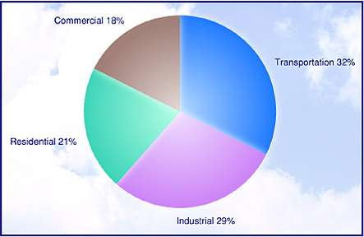
Greenhouse Gas Emissions by Sector
Fhwa.dot.gov
Notes:
Optional slide that shows the contribution of the transportation sector, mostly highway modes, to overall U.S. Greenhouse gas emissions.

Slide 15
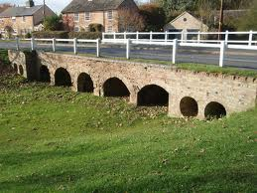
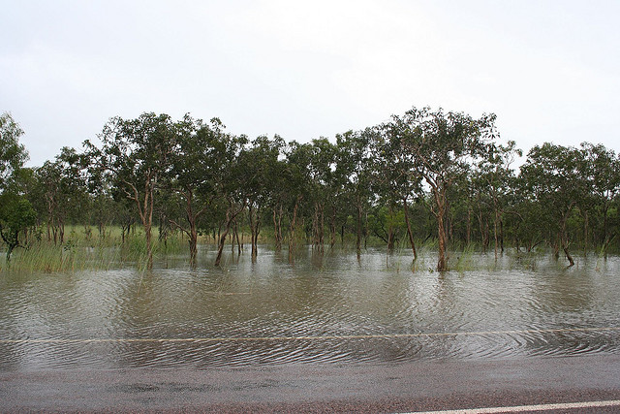
Impacts on Drainage
Reduction of overland flow relative to channelized flow
Impacts of damming due to raised roadbeds
Increase in impervious surface associated with transportation infrastructure
Commons.wikipedia
Florida DOT
Notes:
Optional Slide that shows the impacts of transportation infrastructure on local hydrology

Slide 16
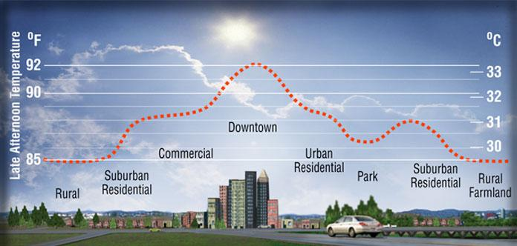
Urban Heat Island
Heatisland.lbl.gov
The built environment typically has lower albedo than vegetated surfaces
Transportation infrastructure and rooftops are the most important contributors
Notes:
Optional slide illustrating the urban heat island effect

Slide 17
Transportation Conformity
“Transportation conformity is required by the Clean Air Act section 176(c) (42 U.S.C. 7506(c)) to ensure that federal funding and approval are given to highway and transit projects that are consistent with ("conform to") the air quality goals established by a state air quality implementation plan (SIP). Conformity, to the purpose of the SIP, means that transportation activities will not cause new air quality violations, worsen existing violations, or delay timely attainment of the national ambient air quality standards.”
https://www.epa.gov/state-and-local-transportation/general-information-transportation-and-conformity
Notes:
As mentioned earlier, it is important that the planners for the various urban systems interact effectively to ensure that the systems for which they are responsible interact properly. The concept of “transportation conformity” was introduced into the Clean Air Act Amendments of 1990 to ensure that environmental and transportation planners were using the same assumptions regarding future transportation activity and economic growth. Conformity had a “rocky start” in the 1990’s with several major cities (e.g. Atlanta, GA) losing federal highway funds since their transportation plans did not match up with their environmental compliance (state implementation) plans. By the early 2000’s, these discrepancies had largely disappeared as the planning process for both were largely conducted jointly. This is an example of a policy that introduced substantive changes into how both Transportation and Air Quality Management plans were formulated.

Slide 18
Transportation Planning
Institute of Transportation Engineers (2016)
Notes:
Some instructors may find it useful to reintroduce this earlier slide to show how transportation data and performance measures are introduced into the planning process.

Slide 19
Transportation Project Evaluation
Evaluation criteria for plans and projects
Costs (and distribution of costs)
Benefits (and distribution of benefits)
Political issues
Opportunity costs
Safety, security, etc.
Environmental and social benefits and costs
Complex evaluations due to time horizons, discount rates, valuation of externalities, etc.
Decision making and planning accountability
Notes:
The relative importance of the various evaluation criteria will vary based on the type of project and the projected impacts. For example, new construction is likely to require more evaluation of equity and environmental impacts than an infrastructure rehabilitation project would require. Likewise, some projects may be mandated by other requirements, for example funds for construction of a major facility may be required to be spent only on that facility. In this case, the evaluation process is between alternative ways of delivering the same project rather than between various projects.

Slide 20
Data for Planning
Transportation Network Characteristics
Ownership
Classification
Physical characteristics
Infrastructure condition
Usage volumes and congestion levels
Crash data
Transit Usage data
Employment data and projections
Economic data by sector
Population data and projections
Demographic data
Travel Surveys
Emissions Modeling and Inventory
Notes:
This slide, of course, discusses only a subset of potential data used in transportation planning. In practice, data requirements vary widely by type of project and specific legal requirements. For example, many safety improvements may require an evaluation of the expected reduction in crashes and/or serious injuries/deaths to evaluate the most effective way to spend limited funds. In this slide, “Travel Surveys” are meant to describe a range of local data collection efforts. These surveys, typically conducted by the MPO itself, aim to examine local attitudes and conditions. These may include surveys of employers, roadway users (e.g. trucking or delivery companies), as well a private citizens regarding their travel behavior, travel activity or plans for the future. The emissions modeling and inventory data are typically produced by state or local environmental compliance organizations and are used to meet the transportation conformity requirements of the Clean Air Act Amendments.

Slide 21
The Transportation Planning Process in the U.S.
Federal
Transportation funding as defined by federal regulation and reauthorization and plans as mandated by federal regulations
State
Statewide Transportation Improvement Plan (STIP) as required by the FHWA
Administer federal funding and distribute funds to regions and local agencies
Local
Metropolitan planning organizations (MPOs) coordinate funding and programming for larger jurisdictions
MPOs and local governments implement and contract out projects
MPOs develop Regional Transportation Plans (RTPs) as part of the long-range transportation plan and for implementation of a TIP project
Notes:
This slide is designed to show how transportation planning responsibilities are divided among the various levels of government in the United States federal system. Under this system, the federal level is responsible for overall regulations, much of the funding of the highway system and other elements of the transportation system (e.g. transportation safety, airports, motor trucking regulations, etc.) while delegating responsibility for the design, construction, operations and maintenance of the system to the States. For their part, the States coordinate with each other in the details of the connections between their jurisdictions as a part of the national highway system (i.e. the interstate network and the U.S. highway system) and provide the overall direction of planning process within their boundaries as well as coordinating their state highway network in cooperation with local authorities. Most of the detailed decisions regarding prioritization and implementation of transportation projects for non-state or federal facilities are, in turn, delegated to local decision makers with MPOs coordinating with various local governments (counties and municipalities) within their jurisdiction. Other counties, especially larger ones, tend to have similar tiered systems but the relative authority of the different levels can vary widely.

Slide 22
Federal Transportation Legislation and Regulations
Federal
Executive
Legislative
Judicial
USDOT
Bill Through Congress
Relevant Cases
STATE
EPA
NEPA
STATE
Notes:
This is a simplified version of the division of powers regarding transportation between the branches of the U.S. government at the federal level. For its part, the legislative branch provides the primary authorizing legislation for the allocation and expenditure of federal transportation funding derived from the federal motor fuels and excise taxes as well as certain other activities (e.g. some safety programs). Unlike annual federal budgets, these “reauthorization acts” (currently MAP-21 passed in June 2012 and since extended) last for several years and their expiration date is often extended until Congress decides to develop a new reauthorization bill becomes law. Transportation planning is also impacted by other laws (for example the Clean Water Act, the Clean Air Act and Amendments, as well as the National Environmental Policy Act that mandates Environmental Impact Evaluations and mandates a public involvement process in transportation planning decisions). These laws are expanded by regulations established the executive branch including the U.S. Department of Transportation (USDOT) and the Environmental Protection Agency (EPA) as well as other agencies (e.g. the National Highway Transportation Safety Administration). The exact administration of these laws and regulations are also influenced by court decisions within the Judiciary branch. As described earlier, many of the actual decisions under these acts are delegated to the States as shown in the arrows to the left.

Slide 23
Typical State Level Planning Process
While State-level Transportation Planning are Broadly Similar they Differ Significantly in Process Details
State Requirements
Develop Statewide Transportation Improvement Plan (STIP)
Administer and Distribute Federal and State Funding Sources
Develop State Standards for Roadways, Bridges and other Infrastructure
Typical Other State-level Activities
Develop Broad State Land Use Planning Goals and Model Zoning Codes
Define Specific Roles and Requirements for MPOs and Regional Planning Agencies
Define and Promote Specific Economic Growth Plans
Define Eligibility for Specific State Funding Initiatives
Review Local Plans for Compliance with Planning Requirements
Other Activities as Defined by State Constitution or Statutes
Notes:
While each of the several States as well as U.S. Territories and the District of Columbia are subject to the same legal requirements, the exact methods by which they go about executing these responsibilities differ significantly. While no definitive statements can be made regarding these differences, large and more populous states tend to delegate more authority to local governments whereas, not surprisingly, smaller states tend to centralize more functions at the state level.

Slide 24
Transportation Planning at the Local Level
Transportation planning at the local level is largely a matter of establishing priorities for the allocation of resources
New Construction
Maintenance and Rehabilitation of Existing Infrastructure
Establishing and Maintaining an Equitable Distribution of Transportation Resources between Competing Interests
These Allocation Decisions are Organized into both Long-Term and Short-Term Priorities
Regional Transportation Plan (5-25 year plan)
Transportation Improvement Program (3-5 year planned allocation of resources)
Final Decisions on the Priorities are Normally Made by Elected Officials Representing the Jurisdictions Impacted by the Plan
Notes:
To a large extent in most countries, but especially in the United States, transportation planning and prioritization is delegated to local governments. This delegation facilitates more detailed examination of all of the aspects of a project, including specific details that may significantly alter the value, or perceived value, of a project to local residents. This local input can be both formal (e.g. through a public comment period) or informal (e.g. informal information sessions) and can range from highly-technical comments on the design of a project to general observations on the overall desirability of a project. These processes are inherently political in the classical sense, that is opposing values and opinions are resolved through a formal vetting process to reach a final decision.

Slide 25
Alternate Modes, Freight and Transit
At present most transportation resources are allocated to traditional highways as most of the resources available resources are obtained by motor fuel and excise taxes paid by highway users
Over the last few decades, increasing emphasis has been placed on support for other transportation modes based on equity considerations and their contributions to overall mobility
On-road Bicycle and Pedestrian Infrastructure (complete streets)
Multi-use Paths
Specialized Freight Infrastructure (e.g. truck-only lanes)
Urban Transit and Transit-Oriented Development
With the advent of new technologies, planning agencies will likely face increased demand for specialized infrastructure
Connected and Autonomous Vehicles
Provisions for Shared Mobility
Increased Demand for Intelligent Transportation Systems
Notes:
While bicycle and pedestrian infrastructure has been a priority for European Nations for many decades, public interest and support for such infrastructure in the U.S. has been increasing steadily over time and many jurisdictions have adopted “complete streets” policies over the last ten to fifteen years. Similarly, many jurisdictions have developed significant long and short-term plans for significantly expanded networks of off-road multi-use pathways based on strong public support. The U.S. Federal “rails-to-trails” program has supported conversions of abandoned railroad right-of-way into a range of such pathways with many now extending dozens of kilometers. Support for transit is more problematic. While public support for transit is high, most jurisdictions are suffering from declining ridership and the long-term effect of ride-hailing services such as Uber and Lyft on long-term transit demand is, at best, uncertain. The introduction of self-driving (autonomous) vehicles onto the roadways also represents a number of challenges for transportation planners. While such vehicles are designed to operate on conventional roadways, their lane-keeping and navigation systems are likely to be more sensitive to the state-of-repair (e.g. the quality of lane markings) of the roadway system than conventional vehicles. This may result in an increased demand for maintenance of existing infrastructure in a time of level or declining budgets.

Slide 26
Public Involvement
In the transportation planning process, formal public involvement occurs in several contexts:
Land Use (zoning) Decisions
RTP and TIP Development
Public Comments on Individual Projects though the NEPA Process
Other Contexts Based on State Law or Local Ordinances
Many MPOs and Regional Planning agencies also seek public input in other contexts:
Public Opinion Surveys
Transportation User Groups
Freight
Transit Riders
Focus Groups
Notes:
In almost all states that have zoning ordinances, there is a formal process for seeking public input on zoning decisions. These typically occur in the form of public meetings that formally seek input from people potentially impacted by the decision. Similarly, in most jurisdictions the development of both the RTP and TIP offers a period for formal public comment, mostly in written form. In the case of particular projects that have potential environmental impacts, the National Environmental Policy Act requires the relevant agency, typically a State or County Department of Transportation to hold both a formal public meeting and to solicit and accept written comments on the proposed design. Some jurisdictions also have formal public involvement processes in other contexts as well.
Beyond these legal requirements, many MPOs seek user input into the overall project development process. This input can be collected by a number of means, but largely aims at understanding existing and future concerns of particular transportation users in order to develop potential projects for evaluation.

Slide 27
Discussion
Transportation planning is a complex process aimed at allocated limited resources to meet broad societal needs:
Personal mobility
Movement of Goods
Delivery of Services
These allocation decisions must be made equitably and consistent with the goals of maintaining and enhancing environmental quality and ensuring maximal economic and social benefit from these investments
The transportation system must work effectively with other social systems to ensure that these systems can effectively perform their functions as well.
Notes:
Depending on the context of the particular course, the instructor may wish to emphasis other elements of the discussion as well.

Slide 28
Research Gaps and Future Directions
Transportation planners and regulatory agencies face a wide range of challenges in the coming years
Concerns over historical inequities have resulted in an increased emphasis on equity considerations in the transportation planning process
Concerns over the impact of climate changes over the coming decades provides additional challenges
Increased emphasis on alternative transportation modes including shared mobility
Phase out of petroleum-based fuels and the electrification of transportation
The need for the development of resilient infrastructure to deal with potential climatic effects
The rapid development and implementation of new technologies including
Connected and autonomous (self-driving) vehicles
Adaptable and smart infrastructure
Transportation planners must also deal with the needs of an aging and increasingly diverse population of users with a variety of specific needs that must be considered in transportation planning
Notes:
Planners are also facing an increasingly polarized political environment where consensus on goals and objectives may be more difficult to achieve. While these challenges are significant, they are in no way unpresented. It is useful to remember that a century ago, most highways were unpaved, motor vehicles were much less common than today, and a much smaller fraction of the population lived in urban areas. Transportation planners have always faced challenges and will continue to do so for the foreseeable future.

Slide 29
Take-Home Messages
Transportation planning in the United States and in much of the world is a tiered process in which the various levels of government have specific roles to play within the overall process
The principal role of the transportation planning process is to ensure that the limited resources available to the development and maintenance of the transportation system are used to:
Provide Mobility and Accessibility to all transportation users
Maintain and improve Environmental Quality
Efficiently contribute to Economic Activity and Development
Transportation planning must continue to adapt to meet future challenges

Slide 30
List of Abbreviations
EPA (U.S.) Environmental Protection Agency
FHWA (U.S.) Federal Highway Administration
MAP-21 Moving Ahead for Progress in the 21st Century Act
MPO Metropolitan Planning Organization
NEPA National Environmental Policy Act
RTP Regional Transportation Plan
TIP Transportation Improvement Program
SIP State Implementation Plan (Air Quality)
STIP Statewide Transportation Improvement Plan
USDOT U.S. Department of Transportation

Slide 31
References
Institute of Transportation Engineers, 2016. Transportation Planning Handbook, 4th edition, Meyer, M.D. (ed.), John Wiley & Sons, Hoboken, NJ.
Meyer, M.D. and Miller E.J., 2014. Urban Transportation Planning, 3rd edition, Boston, McGraw Hill.

Slide 32
Reading List
Federal Transit Administration, “Transportation Planning” available at: https://www.transit.dot.gov/regulations-and-guidance/transportation-planning/transportation-planning
Rodrigue, J.P., 2020. The Geography of Transportation, 5th Edition, Routledge, New York.
Stone, B. and Rodgers, M.O., 2001. Urban Form and Thermal Efficiency: How the Design of Cities Influences the Urban Heat Island Effect, J. American Planning Assoc. 67(2) 186-198.

Slide 33
Acknowledgements
The authors would like to thank Dr. Alice Grossman (Eno Foundation) for contributions to the materials presented here.

